Slide 1

The 6 Principles for
Exemplary Teaching of English Learners
Day 2
TESOL International Association
English Language Teaching
Leadership Development Program – Uzbekistan
September 2021
www.the6principles.org
© 2021 TESOL International Association. All rights reserved.

Slide 2


Introductions

Slide 3
Today’s Objectives
Participants will be able to
identify The 6 Principles for Exemplary Teaching of English Learners;
explore Principles 4, 5, and 6 in more detail;
develop and present a micro-teaching lesson on travel; and
plan a mini 6Ps training.

Slide 4
ACTIVITY
Penny for Your Thoughts
www.the6principles.org

Slide 5
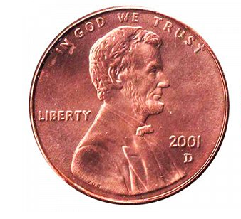
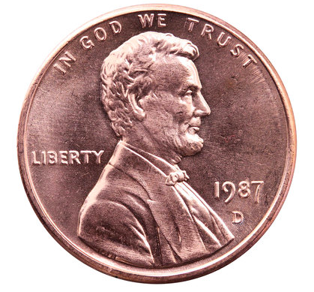
DIRECTIONS – Penny for Your Thoughts
Pick up a penny on your table.
Look at the year it was made.
Think of an important event in your life from that year that you feel comfortable sharing
with others (if it is a year before you were born, you can exchange your penny with another person).
Share the event with your table-group.

Slide 6
ACTIVITY
Turn and Talk / Activity Tracker:
Penny for Your Thoughts
www.the6principles.org

Slide 7
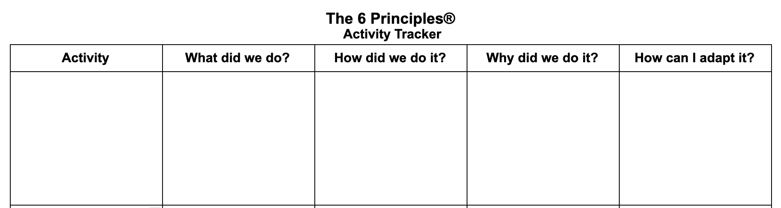
ACTIVITY: Turn and Talk / Activity Tracker – Penny for Your Thoughts

Slide 8
Review of Principles 1, 2, and 3 of
The 6 Principles for Exemplary Teaching of English Learners
(The 6 Ps)
www.the6principles.org

Slide 9
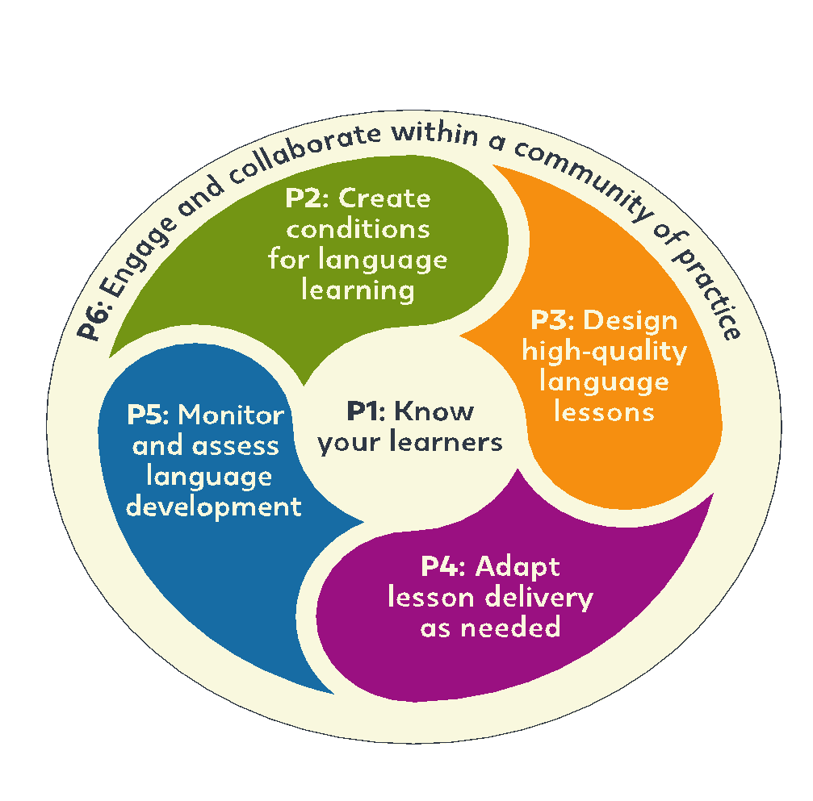
www.the6principles.org

Slide 10

PRINCIPLE 4
Adapt Lesson Delivery as Needed
www.the6principles.org

Slide 11
PRINCIPLE 4: Adapt Lesson Delivery as Needed
BEST PRACTICE 1
Teachers check student understanding often.

Slide 12
PRINCIPLE 4: Adapt Lesson Delivery as Needed
What are some active ways to check student understanding?
Turn and Talk
Think-Pair-Share
Response Cards
Thumbs Up / Thumbs Down

Slide 13
PRINCIPLE 4: Adapt Lesson Delivery as Needed
BEST PRACTICE 2
Teachers adapt their teaching when it is necessary.

Slide 14
PRINCIPLE 4: Adapt Lesson Delivery as Needed
Teacher Supports | Material Supports | Social Supports
simple oral and written English more wait time when asking questions adapted tasks more scaffolds | graphic organizers pictures maps word walls props sentence frames picture dictionaries | small groups structured conversations cooperative learning group work study groups

Slide 15
ACTIVITY
Adapting 3-2-1 Uzbekistan!
www.the6principles.org

Slide 16
DIRECTIONS: Adapting 3-2-1 Uzbekistan! for Your Classrooms
Look back at the notes from the 3-2-1 Uzbekistan! handout from Day 1.
In today’s table-group, choose a grade level/age of students to use this lesson with (e.g., 7th grade Beginners, 11th Grade Advanced). Refer to the Textbook Pages handout from Day 1 for inspiration.
Decide how you need to adapt the lesson for these students. Include a teacher support, a material support, and a social support.

Slide 17
PRINCIPLE 5
Monitor and Assess Student Language Development
www.the6principles.org

Slide 18
PRINCIPLE 5: Monitor and Assess Student Language Development
BEST PRACTICE 1
Teachers take notes of student errors.

Slide 19
PRINCIPLE 5: Monitor and Assess Student Language Development
How can you monitor and give feedback on student errors?
  informal comments in class
  checklists
  student grouping patterns

Slide 20
PRINCIPLE 5: Monitor and Assess Student Language Development
Why are students making errors?
  Are they paying attention?
  Did they learn a concept completely in the previous level?
  Are they incorrectly transferring a first language concept to English?

Slide 21
PRINCIPLE 5: Monitor and Assess Student Language Development
BEST PRACTICE 2
Teachers give prompt and specific feedback to students in a positive and effective way.

Slide 22
PRINCIPLE 5: Monitor and Assess Student Language Development
What do you need to think about when you give feedback to students?
  How can I give students feedback quickly?
  What is the age of the student?
  What kind of tone should I use?
  How can I include positive feedback with corrective feedback at the same time?
  How can I communicate that my feedback is always about helping them improve?
  How can I make most feedback private?

Slide 23
PRINCIPLE 5: Monitor and Assess Student Language Development
What kinds of oral feedback can you give to
the question “What did the boy do?”
Type of Correction | Feedback on a Student Saying “The boy go to school”
explicit | Do you mean the boy went? We say the boy went to school.
recast | The boy went to school.
repetition | The boy go to school?
elicitation | How do you say go in the past?
clarification | Excuse me. I didn’t understand. Can you tell me again?
clues | Did this happen in the past?
questions | Can you tell me something the boy did yesterday?
non-verbal clues

Slide 24
PRINCIPLE 5: Monitor and Assess Student Language Development
BEST PRACTICE 3
Teachers use a variety of assessments to inform teaching and improve learning.

Slide 25
PRINCIPLE 5: Monitor and Assess Student Language Development
Why do you need to use a variety of assessments?
You can gather information over a period of time.
You can check student abilities in more than one skill.
The information you gather can inform your teaching.

Slide 26
PRINCIPLE 5: Monitor and Assess Student Language Development
What kinds of assessments can you use?
teacher observations
teacher-developed tests
comprehension tests
rubrics
  presentations
  multimedia projects
  writing assignments

Slide 27
ACTIVITY
Assessing 3-2-1 Uzbekistan!
www.the6principles.org

Slide 28
DIRECTIONS – Assessing 3-2-1 Uzbekistan!
Look back at your adapted 3-2-1 Uzbekistan! lesson plan from Principle 4.
Decide how you will assess your students’ language skills for this lesson:
      Will you assess their writing, their speaking, or both?
      How will you take notes of student errors?
      How will you give prompt and specific feedback to students in a positive and effective way?
Design an assessment tool.
Present your assessment tool.

Slide 29
PRINCIPLE 6
Engage and Collaborate Within a Community of Practice
www.the6principles.org

Slide 30
Principle 6: Engage and Collaborate Within a Community of Practice
BEST PRACTICE 1
Teachers regularly do self-reflection.

Slide 31
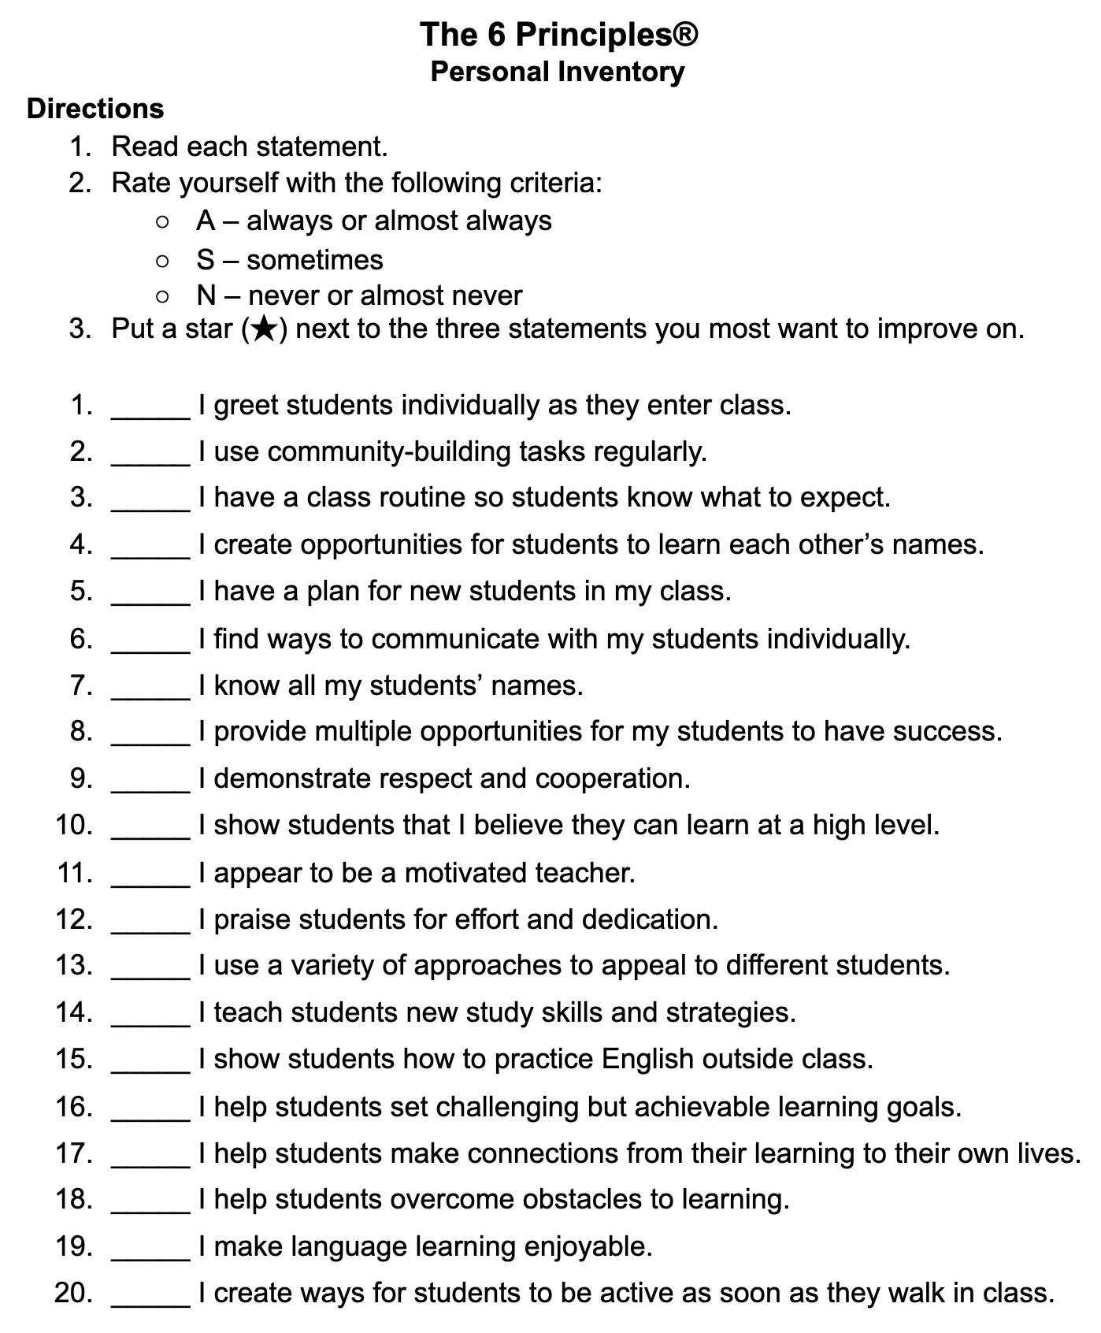
Principle 6: Engage and Collaborate Within a Community of Practice

Slide 32
Principle 6: Engage and Collaborate Within a Community of Practice
How can you do self-reflection?
Reflect on teaching as it happens.
Reflect on teaching after it happens.
  What did I do?
  Was it successful?
  What did I learn?

Slide 33
Principle 6: Engage and Collaborate Within a Community of Practice
BEST PRACTICE 2
Teachers regularly participate in professional development.

Slide 34
Principle 6: Engage and Collaborate Within a Community of Practice
How can you do professional development?
professional growth opportunities
professional memberships (TESOL 😀)
online courses
webinars
professional publications

Slide 35
Principle 6: Engage and Collaborate Within a Community of Practice
BEST PRACTICE 3
Teachers develop leadership skills so they can be a resource in their schools.

Slide 36
Principle 6: Engage and Collaborate Within a Community of Practice
How can you develop leadership skills so you can be a resource in your school?
Do what you are doing right now! 😀
Co-teaching and co-plannning
Peer and self assessment
and . . .

Slide 37
ACTIVITY
Microteaching – The 6 Ps
www.the6principles.org

Slide 38
DIRECTIONS: Microteaching – The 6 Ps
Form groups of 6.
Assign one of The 6 Ps to each member of the group.
Review the materials from our 6 Ps Workshop and Facilitation Guides for your assigned principle.
Prepare a 3–5 minute lesson on your assigned principle.
Present to another group(s).
Give feedback to another group(s) using PQP Feedback.

Slide 39
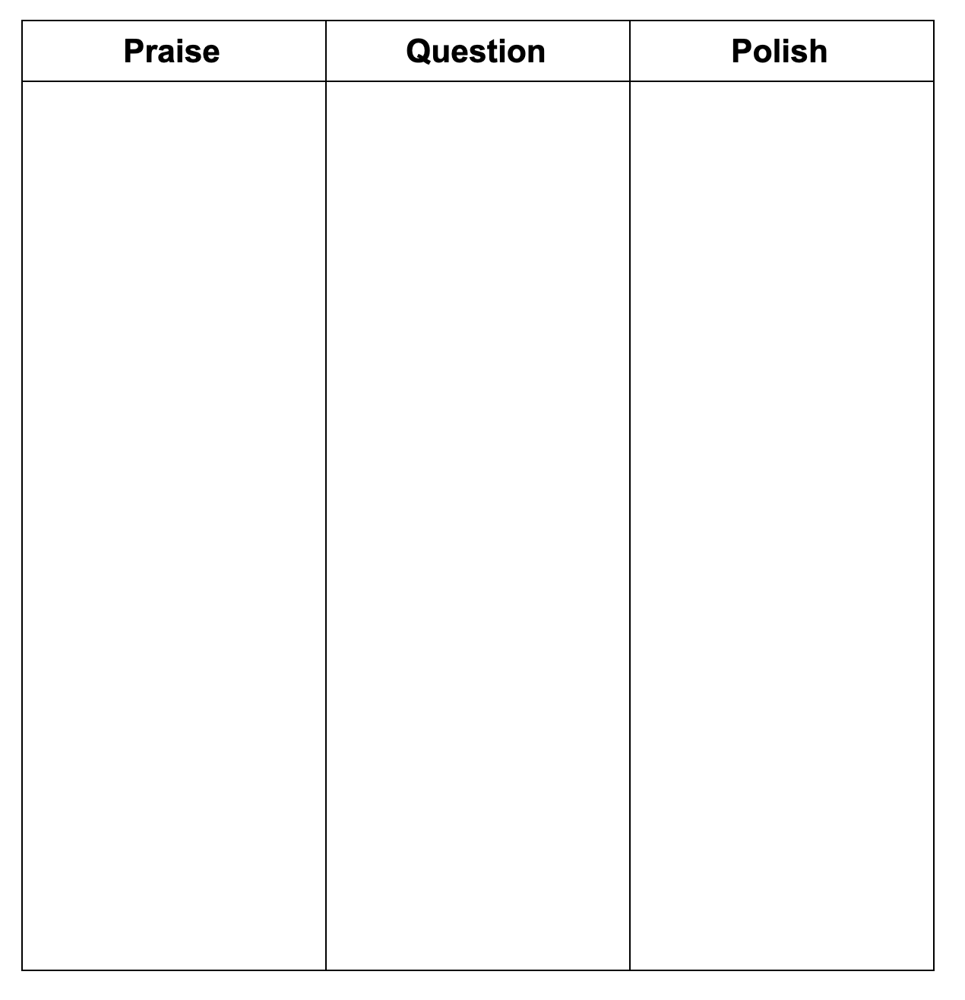
MODELING – PQP Feedback

Slide 40
www.the6principles.org

Slide 41
ACTIVITY
Around the Clock
www.the6principles.org

Slide 42
DIRECTIONS – Around the Clock
Write your name and a short note about a favorite take-away next to 12:00.
Move around the room and ask your colleagues their name and a favorite take-away.
Write one colleague’s name and take-away next to each hour on the clock. IMPORTANT: You cannot repeat a name or a take-away.
Move quickly! You only have five minutes to fill your clock.

Slide 43

MODELING – Around the Clock

Slide 44
www.the6principles.org

Slide 45
Create a Mini- Training Plan for Cascading the 6 Principles
www.the6principles.org

Slide 46
CONGRATULATIONS!
www.the6principles.org

