Slide 1
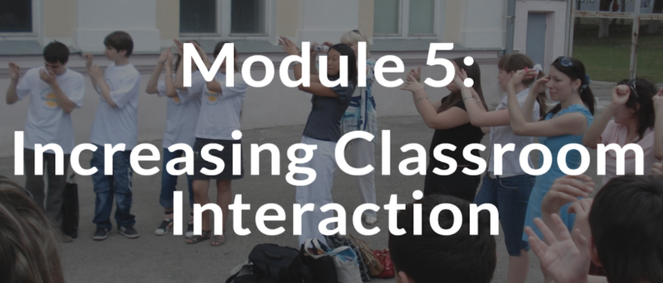
Teaching English Through English

Slide 2
Warm-up: Sentence Scramble
human
while
intellectual
is
factor
The
an
designed
think
Movement
in
moving
to
essential
brain
growth
is

Slide 3
Unscramble the words and read the sentences
The human brain is designed to think while moving.
(Dr.James Levine, Why your chair is killing you and what to do about it, 2014)
Movement is an essential factor in intellectual growth.
(Maria Montessori, The secret of Childhood,1996)

Slide 5
Reflection on teaching
How much English do you use during your lesson?
What percent of time do you talk and use English?
How much English do your students use?
Do the activities and materials interest your students and keep them engaged?
Do you often provide opportunities for all students to participate and use English?

Slide 8
Today, we will:
explore some tips and strategies for increasing student-to student interaction in our classrooms.
practice some activities that promote classroom interaction.

Slide 9
Mingling Activity: Getting to Know You
Handout 1.
Questions: | Name of classmate | Name of classmate | Name of classmate
1.Where do you live?
2.What are your hobbies?
3.What is your favourite food?
4. What is your favourite word in English?
5.Write a question you want to write:__________ _____________________

Slide 10
Reflection
Did you like this activity? Why?
Do you feel that there will be plenty of real-life communication going on in the classroom?
What kind of follow up communicative activity can be used to extend further?

Slide 11
Video Discussion
Video 1.
Find Someone Who Bingo
Link to YouTube: https://youtu.be/oHoVJhnRKCc
Video 2.
Guiding the Artist
Link to YouTube: https://youtu.be/bdIK_k83QPg

Slide 12
Think, Pair, Share
What was the purpose of the activities?
Which of the suggested activities do you think can be adaptable to your teaching context? Why and why not?
How do you plan to apply them into your lessons?
Do you think your pupils will enjoy the activity?

Slide 13
Concentric Circles
Information Gap Activity
Line Up
Anchor Charts
Guessing Game
Jigsaw
Jazz Chants

Slide 14
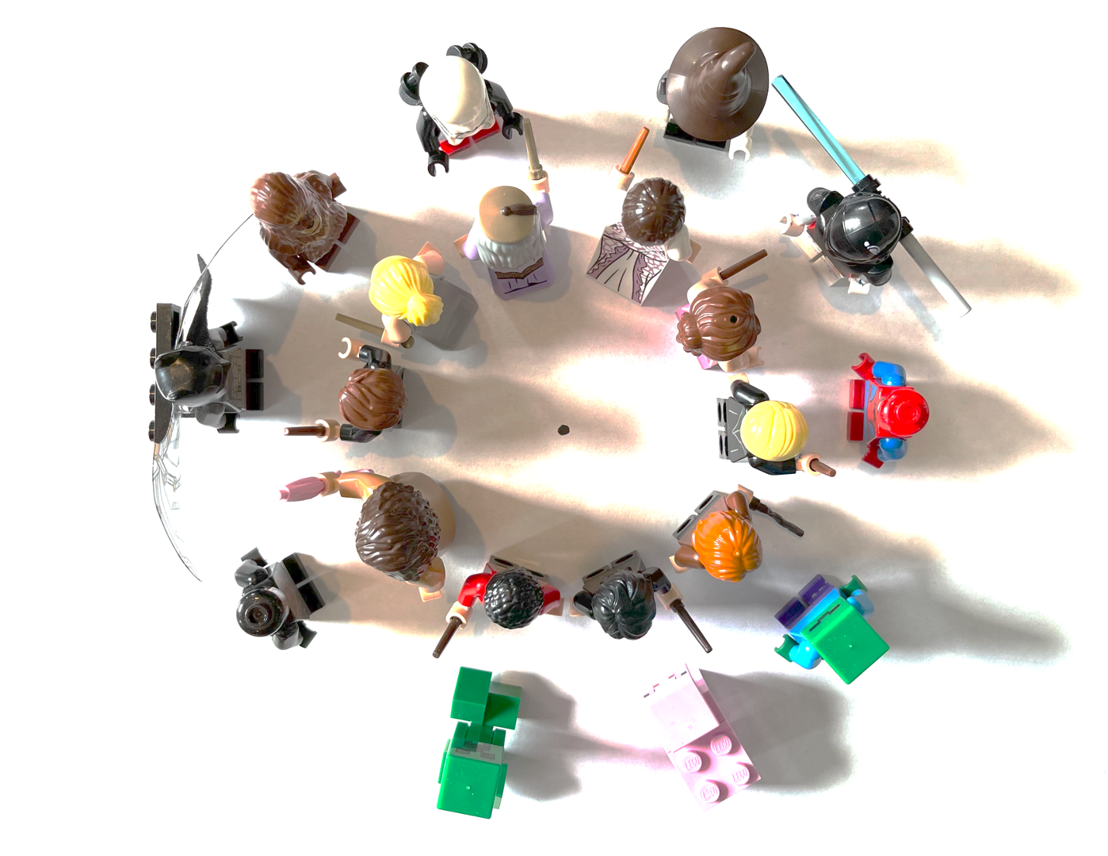
Activities to Increase Classroom Interaction
Concentric Circles
Outer circle
Instructions;
Each student has a partner
They ask and answer a question
Then the Outer Circle moves to
the next person
Each student has a NEW partner
They each ask and answer a question
Then the Outer Circle moves to
the next person
And so on!
Inner Circle

Slide 15
Information Gap Activities
An information gap means that students don’t have all the information they need to complete a task or activity.
Information gap activities require students to speak and share information.
This mirrors real-life communication.
Students have to speak clearly and listen carefully.

Slide 16
.

Slide 17
Activities to Increase Classroom Interaction
LINE UP
Instructions: Each student has a partner; they each ask and answer a question; They move to the next person; One person has to go to the end of the line; Everyone shifted over; Then each student has a NEW partner; And so on!

Slide 19
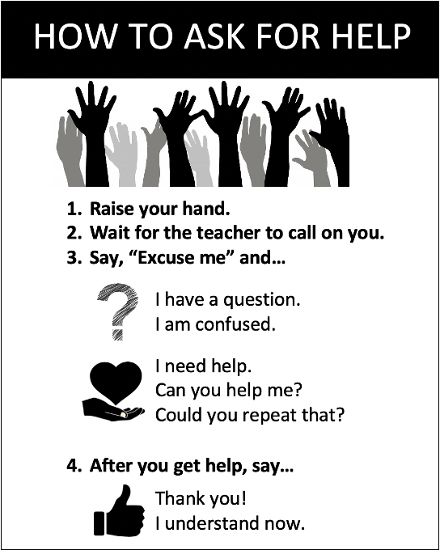
Anchor Charts
Anchor charts are a tool to support students’ language use.
Teachers can create anchor charts with students during a lesson or prepare them before class.
Display them on the classroom walls or whiteboards.

Slide 20
Activities to Increase Classroom Interaction
Guessing Game: What’s in my Backpack?
Teacher:
Students:
Anchor Chart
Expressions for asking for information for this topic
Q: What do you use it for?
A: I use it to...
Q: Do you use it to…?
A: Yes, I use it to…
Q: Is it a…?
A: Yes, it is a...

Slide 21
JIGSAW activity
1. Home Groups 3. Home Groups
2. Expert Groups

Slide 22
Teaching pronunciation, vocabulary, and grammar more interactively…….
Jazz Chants are rhythmic chants and poems, first developed for English language teaching by Carolyn Graham. They can be used to teach pronunciation, vocabulary, and grammar. They require very minimal supplies, can be used in classes of any size, and are appropriate for learners of any age. Adults as well as children and teens enjoy using Jazz Chants.

Slide 23
Do you want to go to Paris?
Do you want to go to Paris?
No, I don’t want to go to Paris.
Do you want to go to Rome?
No, I don’t want to go to Rome.
Do you want to go to London?
No, I don’t want to go to London.
I want to stay at home.
Do you want to go to Paris?
Yes, I want to go to Paris.
Do you want to go to Rome?
Yes, I want to go to Rome.
Do you want to go to London?
Yes, I want to go to London
Then I want to come back home

Slide 24
Classroom interaction: Teacher’s role
A language instructor
A facilitator of learning
A classroom manager
A general overseer of learning and encourage the learners (mentor)
As an advisor or consultant in free communicative activities (monitor)

Slide 25
Conceptualize
Incorporating Opportunities for Interaction and Sharing
https://americanenglish.state.gov/files/ae/resource_files/sept_week_3_interaction_and_sharing_final.pdf
Group 1. Turn and Talk
Group 2. Think, Pair, Share
Group 3. Stand up/Sit down (or Thumbs up/Thumbs down)

Slide 26
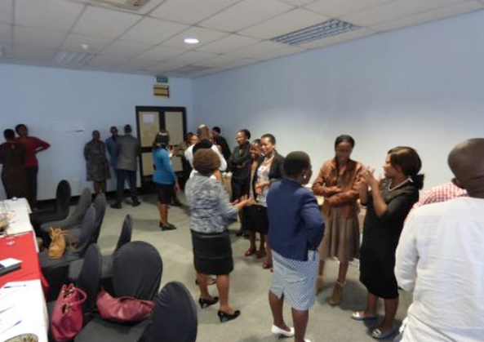
Standing Triangles
Divide the students into groups of three including one member from each home group.
Ask participants to stand in a triangle and share the information that they have read with each other.

Slide 27
Apply
Create a new or adapt an existing activity based on what you learned, you would like to use regularly in your current teaching context.
Practice your activity with others in 5-10 minutes.
-What stage of the lesson can you use this activity (or strategy)and why?
-How has this activity (or strategy) promoted meaningful communication?
-What visual aids can you use, if any, to make your activity (or strategy) more interesting and meaningful?

Slide 28
Digital Wrap-up
https://wordwall.net/resource/5056615

Slide 29
Homework
Create an activity (or strategy) that will generate communicative interactions among students. Use the template below when creating your activity.
Activity Name:
Activity Description:
This activity is effective because…
Here are some steps to help you use this activity in your classroom:
Step 1:
Step 2:
Step 3:
2. Write 1-2 paragraphs to reflect on Module 5 (300-500 words). You may use what you have created, shared, and applied in the previous tasks.

