Slide 1
TEACHING ENGLISH THROUGH ENGLISH
MODULE 0 – ORIENTATION
Friday, April 23, 2021
Shin, J. K., Fox, R., Evmenova, A., Borup, J., Khakimova, D., Kim, W., & Chung, H. (April, 2021). Orientation. Workshop webinar presented for the Teaching English through English online professional development program (Cohort I): Module 0. U.S. Embassy in Tashkent funded English Speaking Nation Program in Uzbekistan (online). https://bit.ly/2VCBxr0

Slide 2


English speaking Nation: Secondary Teacher Training (ESN)

Slide 3

Our Goal
  To strengthen English language secondary education in Uzbekistan over the course of three years
Notes:
The English Speaking Nation: Secondary Teacher Training (ESN) program seeks to strengthen secondary school teachers’ classroom English skills and provide teachers with the opportunity to learn about student-centered pedagogical methods in Uzbekistan.

Slide 4
A Cascading Model
92
Core Certified
Teachers
Key Teacher Trainers
1,000
Regional Peer Mentors
High Performing Teacher Leaders
Mentorship
Professional Development Increases
15,000
Secondary School Teachers
Highest Need Regions

Slide 5
A Phased Implementation
Phase I
  Two cohorts of 40-45 English teacher trainers will participate in a rigorous training program delivered by TESOL International Association (TESOL) and George Mason University (GMU)
  The Core Teacher Trainers will train and mentor 500 Regional Peer Mentor-Teachers, based on content learned at the Training of Trainers Institute.
Phase II
  Under the mentorship and guidance of CTs, the RPMs train and mentor 10 in-service teachers a year through the duration of the program with the goal of training 15,000 teachers by the end of the third year of the project.
Phase III

Slide 6


Partners with American Councils
Notes:
GMU is the largest public university in Virginia. GMU is recognized as one of the nation’s top research universities by the Carnegie Classification of Institutions of Higher Education.

Slide 7

CONTACT INFORMATION:
  American Councils for International Education
  English Speaking Nation Program
  12 Shota Rustaveli Street
  Grand Business Center, Office #208
  Yakkasaroy District
  100070 Tashkent, Uzbekistan
  T: +998 78 150 71 50
  E: esn@americancouncils.org
  W: www.ESN-teachers.org

Slide 8
TETE MODULE 0 - ORIENTATION
Teaching English Through English
What is TETE?

Slide 9
TETE MODULE 0 - ORIENTATION
Teaching English through English (TETE) is ten-module professional development (PD) course, that will help you:
Learn how to build a classroom environment that encourages real communication in English
Explore effective approaches for teaching English while enhancing your ability to use English to manage language learning activities in the classroom.
Share ideas with peers in a community of practice (CoP)
Apply course content to your teaching context
Practice using English for a variety of instructional purpose

Slide 10
TETE MODULE 0 - ORIENTATION
Learning Objectives and Learner Outcomes
By the end of this course, you will be able to:
explain and use various interactive and communicative approaches for teaching English to secondary students.
identify the language needed to carry out various instructional tasks in the classroom.
prepare classroom language needed for various types of lessons and activities.
practice and improve ability to manage your classroom and develop effective language tasks in English.
develop lesson plans and teaching materials that reflect accurate English.
create a reflective teaching portfolio for continuous improvement in teaching English through English.
engage in deep, critical reflection within a CoP of English language teaching professionals in your country.

Slide 11

TETE MODULE 0 - ORIENTATION
We developed TETE, so you can easily use the materials with all the inservice teachers you are mentoring!
We also hope in your reflections you will find ways to
apply TETE materials for your teaching contexts!

Slide 12
A Cascading Model
92
Core Certified
Teachers
Key Teacher Trainers
1,000
Regional Peer Mentors
High Performing Teacher Leaders
Mentorship
Professional Development Increases
15,000
Secondary School Teachers
Highest Need Regions

Slide 13
A Cascading Model
92
Core Certified
Teachers
Key Teacher Trainers
1,000
Regional Peer Mentors
High Performing Teacher Leaders
Mentorship
Professional Development Increases
15,000
Secondary School Teachers
Highest Need Regions

Slide 14
A Cascading Model
92
Core Certified
Teachers
Key Teacher Trainers
1,000
Regional Peer Mentors
High Performing Teacher Leaders
Mentorship
Professional Development Increases
15,000
Secondary School Teachers
Highest Need Regions

Slide 15

TETE MODULE 0 - ORIENTATION
Purpose of Module 0: To prepare you for a successful start in this professional learning process
By the end of the module, you will be able to:
explain the goals and outcomes for this course.
navigate through the Teaching English Through English Google site
get to know your colleagues in an online community of practice.
describe what it means to be a reflective English language educator

Slide 16
TETE MODULE 0 - ORIENTATION
Now let’s meet your
George Mason University
Academic Team!

Slide 17
TETE MODULE 0 - ORIENTATION
George Mason University Academic Team
Faculty
Joan Kang Shin, Ph.D.
Rebecca Fox, Ph.D.
Anya Evmenova, Ph.D.
Jered Borup, Ph.D.
Graduate Research Team
Dildora Khakimova, Ph.D. Woomee Kim, M.A.
Hyunsun Chung, M.A.

Slide 18



TETE MODULE 0 - ORIENTATION
https://sites.google.com/

Slide 19



TETE MODULE 0 - ORIENTATION
“Explore” Activity Icons
Watch Videos
Read Articles
Search Additional Resources

Slide 20





TETE MODULE 0 - ORIENTATION
“Do” Activity Icons
Think
Apply
Create
Reflect
Share

Slide 21
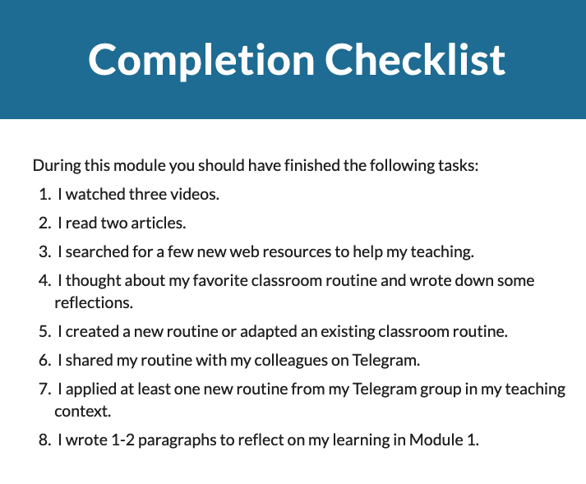
TETE MODULE 0 - ORIENTATION

Slide 22
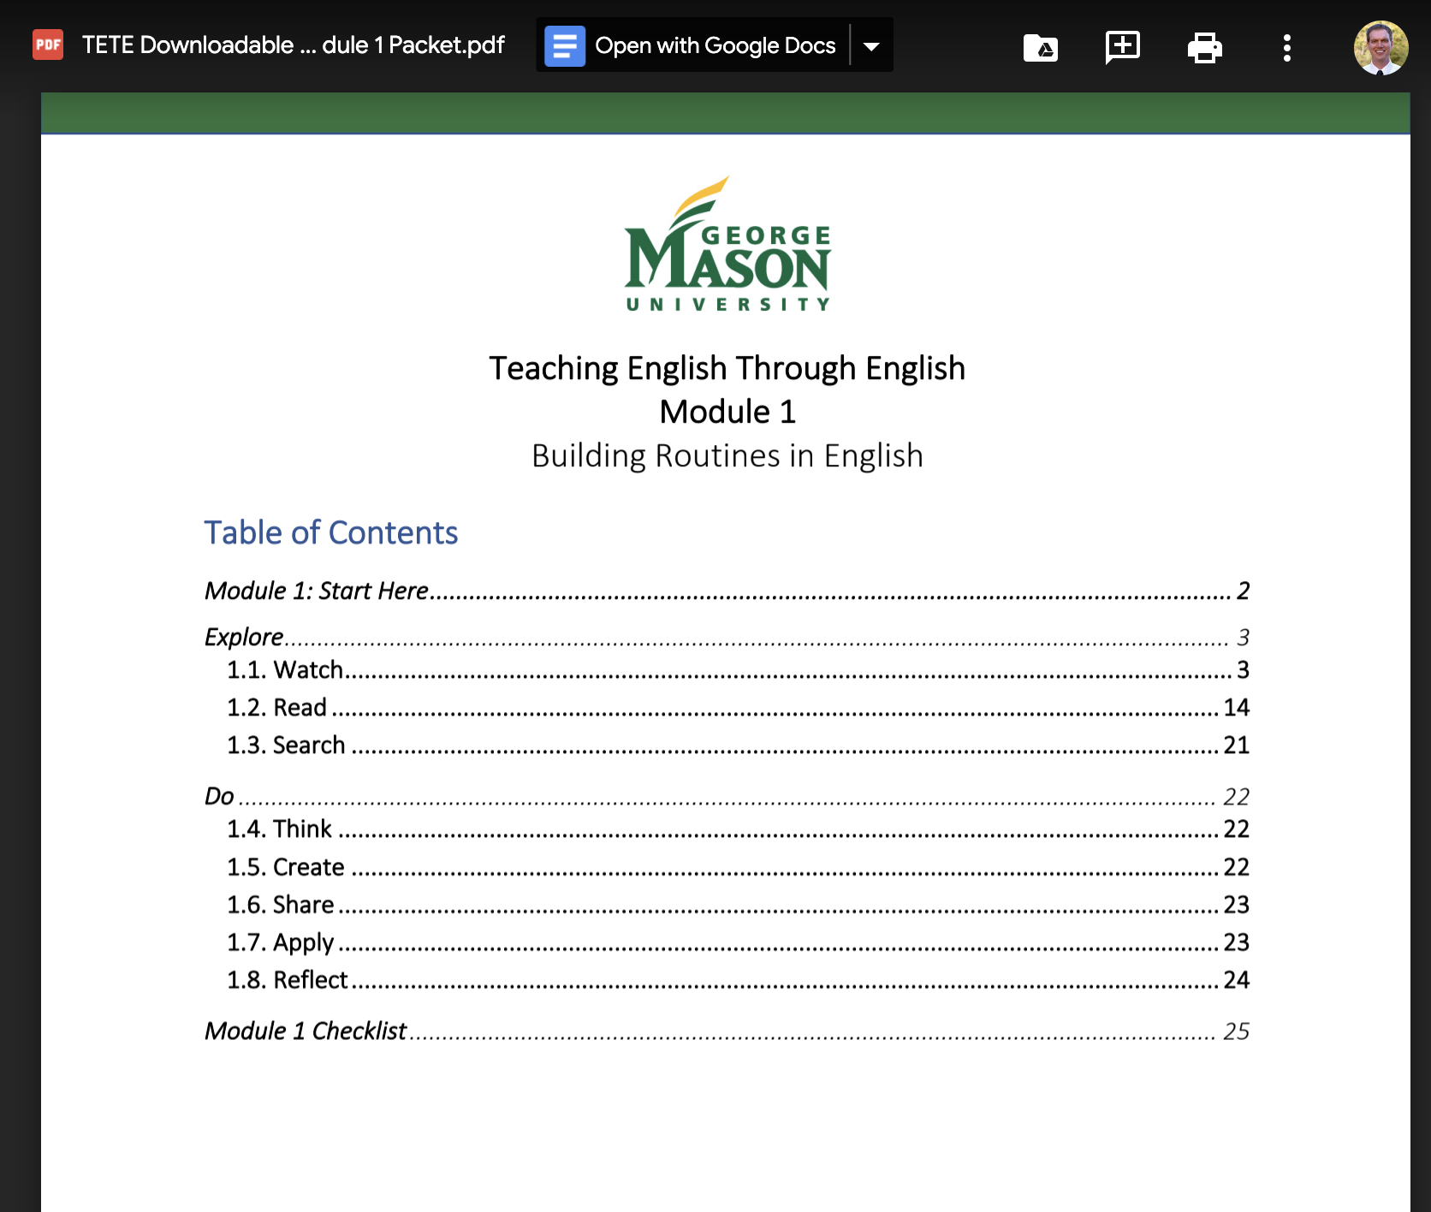
TETE MODULE 0 - ORIENTATION
https://sites.google.com/view/mason-tete/
Notes:
Classroom vs. Google Site

Slide 23
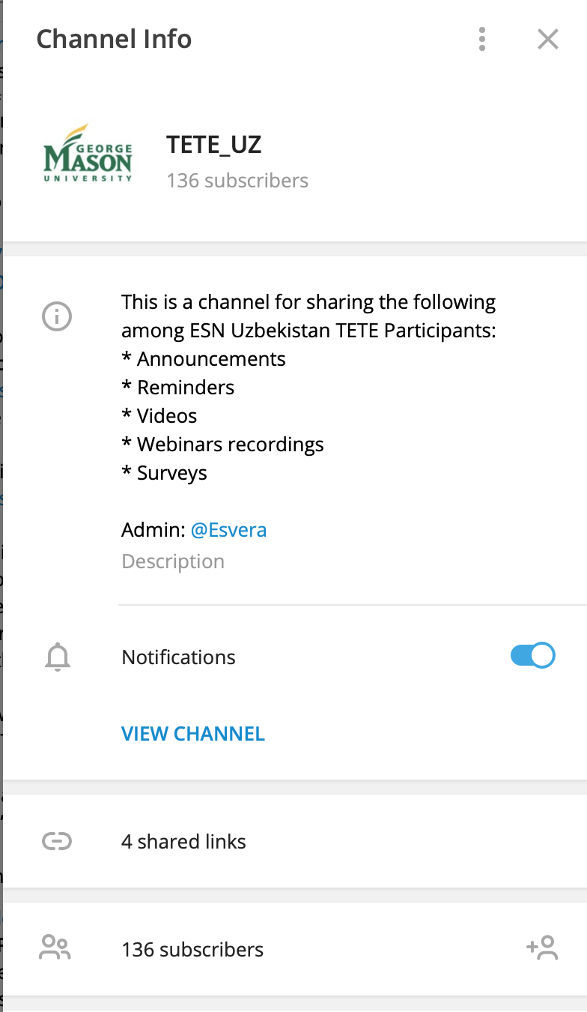
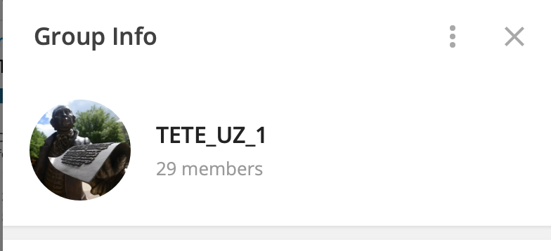

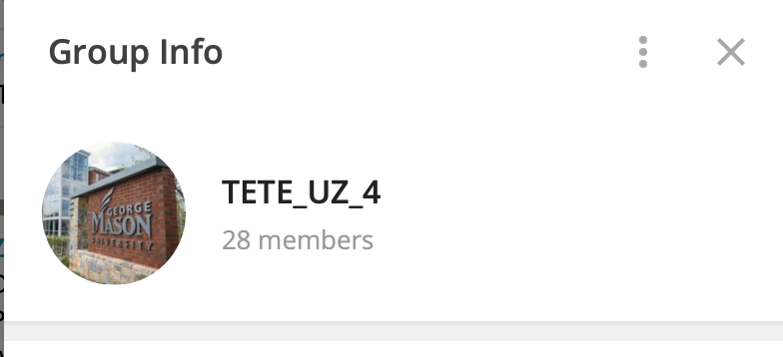


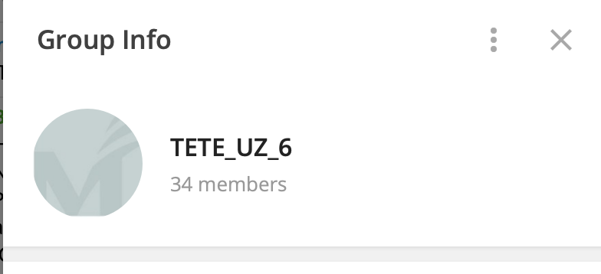
TETE MODULE 0 - ORIENTATION
Community of Practice (CoP) through TELEGRAM

Slide 24
TETE MODULE 0 - ORIENTATION
Share via Telegram
Telegram Channel TETE_UZ:
This channel is for sharing announcements, reminders, videos, webinar recordings, and surveys for all TETE participants.
Group Chats 1, 2, 3, 4, 5, and 6:
The TETE Groups were created to help you form a community of practice.
In the group chats, you will share ideas for teaching English related to your module assignments. You will Share what you Create here. Then you will Apply an activity or strategy that you learn from a colleague in your group.
If you have any questions or issues, email: masontetehelp@gmail.com or send a message to @Esvera

Slide 25

TETE MODULE 0 - ORIENTATION
Create
Reflect

Slide 26
TETE MODULE 0 - ORIENTATION
The Role of Reflection & Critical Reflection in our TETE Modules and in your teaching
What is the reflection?
What does it mean to be a reflective English language educator?
Write briefly in the chat box what the word “Reflection” means to you.
Let’s look at the term, critical reflection
We often have different understandings across languages and cultures
What does this term mean to you?
Please refer to the video and the PPT that are part of Module 0 for more details

Slide 27

Activating Reflection and Critical Reflection into Each Module
In each module, there will be specified times when you will be called to Stop and Reflect on aspects of your learning and to apply your thinking to your classroom. Reflection is also an integral part of your TETE portfolio.

Slide 28
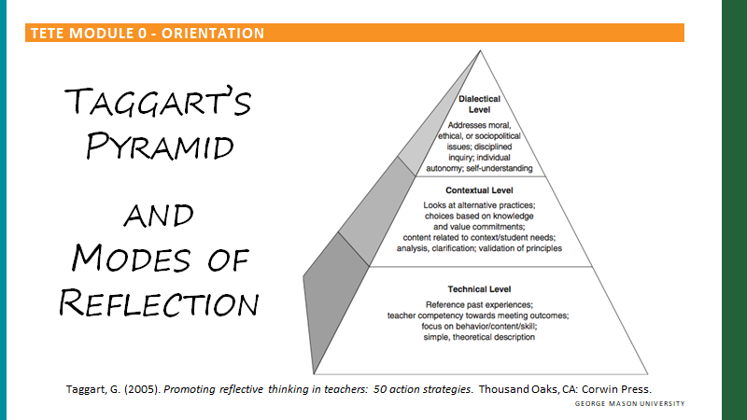
Reflection and Critical Reflection
In Module 0, we also lay the foundation for understanding that here are levels of reflection that can help you develop as critically reflective English educators.
You will also learn about the differences and benefits of Reflection-IN-action that occurs while teaching, and Reflection-ON-action, reflection that occurs after teaching

Slide 29
TETE MODULE 0 - ORIENTATION
Reflection is at the heart of our work in TETE. Within each module, reflection will help educators to:
Consider classroom practice through new eyes
See changes in our practice & the responses of our students to new learning approaches
Be engaged in the teaching-learning cycle WITH our students
Connect with new content in the modules in highly thoughtful ways
Take an inquiry stance toward our teaching - ask questions and investigate answers
See our own growth and change as educators over time
Connect more deeply with colleagues
Become reflective teacher leaders
Critical reflection serves to connect and engage educators with new content as you make sense of your new learning through TETE and activate new knowledge in your contexts

Slide 30

TETE MODULE 0 - ORIENTATION

Slide 31
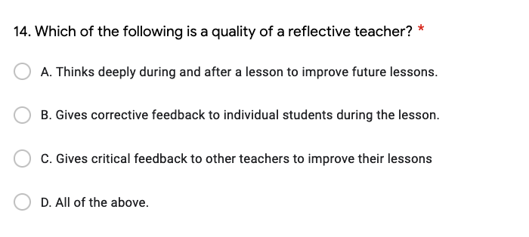
TETE MODULE 0 - ORIENTATION
Pre-course Assessment Question

Slide 32
TETE MODULE 0 - ORIENTATION
Pre-course Assessment Question

Slide 33
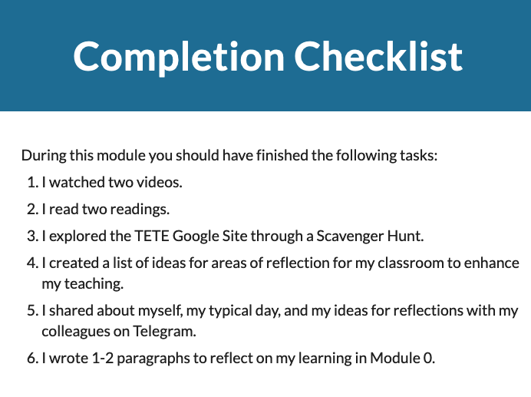

TETE MODULE 0 - ORIENTATION
What is due on Sunday, April 25th?

Slide 34
TETE MODULE 0 - ORIENTATION
ANNOUNCEMENTS
Module 1: Building Routines in English
will be announced on Monday, April 26th!
WEBINAR TIME CHANGE
Friday, April 30th
Friday, May 7th
6:00-7:00 PM Uzbekistan Time

Slide 35
TETE MODULE 0 - ORIENTATION
“I never stop learning,
because life never stops teaching.”

Slide 36

TETE MODULE 0 - ORIENTATION

