Slide 1
TEACHING ENGLISH THROUGH ENGLISH
Module 10 - Managing Cooperative Activities
Friday, September 10, 2021
Kelley Webb, M.A.Ed.
Anya Evmenova, Ph.D.
Rebecca Fox, Ph.D.
Webb, K., Evmenova, A., & Fox, R. (September, 2021). Managing Cooperative Activities. Workshop webinar presented for the Teaching English through English online professional development program (Cohorts I & II): Module 10. U.S. Embassy in Tashkent funded English Speaking Nation Program in Uzbekistan (online). https://bit.ly/3q7PA5i

Slide 2
TETE MODULE 10: MANAGING COOPERATIVE ACTIVITIES
Module 10
Webinar Agenda:
Discuss Module 10 content and share ways to develop and manage project work and cooperative activities in the English language classroom
Presentation of additional ideas to consider to support and assess all learners
Final Reflection Review & Cooperative Activity
Module 10 Completion Checklist and Exit Ticket
Announcements for completing TETE Portfolios, Final Summative Reflection, and End of Program Survey

Slide 3
TETE MODULE 10: MANAGING COOPERATIVE ACTIVITIES
Purpose of Module 10: To effectively manage cooperative activities
By the end of the module, you will be able to:
describe the purpose and benefits of project work and cooperative activities in the language classroom
explore various ways to develop and present project work and cooperative activities to and for all students
exchange ideas for project work and cooperative activities that work well for all learners
develop project ideas and cooperative activities that can be modified for multiple units of study using checklists, rubrics, collaborative work guidelines/expectations
reflect on ways to adapt and differentiate project work and cooperative activities for all learners

Slide 4
Preparing for Cooperative and Collaborative Activities

Slide 5
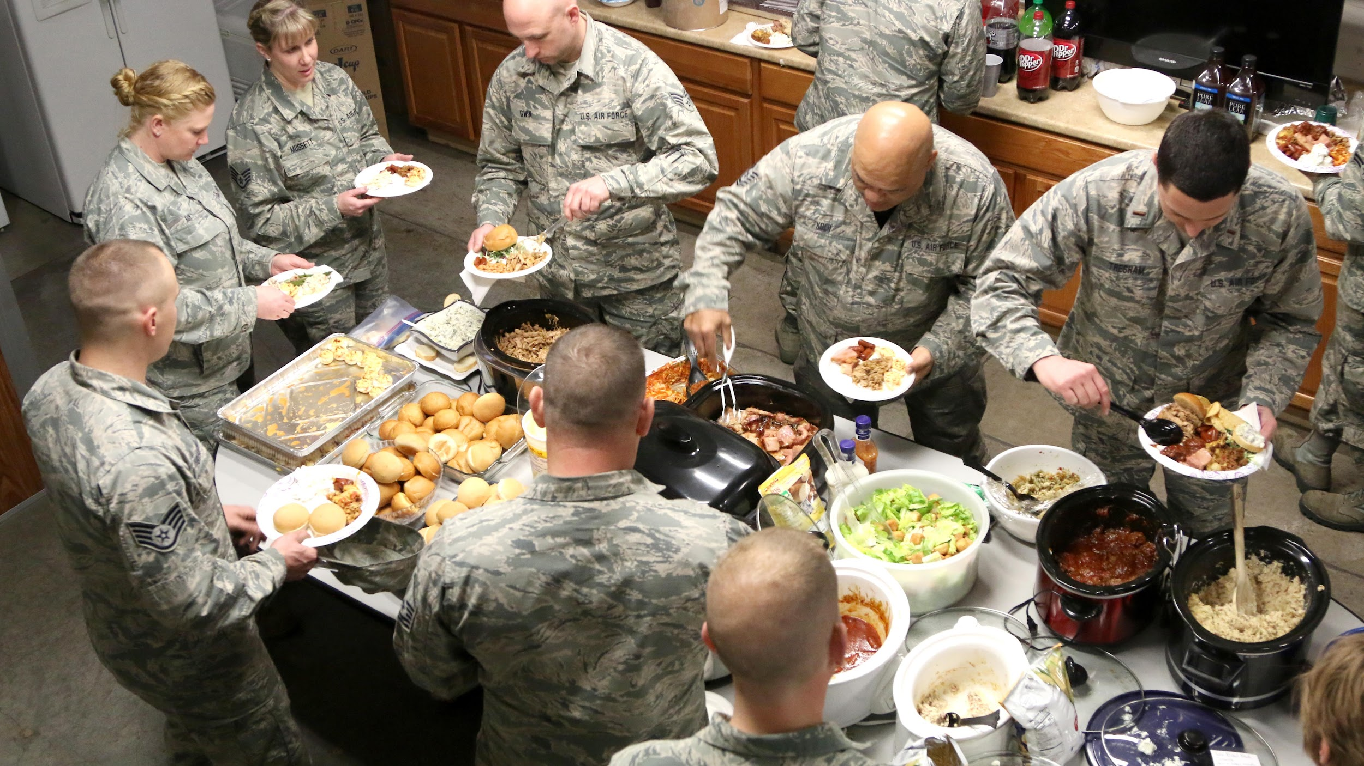
TETE MODULE 10: MANAGING COOPERATIVE ACTIVITIES
Cooperation
vs.
Collaboration
Cooperative Work/Learning
-working together to create an end product or accomplish a shared goal
-the task is divided among participants, everyone does their assigned parts of the task
Collaborative Work/Learning
-sharing in the process of creation and learning
-everyone interacts to produce a final product
-equal contribution among participants
-final product is more than the sum of all parts, it synthesizes and accommodates everyone’s ideas and perspectives

Slide 6
TETE MODULE 10: MANAGING COOPERATIVE ACTIVITIES
Creating a Classroom Community
Stack the Tower
Ball of Knowledge
Hold/ Pass the Baton

Slide 7
TETE MODULE 10: MANAGING COOPERATIVE ACTIVITIES
Considerations for Choosing Cooperative Activities
Purpose
Outcomes
Language
Learning
What is the purpose of project work and cooperative activities?
engagement
all students can participate in that activity by doing, communicating, and interacting with the application of content through real-world tasks

Slide 8
TETE MODULE 10: MANAGING COOPERATIVE ACTIVITIES
Modes of Communication
for conveying and understanding the message
interpersonal
two-way communication (speaking/listening)
interpretive
one-way communication (listening/reading)
presentational
one-way communication (speaking/writing)

Slide 9
Managing Cooperative Activities
www.reddit.com/r/gifs/comments/3k8kh9/just_some_goofy_penguins_to_brighten_up_your/

Slide 10
TETE MODULE 10: MANAGING COOPERATIVE ACTIVITIES
Management Strategies
to do in Advance
establish expectations for transitions, getting attention, tasks to be completed, consequences, etc.
grouping students purposefully
assigning roles / tasks for students to do throughout the activity
Management Strategies
to do During
provide scaffolding supports at the start and throughout each task / step of the activity
visually check for comprehension and task completion
set a timer /
make it visible
for students to see

Slide 11
TETE MODULE 10: MANAGING COOPERATIVE ACTIVITIES
Assessing Student Projects and Activities
Rubrics
Self-Assessments
Group Evaluations

Slide 12
Five Finger Summary
TETE MODULE 10: MANAGING COOPERATIVE ACTIVITIES
3
2
4
How do you know if students really understand and comprehend something they read? Ask them to summarize it! Summarizing is an important strategy when learning a language because it signifies one has interpreted the material in their own words and can synthesize the information succinctly.
This simple strategy can be used to visually and kinesthetically engage students in discussion about a resource, such as an infographic, short text, or reading. Students use their interpretive skills to make sense of what they read by summarizing the five most important details in the resource. Stating one sentence per detail, students count them on their five fingers when presenting to a group, class, or individually as a self-reflective activity.
Another adaptation to the Five Fingered Summary is to have students roll a number cube and use the sentence starter for the number (displayed to the right) to complete the sentence and state information about the material they are discussing as a small group or pair. The sentence starters encourage creative and critical thinking about the material.
5
1
#1 - I am wondering…
#2 - At first I thought…,
but now I think…
#3 - The article suggests…
#4 - It can be concluded that…
#5 - It’s obvious that...

Slide 13
Differentiating Cooperative Activities

Slide 14
TETE MODULE 10: MANAGING COOPERATIVE ACTIVITIES
Think about the classes that have students with different ways of learning and language proficiency levels.
What might you do to address students’ varying language proficiencies during cooperative activities?
YOUR TURN!
Please type your answers into the chat box
to share your ideas!

Slide 15
TETE MODULE 10: MANAGING COOPERATIVE ACTIVITIES
Give each student a color card/stick
group students with same color
Or have them form groups with different colors represented, like a Rainbow!
Determine a role for each color
Red - Group Facilitator
Orange - Note Taker
Yellow - Encourager
Green - Timekeeper
Assign the collaborative task for them to complete together
Call on specific colors to present / share their work
Rainbow Learning

Slide 16
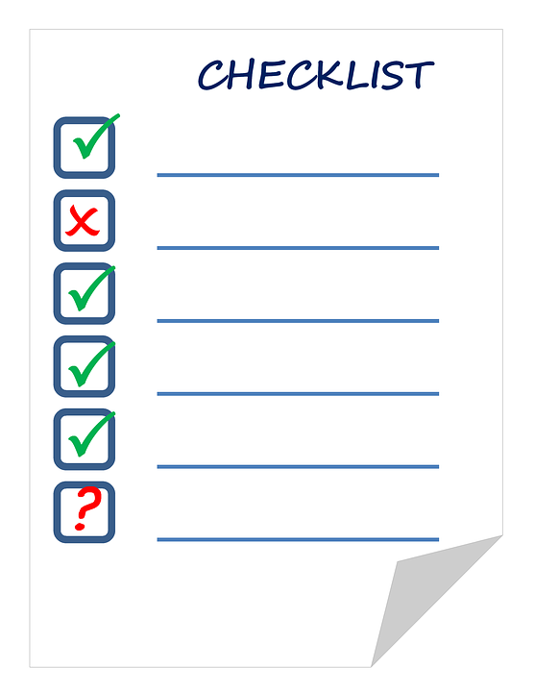
TETE MODULE 10: MANAGING COOPERATIVE ACTIVITIES
Supporting Students
Tiered (Leveled) Activities
Checklists
Activity Work Logs

Slide 17
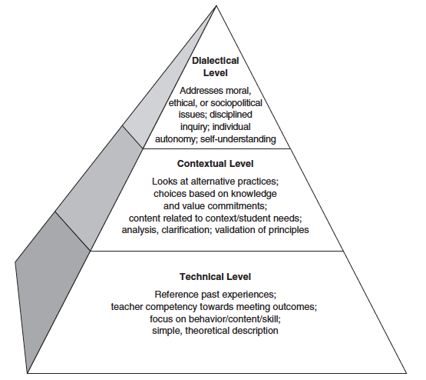
TETE MODULE 10: MANAGING COOPERATIVE ACTIVITIES
Now It’s Your Turn!
Final Reflection Cooperative Activity
But before … let’s take a look at preparing for your Final Reflection

Slide 18
TETE MODULE 10: MANAGING COOPERATIVE ACTIVITIES
Final Reflection:
Prepare - Look back on the content of Modules 0-10. Review the content of each module and read the reflections you wrote in each module.
Think - Reflect upon your own learning across these modules - where you were at the beginning of the course, what you were more comfortable with at the mid-point, and how you feel about communicative language teaching and learning now. Think about 1) how all the modules have called you to activate your knowledge for your learners (connecting Modules 0-5 that focused particularly on teachers and Modules 6-10 that focused more on learner engagement), 2) what new knowledge has been the most meaningful to you, particularly with regard to activating and creating communicative language tasks and approaches that actually engage your learners, and 3) think about how you and your teaching practice may have been refined.
Write - Choose 2-3 topics from the TETE Course that were the most eye-opening to you. Now, using our three modes of reflection (that you used in the Mid-point reflection) please respond to the three following areas:
Describe (Technical Mode) - provide a brief listing or description of what stood out for you in those topics
Connect (Contextual Mode) - in what ways does what you have described/listed above connect to readings, new research, new practices
Make Deeper Connections and Consider Impact (Dialectical Mode) - this is the mode where you add to/expand upon the Connections section and consider the impact of your learning. You might use some of the following questions to help you as you reflect: Why is your new learning or are these new topics/practices important? What changes or impact are you looking for as you try out some of the new tasks, approaches, or strategies in those topics? Why is this change or impact important for your context? How do you plan to work toward implementing these new practices after the program?
https://sites.google.com/view/tete-portfolio-template/final-summative-reflection

Slide 19
FINAL REFLECTION Scaffold
Managing Cooperative Activities
Example of Reflection when Activating the Modes of Reflection
Dialectical Mode: I think it will be important to monitor my students’ learning during cooperative activities. What impact will Cooperative Activities have on their learning? I’ll plan to circle around to collect student data and consider the changes in students’ engagement. I’d like to ask them about their most important learning during CAs, and also monitor changes in their language production.
Contextual Mode: Cooperative work allows students to interact with one another, activate their ability to communicate authentically, and engages students actively in their own learning. In Module 10, I read about how important it is to plan carefully and manage cooperative learning so that it is purposeful. I’ll need to really plan carefully for Purpose, Outcomes, Language, and Learning.
Technical Mode: I learned the purpose of cooperative work is to engage students with each other as they interact in English and achieve a mutual goal through an interactive task. Students should have responsibility in managing the task through checklists, having assigned roles, and partnering students purposefully.

Slide 20
TETE MODULE 10: MANAGING COOPERATIVE ACTIVITIES
Final Reflection Cooperative Activity
Where: Zoom Breakout Rooms
What: Choose one topic to discuss
Review the technical mode
Brainstorm the contextual & dialectical modes
How: Join the breakout room
Follow the GMU TETE Team lead
Discuss and contribute to a joint document

Slide 21
TETE MODULE 10: MANAGING COOPERATIVE ACTIVITIES
Random Grouping
Group Yellow
Group Red
Group Blue
Group Green
Group Purple
Group Gray
Group Pink
Group Acqua

Slide 22
TETE MODULE 10: MANAGING COOPERATIVE ACTIVITIES
Joining Breakout Room

Slide 23
TETE MODULE 10: MANAGING COOPERATIVE ACTIVITIES
Contributing to a Joint Document

Slide 24
TETE MODULE 10: MANAGING COOPERATIVE ACTIVITIES
Wrapping Up

Slide 25
TETE MODULE 10: MANAGING COOPERATIVE ACTIVITIES
Remember!
This Cooperative Activity
Real Cooperative Activity
https://pixabay.com/photos/lion-cat-mirror-image-fantasy-3677582/

Slide 26
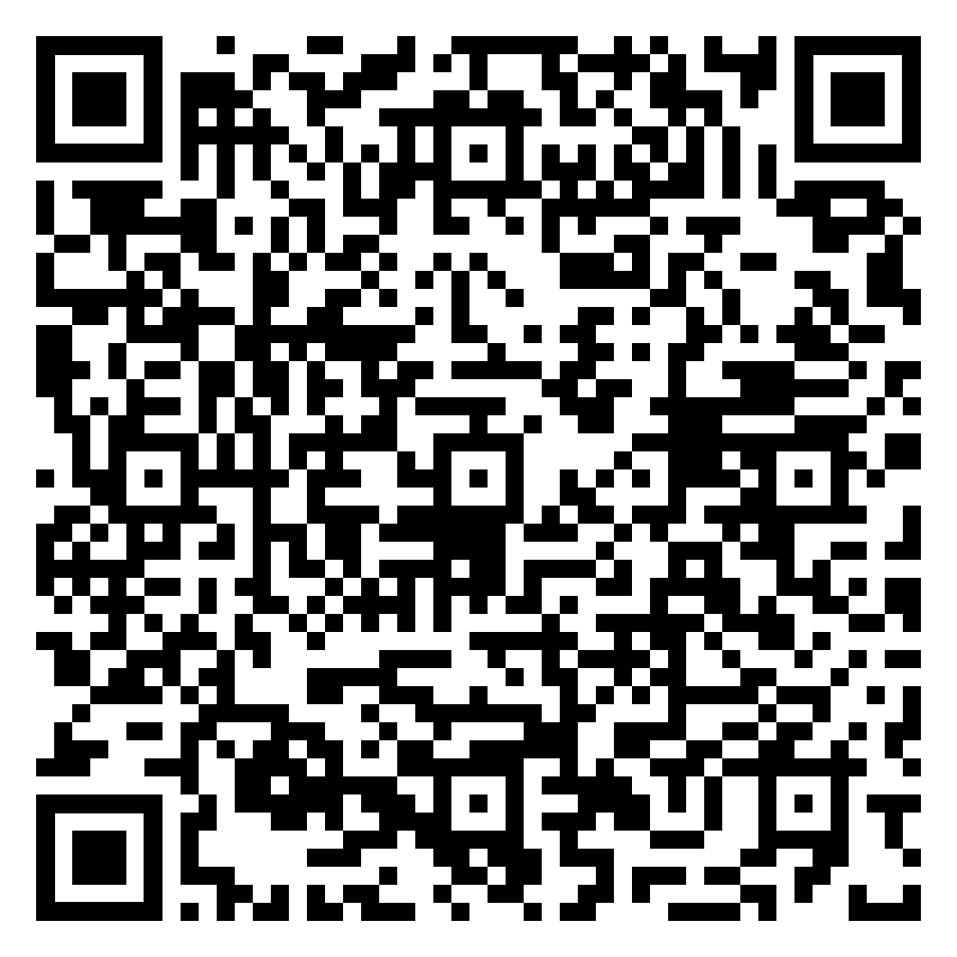
TETE MODULE 10: MANAGING COOPERATIVE ACTIVITIES
In place of sharing ...
https://tinyurl.com/final-reflection-activity

Slide 27
TETE MODULE 10: MANAGING COOPERATIVE ACTIVITIES
Module 10 Wrap-up & Review
The purpose of project and cooperative work is to engage students with each other as they interact in the target language, achieve a mutual goal through completing a task, and build skills for communication
Student-centered management strategies include checklists for task completion, assigned roles for group work, and grouping students purposefully. Students should have responsibility in managing the cooperative task!
Assessment strategies include Five Finger Summary, rubrics, group evaluations, activity logs, and self-assessments.
Differentiation strategies include tiering activities (by level), providing student choice, and checklists. Remember to support students with sentence starters, sentence frames, and anchor charts for referencing vocabulary and phrases.

Slide 28
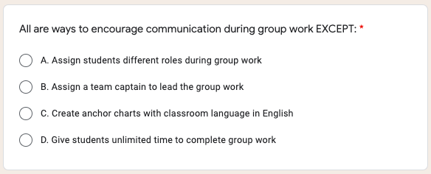
TETE MODULE 10: MANAGING COOPERATIVE ACTIVITIES
Let’s Review!
Type your answer in the Chat Box.

Slide 29
TETE MODULE 10: MANAGING COOPERATIVE ACTIVITIES
The answer is...

Slide 30
TETE MODULE 10: MANAGING COOPERATIVE ACTIVITIES
Let’s Review!
Type your answer in the Chat Box.

Slide 31
TETE MODULE 10: MANAGING COOPERATIVE ACTIVITIES
The answer is...

Slide 32
TETE MODULE 10: MANAGING COOPERATIVE ACTIVITIES
What is due on Sunday, September 12th?
Remember to complete your portfolios!

Slide 33
TETE MODULE 10: MANAGING COOPERATIVE ACTIVITIES
EXIT TICKET - TIME FOR D.E.A.R.
Drop Everything And Reflect
What is one new idea from Module 10 that you learned about managing cooperative activities that you would like to try?
Now we will do our Module 10 Exit Ticket!
Click on the link in the chat box.
Notes:
MODULE 10 EXIT TICKET LINK - https://forms.gle/663ytfT9F1uy1Jjc6

Slide 34
TETE MODULE 10: MANAGING COOPERATIVE ACTIVITIES
ANNOUNCEMENTS
Final TETE Portfolios due Sunday, September 19th!
Post your Create and Reflect Tasks for all modules.
Post your Final Summative Reflection.
On Monday, September 13th you will receive a message from Dr. Shin with information and access links to the
Post-Course Assessment and Consent Form.

Slide 35
TETE MODULE 10: MANAGING COOPERATIVE ACTIVITIES
Publishing Your Portfolio
(NOT mandatory)
Video Directions: https://youtu.be/WX4OUYTyOck or https://sites.google.com/view/tete-portfolio-template/home

Slide 36
TETE MODULE 10: MANAGING COOPERATIVE ACTIVITIES
Publishing Your Portfolio (cont.)
Video Directions: https://youtu.be/WX4OUYTyOck or https://sites.google.com/view/tete-portfolio-template/home

Slide 37
TETE MODULE 10: MANAGING COOPERATIVE ACTIVITIES
QUESTIONS
Do you have any questions about the TETE Portfolio or course? Contact us at georgemasontete@gmail.com

Slide 38
TETE MODULE 10: MANAGING COOPERATIVE ACTIVITIES
"Learning another language is not only learning different words for the same things, but learning another way to think about things."
‒ Flora Lewis
Notes:
Update photo

Slide 39
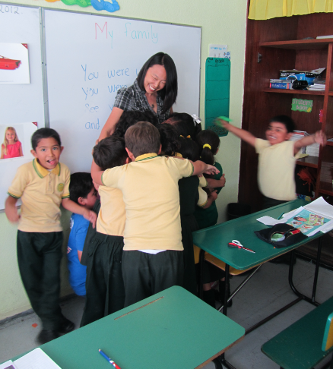
TETE MODULE 10: MANAGING COOPERATIVE ACTIVITIES
Goodbye Song
Goodbye! It’s time to go.
Time to go.
Time to go.
Goodbye! It’s time to go.
See you later!
From Welcome to Our World published by National Geographic Learning

