Slide 1
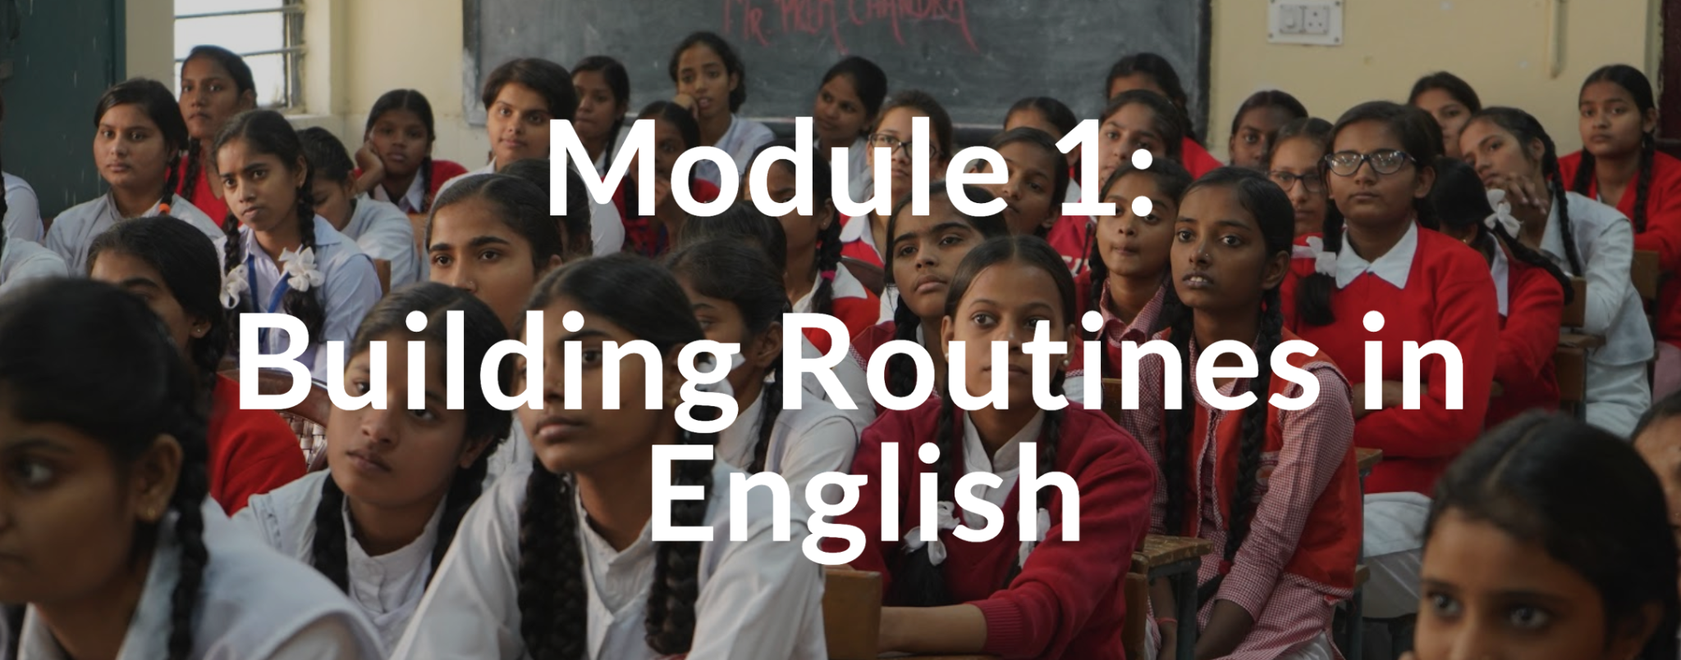
TEACHING ENGLISH THROUGH ENGLISH
MODULE 1 – Building Routines in English
Friday, April 30, 2021
Joan Kang Shin, Ph.D.
Woomee Kim, M.A.
Shin, J. K., & Kim, W. (April, 2021). Building Routines in English. Workshop webinar presented for the Teaching English through English online professional development program (Cohort I): Module 1. U.S. Embassy in Tashkent funded English Speaking Nation Program in Uzbekistan (online). https://bit.ly/3ir1OSa

Slide 2
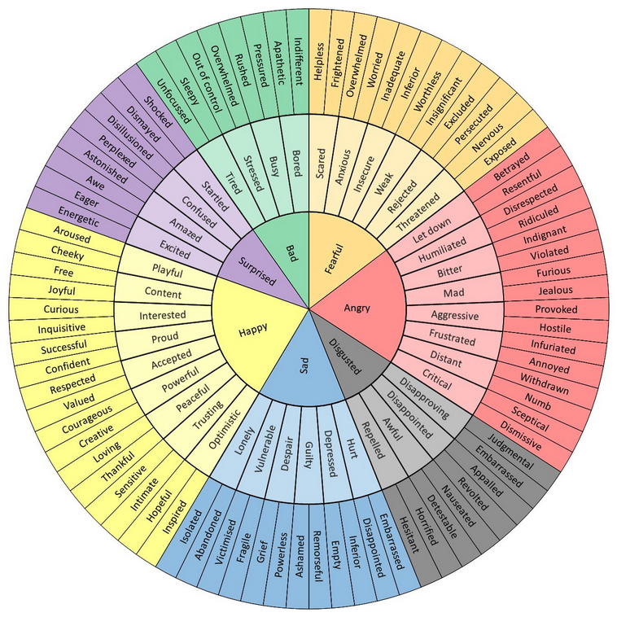
TETE MODULE 1 - BUILDING ROUTINES IN ENGLISH
Start each class with “How are you?”
The Feel Wheel
https://imgur.com/gallery/tCWChf6
One Word Share

Slide 3
TETE MODULE 1 - BUILDING ROUTINES IN ENGLISH
Start each class with “How are you?”
The Feel Wheel
https://imgur.com/gallery/tCWChf6
One Word Share
One Sentence Share
One Object Share
One Picture Share

Slide 4
TETE MODULE 1 - BUILDING ROUTINES IN ENGLISH
Module 1
Webinar Agenda:
Discuss Module 1 content and share some communicative daily routines
Q&A about Mason TETE Google Site
Q&A about effective use of Telegram Groups as a Community of Practice

Slide 5
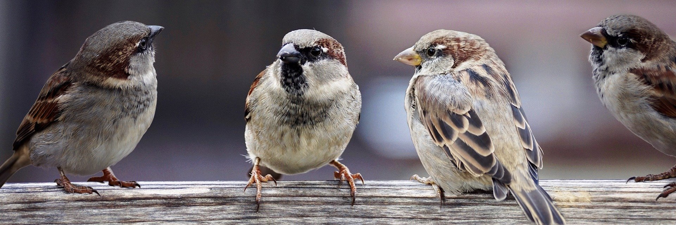
TETE MODULE 1 - BUILDING ROUTINES IN ENGLISH
Purpose of Module 1: To prepare you to use good daily routines to build a communicative language classroom environment
By the end of the module, you will be able to:
describe the purpose and process of good instructional routines using English to maintain a well-managed and communicative learning environment.
apply some of the new classroom routine expressions in the classroom
share some of the effective instructional routines you want to use in your current classroom to increase the use of English

Slide 6
TETE MODULE 1 - BUILDING ROUTINES IN ENGLISH
Why are routines important?
YOUR TURN!
Please type your answers into the chat box or raise your hand to say an answer!

Slide 7
TETE MODULE 1 - BUILDING ROUTINES IN ENGLISH
Why are routines important?
Promote classroom management
Establish shared expectations with your students
Reduce stress for language learning
Develop students’ independence and confidence
Provide smooth transitions from one stage of the lesson to the next
Give more opportunities to use English communicatively!

Slide 8
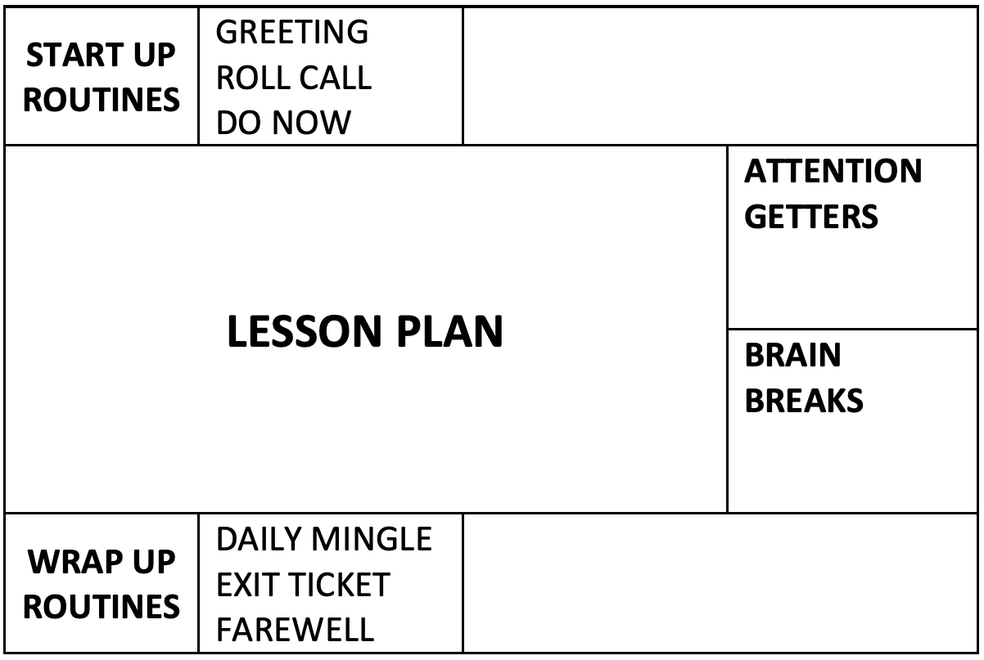
TETE MODULE 1 - BUILDING ROUTINES IN ENGLISH
Plan your lessons with routines!
Routine Chart
by Joan Kang Shin

Slide 9
TETE MODULE 1 - BUILDING ROUTINES IN ENGLISH
Plan your lessons with routines!
Routine Chart
by Joan Kang Shin

Slide 10
TETE MODULE 1 - BUILDING ROUTINES IN ENGLISH
Start-Up Language Routines
Greetings: follow-up questions, students greet each other
Roll call: attendance
Warm-up routines: weather chart, visual aids, daily learning objectives

Slide 11

TETE MODULE 1 - BUILDING ROUTINES IN ENGLISH
https://youtu.be/XauhiNLr6L0?t=268

Slide 12
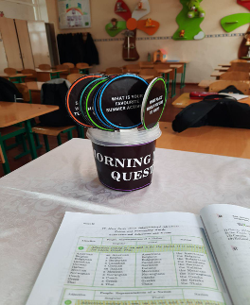
TETE MODULE 1 - BUILDING ROUTINES IN ENGLISH
Start-Up Language Routine from Shahnoza
Morning Meeting Questions
Questions:
Give one adjective to describe your morning.
What are you looking forward to this week?
What is one thing you are excited for this weekend?
What is your favorite place in our community?
What is one way you can show someone you care?
Who is your hero?
What does it mean to be a good friend?
What is one thing you want to learn this year?
If you could have any superpower, what would you choose?

Slide 13
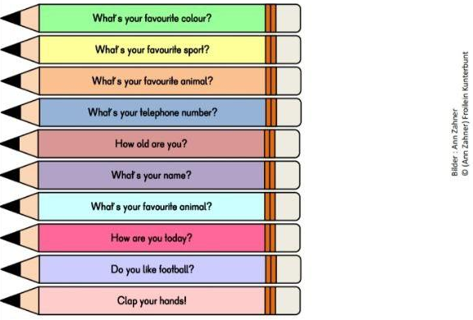
TETE MODULE 1 - BUILDING ROUTINES IN ENGLISH
Start-Up Language Routine from Gulmira

Slide 14
TETE MODULE 1 - BUILDING ROUTINES IN ENGLISH
Do Now Routines
Do this routine at the start of every class
Write a “Do Now” on the board at the beginning of a lesson
Have a student read it out loud
Check for understanding

Slide 15

TETE MODULE 1 - BUILDING ROUTINES IN ENGLISH
Do Now Routine: “Power Quotes”
What do you think this quote means?
Think, write, and discuss with your partner.
“In order to become a real writer,
one must comprehensively study life,
for this he must be familiar with every branch of life.” Abdullah Qadiri
“i

Slide 16
TETE MODULE 1 - BUILDING ROUTINES IN ENGLISH
Plan your lessons with routines!
Routine Chart
by Joan Kang Shin

Slide 17
TETE MODULE 1 - BUILDING ROUTINES IN ENGLISH
Wrap-Up Routines
Do this routine at the end of every class
The purpose is to reflect on the class
It can be done individually, in pairs, or in groups

Slide 18
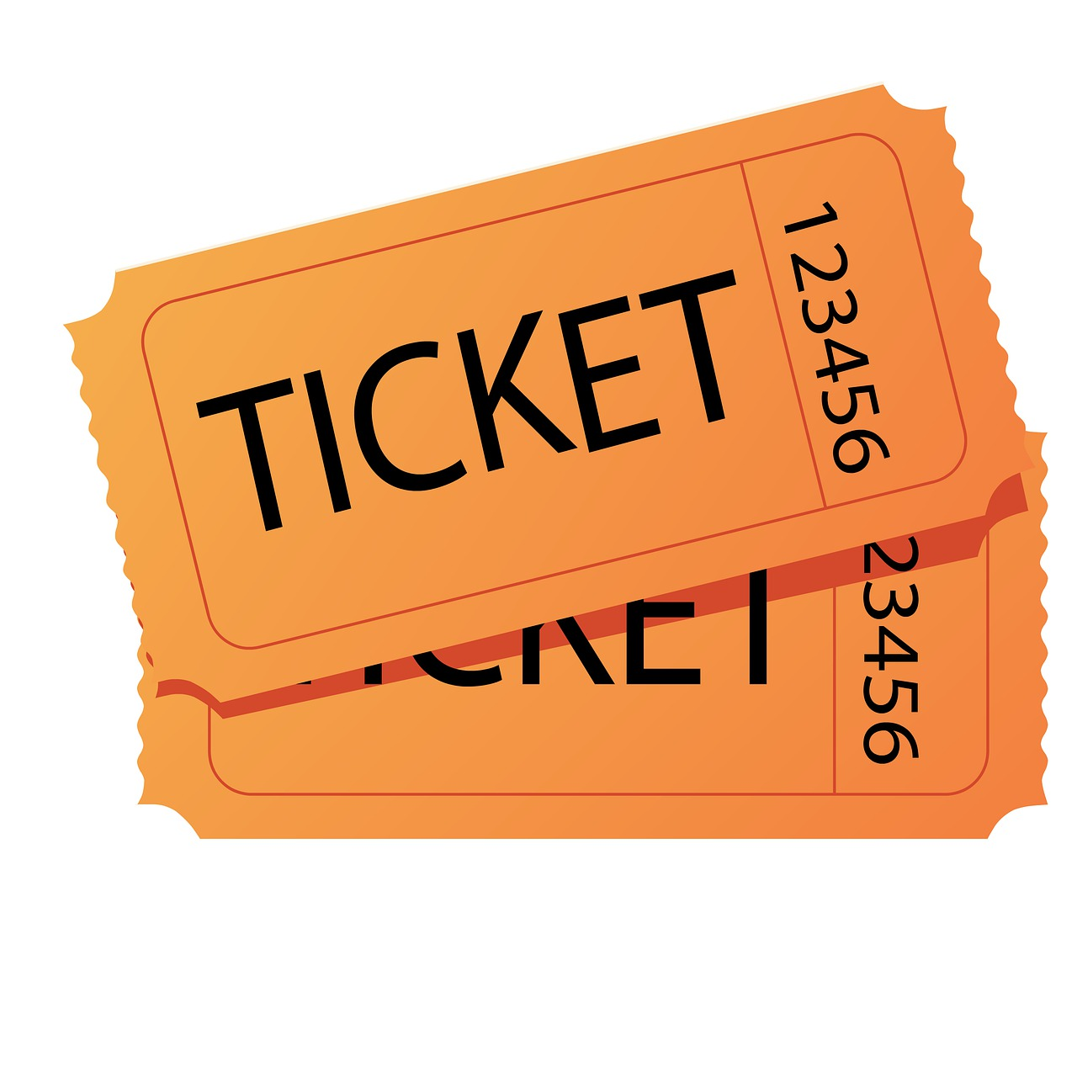
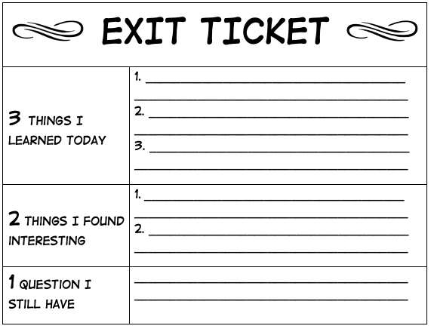
Exit Ticket - Wrap Up Routine
TETE MODULE 1 - BUILDING ROUTINES IN ENGLISH
Easy assessment routine
Teachers use it at the end of each class before students “exit” the class.
Students can show what they learned before they leave class.

Slide 19
TETE MODULE 1 - BUILDING ROUTINES IN ENGLISH
Wrap Up Daily Mingle
A daily mingle is a short activity where learners walk around the classroom and talk to each other.
It can be a good wrap-up routine.
Students practice speaking with one another and share their reflections.

Slide 20

TETE MODULE 1 - BUILDING ROUTINES IN ENGLISH
Wrap-Up Sample Questions
DISCUSS WITH A PARTNER!
What is one thing that you learned today?
What is one question that you still wonder?
What is one way someone helped you to learn?

Slide 21
TETE MODULE 1 - BUILDING ROUTINES IN ENGLISH
Daily Mingle Challenges:
Not enough time
Not enough space
Students are too noisy
How can we overcome these challenges?
YOUR TURN!
Please type your ideas into the chat box or raise your hand to speak!

Slide 22
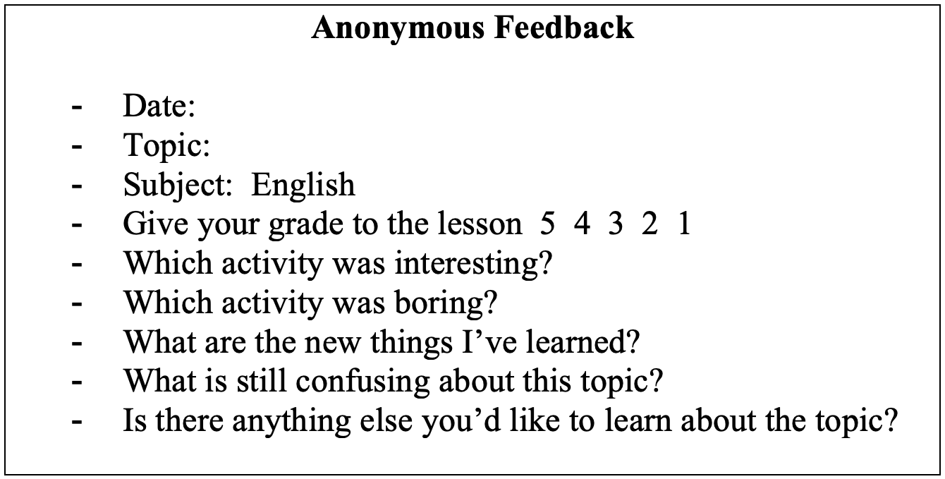
TETE MODULE 1 - BUILDING ROUTINES IN ENGLISH
Wrap-Up Feedback Routine from Evelina

Slide 23
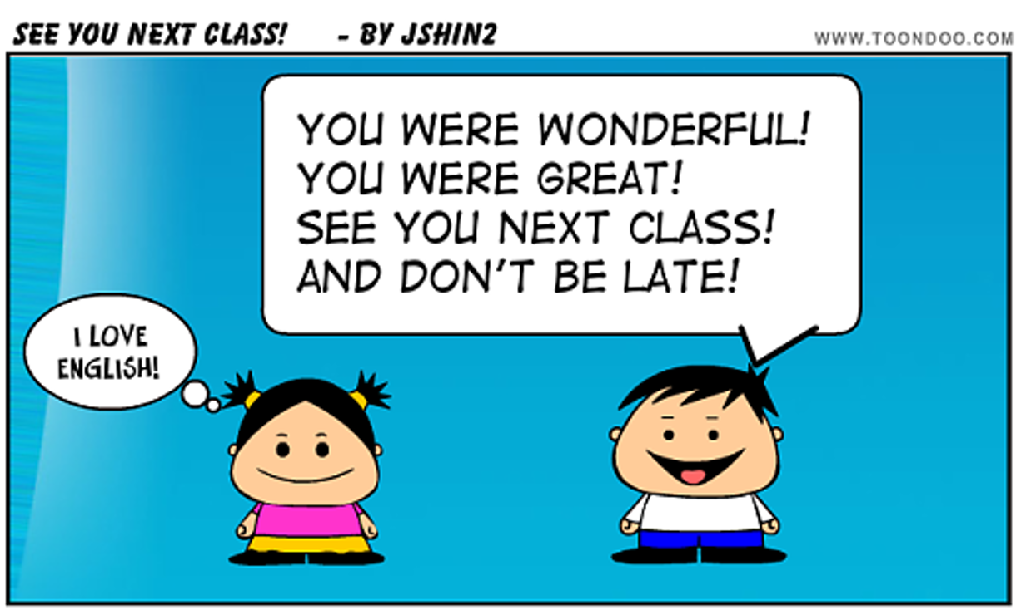
TETE MODULE 1 - BUILDING ROUTINES IN ENGLISH
Farewell Routine

Slide 24
TETE MODULE 1 - BUILDING ROUTINES IN ENGLISH
Routines for Everyday Language
Do a daily calendar activity (e.g. important events)
Involve students in classroom routines (e.g. jobs board)
Do a daily mingle

Slide 25
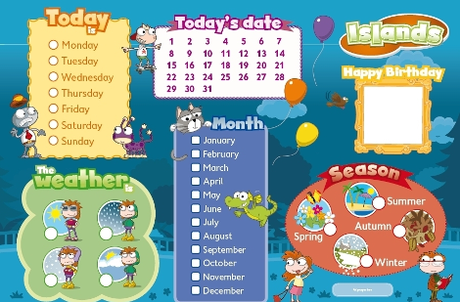
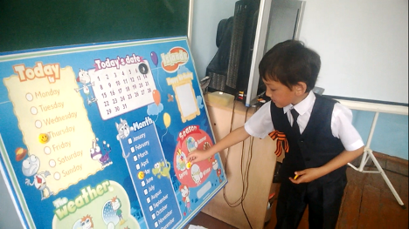
TETE MODULE 1 - BUILDING ROUTINES IN ENGLISH
Routines for Everyday Language from Oybek
The Duty’s Report
The Duty should answer the questions, which are asked by a teacher or a student, and stick magnets on the chart. The questions are following:
What date is it today?
What weekday is it today?
What season is it now?
How is the weather today?
In the chart there is also a section “Happy birthday!” where you can put photos of write names of the students, whose birthdays are on that day.

Slide 26
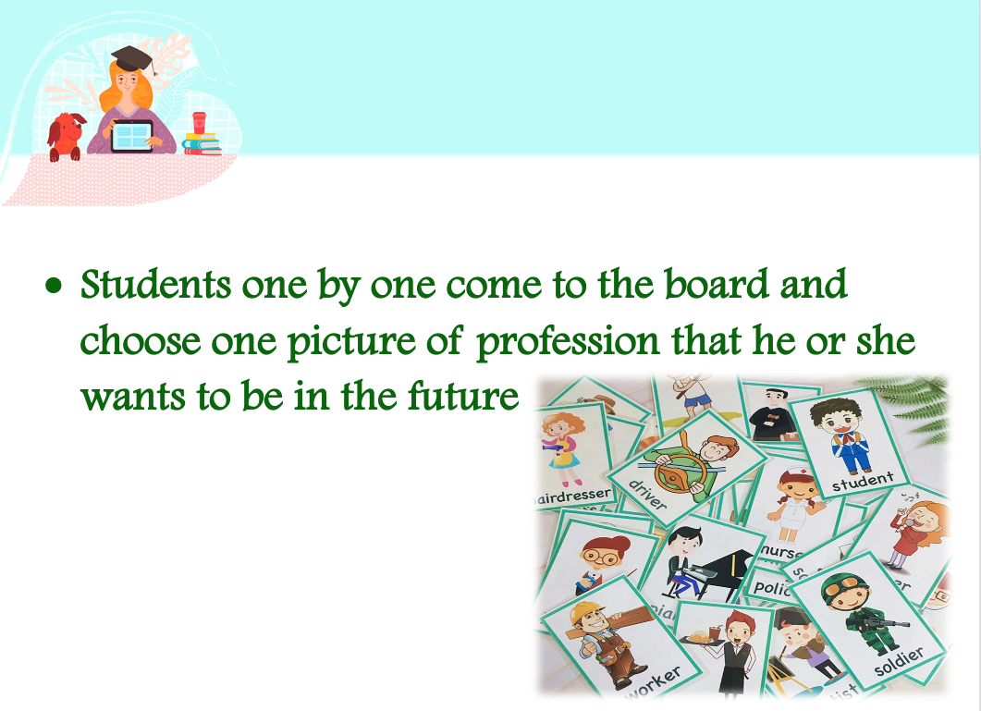
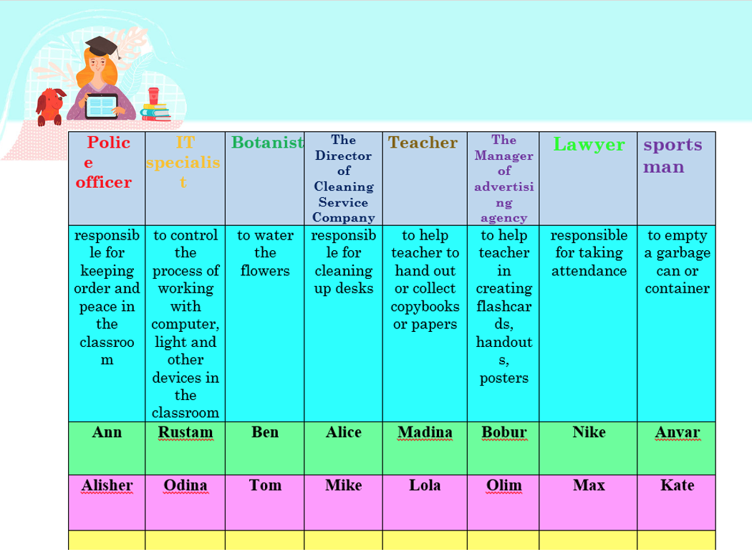
TETE MODULE 1 - BUILDING ROUTINES IN ENGLISH
Routines for Everyday Language from Lora
My Dream Job Activity

Slide 27
TETE MODULE 1 - BUILDING ROUTINES IN ENGLISH
Plan your lessons with routines!
Routine Chart
by Joan Kang Shin

Slide 28
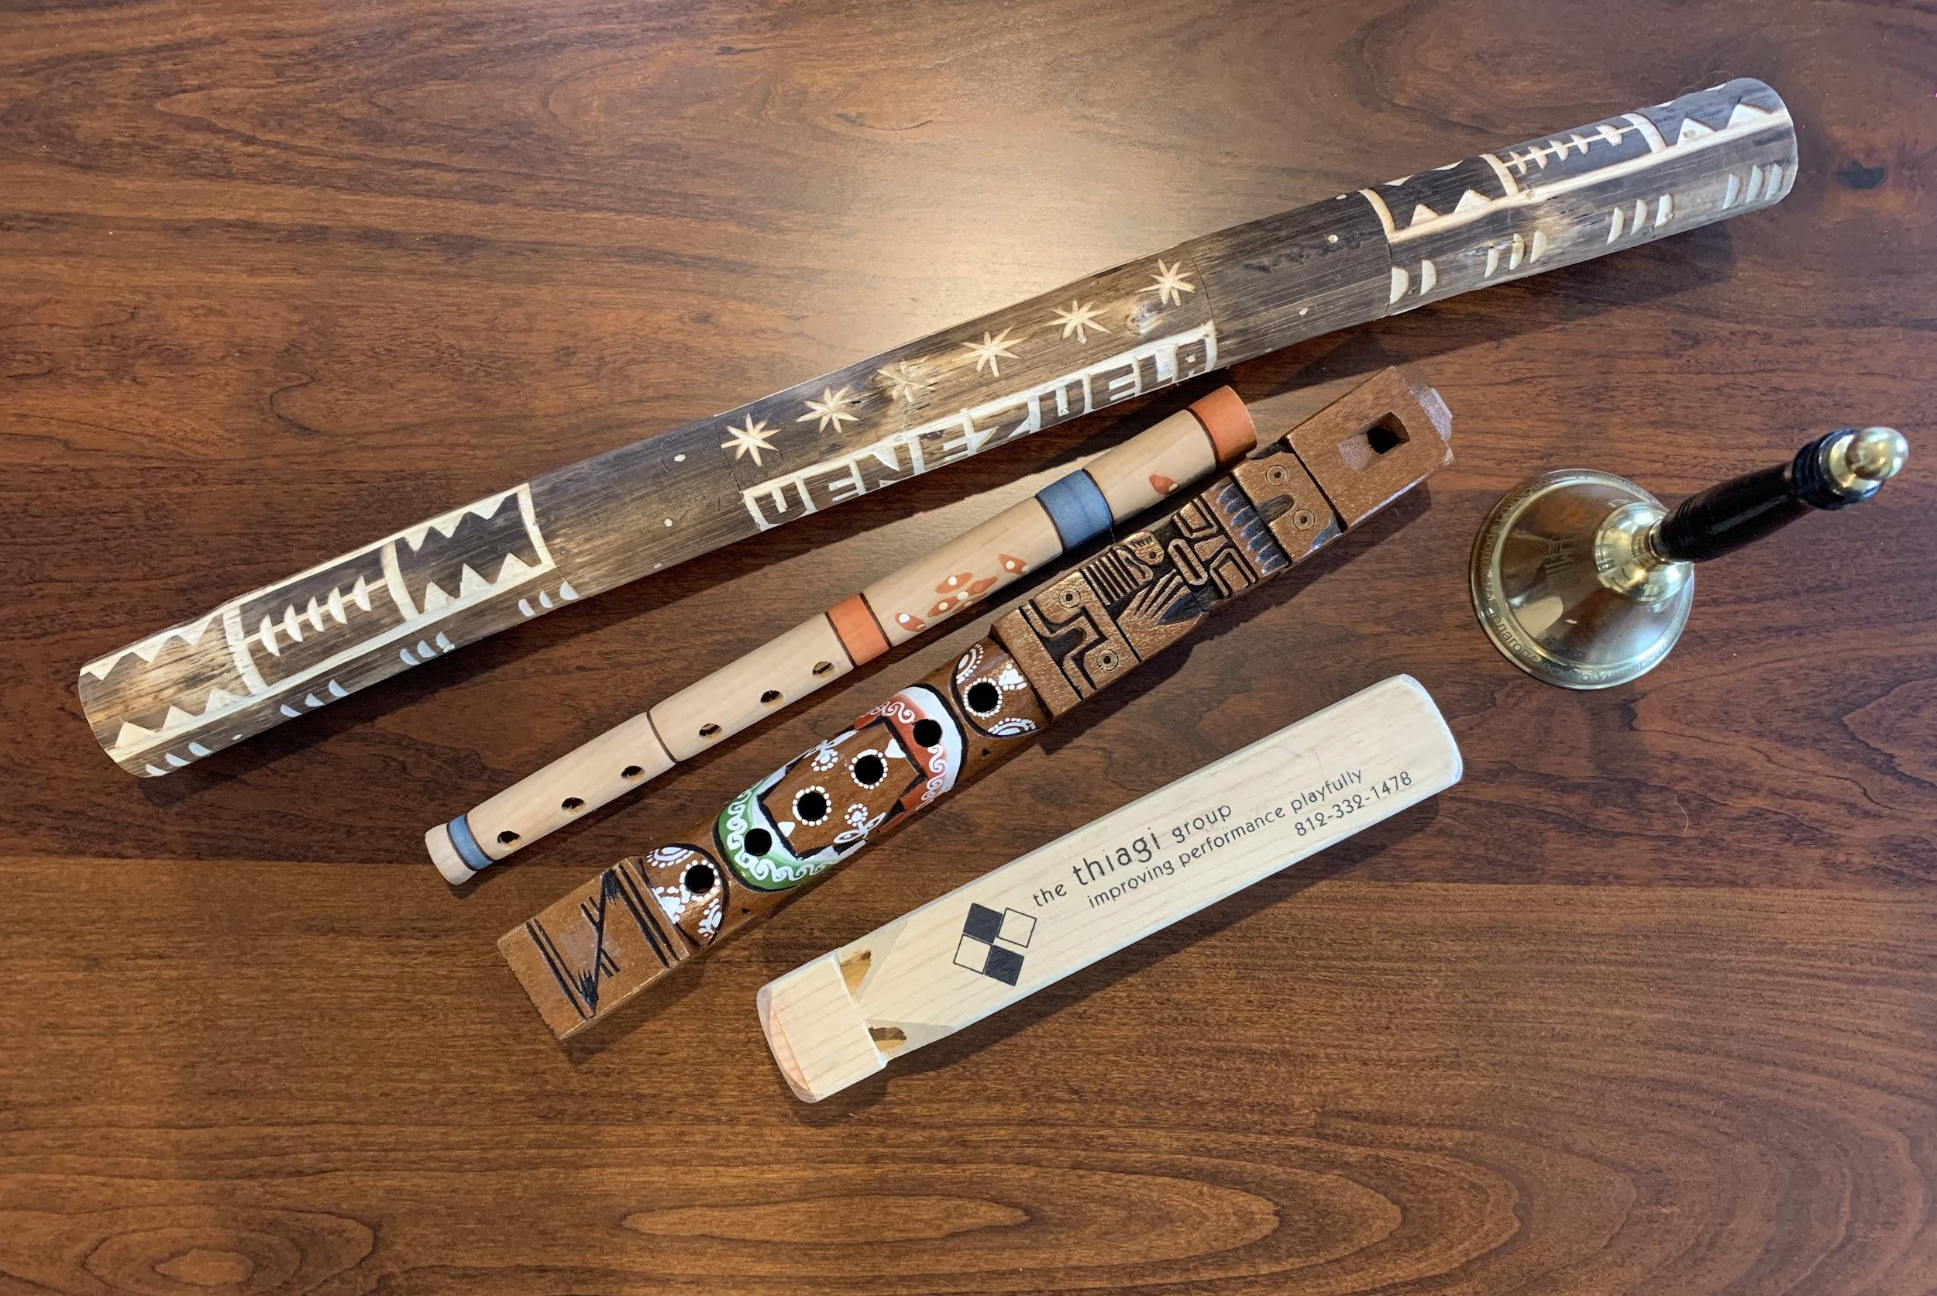
Attention Getters
TETE MODULE 1 - BUILDING ROUTINES IN ENGLISH
Signals:
Bells
Whistles
Lights out
Clapping

Slide 29


Attention Getters
TETE MODULE 1 - BUILDING ROUTINES IN ENGLISH
Try to add more English! Call and Response:
Teacher: 1-2-3 eyes on me!
Students: 1-2 eyes on you!
Ready to rock?
When I say… You say…
Teacher: When I say Hello, you say Good-bye!
Hello!
Students: Good-bye!
Teacher: Hello!
Students: Good-bye!
Ready to roLL!

Slide 30



Brain Breaks
TETE MODULE 1 - BUILDING ROUTINES IN ENGLISH
Shake Shakes: Shake one hand (or foot) for 3 seconds then the other. Repeat 5x.
Arm and Leg Stretch: Stretch arms and legs standing up or sitting down.
Breathing Break: Close your eyes and breathe in, breathe out (5x)
Nosey Ear: Get your left hand to touch your right ear lobe and then get your right hand to touch the tip of your nose. Then swap positions. Repeat 5x.
One Minute Dance Party: Play a song for one minute and let students dance (while seated if no space)

Slide 31
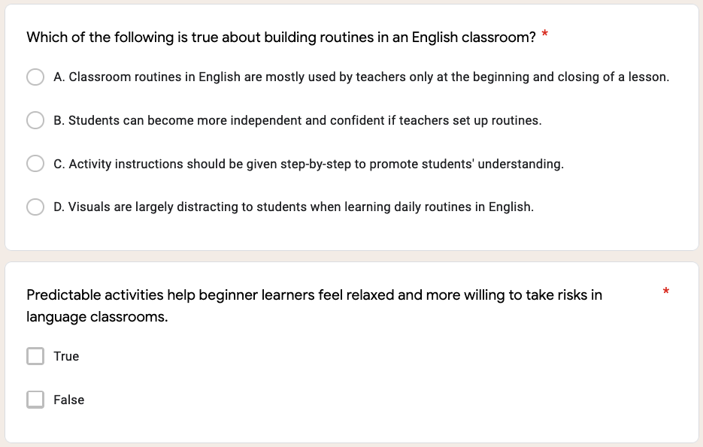
TETE MODULE 1 - BUILDING ROUTINES IN ENGLISH

Slide 32
TETE MODULE 1 - BUILDING ROUTINES IN ENGLISH

Slide 33
TETE MODULE 1 - BUILDING ROUTINES IN ENGLISH

Slide 34
TETE MODULE 1 - BUILDING ROUTINES IN ENGLISH
My Routines
Ask: Did you find any from your online searches? What key words did you use?
Get examples from group chats?

Slide 35

TETE MODULE 1 - BUILDING ROUTINES IN ENGLISH
QUESTIONS
Do you have any questions about the TETE Google Site?
Do you have any questions about the TETE Telegram groups?

Slide 36
TETE MODULE 1 - BUILDING ROUTINES IN ENGLISH
EXIT TICKET
Now we will do our Module 1 Exit Ticket!
Click on the link in the chat box.

Slide 37
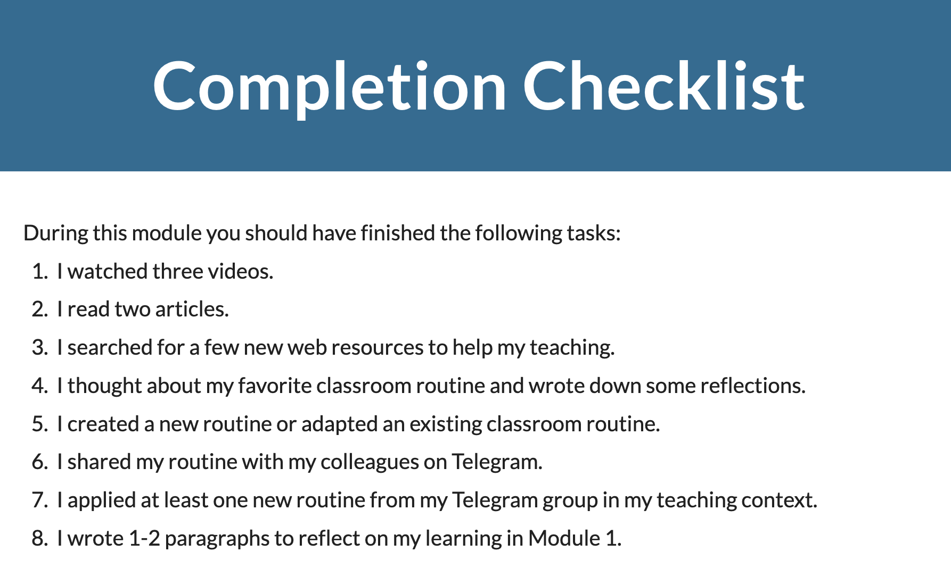
TETE MODULE 1 - BUILDING ROUTINES IN ENGLISH
What is due on Sunday, May 2nd?

Slide 38
TETE MODULE 1 - BUILDING ROUTINES IN ENGLISH
ANNOUNCEMENTS
Module 2: Giving Clear Instructions
will be announced on Monday, May 3rd!
NEXT WEBINAR
Friday, May 7th
6:00-7:00 PM Uzbekistan Time

Slide 39
TETE MODULE 1 - BUILDING ROUTINES IN ENGLISH
"Tell me and I forget.
Teach me and I remember.
Involve me and I learn."
- Benjamin Franklin

