Slide 1
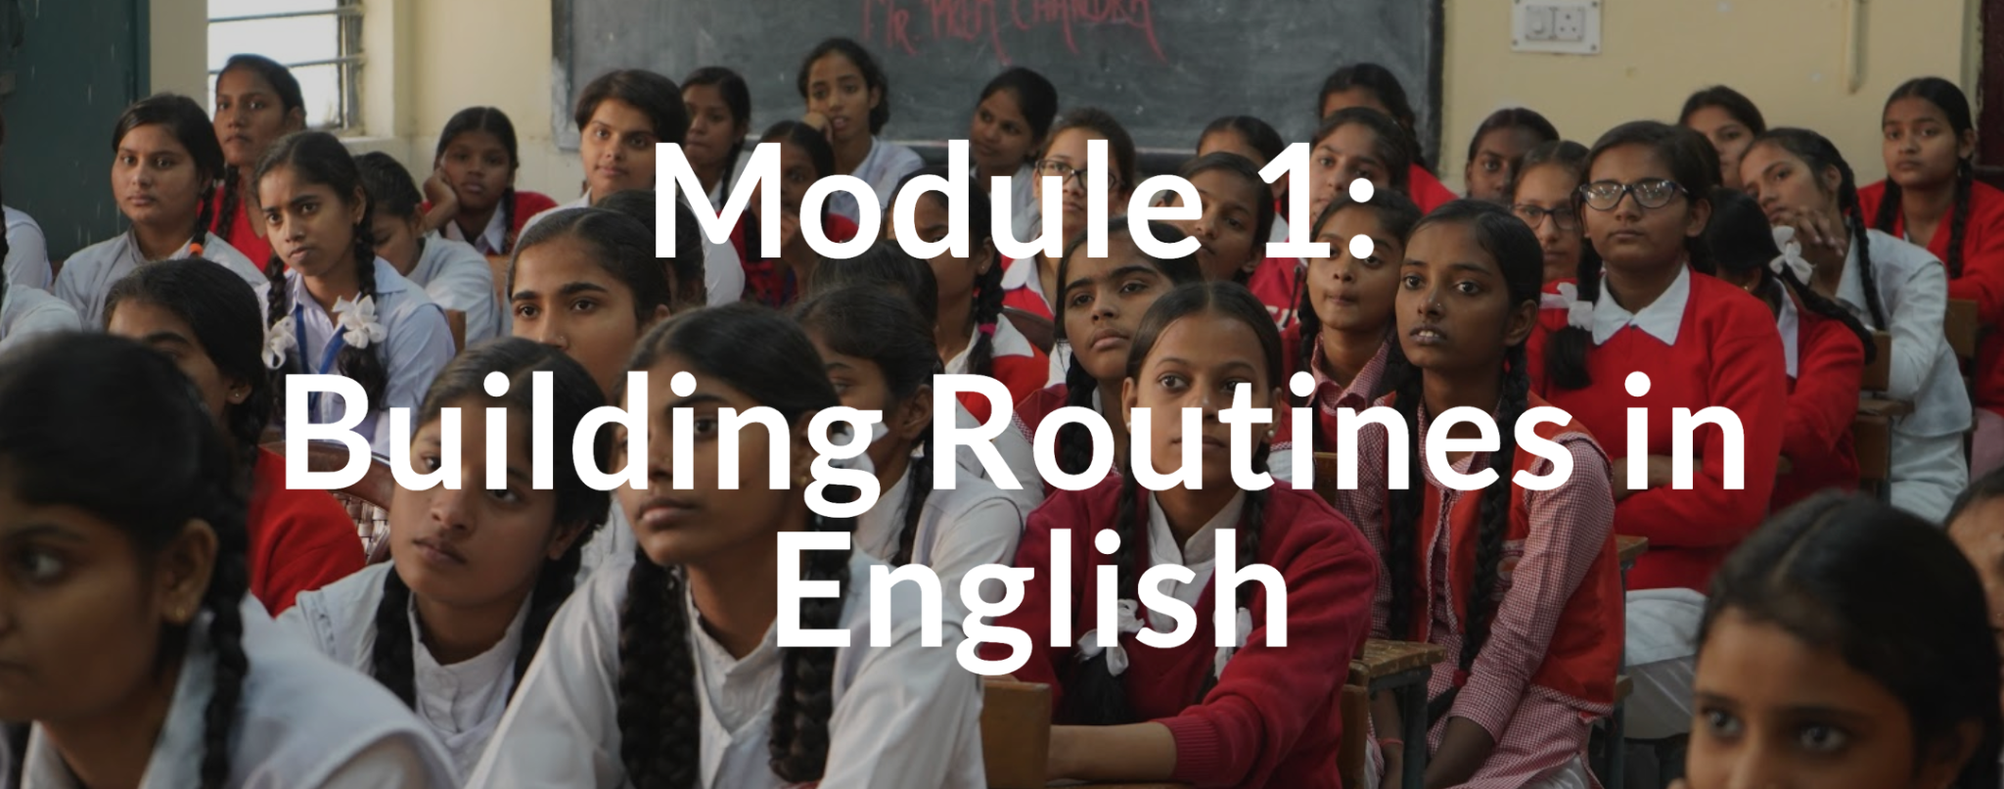
TEACHING ENGLISH THROUGH ENGLISH
MODULE 1 – Building Routines in English
Friday, July 9, 2021
Joan Kang Shin, Ph.D.
Woomee Kim, M.A.
Shin, J. K., & Kim, W. (July, 2021). Building Routines in English. Workshop webinar presented for the Teaching English through English online professional development program (Cohort II): Module 1. U.S. Embassy in Tashkent funded English Speaking Nation Program in Uzbekistan (online). https://bit.ly/3Amu6Dr

Slide 2
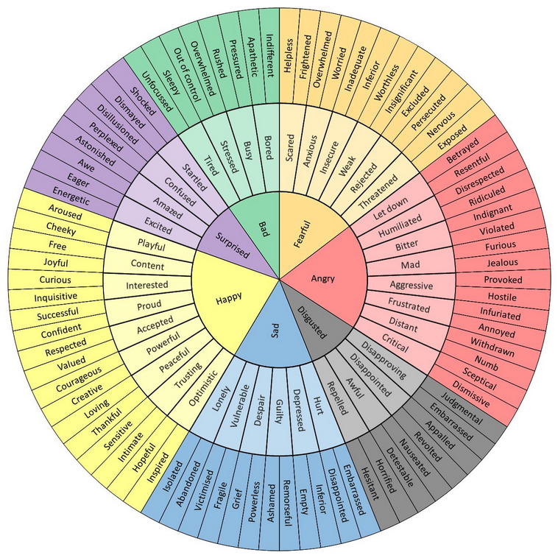
TETE MODULE 1 - BUILDING ROUTINES IN ENGLISH
Start each class with “How are you?”
The Feel Wheel
https://imgur.com/gallery/tCWChf6
One Word Share

Slide 3
TETE MODULE 1 - BUILDING ROUTINES IN ENGLISH
Start each class with “How are you?”
The Feel Wheel
https://imgur.com/gallery/tCWChf6
One Word Share
One Sentence Share
One Object Share
One Picture Share

Slide 4
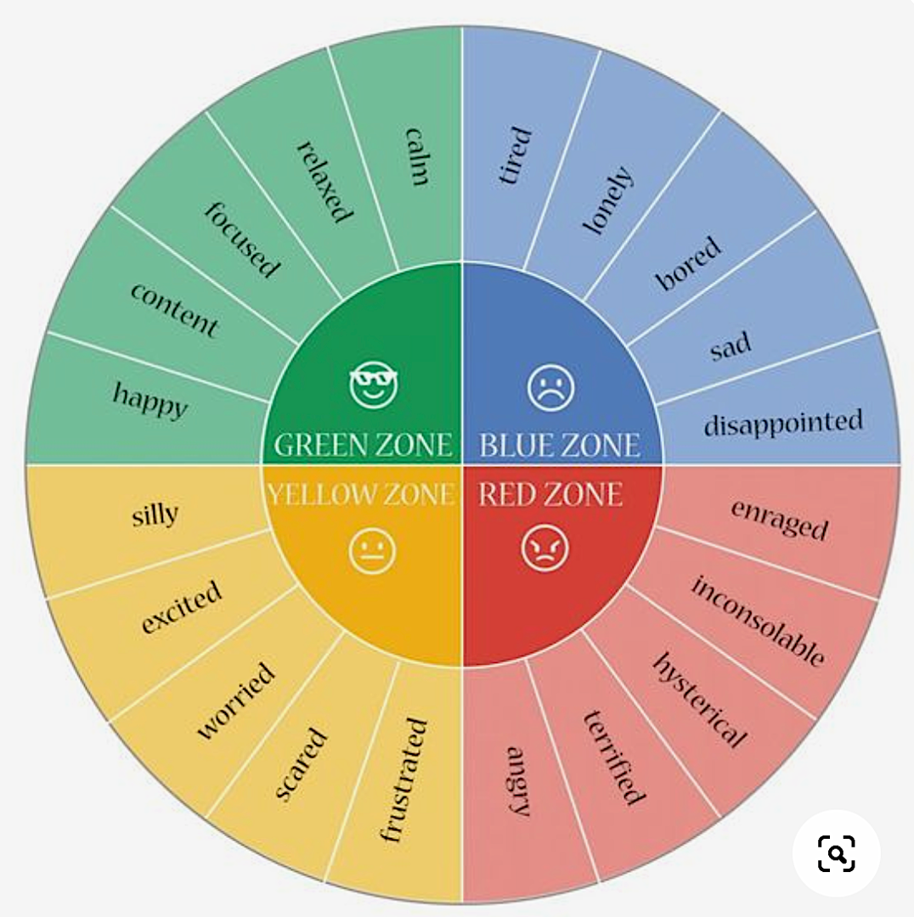
TETE MODULE 1 - BUILDING ROUTINES IN ENGLISH
Start each class with “How are you?”
The Feel Wheel
hes-extraordinary.com
One Word Share
One Sentence Share
One Object Share
One Picture Share

Slide 5
TETE MODULE 1 - BUILDING ROUTINES IN ENGLISH
Module 1
Webinar Agenda:
Discuss Module 1 content and share some communicative daily routines
Q&A about Mason TETE Google Site
Q&A about effective use of Telegram Groups as a Community of Practice

Slide 6
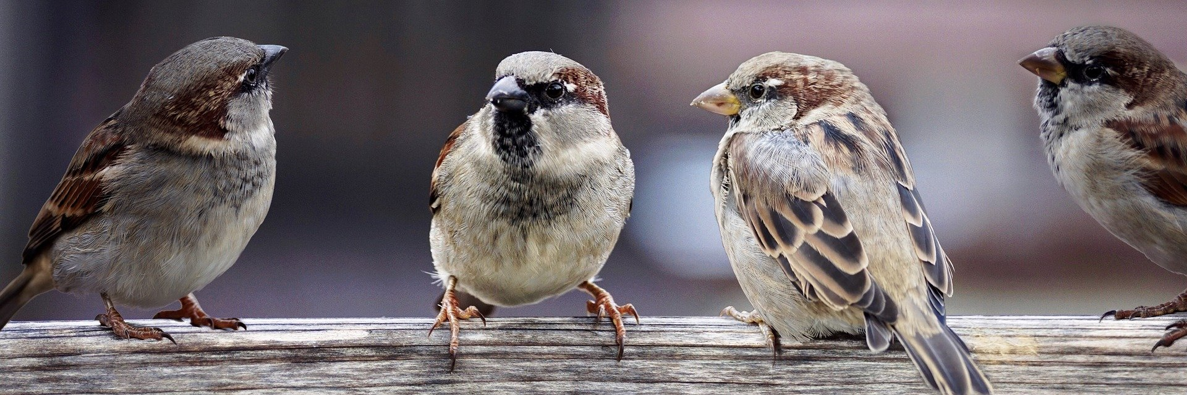
TETE MODULE 1 - BUILDING ROUTINES IN ENGLISH
Purpose of Module 1: To prepare you to use good daily routines to build a communicative language classroom environment
By the end of the module, you will be able to:
describe the purpose and process of good instructional routines using English to maintain a well-managed and communicative learning environment.
apply some of the new classroom routine expressions in the classroom
share some of the effective instructional routines you want to use in your current classroom to increase the use of English

Slide 7
TETE MODULE 1 - BUILDING ROUTINES IN ENGLISH
Why are routines important?
YOUR TURN!
Please type your answers into the chat box or raise your hand to say an answer!

Slide 8
TETE MODULE 1 - BUILDING ROUTINES IN ENGLISH
Why are routines important?
Promote classroom management
Establish shared expectations with your students
Reduce stress for language learning
Develop students’ independence and confidence
Provide smooth transitions from one stage of the lesson to the next
Give more opportunities to use English communicatively!

Slide 9
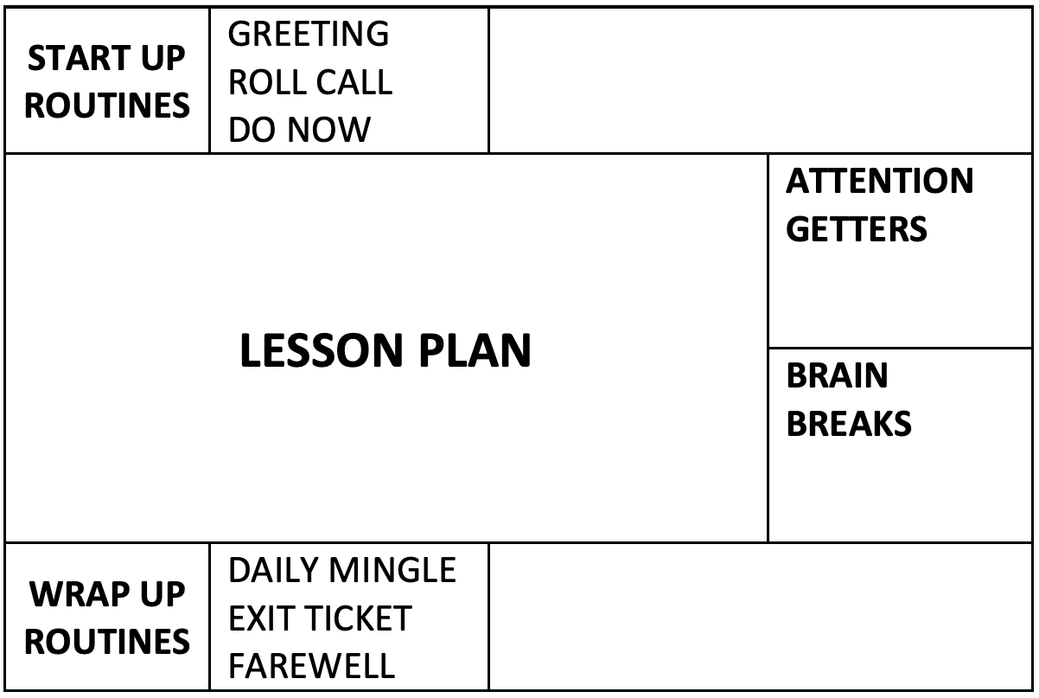
TETE MODULE 1 - BUILDING ROUTINES IN ENGLISH
Plan your lessons with routines!
Routine Chart
by Joan Kang Shin

Slide 10
TETE MODULE 1 - BUILDING ROUTINES IN ENGLISH
Plan your lessons with routines!
Routine Chart
by Joan Kang Shin

Slide 11
TETE MODULE 1 - BUILDING ROUTINES IN ENGLISH
Start-Up Language Routines
Greetings: follow-up questions, students greet each other
Roll call: attendance
Warm-up routines: weather chart, visual aids, daily learning objectives

Slide 12

TETE MODULE 1 - BUILDING ROUTINES IN ENGLISH
https://youtu.be/XauhiNLr6L0?t=268

Slide 13
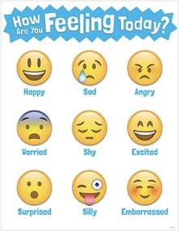
TETE MODULE 1 - BUILDING ROUTINES IN ENGLISH
Start-Up Language Routine from Umidakhon Usmonova
How are you feeling today?
Time: About 5 minutes at the beginning of the lesson. (Teacher modeling included in)
Goals: Providing students interactive practice with feelings vocabulary, and questions/answers, giving students a chance to practice speaking and listening.
Materials: Sentence frames or a list of vocabulary words and, ‘Feelings emoji chart’ are displayed on the board.
Preparation: Teacher prepares visuals beforehand and, displays them on the board. One chart is for Vocabulary with sample question and answers, the other is ‘Emoji chart’ with 6-9 feelings described. Before asking students to mingle Teacher models a question and answer with one of active students.
Option: Teacher asks students to draw the feelings on their fingers and ask which of the feelings describes them best for today.
Notes:
1. Begin by explaining to students that the purpose of the daily mingle is to practice ways to feelings and, to ask and answer related questions in English. Tell students that you will write the targeted language structures on the board and model what to say before each mingle.
2. For demonstration purposes, write the following on the board: Hello! How do you feel today? – I am______, because________.
3. Model with one of your students:
T: How do you feel today? S: I am happy because I slept well today.
S: How are feeling today? T: I am happy because today is my birthday.
4. Check students’ understanding your instruction and, tell them that answers may warry.
5. Explain that you will count till 5 and students should walk around until. When it stops, they should find a partner to practice the target vocabulary with questions and answers.
6. Allow time for any questions from your students. Then, practice the procedure with the whole class by having everyone get out of their seats and move around. Count and stop periodically so that students can mingle with several different classmates to practice the language structures. Provide guidance or corrections as needed.
7. Once students are familiar with the procedures for the daily mingle, you can change the content based on what you would like the class to practice.

Slide 14
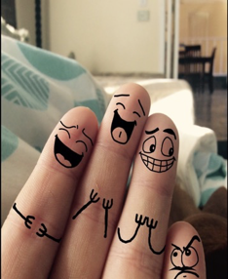
TETE MODULE 1 - BUILDING ROUTINES IN ENGLISH
Start-Up Language Routine from Umidakhon Usmonova
How are you feeling today?
Topic/Content | Example Vocabulary | Example Questions | Example Responses
Talking about one’s feelings | Feelings: happy, sad, angry, worried, shy, excited, surprised, silly, embarrassed, tired | Hello, how are you feeling today? Why are you feeling…? Hi, how do you feel today? Why? What happened? | I am happy because… I feel…because...
Notes:
1. Begin by explaining to students that the purpose of the daily mingle is to practice ways to feelings and, to ask and answer related questions in English. Tell students that you will write the targeted language structures on the board and model what to say before each mingle.
2. For demonstration purposes, write the following on the board: Hello! How do you feel today? – I am______, because________.
3. Model with one of your students:
T: How do you feel today? S: I am happy because I slept well today.
S: How are feeling today? T: I am happy because today is my birthday.
4. Check students’ understanding your instruction and, tell them that answers may warry.
5. Explain that you will count till 5 and students should walk around until. When it stops, they should find a partner to practice the target vocabulary with questions and answers.
6. Allow time for any questions from your students. Then, practice the procedure with the whole class by having everyone get out of their seats and move around. Count and stop periodically so that students can mingle with several different classmates to practice the language structures. Provide guidance or corrections as needed.
7. Once students are familiar with the procedures for the daily mingle, you can change the content based on what you would like the class to practice.

Slide 15
TETE MODULE 1 - BUILDING ROUTINES IN ENGLISH
Do Now Routines
Do this routine at the start of every class
Write a “Do Now” on the board at the beginning of a lesson
Have a student read it out loud
Check for understanding

Slide 16

TETE MODULE 1 - BUILDING ROUTINES IN ENGLISH
Do Now Routine: “Power Quotes”
What do you think this quote means?
Think, write, and discuss with your partner.
“In order to become a real writer,
one must comprehensively study life,
for this [s/he] must be familiar with every branch of life.” Abdullah Qadiri
“i

Slide 17
TETE MODULE 1 - BUILDING ROUTINES IN ENGLISH
Plan your lessons with routines!
Routine Chart
by Joan Kang Shin

Slide 18
TETE MODULE 1 - BUILDING ROUTINES IN ENGLISH
Wrap-Up Routines
Do this routine at the end of every class
The purpose is to reflect on the class
It can be done individually, in pairs, or in groups

Slide 19
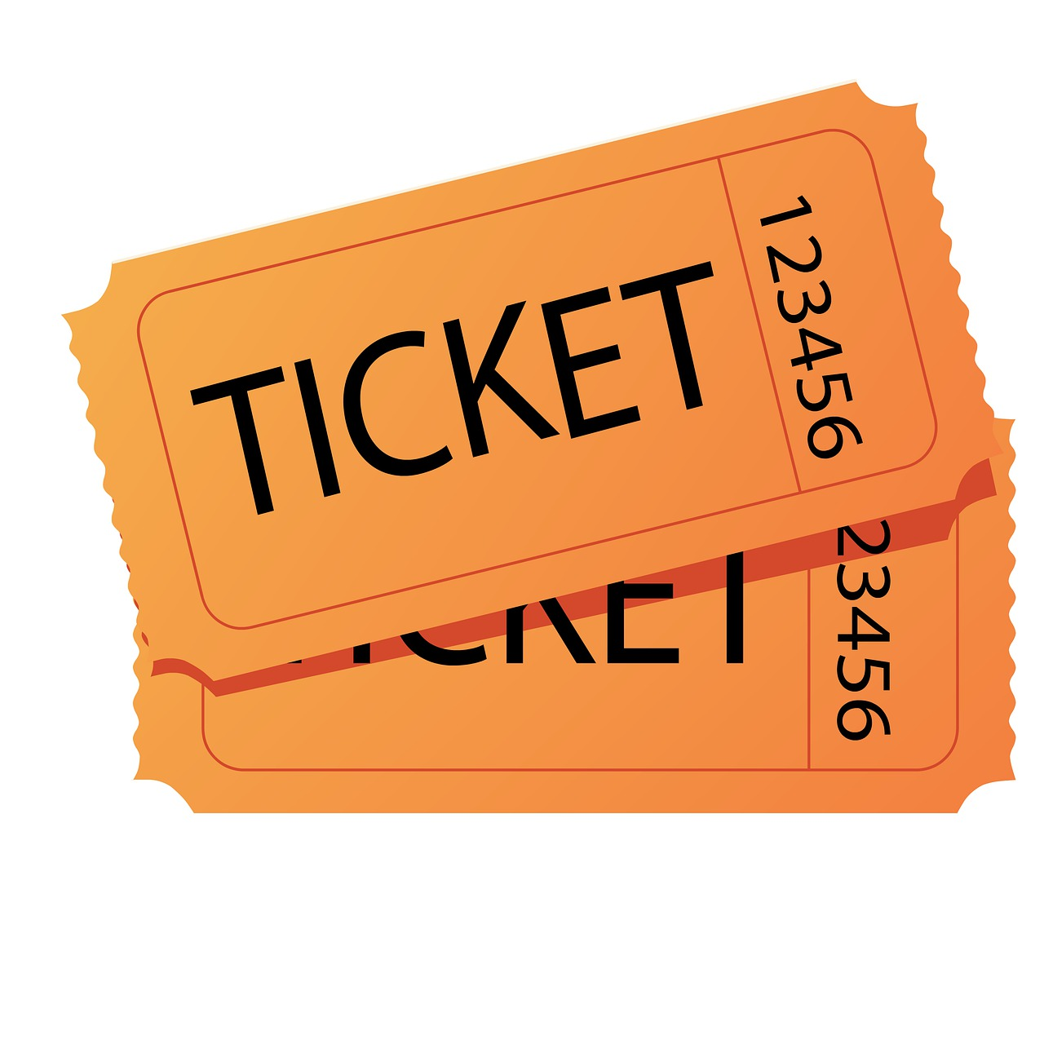
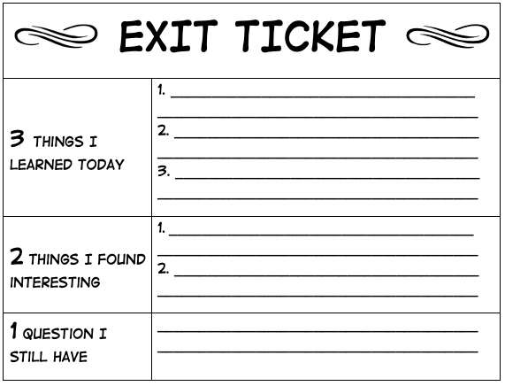
Exit Ticket - Wrap Up Routine
TETE MODULE 1 - BUILDING ROUTINES IN ENGLISH
Easy assessment routine
Teachers use it at the end of each class before students “exit” the class.
Students can show what they learned before they leave class.

Slide 20
TETE MODULE 1 - BUILDING ROUTINES IN ENGLISH
Wrap Up Daily Mingle
A daily mingle is a short activity where learners walk around the classroom and talk to each other.
It can be a good wrap-up routine.
Students practice speaking with one another and share their reflections.

Slide 21

TETE MODULE 1 - BUILDING ROUTINES IN ENGLISH
Wrap-Up Sample Questions
DISCUSS WITH A PARTNER!
What is one thing that you learned today?
What is one question that you still wonder?
What is one way someone helped you to learn?

Slide 22
TETE MODULE 1 - BUILDING ROUTINES IN ENGLISH
Daily Mingle Challenges:
Not enough time
Not enough space
Students are too noisy
How can we overcome these challenges?
YOUR TURN!
Please type your ideas into the chat box or raise your hand to speak!

Slide 23
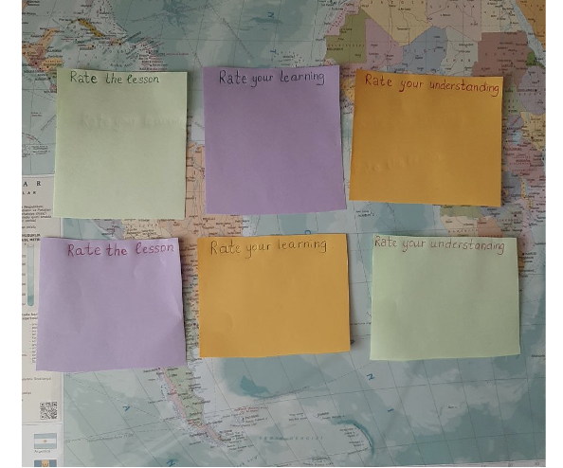
TETE MODULE 1 - BUILDING ROUTINES IN ENGLISH
Wrap-Up Feedback Routine from
Dilnozakhon Abdukayumova: “Rate the Lesson”
At the end of the lesson, get student feedback (anonymous)
Use the sticky note as an exit ticket
Rate 1 - 10 on how well did the students understand the day’s lesson
If their rating is low, ask them to write down what they need more of (e.g., more time, more explanation, more speaking practice)
Collect, calculate the average and read any written feedback. If low average, explain more, review and/or reteach.
Notes:
This “Wrap up” activity is effective, because it allows students to check their understanding and create an opportunity to reflect in every lesson, as well as gives them chance to use their voice. I can follow this activity especially with upper graders as a closing routine.

Slide 24
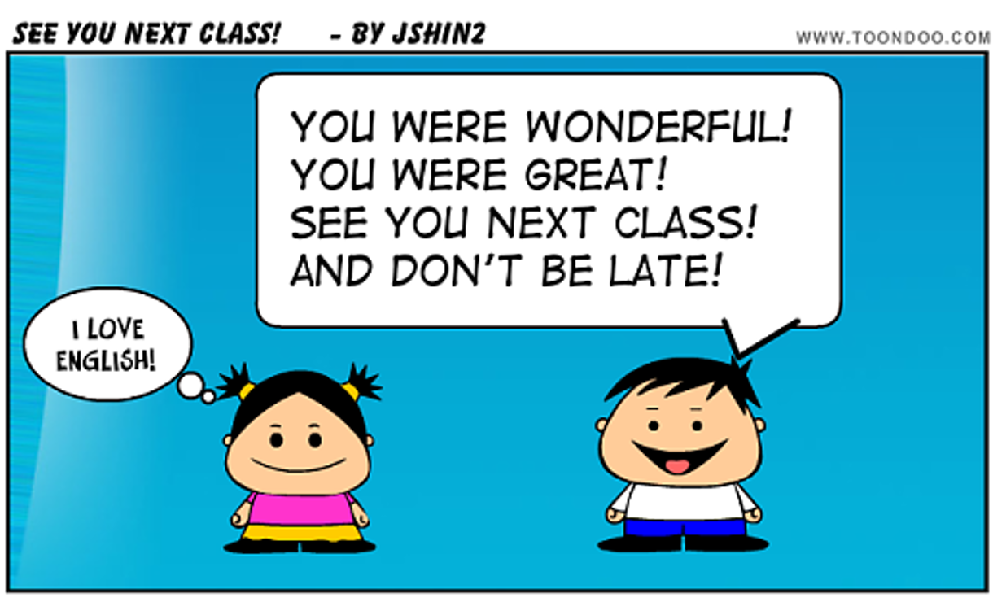
TETE MODULE 1 - BUILDING ROUTINES IN ENGLISH
Farewell Routine

Slide 25
TETE MODULE 1 - BUILDING ROUTINES IN ENGLISH
Routines for Everyday Language
Do a daily calendar activity (e.g. important events)
Involve students in classroom routines (e.g. jobs board)
Do a daily mingle

Slide 26
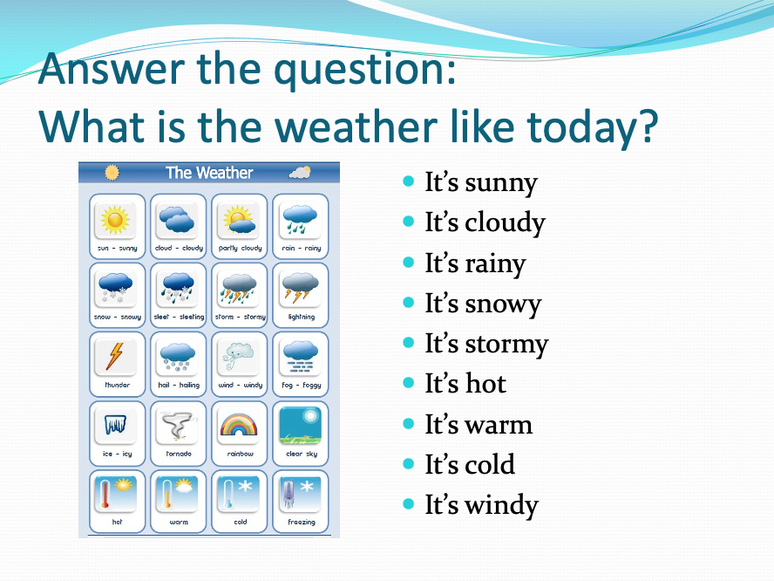
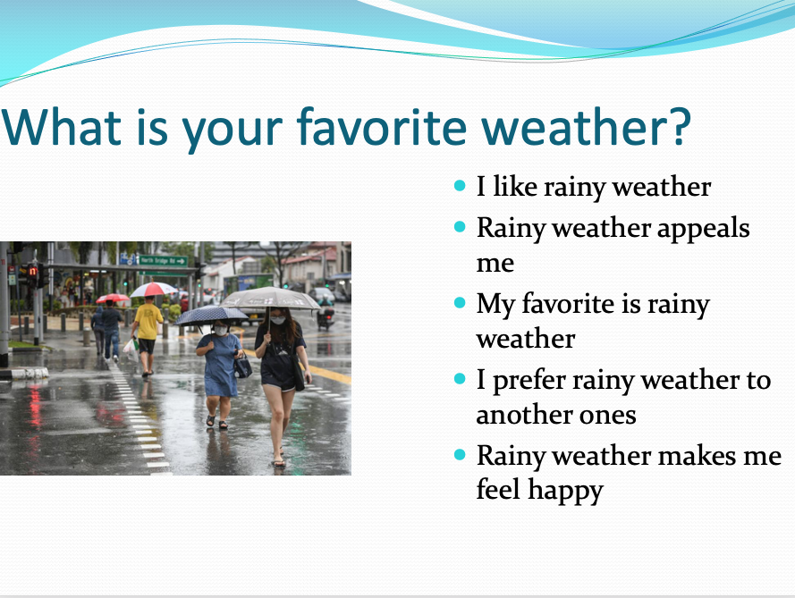
TETE MODULE 1 - BUILDING ROUTINES IN ENGLISH
Routines for Everyday Language from Azimjonova Yelena
What’s the weather like today?
Notes:
Talking about the weather by Azimjonova Yelena from Karakul district
“This is one of my daily greeting routines. I find it very useful because my students are able to talk not only about their favorite weather but also why do they prefer it and what do they do experiencing such kind of weather. “

Slide 27
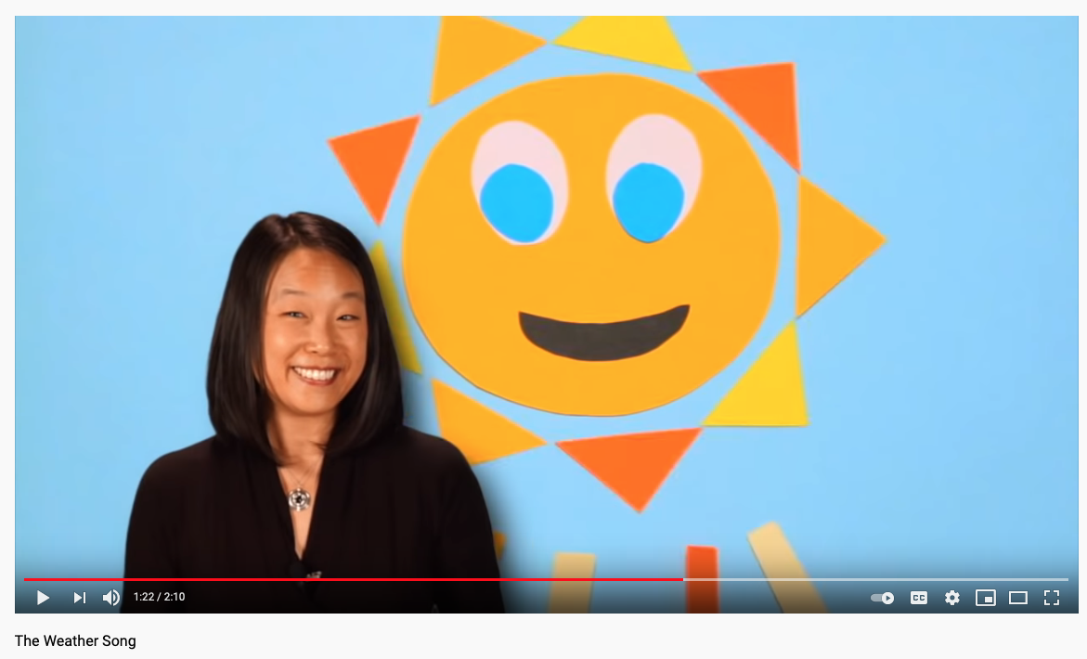
TETE MODULE 1 - BUILDING ROUTINES IN ENGLISH
The Weather Song
https://youtu.be/hQCt_tDh3s4?t=82

Slide 28

TETE MODULE 1 - BUILDING ROUTINES IN ENGLISH
The Weather Song
What’s the weather?
What’s the weather?
What’s the weather like today?
Tell us (student’s name),
What’s the weather?
What’s the weather like today?
Is it sunny?
Is it cloudy?
Is it rainy out today?
Is it snowy?
Is it windy?
What’s the weather like today?

Slide 29
TETE MODULE 1 - BUILDING ROUTINES IN ENGLISH
Plan your lessons with routines!
Routine Chart
by Joan Kang Shin

Slide 30

Attention Getters
TETE MODULE 1 - BUILDING ROUTINES IN ENGLISH
Signals:
Bells
Whistles
Lights out
Clapping

Slide 31


Attention Getters
TETE MODULE 1 - BUILDING ROUTINES IN ENGLISH
Try to add more English! Call and Response:
Teacher: 1-2-3 eyes on me!
Students: 1-2 eyes on you!
Ready to rock?
When I say… You say…
Teacher: When I say Hello, you say Good-bye!
Hello!
Students: Good-bye!
Teacher: Hello!
Students: Good-bye!
Ready to roLL!

Slide 32



Brain Breaks
TETE MODULE 1 - BUILDING ROUTINES IN ENGLISH
Shake Shakes: Shake one hand (or foot) for 3 seconds then the other. Repeat 5x.
Arm and Leg Stretch: Stretch arms and legs standing up or sitting down.
Breathing Break: Close your eyes and breathe in, breathe out (5x)
Nosey Ear: Get your left hand to touch your right ear lobe and then get your right hand to touch the tip of your nose. Then swap positions. Repeat 5x.
One Minute Dance Party: Play a song for one minute and let students dance (while seated if no space)

Slide 33
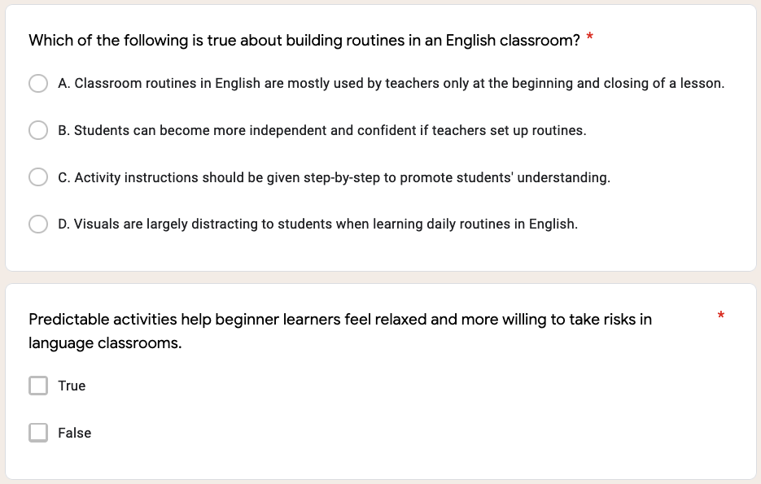
TETE MODULE 1 - BUILDING ROUTINES IN ENGLISH

Slide 34
TETE MODULE 1 - BUILDING ROUTINES IN ENGLISH

Slide 35
TETE MODULE 1 - BUILDING ROUTINES IN ENGLISH

Slide 36
TETE MODULE 1 - BUILDING ROUTINES IN ENGLISH
My Routines
Ask: Did you find any from your online searches? What key words did you use?
Get examples from group chats?

Slide 37

TETE MODULE 1 - BUILDING ROUTINES IN ENGLISH
QUESTIONS
Do you have any questions about the TETE Google Site?
Do you have any questions about the TETE Telegram groups?

Slide 38
TETE MODULE 1 - BUILDING ROUTINES IN ENGLISH
EXIT TICKET
Now we will do our Module 1 Exit Ticket!
Click on the link in the chat box.

Slide 39
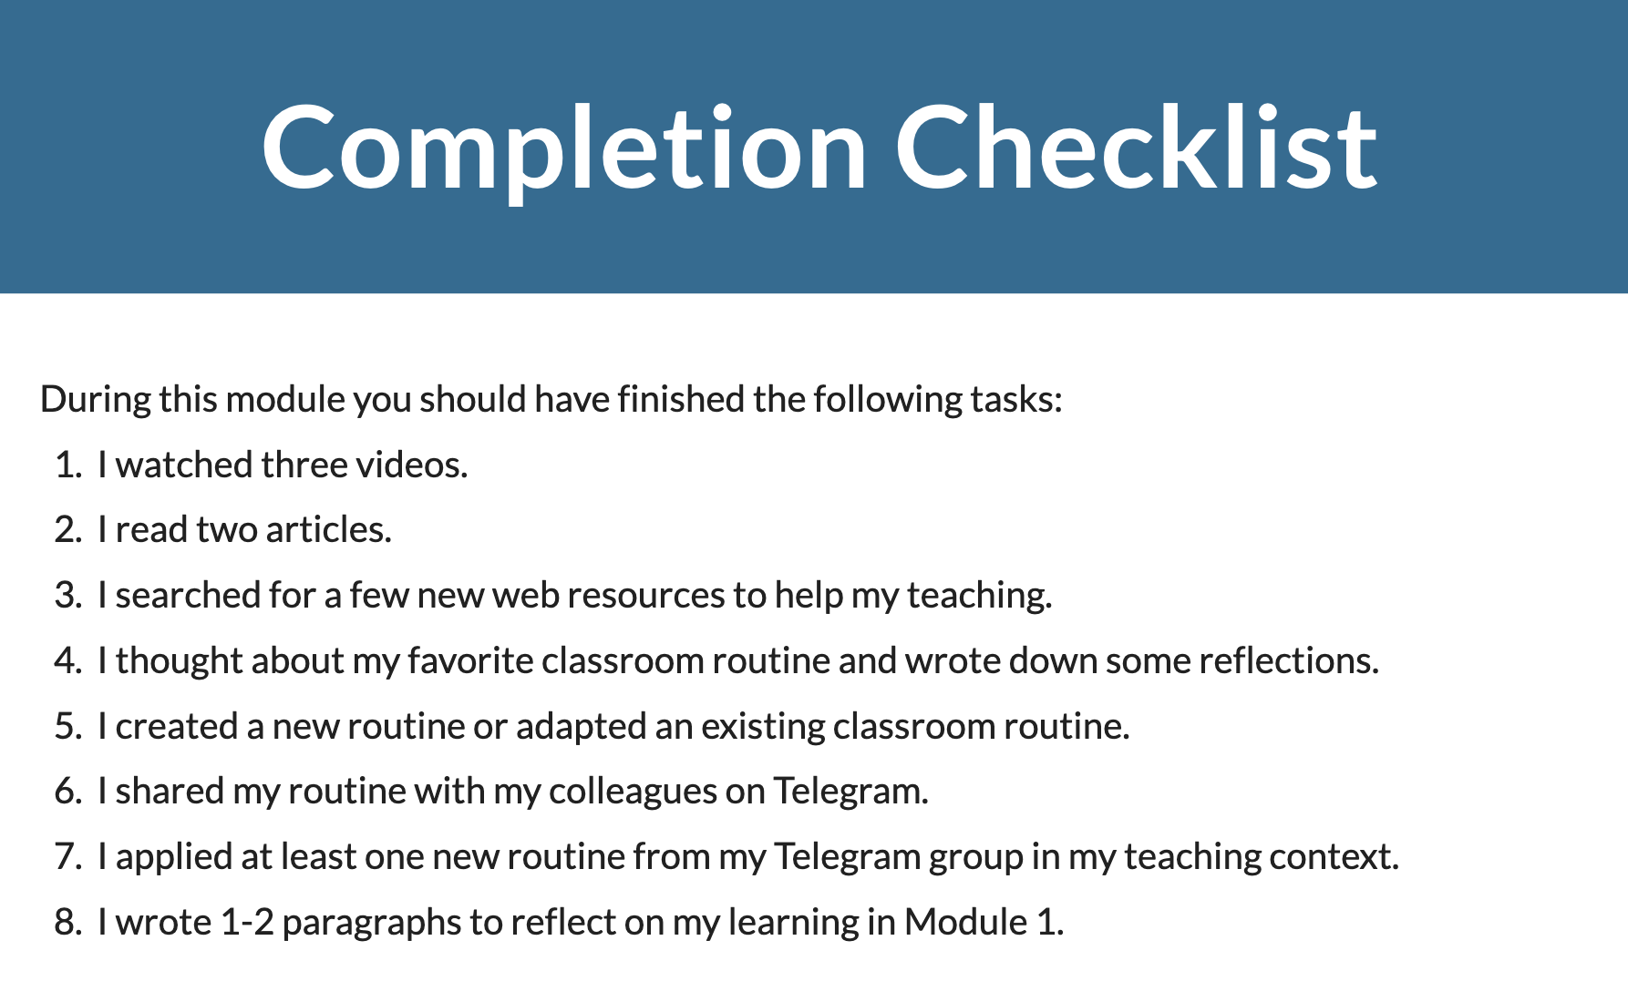
TETE MODULE 1 - BUILDING ROUTINES IN ENGLISH
What is due on Sunday, July 11th?

Slide 40
TETE MODULE 1 - BUILDING ROUTINES IN ENGLISH
ANNOUNCEMENTS
Module 2: Giving Clear Instructions
will be announced on Monday, July 12th!
NEXT WEBINAR
Friday, July 16th
7:00-8:00 PM Uzbekistan Time

Slide 41
TETE MODULE 1 - BUILDING ROUTINES IN ENGLISH
"Tell me and I forget.
Teach me and I remember.
Involve me and I learn."
- Benjamin Franklin

Slide 42
TETE MODULE 1 - BUILDING ROUTINES IN ENGLISH
Farewell Routine

