Slide 1

TEACHING ENGLISH THROUGH ENGLISH
Module 2 - Giving Clear Instructions
Friday, May 7, 2021
Rebecca Fox, Ph.D.
Hyunsun Chung, M.A.
Fox, R., & Chung, H. (May, 2021). Giving Clear Instructions. Workshop webinar presented for the Teaching English through English online professional development program (Cohort I): Module 2. U.S. Embassy in Tashkent funded English Speaking Nation Program in Uzbekistan (online). https://bit.ly/2X6fZE1

Slide 2
TETE MODULE 2 – GIVING CLEAR INSTRUCTIONS
Reflecting on your learning how do you feel about classroom routine?
Welcome, everyone!
Last week, our Module 1 content focused on using classroom routines.
Using your Handout 1 find someone who tried out any new practices this week.
How is the activity called?
“Find someone who…”
In each grid of your handout 1, please write the name of a teacher who has tried out any new practices since last week, or one that s/he plans to use soon.
Zoom Poll
Notes:
HS: chat box share

Slide 3
TETE MODULE 2-GIVING CLEAR INSTRUCTIONS
Purpose of Module 2:
Using “good” teacher talk in your classes;
Modeling strategies for giving clear instructions
By the end of the module, you will be able to:
describe the features of good teacher talk
use several modeling strategies
write about and practice effective teacher talk in your lessons
reflect on how to prepare effective teacher talk and share a sample of effective teacher talk during an activity
Notes:
HS

Slide 4
TETE MODULE 2 – GIVING CLEAR INSTRUCTIONS
What are some features of “good” teacher talk?
Consider the level of your learners
Show careful modeling for your learners
Be specific in expectations (purpose, group, time, etc.)
Scaffold what is expected (break it down step-by-step)
Remind your students of expectations – seek student understanding
Give more ‘time’ for using and learning and ‘less side-comments’ (less is more)

Slide 5
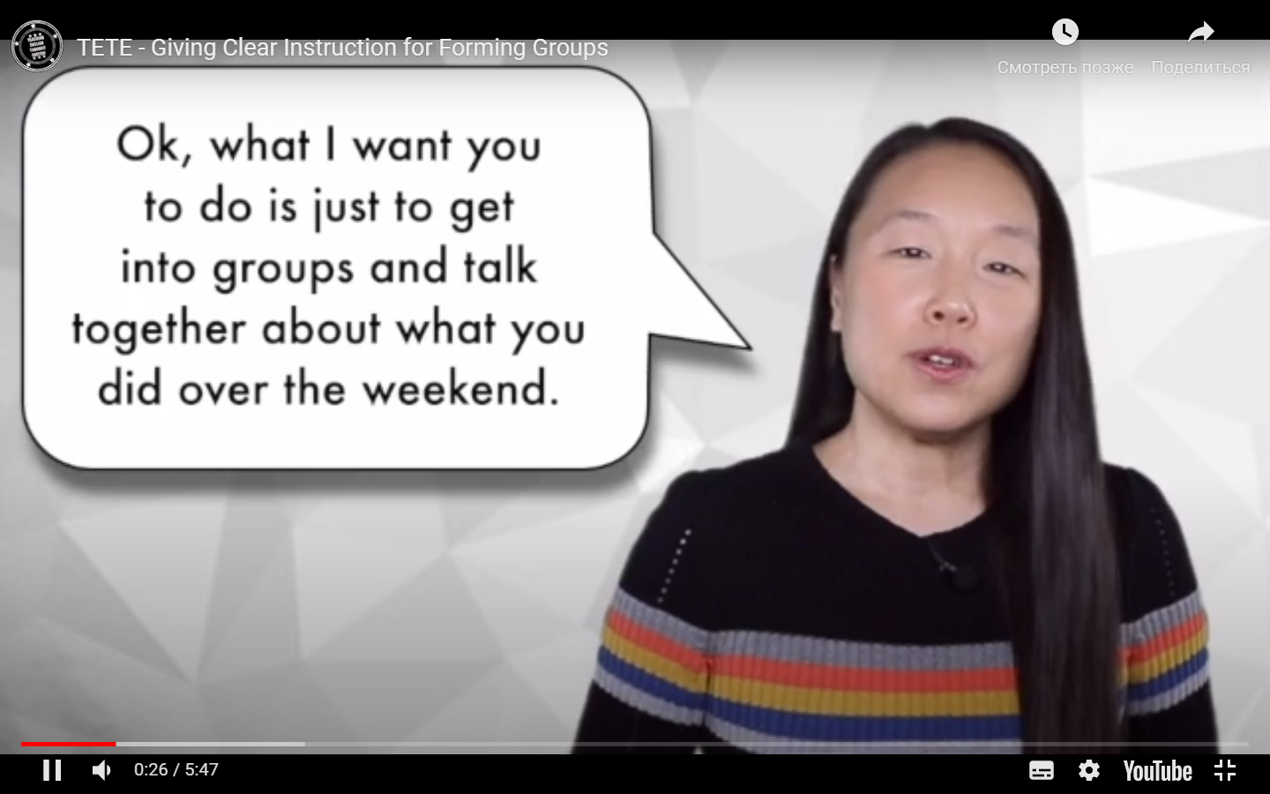
TETE MODULE 2 – GIVING CLEAR INSTRUCTIONS
Consider the level of your learners
YOUR TURN!
How would you make this instruction clear and effective to your beginner or intermediate level learners?
Discuss with your elbow partners!
https://www.youtube.com/watch?v=1sNEHr5uczE
Notes:
HS

Slide 6
TETE MODULE 2 – GIVING CLEAR INSTRUCTIONS
Modeling: Think Aloud – one modeling strategy
Think Aloud is the teacher talking aloud to model what students might be thinking about as they read a text.
These are focused ideas, modeled by the teacher.
Think aloud is a strategy with a plan to guide student thinking.
Predict | What happens next? Think: “In the next part, I think this woman will….”
Summarize | Bring ideas together – Think: “ I think this story is mainly about….” “The most important idea in this passage is ….”
Question | Prompt thinking with questions – Think: “ What did the main character do ….?” “ Why did Thomas……?
Students Reflect | Look back on what you tried and consider results - Think: “Maybe I need to…..next time.:” “I realized that…..” “I wonder if……”
And more...

Slide 7
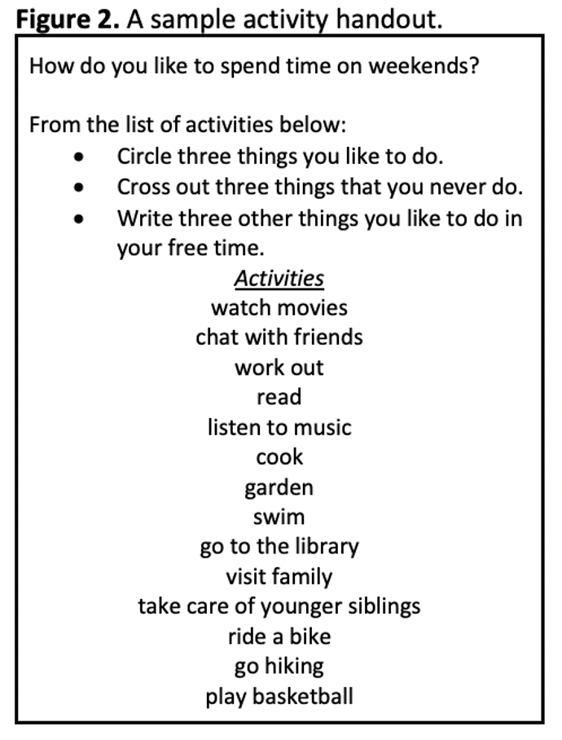
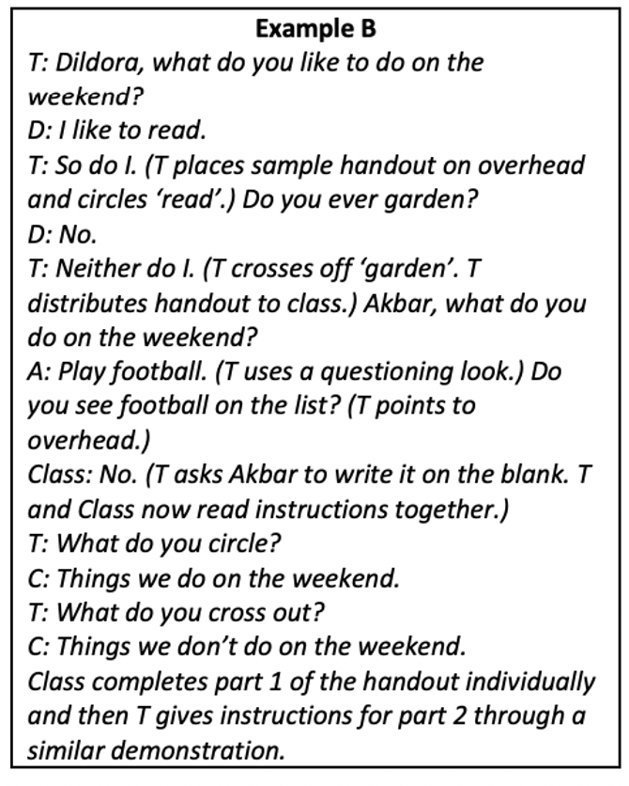
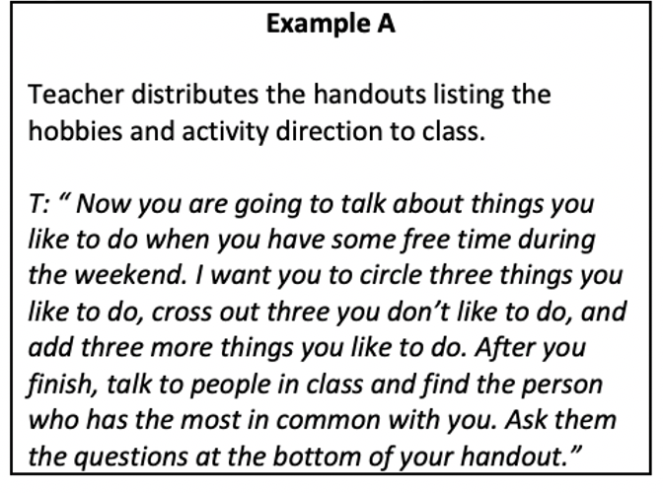
TETE MODULE 2 – GIVING CLEAR INSTRUCTIONS
Which teacher talk do you think provides modeling of language for the activity?
Example A or B?
Support your idea.
B
Notes:
HS

Slide 8

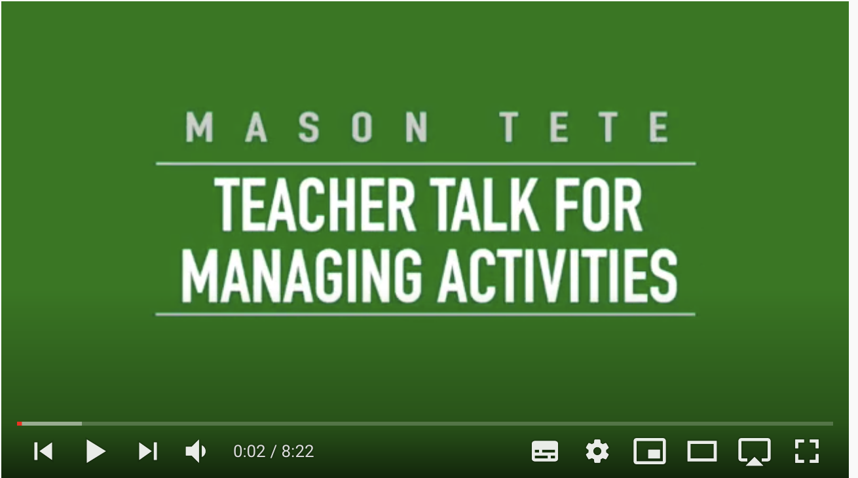
TETE MODULE 2 – GIVING CLEAR INSTRUCTIONS
Step-by-Step scaffolding in giving instruction in English
https://www.youtube.com/watch?v=F4RfqykJ6r8&list=PLSiU_EtuKTGE4IZ1tSFmGAhVywaIz06qm&index=7&t=2s

Slide 9
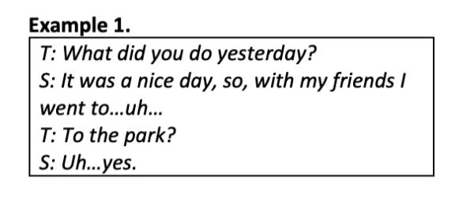
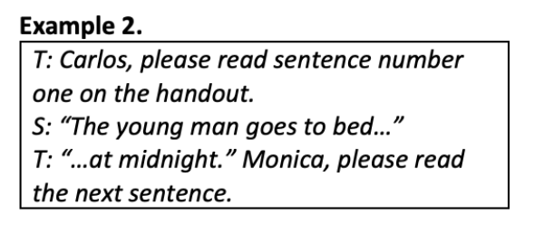
TETE MODULE 2 – GIVING CLEAR INSTRUCTIONS
For effective teacher talk, let’s remember . . . .
. . . . to give students enough chance to finish!

Slide 10
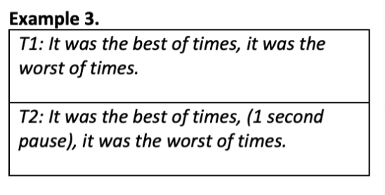
TETE MODULE 2 – GIVING CLEAR INSTRUCTIONS
For effective teacher talk, let’s remember . . . .
. . . .it’s important to slow down and give time for pause!

Slide 11
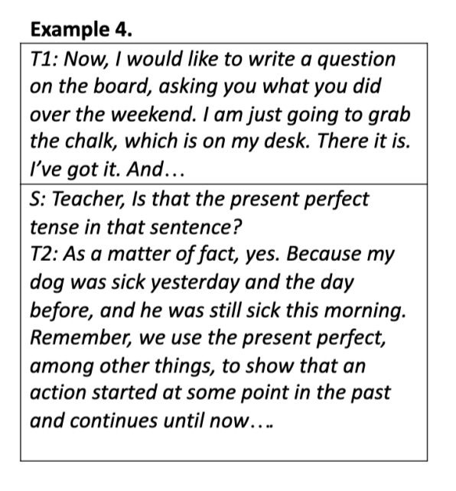
TETE MODULE 2 – GIVING CLEAR INSTRUCTIONS
For effective classroom communication, let’s
remember . . . .
. . . . ‘Less is More’

Slide 12
TETE MODULE 2 –GIVING CLEAR INSTRUCTIONS
What are some challenges you face when giving instructions in English in your class?
YOUR TURN!
Please write your ideas in your notebook!
Think and Reflect:
How can I overcome these challenges?

Slide 13
TETE MODULE 2 –GIVING CLEAR INSTRUCTIONS
Turning to our Pre-course assessment, let’s anchor with our Module 2 content:
3. The characteristics of effective teacher talk can be explained in all the following ways EXCEPT:
A. Teachers should use clear and grammatically correct English in their teacher talk.
B. The need for teachers to modify language depends on the level of the learner.
C. Activity instructions should be given step-by-step to promote students' understanding.
D. Teachers should always introduce challenging new topics in the native language.
4. Teacher talk should be spontaneous and unrehearsed to promote more authentic conversations in the English language classroom.
True or False?
Notes:
HS

Slide 14
TETE MODULE 2 –GIVING CLEAR INSTRUCTIONS
3. The characteristics of effective teacher talk can be explained in all the following ways EXCEPT:
A. Teachers should use clear and grammatically correct English in their teacher talk.
B. The need for teachers to modify language depends on the level of the learner.
C. Activity instructions should be given step-by-step to promote students' understanding.
D. Teachers should always introduce challenging new topics in the native language.
4. Teacher talk should be spontaneous and unrehearsed to promote more authentic conversations in the English language classroom.
True or False?

Slide 15
TETE MODULE 2 – GIVING CLEAR INSTRUCTIONs
3-2-1 Exit Ticket
Three words I’ve learned that capture effective teacher talk
Two Questions I have from Module Two
One new thing I will try out this week to give clear(er) instructions

Slide 16
TETE MODULE 2 – GIVING CLEAR INSTRUCTIONS
D.E.A.R.
Drop Everything And Reflect!
Time for our Module 2 “3-2-1 reflection”!

Slide 17

TETE MODULE 2 – GIVING CLEAR INSTRUCTIONS

Slide 18
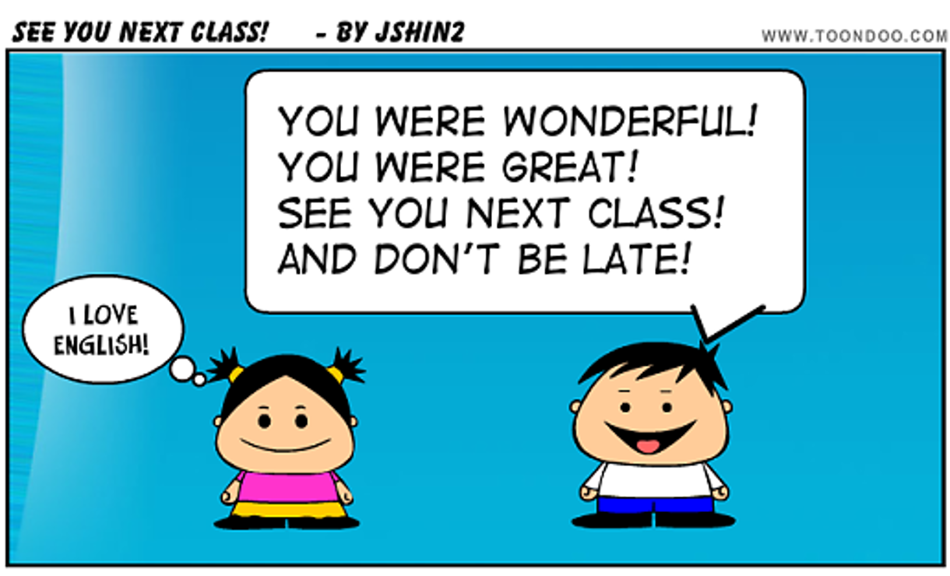
TETE MODULE 2 – GIVING CLEAR INSTRUCTIONS
Thanks for coming! See you next Friday!
Any questions or concerns?

