Slide 1

TEACHING ENGLISH THROUGH ENGLISH
Module 2 - Giving Clear Instructions
Friday, May 7, 2021
Rebecca Fox, Ph.D.
Hyunsun Chung, M.A.
Fox, R., & Chung, H. (May, 2021). Giving Clear Instructions. Workshop webinar presented for the Teaching English through English online professional development program (Cohort I): Module 2. U.S. Embassy in Tashkent funded English Speaking Nation Program in Uzbekistan (online). https://bit.ly/2X6fZE1

Slide 2
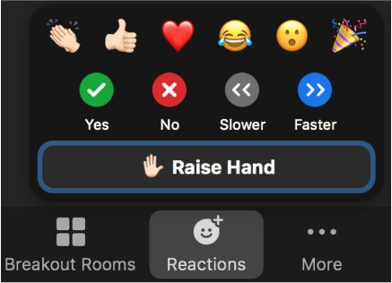
TETE MODULE 2 – GIVING CLEAR INSTRUCTIONS
Reflecting on your learning how do you feel about classroom routine?
Welcome, everyone!
Last week, our Module 1 content focused on using classroom routines.
Did you try out any new practices this week?
How did it go?
Click on the Reactions at the bottom of your zoom screen to capture how your classroom routine is going.
Now! Chat Box Share
In the Chat Box, please write one or two words to share a routine that you’ve tried out since last week, or one that you plan to use soon.
Zoom Poll
Notes:
HS: chat box share

Slide 3
TETE MODULE 2 –Giving Clear Instructions
Module 2
Webinar Agenda
Discuss some Module 2 content on giving clear instructions and using effective teacher talk
Share some examples of giving clear instructions and using good teacher talk
Touch base on our growing understanding of reflection and developing deep reflective practice

Slide 4
TETE MODULE 2-GIVING CLEAR INSTRUCTIONS
Purpose of Module 2:
Using “good” teacher talk in your classes;
Modeling strategies for giving clear instructions
By the end of the module, you will be able to:
describe the features of good teacher talk
use several modeling strategies
write about and practice effective teacher talk in your lessons
reflect on how to prepare effective teacher talk and share a sample of effective teacher talk during an activity
Notes:
HS

Slide 5
TETE MODULE 2 – GIVING CLEAR INSTRUCTIONS
What are some features of “good” teacher talk?
Consider the level of your learners
Show careful modeling for your learners
Be specific in expectations (purpose, group, time, etc.)
Scaffold what is expected (break it down step-by-step)
Remind your students of expectations – seek student understanding
Give more ‘time’ for using and learning and ‘less side-comments’ (less is more)

Slide 6
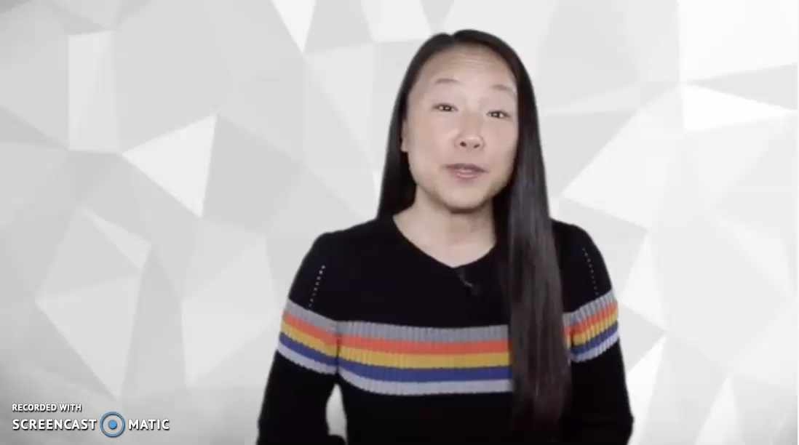
TETE MODULE 2 – GIVING CLEAR INSTRUCTIONS
Consider the level of your learners
YOUR TURN!
How would you make this instruction clear and effective to your beginner or intermediate level learners?
Write in the chat box!
Notes:
HS

Slide 7
TETE MODULE 2 – GIVING CLEAR INSTRUCTIONS
Modeling: Think Aloud – one modeling strategy
Think Aloud is the teacher talking aloud to model what students might be thinking about as they read a text.
These are focused ideas, modeled by the teacher.
Think aloud is a strategy with a plan to guide student thinking.
Predict | What happens next? Think: “In the next part, I think this woman will….”
Summarize | Bring ideas together – Think: “ I think this story is mainly about….” “The most important idea in this passage is ….”
Question | Prompt thinking with questions – Think: “ What did the main character do ….?” “ Why did Thomas……?
Students Reflect | Look back on what you tried and consider results - Think: “Maybe I need to…..next time.:” “I realized that…..” “I wonder if……”
And more...

Slide 8
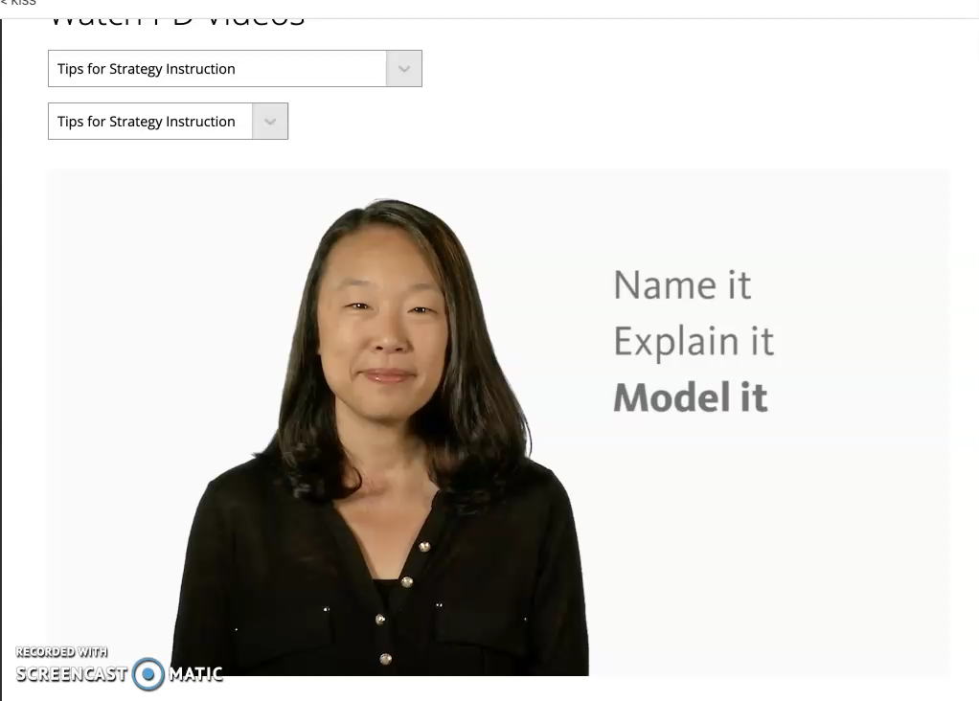
TETE MODULE 2 – GIVING CLEAR INSTRUCTIONS
Modeling: Think Aloud
Think Aloud is the teacher talking aloud to model what they are thinking about as they read a text.
These are focused thoughts, not randomly spoken.
Teachers can use it strategically with specific plan for the lesson objectives.

Slide 9
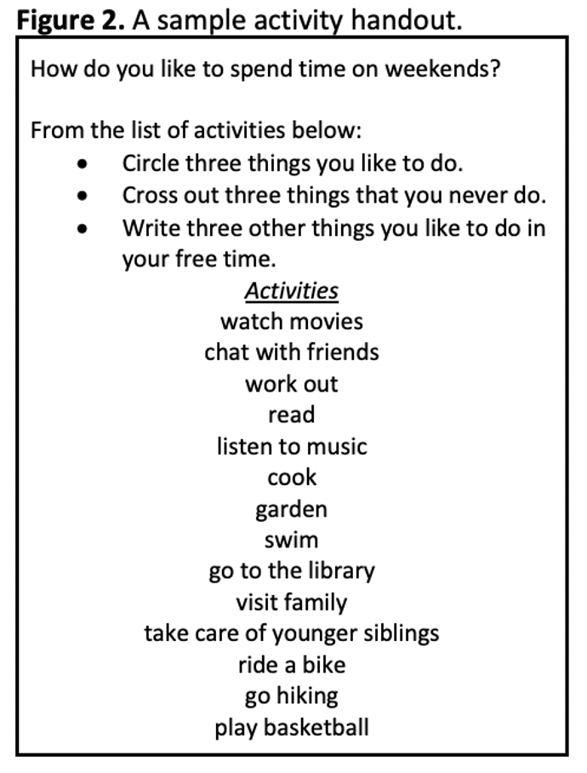
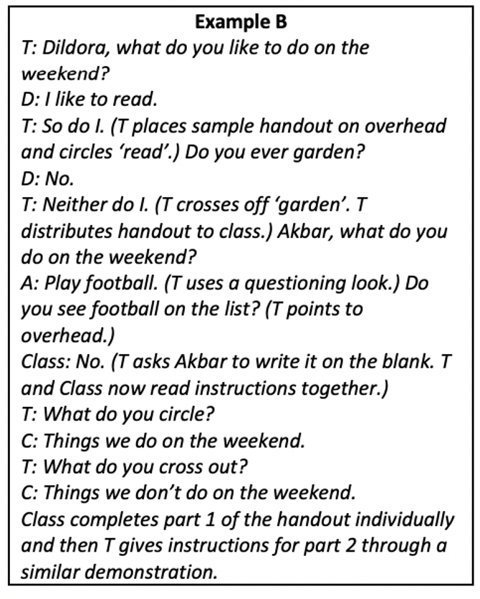
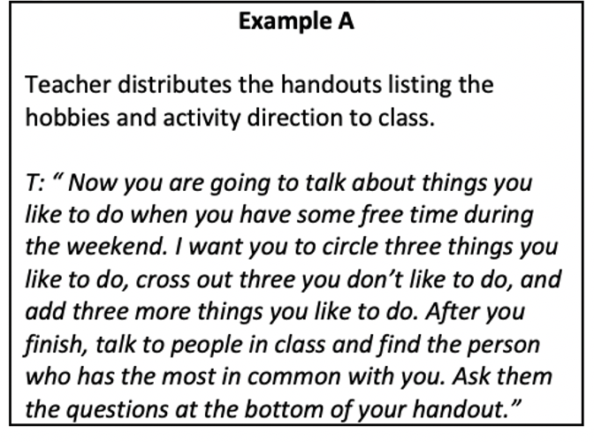
TETE MODULE 2 – GIVING CLEAR INSTRUCTIONS
Which teacher talk do you think provides modeling of language for the activity?
Example A or B?
Write in the chat box.
B
Notes:
HS

Slide 10
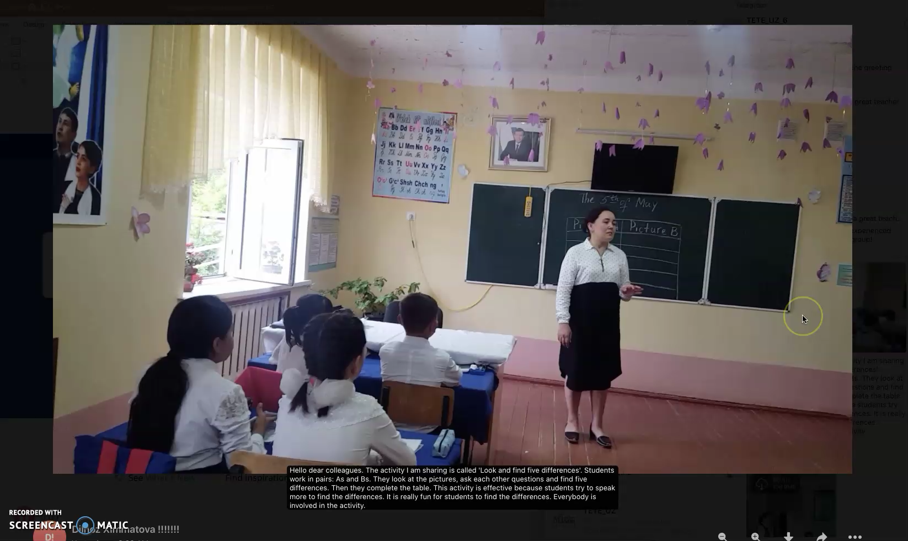
TETE MODULE 2 – GIVING CLEAR INSTRUCTIONS
Be specific in your expectations
An example video from Teacher Dilnoz

Slide 11

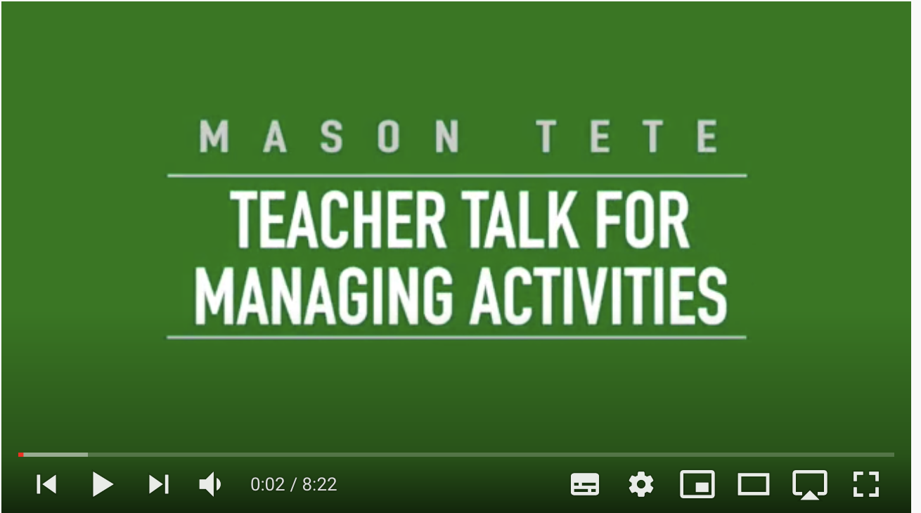
TETE MODULE 2 – GIVING CLEAR INSTRUCTIONS
Step-by-Step scaffolding in giving instruction in English
https://www.youtube.com/watch?v=F4RfqykJ6r8&list=PLSiU_EtuKTGE4IZ1tSFmGAhVywaIz06qm&index=7&t=2s

Slide 12
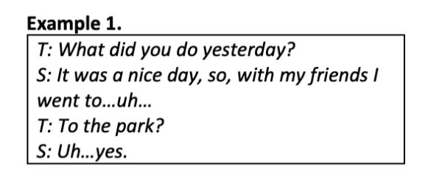
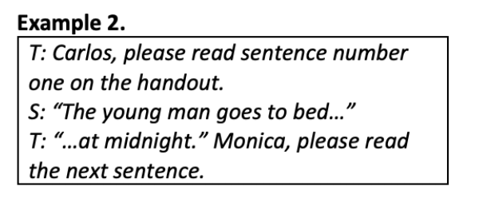
TETE MODULE 2 – GIVING CLEAR INSTRUCTIONS
For effective teacher talk, let’s remember . . . .
. . . . to give students enough chance to finish!

Slide 13
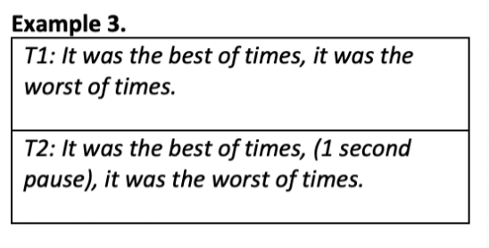
TETE MODULE 2 – GIVING CLEAR INSTRUCTIONS
For effective teacher talk, let’s remember . . . .
. . . .it’s important to slow down and give time for pause!

Slide 14
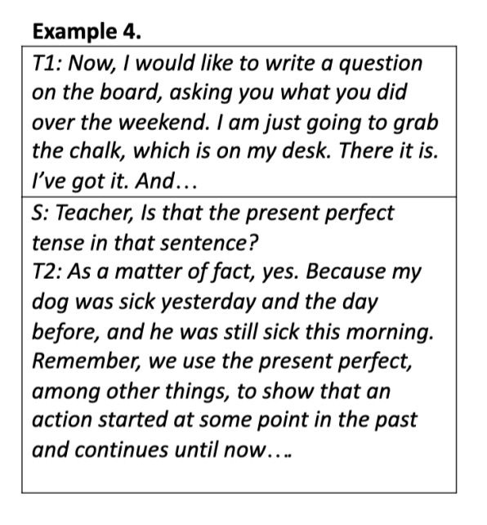
TETE MODULE 2 – GIVING CLEAR INSTRUCTIONS
For effective classroom communication, let’s
remember . . . .
. . . . ‘Less is More’

Slide 15
TETE MODULE 2 –GIVING CLEAR INSTRUCTIONS
What are some challenges you face when giving instructions in English in your class?
YOUR TURN!
Please type your ideas into the chat box or raise your hand to speak!
Think and Reflect:
How can I overcome these challenges?

Slide 16
TETE MODULE 2 –GIVING CLEAR INSTRUCTIONS
Turning to our Pre-course assessment, let’s anchor with our Module 2 content:
3. The characteristics of effective teacher talk can be explained in all the following ways EXCEPT:
A. Teachers should use clear and grammatically correct English in their teacher talk.
B. The need for teachers to modify language depends on the level of the learner.
C. Activity instructions should be given step-by-step to promote students' understanding.
D. Teachers should always introduce challenging new topics in the native language.
4. Teacher talk should be spontaneous and unrehearsed to promote more authentic conversations in the English language classroom.
True or False?
Notes:
HS

Slide 17
TETE MODULE 2 –GIVING CLEAR INSTRUCTIONS
3. The characteristics of effective teacher talk can be explained in all the following ways EXCEPT:
A. Teachers should use clear and grammatically correct English in their teacher talk.
B. The need for teachers to modify language depends on the level of the learner.
C. Activity instructions should be given step-by-step to promote students' understanding.
D. Teachers should always introduce challenging new topics in the native language.
4. Teacher talk should be spontaneous and unrehearsed to promote more authentic conversations in the English language classroom.
True or False?

Slide 18

TETE MODULE 2 –GIVING CLEAR INSTRUCTIONS
Let’s touch base with your deepening reflective practice
Why do you think Reflection is so important for us as TETE educators?
YOUR TURN!
Please type a short answer into the chat box or raise your hand to say an answer!

Slide 19

TETE MODULE 2 – GIVING CLEAR INSTRUCTIONs
Let’s look at what some of our teachers’ have already written about reflection.
Reflection helps me to solve a problem, figure out something what is bothering me, make a decision, clarify a confusion, more deeply enjoy something wonderful, learn from mistakes and success. By Albina
Reflection questions for teachers’ professional development In what ways can I support my colleagues in their student’s learning? In what aspects can I still improve my teaching? What’s stopping me from improving in these aspects? What opportunities are there to improve myself as a teacher? Do my actions as a teacher show that I take pride in my work? By Rokhat
Moreover, deep reflection can give us the sense of satisfaction from our job and motivation to our further professional process and progress. If we do this systematically, our students will get encouraged and at the same time we can notice their interest to the subject. By Uchiqun

Slide 20
TETE MODULE 2 – GIVING CLEAR INSTRUCTIONs
3-2-1 Exit Ticket
Three words I’ve learned that capture effective teacher talk
Two Questions I have from Module Two
One new thing I will try out this week to give clear(er) instructions

Slide 21
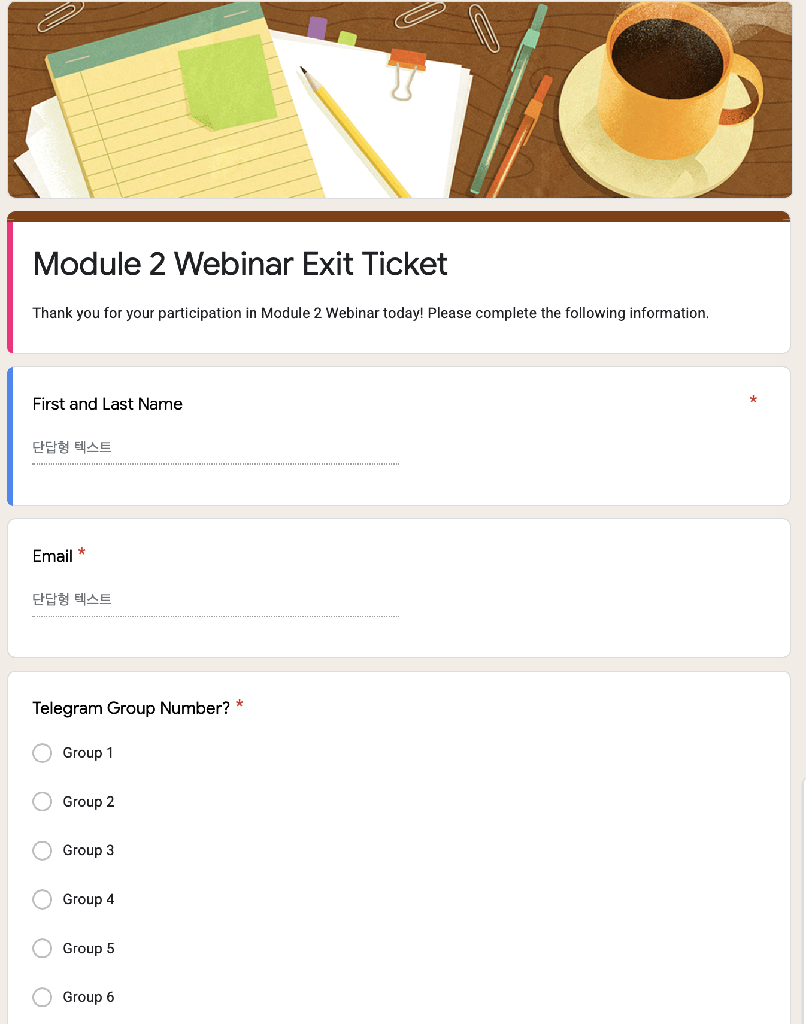
TETE MODULE 2 – GIVING CLEAR INSTRUCTIONS
D.E.A.R.
Drop Everything And Reflect!
Time for our Module 2 “3-2-1 reflection”!
Click on the link in the Zoom chat box to begin now –
https://docs.google.com/forms/d/e/1FAIpQLScFe45KvffadPayZZQLk24qHxyV5aT_7sz62_v6pxc2N706AA/viewform?usp=pp_url

Slide 22
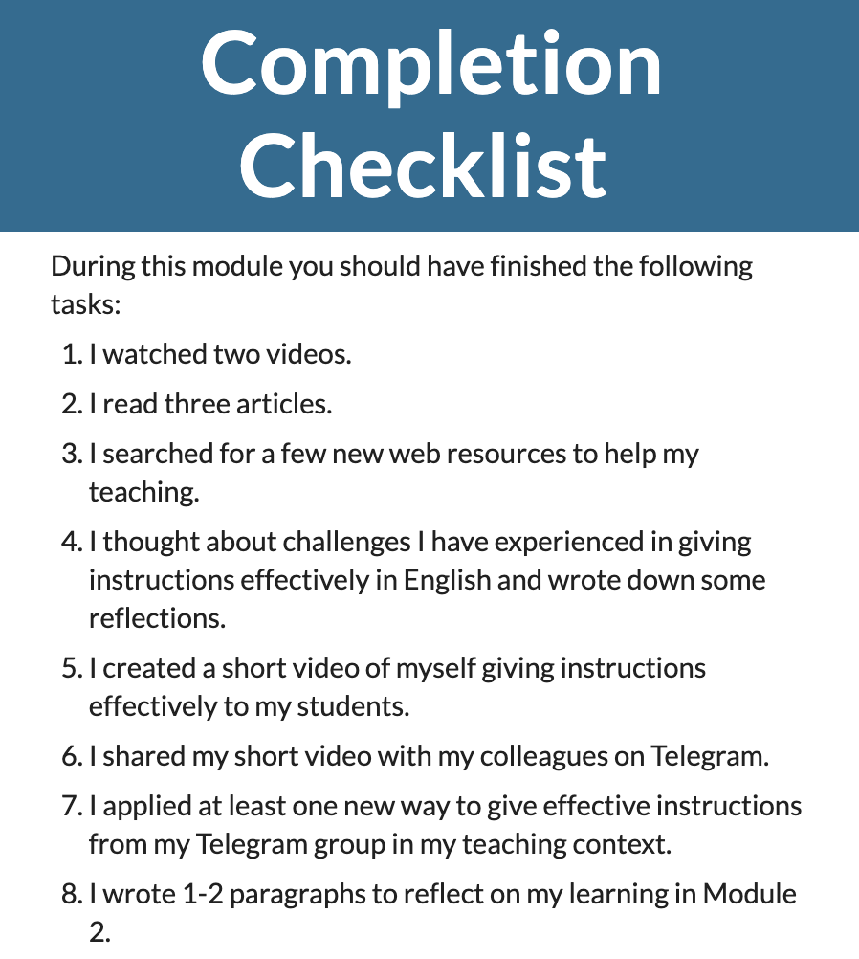
TETE MODULE 2 – GIVING CLEAR INSTRUCTIONS
What is due on Sunday, May 9TH?
Notes:
HS

Slide 23
TETE MODULE 2 – GIVING CLEAR INSTRUCTIONS
LOOKING AHEAD
Module 3: EFFECTIVE WAYS for QUESTION AND ANSWER will be announced on Monday, May 10th!
NEXT WEBINAR
Friday, May 14th
7:00-8:00 PM Uzbekistan Time

Slide 24

TETE MODULE 2 – GIVING CLEAR INSTRUCTIONS

Slide 25
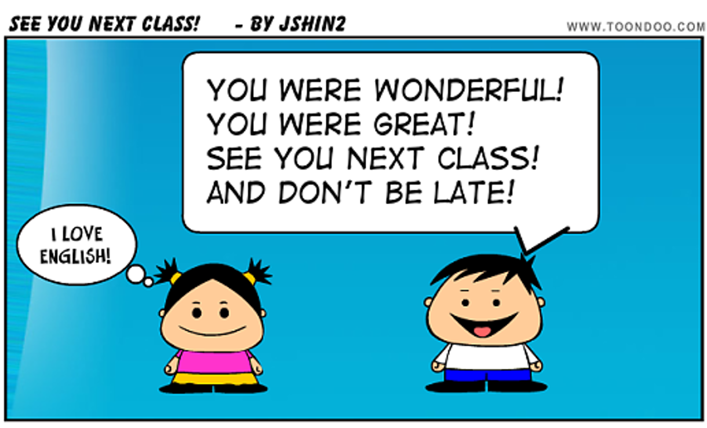
TETE MODULE 2 – GIVING CLEAR INSTRUCTIONS
Thanks for attending! See you next Friday!
Any questions or concerns?

