Slide 1

TEACHING ENGLISH THROUGH ENGLISH
MODULE 3 – Building Routines in English
Friday, May 14 2021
Rebecca Fox, Ph.D.
Woomee Kim, M.A.
Anya Evmenova, Ph.D.
Fox, R., Kim, W., & Evmenova, A. (May, 2021). Effective Question and Answer. Workshop webinar presented for the Teaching English through English online professional development program (Cohort I): Module 3. U.S. Embassy in Tashkent funded English Speaking Nation Program in Uzbekistan (online). https://bit.ly/3iqMoNH

Slide 2

TETE MODULE 3 - EFFECTIVE QUESTION AND ANSWER
Let’s do a Question Game
“Interactive/Alternative Student Responses (ISR)”
Notes:
Reading says “non-traditional”, but another way to think of these types of questions is to think of them as “interactive” student responses.

Slide 3

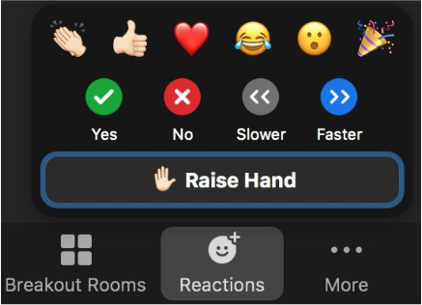
TETE MODULE 3 - EFFECTIVE QUESTION AND ANSWER
Question Game
“Interactive/Alternative Student Responses”
Hand Signals: “Thumbs up” or “Thumbs down”
Stand Up/Sit Down
Move to the Answer:
“Right or Left” (Yes/No)
“Reactions” (Yes/No via Zoom)
Notes:
Good for beginning learners or as a listening warm-up or even formative assessment.
Are you hungry?
Did you do your homework?
Do you know how to access and use Mason TETE Site?
Did you enjoy your holiday?
Did you learn something new in Modules 1 & 2?

Slide 4
TETE MODULE 3 - EFFECTIVE QUESTION AND ANSWER
Question Game
“Interactive/Alternative Student Responses”
Hand Signals: “Thumbs up” or “Thumbs down”
Stand Up/Sit Down
Move to the Answer:
“Right or Left” (Yes/No)
“Reactions” (Yes/No via Zoom)
Notes:
Were you able to apply giving clear instructions this week?
Last week many of you were going to
try out “scaffolding”
engage in modeling summaries…”modeling”
How did it go?
What are your reflections on trying out something new?
If it did not go as well as you had hoped, what will you do differently next time?

Slide 5
TETE MODULE 3 - EFFECTIVE QUESTION AND ANSWER
Module 3
Webinar Agenda:
Module 3 content and strategies for effective questioning in English
TETE Portfolio and Reflection
Q & A about TETE Portfolio, Reflection, and Module 3 content

Slide 6

TETE MODULE 3 - EFFECTIVE QUESTION AND ANSWER
Purpose of Module 3: To prepare you to use effective questioning and answering techniques in your English classroom
By the end of the module, you will be able to:
understand how different types of questions are used in effective teacher talk
form beginner friendly questions
scaffold students’ response in more comfortable and effective ways
practice basic question forms and answers with students

Slide 7
TETE MODULE 3 - EFFECTIVE QUESTION AND ANSWER
Why is asking questions in English important?
YOUR TURN!
Please type your answers into the chat box or raise your hand to say an answer!
Notes:
3.4 Think - Do you use English when you ask questions in your classroom? If yes, what are some examples of the questions that you ask? If not, what are some challenges that prevent you from asking questions in English?
When you ask them questions, do your students try to answer in English? What might help them to answer in English during the lesson?

Slide 8
TETE MODULE 3 - EFFECTIVE QUESTION AND ANSWER
Why is asking questions in English important?
Initiate interactions in English
Reduce teacher talk time
Increase student talk time
Establish the routine of target language use
Model communicative interactions
Engage students actively in the lesson
Provide time for formative assessment

Slide 9
TETE MODULE 3 - EFFECTIVE QUESTION AND ANSWER
Questioning Techniques
Predicting
Understanding Main Ideas
Specific Information
Making Inference and asking opinions
Using WH-Questions (who, what, when, where, which, why, how)
Notes:
Questions techniques that are effective and you will see some examples how these can be carried out in your class

Slide 10

TETE MODULE 3 - EFFECTIVE QUESTION AND ANSWER
Questioning Techniques: Let’s take a look . . .
Using Silent Video
Descriptive Information
Predicting
Extensions:
Making Inference and
asking opinions
Notes:
https://youtu.be/XZVHmRvfDHM
What else can we pull out from this silent video? add a link youtube

Slide 11
TETE MODULE 3 - EFFECTIVE QUESTION AND ANSWER
Questioning Techniques: Using Silent Video
Sample questions we can ask:
What do you see around the room?
How many people are there?
What do you think their relationships are?
What do you think might be happening?
What emotions are they feeling?
What do you think will happen next?
Using WH-Questions
Notes:
Cultural piece and ask intercultural competence

Slide 12

TETE MODULE 3 - EFFECTIVE QUESTION AND ANSWER
Questioning Techniques:
Using WH-Questions
 | Questions | Classmate 1 | Classmate 2
who?
what?
when?
where?
which?
why?
how?
Notes:
Cultural piece and ask intercultural competence

Slide 13
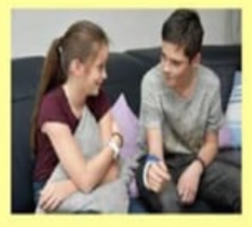
TETE MODULE 3 - EFFECTIVE QUESTION AND ANSWER
Effective Questioning from Lora
Instructions and questions for a textbook listening activity:
“Before you listen, try to guess the topic. Look at the picture. When you see this picture what thoughts come to your mind? How can you connect the picture with the topic?
“Now listen to find out what the conversation is about. Just listen for the main idea. Are the speakers friends or siblings? Are they talking about school or house? What is the topic of conversation?”
“Now listen again carefully and try to understand. What room did the girl like? Why did the boy not like the room with the balcony? What did the boy want to buy for his room?”
“What do you think about the speaker’s final decision about his house? Do you agree or disagree with their opinion about how to furnish the house?
Notes:
Predicting
Understanding Main Ideas
Specific Information
Making Inference and asking opinions
Using WH-Questions (who, what, when, where, which, why, how)

Slide 14
TETE MODULE 3 - EFFECTIVE QUESTION AND ANSWER
Effective Questioning from Ravshanbek
Teacher-student questioning-answering for a textbook pre-reading activity on “Healthy Eating Habits”:
T: Students, look at the picture. What can you see in the pictures?
S: Here, I can see different foods, like hamburgers, pizza, palov and fruits.
T: What do you think, which foods are healthy? Hilola?
S: I believe that fruits are very beneficial for our health, due to the containing in minerals and vitamins.
T: Good, Hilola! What about other foods? Who has an idea? Bilol?
S: I think palov is also good for us.
T: Bilol, why do you think is palov good?
S: Because it consists of many nutrients, such as, carrots, onions, pea, rice and meat. It gives us a lot of energy.
T: Yes, you are right, well done! Students, which foods are unhealthy in the given pictures? Why?
S: I am sure that hamburgers, pizza and chocolate cake are unhealthy foods. Because, they have many fat and sugar, besides that, they usually do not contain fresh ingredients.
T: Excellent, Barno! If people do not pay attention to their food ingredients, it can cause health issues like, putting on weight, heart diseases, high blood pressure and etc. As you knew, today we will read the text about healthy and unhealthy foods. Let’s look for new vocabulary words and define them.

Slide 15



TETE MODULE 3 - EFFECTIVE QUESTION AND ANSWER
https://sites.google.com/view/tete-portfolio-template
Create
Reflect

Slide 16
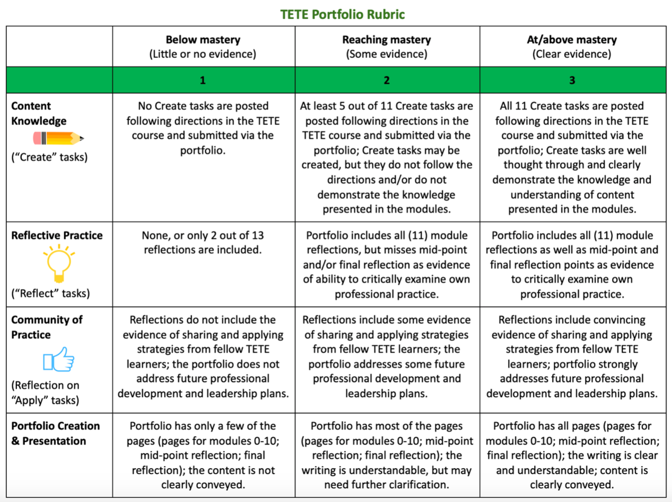

Slide 17







TETE MODULE 3 - EFFECTIVE QUESTION AND ANSWER
TETE Successful Completion & Certificate
Watch videos
Read articles
Search additional resources
Think
Create & post in the Portfolio
Share in Telegram
Apply in the classroom
Reflect & post in the Portfolio
Notes:
They have to weave the module content in their reflections!
Mention certificate Here?

Slide 18
TETE MODULE 3 - EFFECTIVE QUESTION AND ANSWER
Reflection - your continuing journey
! An essential part of your portfolio
! An essential part of each module
Let’s continue to look at reflection, deep (or critical) reflection, and how the modes of reflection we addressed in Module 0 can now come to life!
Recall the Taggart Pyramid (2005), and let’s connect these three modes to your module reflections and portfolio work!
Notes:
sample reflection prompts

Slide 19
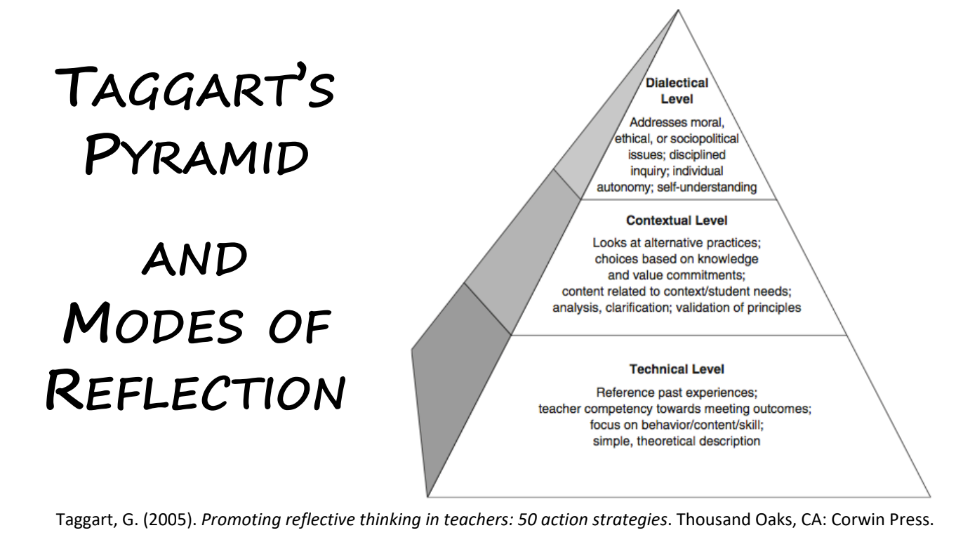
TETE MODULE 3 - EFFECTIVE QUESTION AND ANSWER
Notes:
sample reflection prompts

Slide 20
TETE MODULE 3 - EFFECTIVE QUESTION AND ANSWER
Do you recall the three modes of reflection?
Technical Level of Reflection
• Descriptions or observations and a Focus on describing
Contextual Level of Reflection
• Reflects on teaching practices and considers how they affect student learning
• Reflects on decisions, considers if something worked
• Relates theory to practice – connects actions to research & theory to promote student learning
• Analyzes, clarifies, and validates teaching decisions
Dialectical Mode or Level
•• Systematically questions and seeks why or why not?
• Suggests alternatives to result in change
• Reflects on decisions & resulting consequences
• Brings moral, ethical, and student learning results to bear on educational practices
• Looks for change to promote desired results

Slide 21
TETE MODULE 3 - EFFECTIVE QUESTION AND ANSWER
Deepening your reflection: Remember - to connect your reflection to Module Contents!
First, when you list the contents of a module, or describe what you did, this is an example of reflection at the Technical level.
Fine to “set the stage” but this is the beginning. Keep going!
Next, connect what you did to your readings. Tell why you engaged in a certain activity or approach. To which readings does this activity connect? Explain how and why you did the activity. This is reflection at the Contextual level .
Last, consider the results of what you did and their impact on student learning, or on your classroom.
If your actions made a change, think about these changes and what more you can do.
Did some or ALL of your students engage in this new practice? How did it go? Do you need to make any changes?
What will you do next to engage your students, and why?
This is reflection at the Dialectical level.
Notes:
This week we covered scaffolding, step-by-step instructions, using English in simple and precise communication, modeling, and using body language to communicate effectively :-) TECHNICAL
in the

Slide 22
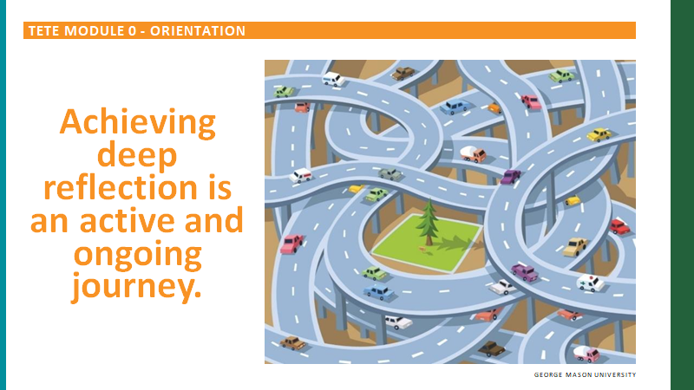
TETE MODULE 3 - EFFECTIVE QUESTION AND ANSWER
AND Remember!

Slide 23
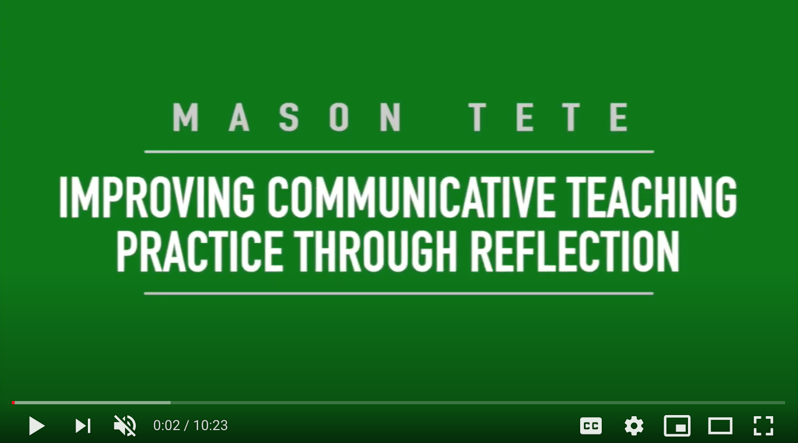
TETE MODULE 3 - EFFECTIVE QUESTION AND ANSWER
Reflection - a good time to revisit the Module 0 video
Notes:
sample reflection prompts

Slide 24

TETE MODULE 3 - EFFECTIVE QUESTION AND ANSWER
Polls in the Classroom
Run quizzes and competitions
Use as exit ticket
Receive feedback
Check for understanding:
Question and answer choices on the board
Paper-based surveys
Free web-based tools: Kahoot, Poll Everywhere, Google Forms
Notes:
Questions for Zoom poll - all True/False
I need to have a gmail account to be able to create TETE portfolio.
I need to create 13 different pages in my TETE portfolio.
My create and reflect tasks that I post in my portfolio should have a clear connection to what I learned in the module.
I need to simply list what I did in all my reflections.

Slide 25

TETE MODULE 3 - EFFECTIVE QUESTION AND ANSWER
Still Have Questions?
Ask your Community of Practice in Telegram
Reach out for help:
  TETE Portfolio:
aevmenov@gmu.edu
  Reflection:
rfox@gmu.edu
Notes:
GIVE ANYA’s EMAIL

Slide 26
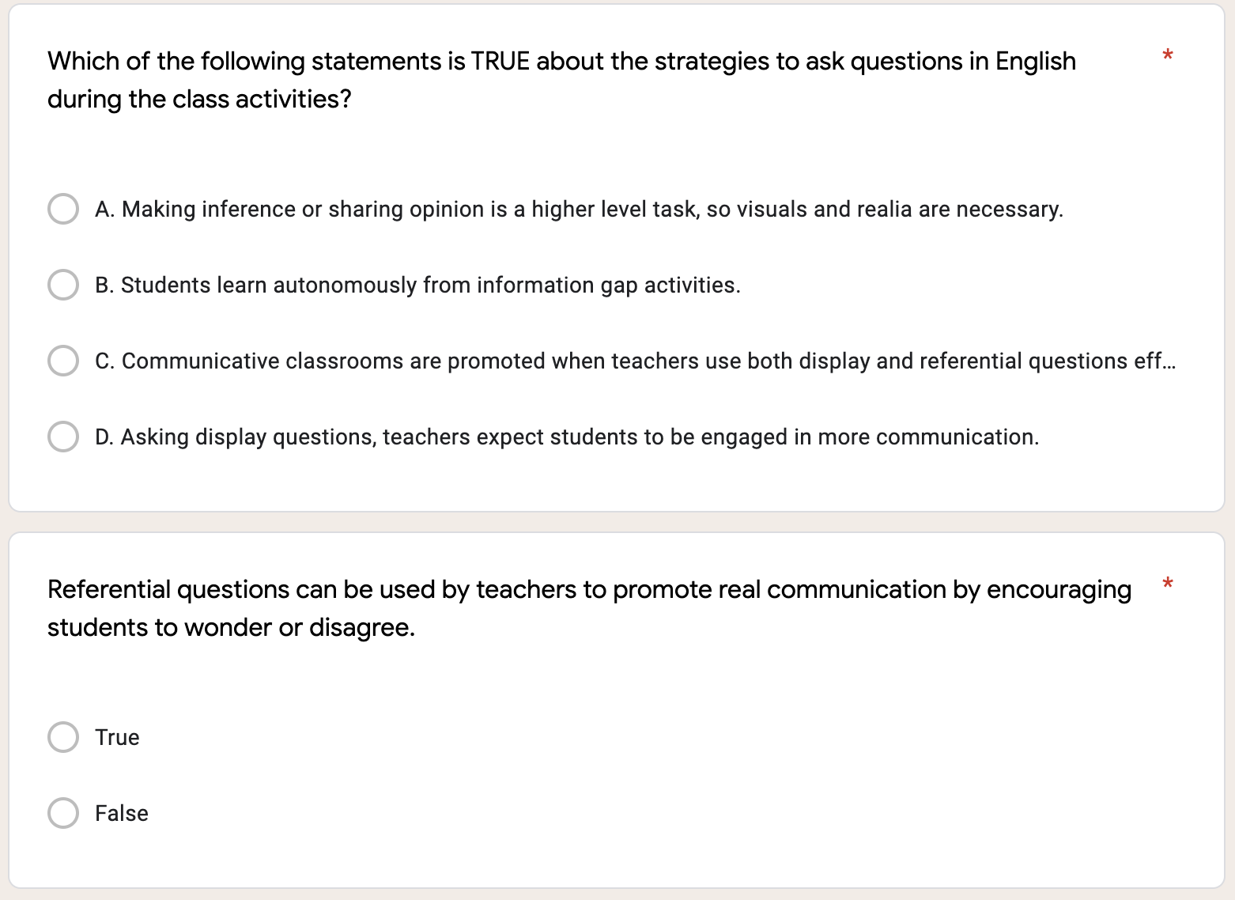
TETE MODULE 3 - EFFECTIVE QUESTION AND ANSWER

Slide 27
TETE MODULE 3 - EFFECTIVE QUESTION AND ANSWER

Slide 28
TETE MODULE 3 - EFFECTIVE QUESTION AND ANSWER

Slide 29
TETE MODULE 3 - EFFECTIVE QUESTION AND ANSWER
Time for D.E.A.R.!
Drop Everything and Reflect!
3: Three words that capture effective questioning.
2: Two things I need to do about TETE this/next week.
1: One new thing I will try out this/next week from Module 3, "Effective Question and Answer".
Now we will do our Module 3 Exit Ticket!
Click on the link in the chat box.
Notes:
Drop everything and reflect! Our DEAR this week is a 3-2-1. Do you have questions about the questioning techniques. (They are not used to asking questions. “Having questions means that we didn’t do a good job.” )

Slide 30
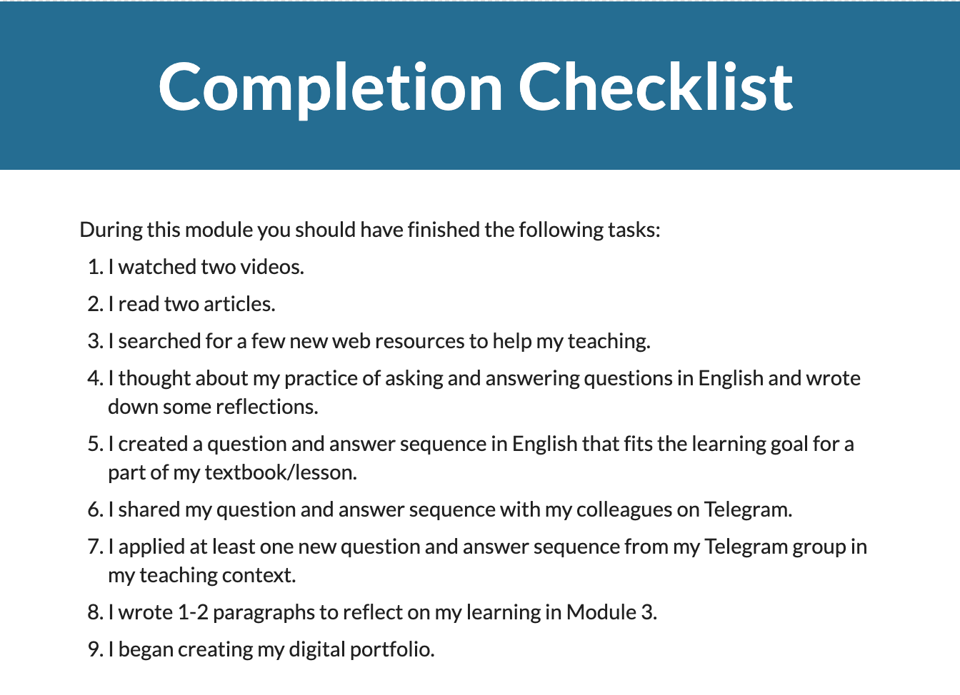
TETE MODULE 3 - EFFECTIVE QUESTION AND ANSWER
What is due on Sunday, May 16th?

Slide 31
TETE MODULE 3 - EFFECTIVE QUESTION AND ANSWER
ANNOUNCEMENTS
Module 4: Checking Comprehension and Providing Feedback
will be announced on Monday, May17th!
Module Packets in “Start Here”
NEXT WEBINAR
Friday, May 21st
7:00-8:00 PM Uzbekistan Time

Slide 32

TETE MODULE 3 - EFFECTIVE QUESTION AND ANSWER
"[Wise people don’t] give the right answers,
[they] pose the right questions."
- Claude Levi-Strauss

Slide 33
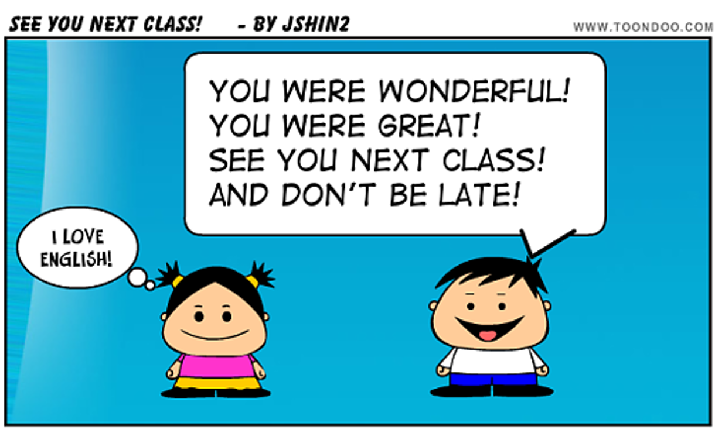
TETE MODULE 3 - EFFECTIVE QUESTION AND ANSWER
Farewell Routine

Slide 34
TETE MODULE 3 - EFFECTIVE QUESTION AND ANSWER
Question Game 2 (Anya)
“21 Questions”
Anyone in the room can ask Yes/No questions, only.
Students can also take turns.
If there are enough clues, someone can guess the answer.
Topic: “What did I eat for breakfast today?”
Notes:
Do an example. “Was it hot?” or “Did you eat something hot?” “Was it spicy?” or “Did you eat something spicy?”
Volunteer question counter.
The question can be more open-ended and the person in the middle has to answer the question like an interview.

