Slide 1
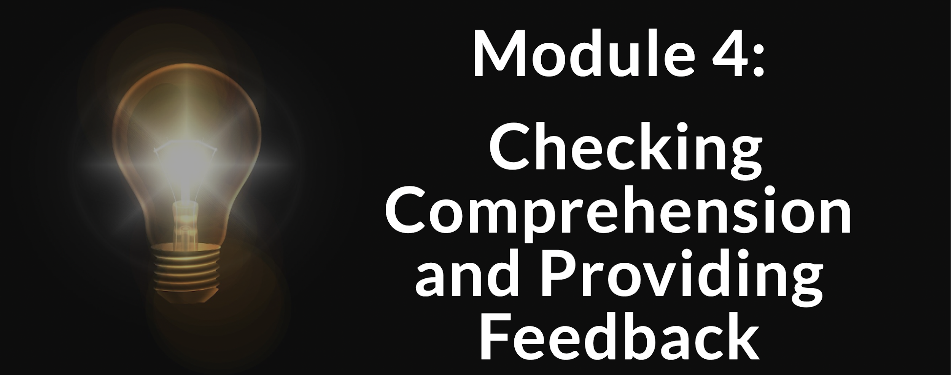
TEACHING ENGLISH THROUGH ENGLISH
Friday, May 21, 2021
Rebecca Fox, Ph.D.
Hyunsun Chung, M.A.
Fox, R., & Chung, H. (May, 2021). Checking Comprehension and Providing Feedback. Workshop webinar presented for the Teaching English through English online professional development program (Cohort I): Module 2. U.S. Embassy in Tashkent funded English Speaking Nation Program in Uzbekistan (online). https://bit.ly/3jxlSlc

Slide 2

TETE MODULE 4 - EFFECTIVE QUESTION AND ANSWER
Polls in the Classroom to Recall Information
Run quizzes and competitions
Use as exit ticket
Receive feedback
Check for understanding:
Question and answer choices on the board
Paper-based surveys
Free web-based tools: Kahoot, Poll Everywhere, Google Forms
CHECKING PORTFOLIO CREATION COMPREHENSION USING POLLING
Notes:
Questions for Zoom poll - all True/False
I need to have a gmail account to be able to create TETE portfolio.
I need to create 13 different pages in my TETE portfolio.
My create and reflect tasks that I post in my portfolio should have a clear connection to what I learned in the module.
I need to simply list what I did in all my reflections.

Slide 3
TETE MODULE 4 - CHECKING COMPREHENSION & PROVIDING FEEDBACK
Recalling our Module 3 content from last week on effective questioning and answering in class,
think about your most important new learning, (such as predicting, questioning for main ideas, making inference, etc.)
NOW, use the chat box to share:
one new questioning technique that you applied this past week in your English class.

Slide 4
TETE MODULE 4 –CHECKING COMPREHENSION & PROVIDING FEEDBACK
Module 4
Webinar Agenda
Address Module 4 content on checking comprehension and providing feedback
Share examples and ideas
Pushing toward deeper reflection

Slide 5
TETE MODULE 4 –CHECKING COMPREHENSION & PROVIDING FEEDBACK
Let’s think about using Comprehension Checks during your interactive lessons :-)
1.When do you check your students’ comprehension?
Any time, all the time!
2. How do you check your students’ comprehension effectively?
Simply and quickly/physically interactive ways
3. Why is it so important to check students’ comprehension during a lesson?
To engage your students!
To see how they are progressing and feeling
To offer extra support on the spot
To help students "own" their learning
Notes:
When? Anytime, after giving directions, during the group work, while they are in activities, after finishing a task

Slide 6

TETE MODULE 4 –CHECKING COMPREHENSION & PROVIDING FEEDBACK
How do you check? Let's consider multiple ways to check comprehension quickly & effectively:
Make it simple and quick!
Thumbs up/down
Scale of 1-5 with fingers
(or fist to five)
This Photo by Unknown Author is licensed under CC BY-NC-ND
Notes:
Thumbsup if you understand, thumbs down if you feel lost
Fist to five: when ss are working in groups 1-2 if you are not very comfortable with learning, 4-5 if you feel you got it down!

Slide 7
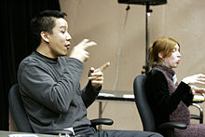
TETE MODULE 4 –CHECKING COMPREHENSION & PROVIDING FEEDBACK
How do you check? Let's look at some additional ways to check comprehension quickly & effectively:
More interactive body language to try!
Signal (respond to a cue)
  Touch your nose (whenever you hear words related to airport)
  Hand on your head (if you hear the days in a week_)
"Blind" Quiz
Close your eyes. Now, raise hand if true. . .
Gesture
This Photo by Unknown Author is licensed under CC BY-SA
Notes:
1.Ss respond to a cue such as touch your nose whenever you hear the word meaning ________. Hand on your head if you hear _______, hand on your belly if you hear _______.
2. all students close your eyes. Raise your hand if a true statement is given. Keep your hands down if you think the statement is false

Slide 8

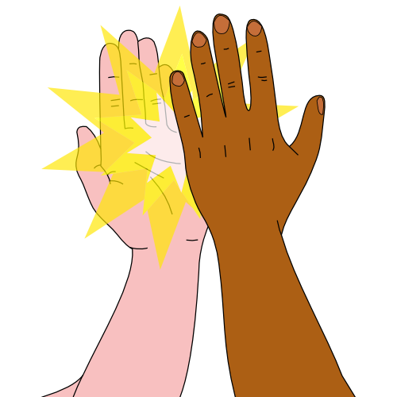

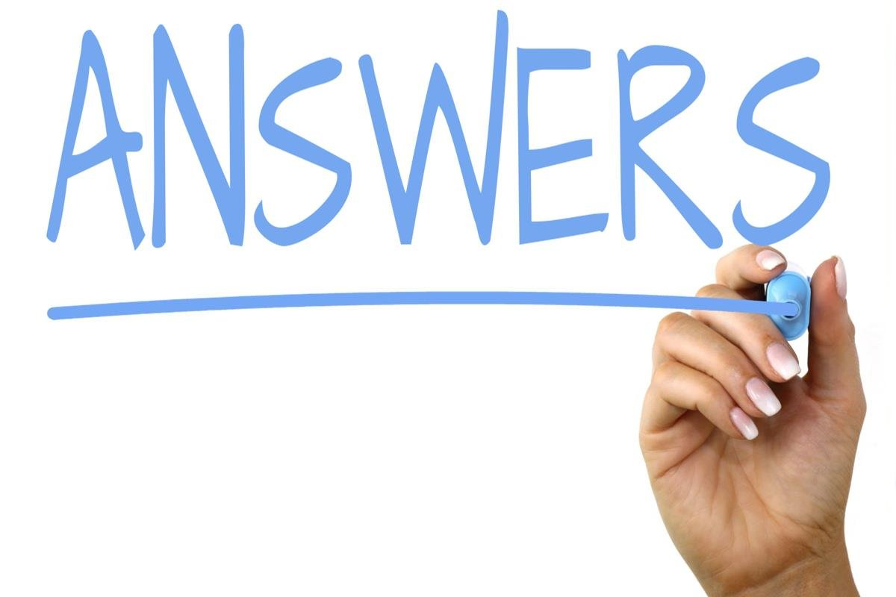
TETE MODULE 4 –CHECKING COMPREHENSION & PROVIDING FEEDBACK
How do you check?
More ways to check comprehension
effectively:
Use simple & diverse modes of expression!
Check in Pairs & give High Five when getting correct answers
Placard – yes/no, or red light/green light, or agree/disagree
Draw/write
This Photo by Unknown Author is licensed under CC BY
This Photo by Unknown Author is licensed under CC BY-SA-NC
This Photo by Unknown Author is licensed under CC BY-SA
Notes:
1.Ss say the answer to the partner. The teacher gives the answer, and if they got the right answer, ss high-five. 2.

Slide 9
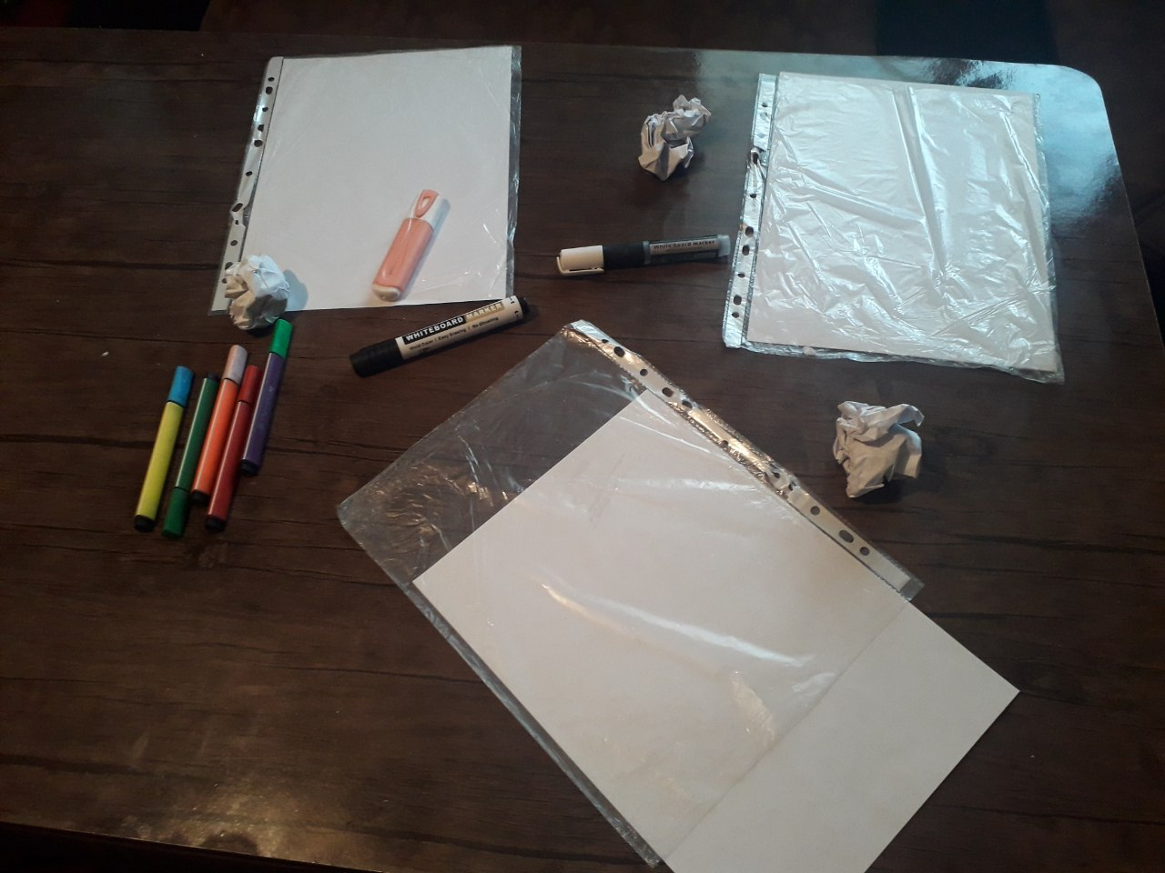
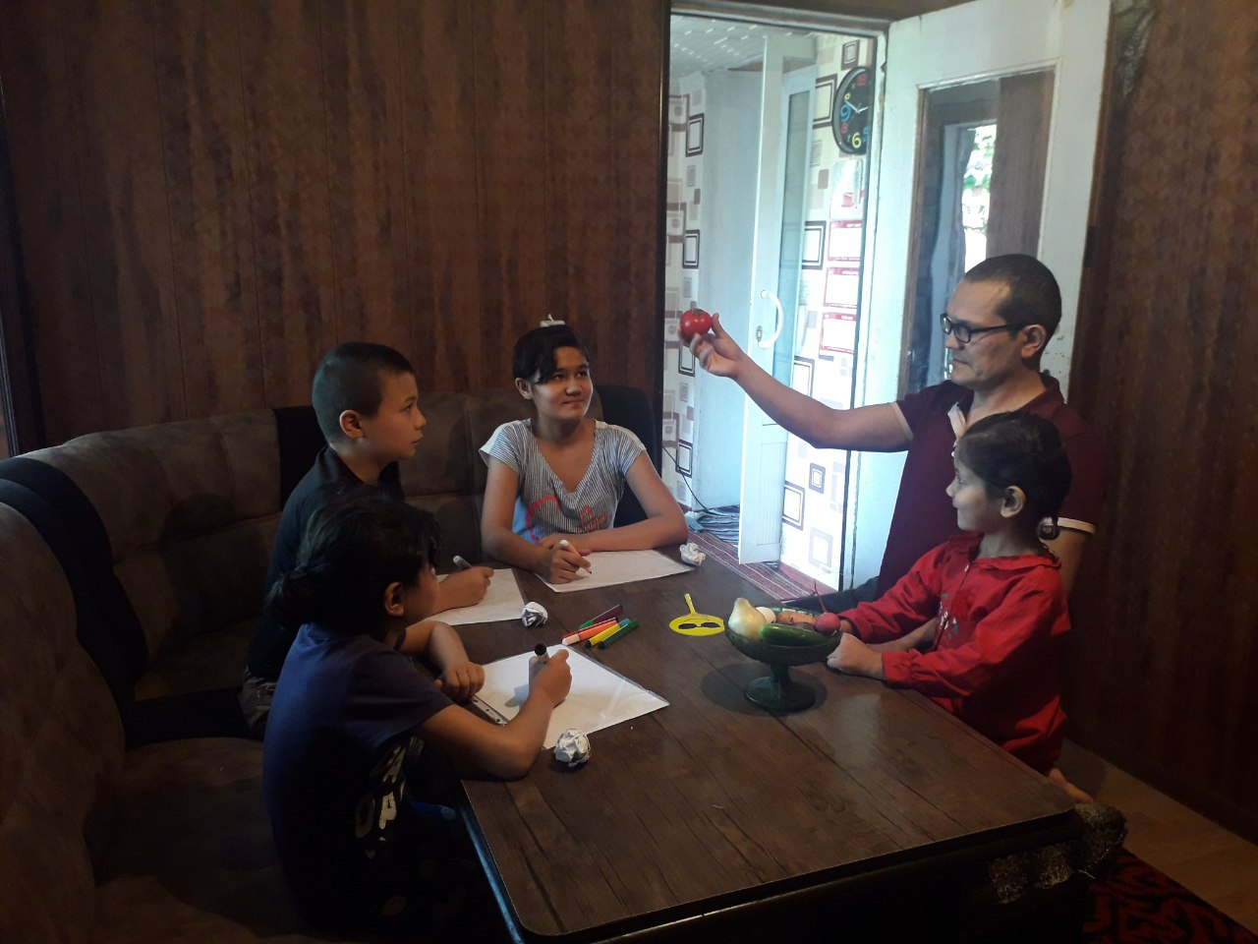
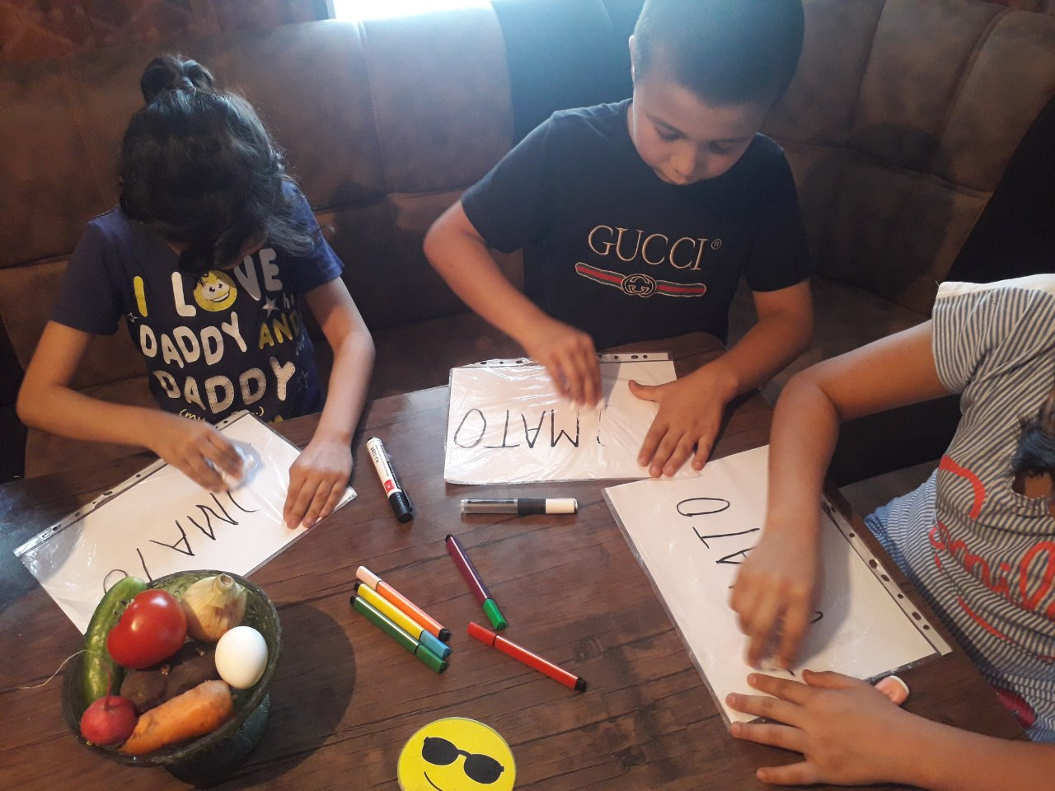
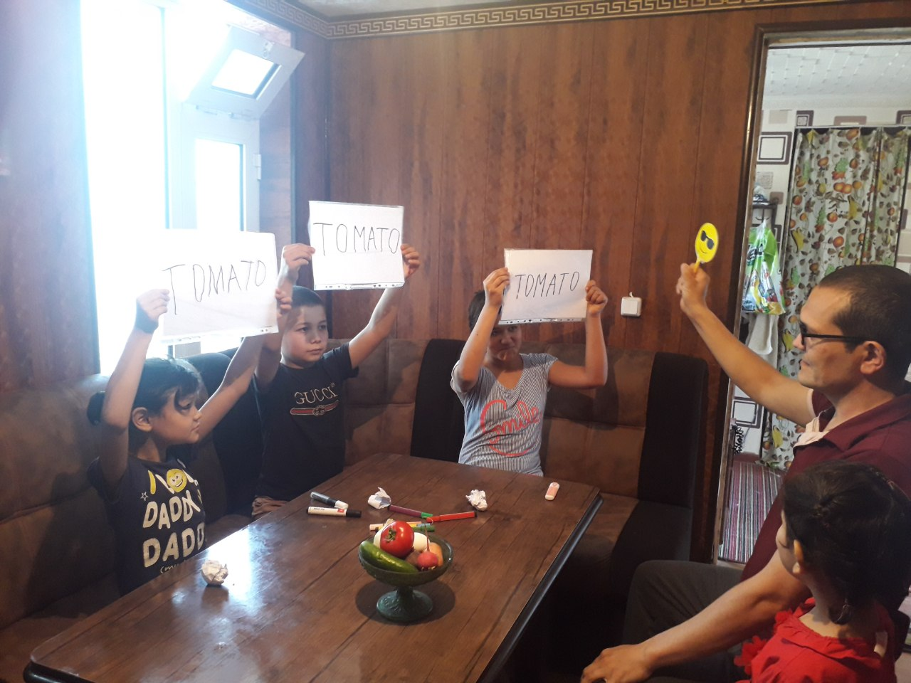
TETE MODULE 4 –CHECKING COMPREHENSION & PROVIDING FEEDBACK
‘Personal Whiteboard’ by teacher Oybek
Benefits
-The whole class is engaged!
-Students feel confident and enjoy the process of writing and erasing on their white boards.
-It saves time. Teacher can easily check Ss’ comprehension and give an appropriate feedback to them in a very little time.
Notes:
This is an idea from teacher Oybek; using a clear file pocket and white paper, teachers can provide students with personal whiteboard. Students can write, draw, and use it as a placard in various activities.

Slide 10
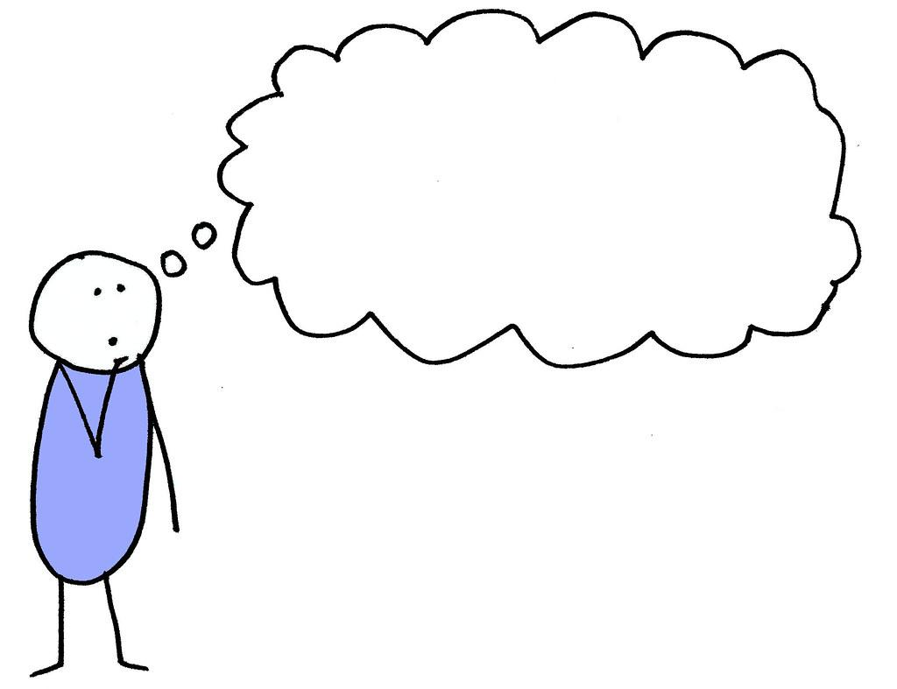
TETE MODULE 4 –CHECKING COMPREHENSION & PROVIDING FEEDBACK
Metacognitive checks: self-evaluation checks
Teacher asks students to self-report and explain their learning
"Can do"
statements
Checklists
Yes, I got it!
Almost there.
Still need help.
I can use the past tense now!
This Photo by Unknown Author is licensed under CC BY-SA

Slide 11
TETE MODULE 4 –CHECKING COMPREHENSION & PROVIDING FEEDBACK
YOUR TURN!
Please type your ideas into the chat box
or
raise your hand to speak!
Are there any comprehension check strategies that you already have tried from our modules?
Share any other comprehension check strategy that you've used

Slide 12
TETE MODULE 4 –CHECKING COMPREHENSION & PROVIDING FEEDBACK
Providing Effective Feedback:
Different Goals = Different Feedback Approaches
Consider these:
1. Formative feedback – for whole class situations
2. Accuracy: Different ways of providing direct feedback that is positive
3. Different ways to provide indirect feedback
Varying approaches for different situations
Notes:
Let’s look in details.

Slide 13
TETE MODULE 4 –CHECKING COMPREHENSION & PROVIDING FEEDBACK
Let's look at how to provide Whole Class Formative and ongoing Feedback – keep it positive!
Small group activity for communication
Group presentation
Encouragement and praise
Careful listening and noting students’ errors
Whole class feedback on some common errors or error patterns
Practice together and give students more chances for mastery

Slide 14
TETE MODULE 4 –CHECKING COMPREHENSION & PROVIDING FEEDBACK
Times when we want to provide feedback for Accuracy: Setting the stage. . .
Teacher: What did you do with your family yesterday after finishing homework?
Student: Mmm, I, I go to dinner with my family.
The teacher thinks: Hmm. I hear this type of verb tense error frequently. I'd like to help my students understand this important use of past tense because we were just studying it. I see this is an error that lots of students make, so this is a "teaching moment."
I want to use this perfect moment to help them see how they can apply their new knowledge about past tense verbs.
Notes:
Teacher’s reflection in action (and on action)

Slide 15
TETE MODULE 4 –CHECKING COMPREHENSION & PROVIDING FEEDBACK
A Time for Accuracy: Different examples of effective direct feedback
1. Teacher correction:
T: “I understand what you mean but let’s look more closely at the verb.
Here, the correct form of this verb should be went.” "You meant to indicate the past, yes? When you say go you mean right now.” “We should say went here because it happened yesterday. Ok, everyone, today we go, yesterday we went.”
2. Peer correction:
T: ‘go’ is not an accurate form of the verb here. Turn to your elbow partner to see if you can come up with the past tense of the verb.” OK, which pair can tell me?
Ss: “Went?”
T: “That’s correct. Great! OK, class, why do we use went here?”
S: “Because it was yesterday! Yes! Yesterday, I went.”
3. Self correction:
T: “Oh, I understand what you mean! But let’s look at the verb again. Can you recall the grammar we focused in today’s lesson when we looked at past tense?”
S: (Thinking . ..) “Ah yes! I, I had dinner yesterday.”
T: “Yes! Good job!”

Slide 16
TETE MODULE 4 –CHECKING COMPREHENSION & PROVIDING FEEDBACK
Clarifying meaning: Different ways of indirect feedback
Recast
T: “Imagine you are the president of the country. Then, tell us what you want to do.”
S: “If I am a president, I want, want better medicine and hospitals.
T: “I see, so, if you were the president, you would want to improve medical science and facilities?
S: “Oh, yes, if I were the president, I will to work for that.
Requesting Clarification
S: “Uhm, can the homework will be finished by tomorrow?”
T :“Could you repeat ...?” (“Pardon me?”/”I don’t quite understand”)
S: “Um, can I finish the homework by tomorrow?”
T: “ Yes. Class, please finish your homework by tomorrow.”
Notes:
Both recase and requesting clarification is indirect corrective feedback. In recast teacher imply the students’ errors by reformulating the sentence and providing the correct model…
In clarifying request, teachers can use phrases like excuse me? Or I don’t understand. Then the teacher indicate the student’s message has not been understood or there is some kind of mistakes.

Slide 17
TETE MODULE 4 –CHECKING COMPREHENSION & PROVIDING FEEDBACK
How to Reduce Students’ Anxiety in Corrective Feedback:
If you keep the “affective filter” low and reinforce the Positive, you motivate students to speak up and use their English to communicate!
Praise correct answers | Start with the positive | Encouraging Self-Correction
That was a good answer! Well done! Excellent work! I can see you used new vocabulary! You did a very good job on this! I knew you could do it! Correct! Right you are! | Good idea, but let's look more closely at the verb you chose. . .. I understand what you mean, and now let's refine that answer a bit more . . . . That's a good start. Now, how else . . . | You are so close. Keep going! There is no hurry – take your time. So far, so good! Do you remember our lesson on . . . . Let's see now if you can use some of the new vocabulary to be more specific . . .

Slide 18

TETE MODULE 4 –CHECKING COMPREHENSION & PROVIDING FEEDBACK
Remember! Increase the positive and reduce anxiety when providing feedback
Positive emotion broadens learners’ perspective and repertoire.
Encourages creativity & more conversation
Learner’s motivational energy is the key in language learning.
With positive encouragement, learners experience feelings of joy, relief, and pride from tackling difficult tasks or speaking in class.

Slide 19
TETE MODULE 4 –CHECKING COMPREHENSION & PROVIDING FEEDBACK
What are your goals of using effective feedback in your English classroom with your students?
YOUR TURN!
Please type your ideas into the chat box or raise your hand to speak!

Slide 20
TETE MODULE 4 –CHECKING COMPREHENSION & PROVIDING FEEDBACK
Turning to our Pre-course assessment, let’s anchor with our Module 4 content:
Q7. Oral corrective feedback demotivates foreign language learners, so teachers should not directly correct the errors.
True
False
Q8. Which of the following is NOT true about checking students’ comprehension?
A. Teachers should check students’ comprehension after giving activity instructions, during the activity, and after the activity.
B. Comprehension checks and metacognitive checks are used to keep learners focused during an activity and keep teachers informed about the learners’ progress.
C. Metacognitive checks focus on the learners’ whole understanding of the learning materials.
D. Comprehension checks can be used by teachers as a formative assessment to make instructional adjustments before giving a final or summative assessment.

Slide 21
TETE MODULE 4 –CHECKING COMPREHENSION & PROVIDING FEEDBACK
Turning to our Pre-course assessment, let’s anchor with our Module 4 content:
Q7. Oral corrective feedback demotivates foreign language learners, so teachers should not directly correct the errors.
True
False
Answer: False
Q8. Which of the following is NOT true about checking students’ comprehension?
A. Teachers should check students’ comprehension after giving activity instructions, during the activity, and after the activity.
B. Comprehension checks and metacognitive checks are used to keep learners’ focused during an activity and keep teachers informed about the learners’ progress.
C. Metacognitive checks focus on the learners’ whole understanding of the learning materials.
D. Comprehension checks can be used by teachers as a formative assessment to make instructional adjustments before giving a final or summative assessment.
Answer: C

Slide 22
TETE MODULE 4 –CHECKING COMPREHENSION & PROVIDING FEEDBACK
D.E.A.R.
Drop Everything And Reflect!
Type in the answer to 1-2 reflection in the chat, BUT –
DO NOT submit (hit Enter) until I say so …
This is called a "waterfall" strategy in Zoom
1 1 thing that I can do | 2 2 motivate students is…..

Slide 23
TETE MODULE 4 –CHECKING COMPREHENSION & PROVIDING FEEDBACK
Exit Ticket
Click on the link in the Zoom chat box to complete the Exit Ticket
https://forms.gle/BCM7ZTkTdv6HC4AP8

Slide 24
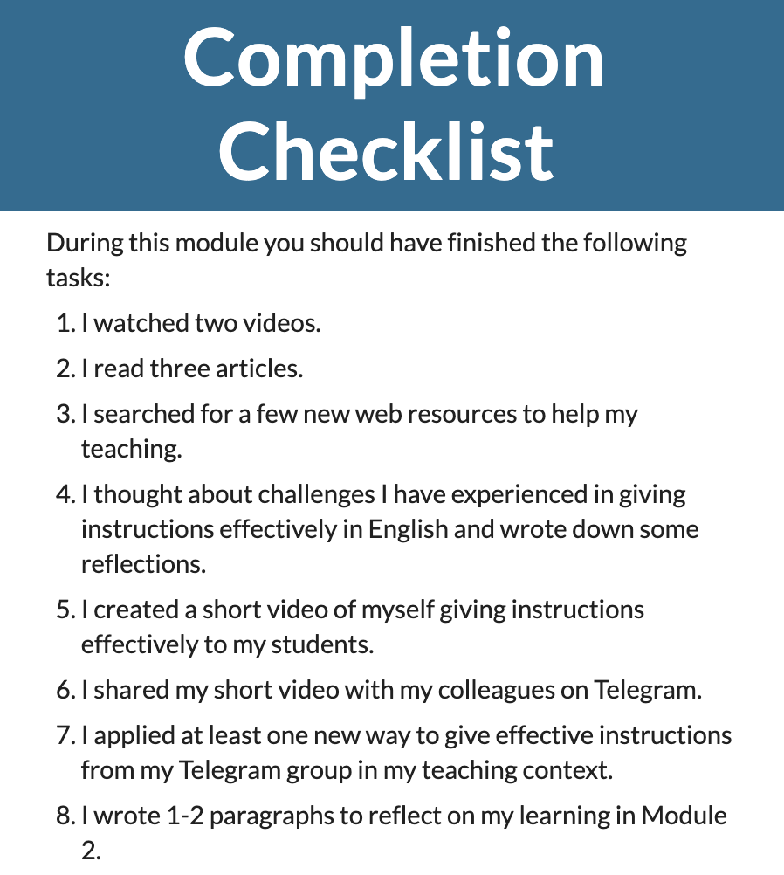
TETE MODULE 4 –CHECKING COMPREHENSION & PROVIDING FEEDBACK
What is due on Sunday, May 23?

Slide 25
TETE MODULE 4 –CHECKING COMPREHENSION & PROVIDING FEEDBACK
LOOKING AHEAD
Module 5: on Monday, May 24th!
NEXT WEBINAR
Friday, May 28th
7:00-8:00 PM Uzbekistan Time

Slide 26
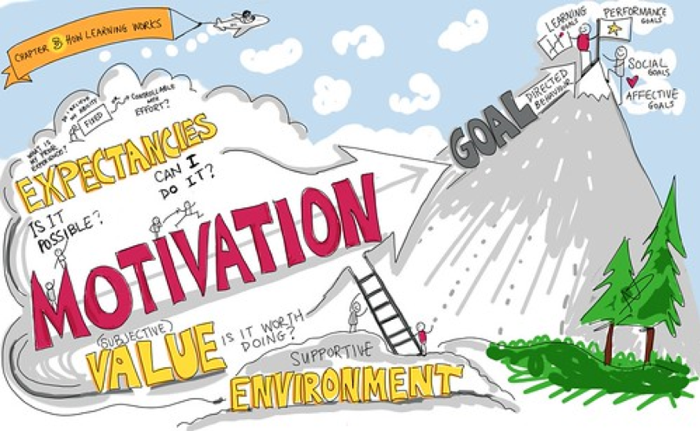
TETE MODULE 4 –CHECKING COMPREHENSION & PROVIDING FEEDBACK
"We expert teachers know that motivation and emotional impact are what matter." - Donald Norman
This Photo by Unknown Author is licensed under CC BY

Slide 27
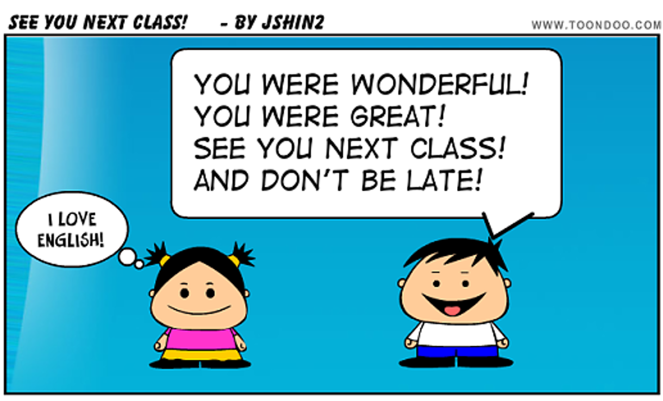
TETE MODULE 4 –CHECKING COMPREHENSION & PROVIDING FEEDBACK
Thanks for attending! See you next Friday!

