Slide 1
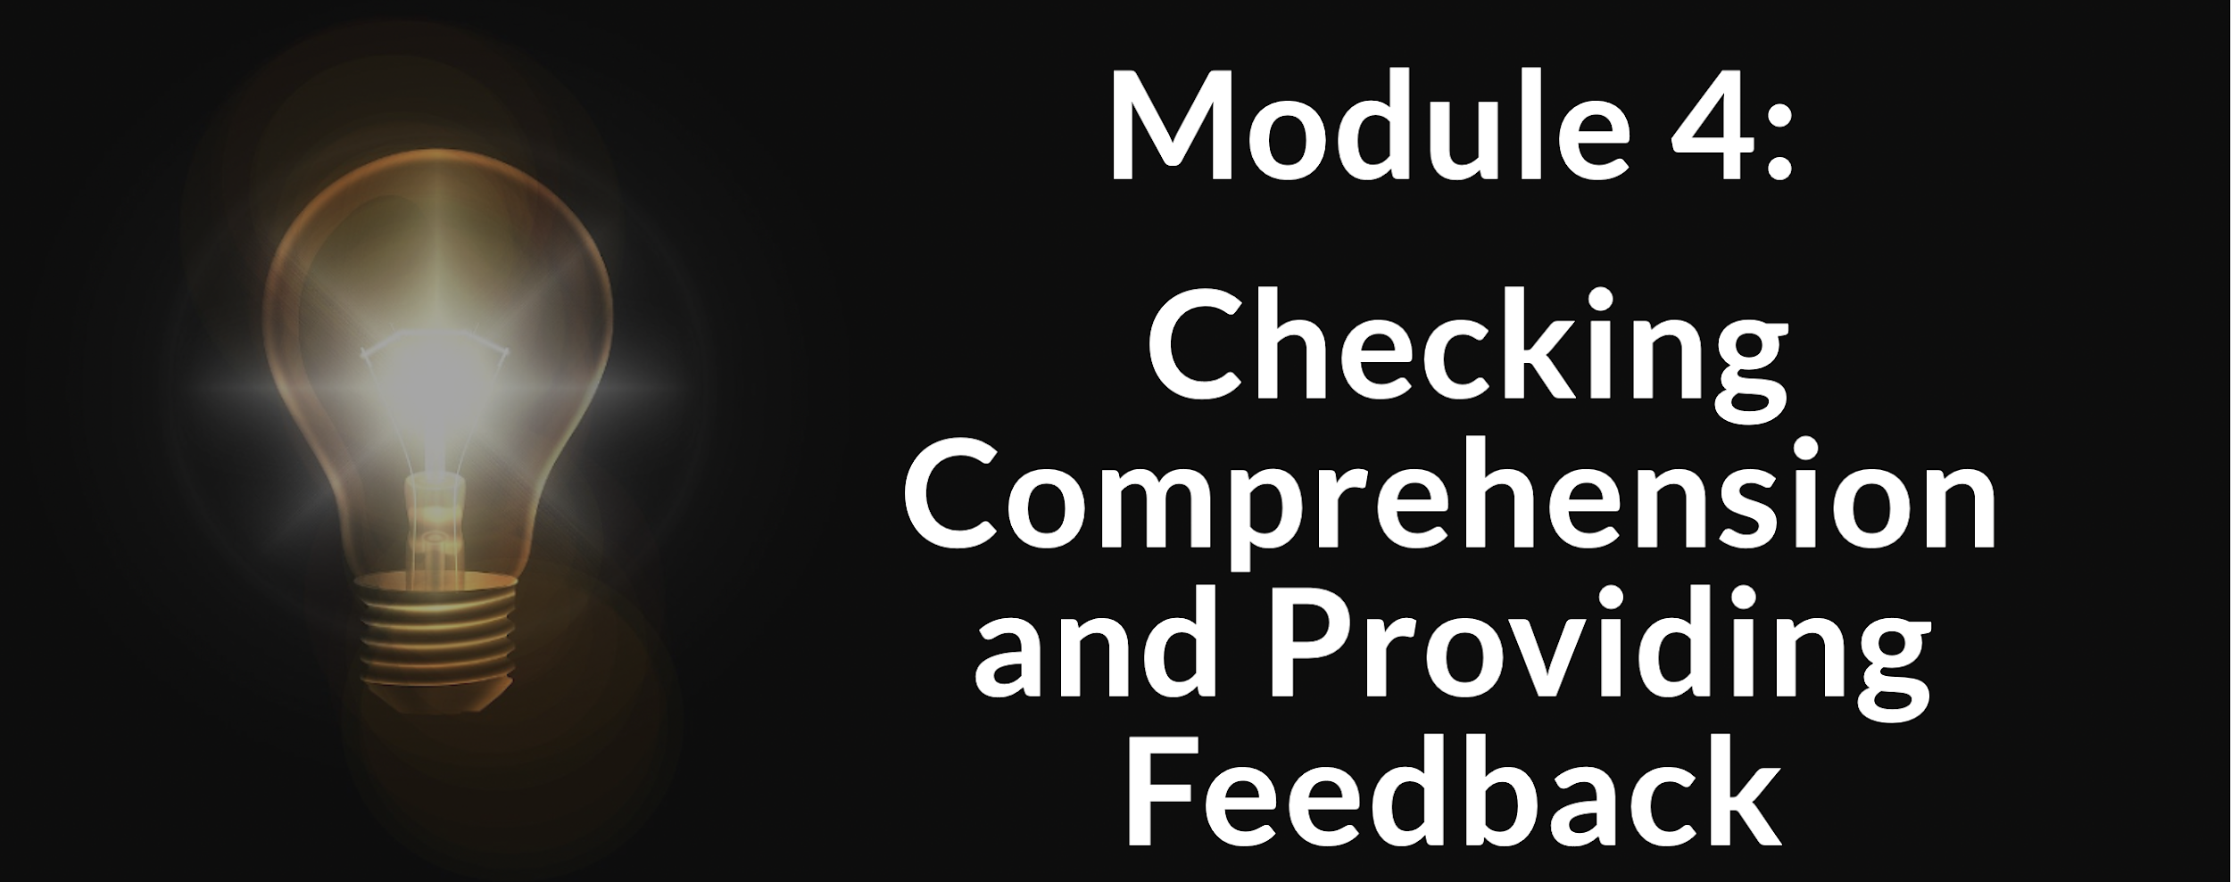
TEACHING ENGLISH THROUGH ENGLISH
Module 4 - Checking Comprehension and Providing Feedback
Friday, July 30, 2021
Rebecca Fox, Ph.D.
Anya Evmenova, Ph.D.
Hyunsun Chung, M.A.
Fox, R., Chung, H. & Evmenova, A. (July, 2021). Checking Comprehension and Providing Feedback. Workshop webinar presented for the Teaching English through English online professional development program (Cohort II): Module 4. U.S. Embassy in Tashkent funded English Speaking Nation Program in Uzbekistan (online). https://bit.ly/3s2h62X
Notes:
Dr. Fox opens

Slide 2

TETE MODULE 4 - EFFECTIVE QUESTION AND ANSWER
Polls to Recall Information
Run quizzes and competitions
Use as exit ticket
Receive feedback
Check for understanding:
Question and answer choices on the board
Paper-based surveys
Free web-based tools: Kahoot, Poll Everywhere, Google Forms
CHECKING PORTFOLIO CREATION COMPREHENSION USING POLLING
Notes:
Dr. Evmenova:
Questions for Zoom poll - all True/False
I need to have a gmail account to be able to create TETE portfolio.
I need to create 13 different pages in my TETE portfolio.
My create and reflect tasks that I post in my portfolio should have a clear connection to what I learned in the module.
I need to simply list what I did in all my reflections.

Slide 3
TETE MODULE 4 - CHECKING COMPREHENSION & PROVIDING FEEDBACK
Recalling our Module 3 content from last week on effective questioning and answering in class,
think about your most important new learning, (such as predicting, questioning for main ideas, making inference, etc.)
NOW, use the chat box to share:
one new questioning technique that you applied this past week in your English class.
Notes:
Dr. Fox leads; Hyunsun reports the chat box together

Slide 4
TETE MODULE 4 –CHECKING COMPREHENSION & PROVIDING FEEDBACK
Module 4
Webinar Agenda
Address Module 4 content on checking comprehension and providing feedback
Share examples and ideas
Pushing toward more reflective feedback practice
Notes:
Dr. Fox

Slide 5
TETE MODULE 4 –CHECKING COMPREHENSION & PROVIDING FEEDBACK
Let’s think about using [Comprehension Checks] during your interactive lessons
1.When do you check your students’ comprehension?
Any time, all the time!
2. How do you check your students’ comprehension effectively?
Simply and quickly/physically interactive ways
3. Why is it so important to check students’ comprehension during a lesson?
To engage your students
To see how they are progressing and feeling
To offer extra support on the spot
To help students "own" their learning!
Notes:
Dr.Fox
When? Anytime, after giving directions, during the group work, while they are in activities, after finishing a task

Slide 6

TETE MODULE 4 –CHECKING COMPREHENSION & PROVIDING FEEDBACK
How do you check?
Check students’ comprehension with body language
Make it simple, quick, and interactive!
Hand Gestures
  Thumbs up/down
  Scale of 1-5 with fingers
Signal (respond to a cue)
Touch your ear (whenever you hear words related to airport)
Hand on your head (if you hear the days in a week,~)
Blind Comprehension Check
Close your eyes.
Now, raise your hand if you think this statement is true. . .
Keep your hands in your lap if the statement is false . . .
Notes:
HS:

Slide 7

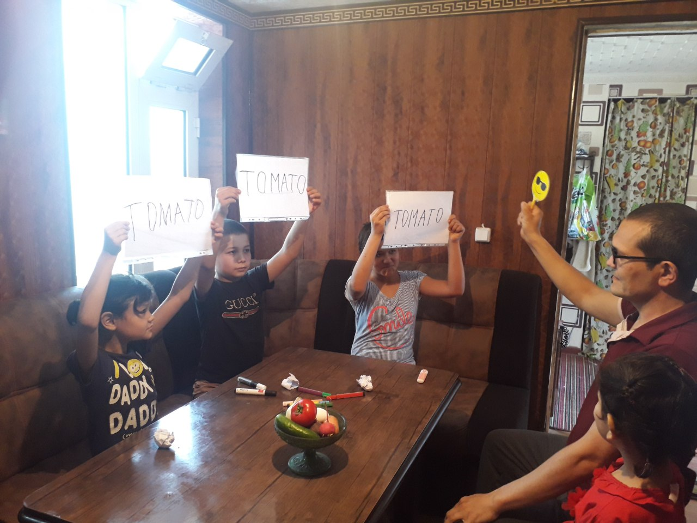
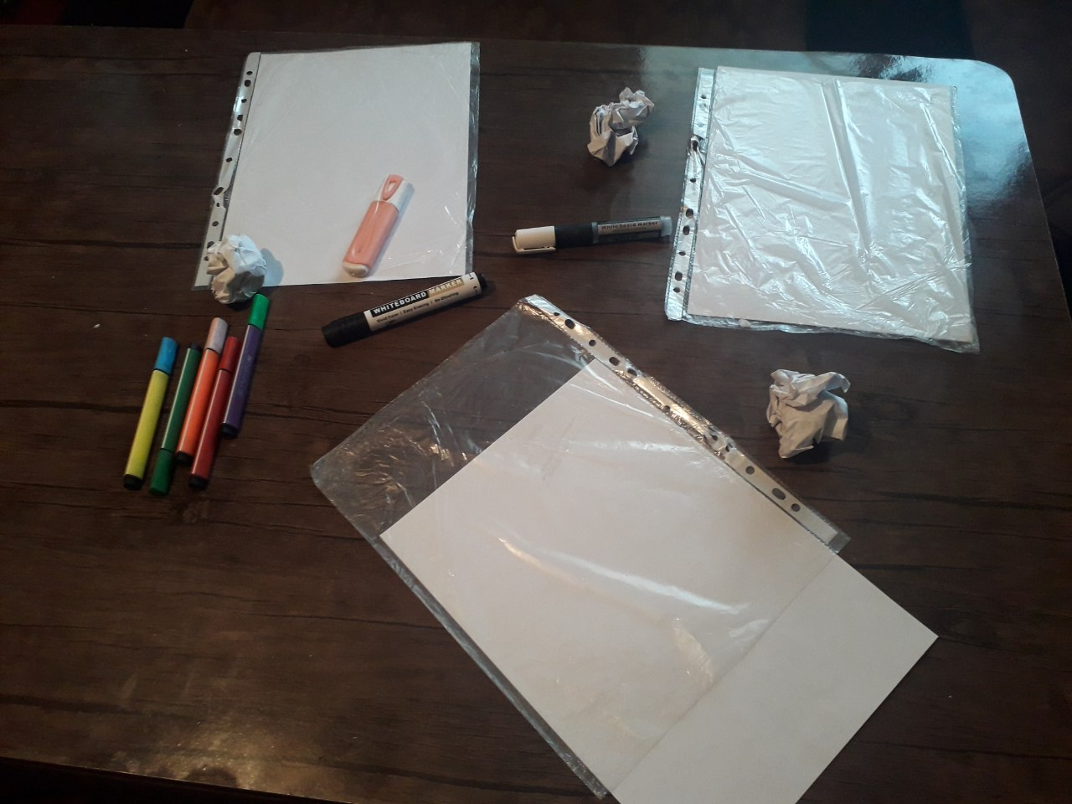
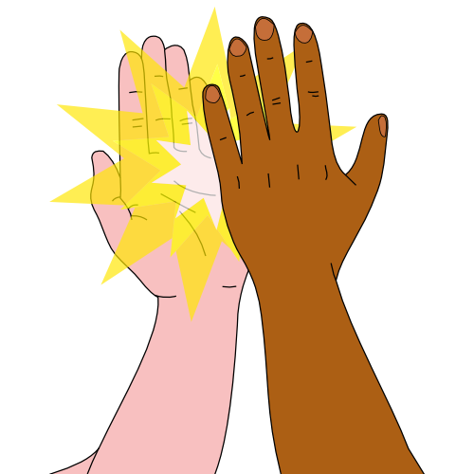

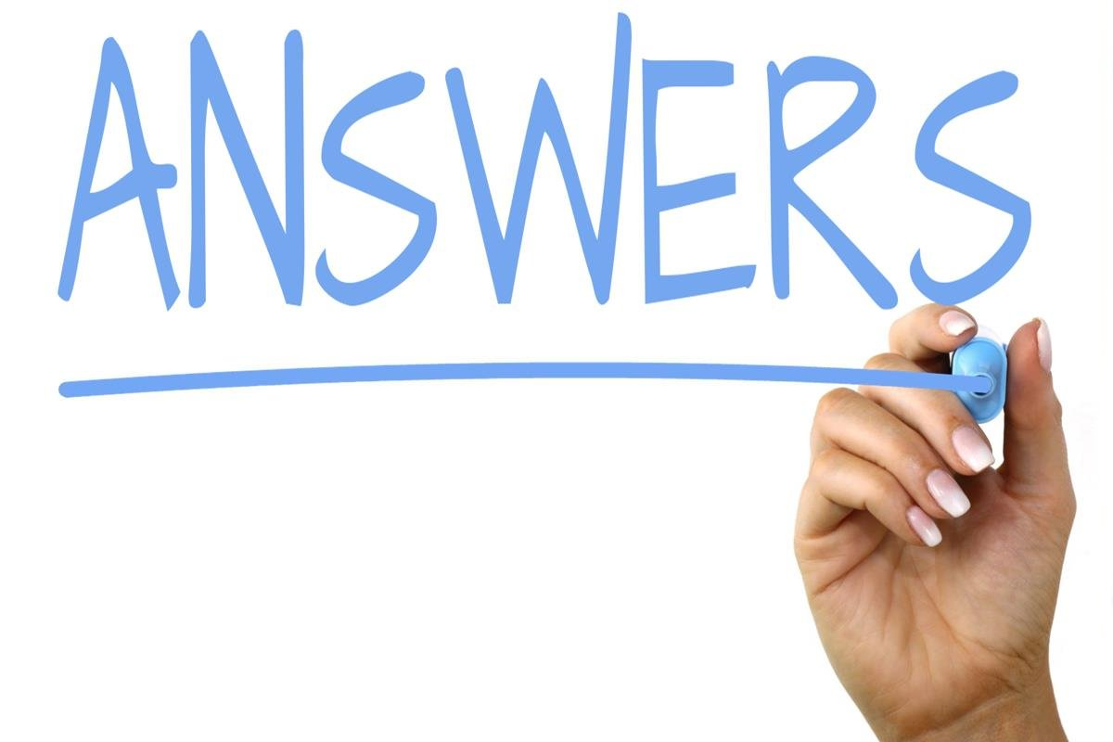
TETE MODULE 4 –CHECKING COMPREHENSION & PROVIDING FEEDBACK
How do you check?
More ways to check comprehension effectively
Use simple & diverse modes of expression!
Placard – yes/no, or red light/green light, or agree/disagree
Draw/write on personal whiteboard
Check in pairs & give High Five when getting correct answers
This Photo by Unknown Author is licensed under CC BY-SA
Notes:
HS

Slide 8
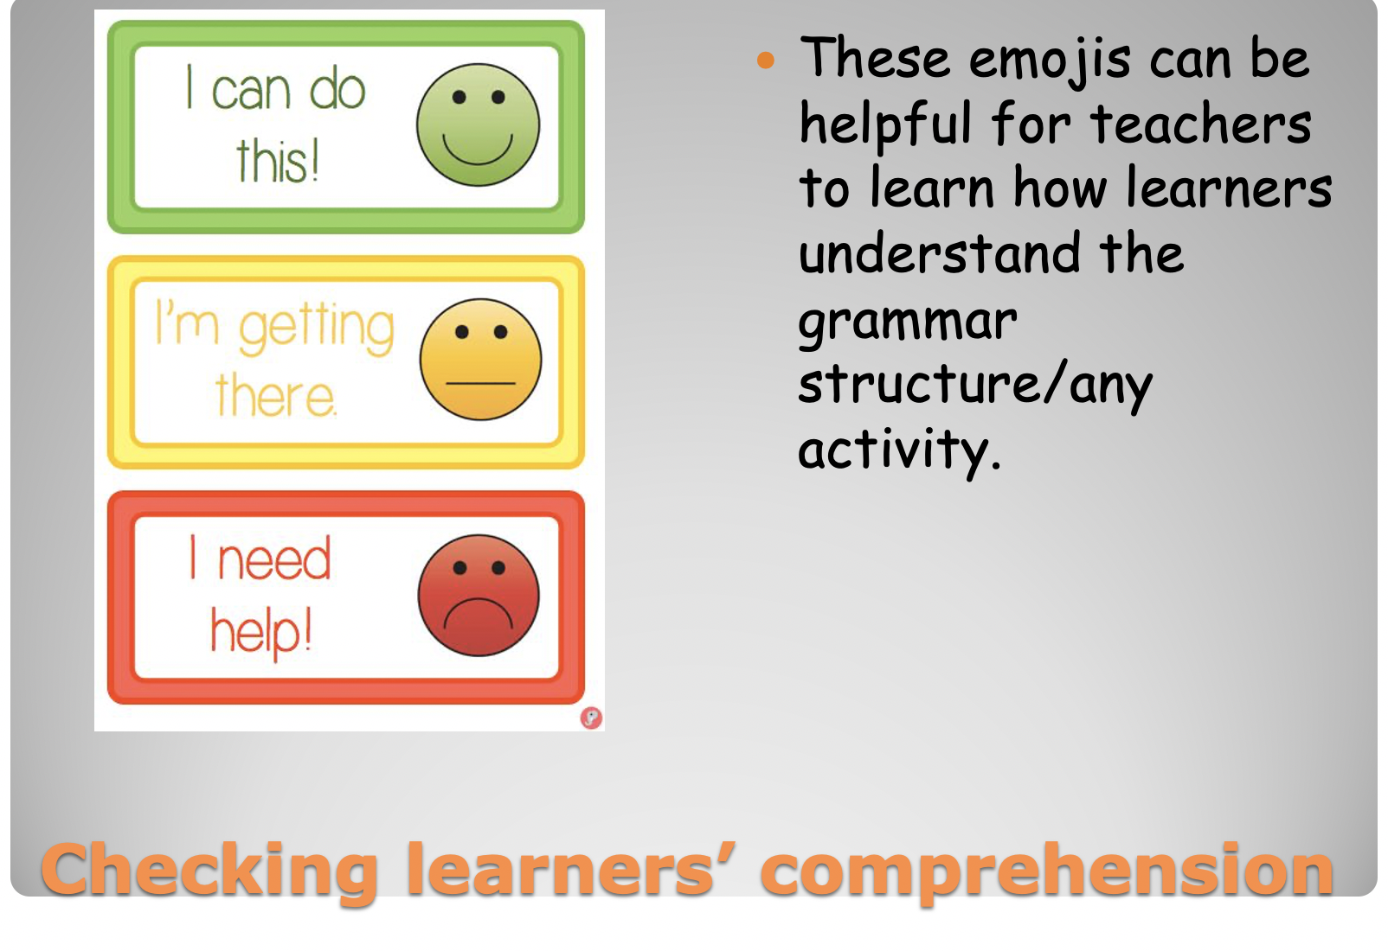
TETE MODULE 4 –CHECKING COMPREHENSION & PROVIDING FEEDBACK
How do you check? Teacher Albina
Notes:
HS

Slide 9
TETE MODULE 4 –CHECKING COMPREHENSION & PROVIDING FEEDBACK
YOUR TURN!
Please type your ideas into the chat box
or
raise your hand to speak!
Are there any comprehension check strategies
that you already have tried from our modules?
Share any other comprehension check strategy that you've used
Notes:
Dr. Fox leads; Hyunsun reports the chat box

Slide 10

TETE MODULE 4 –CHECKING COMPREHENSION & PROVIDING FEEDBACK
Providing Effective Feedback
Different Goals = Different Feedback Approaches
Formative feedback for whole class situations
Accuracy: Different ways of providing direct feedback that is positive
Different ways to provide indirect feedback
Notes:
Dr. Fox

Slide 11
TETE MODULE 4 –CHECKING COMPREHENSION & PROVIDING FEEDBACK
Let's look at how to provide Whole Class Formative and Ongoing Feedback
Keep it strategic and positive!
Small group activity among students
Group presentation
Encouragement and praise
Careful listening and noting students’ errors
Whole class feedback on some common errors or error patterns
Practice together and give students more chances for mastery
Notes:
HS

Slide 12
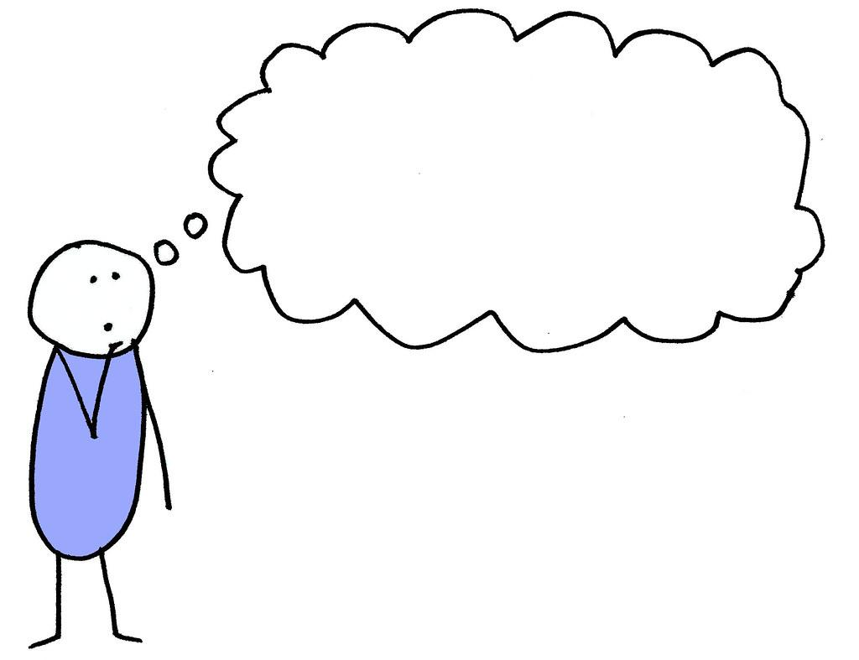
TETE MODULE 4 –CHECKING COMPREHENSION & PROVIDING FEEDBACK
Times when we want to provide feedback for Accuracy: Setting the stage. . .
T: What did you do with your family yesterday after finishing homework?
S: Mmm, I, I go to dinner with my family.
Hmm. I hear this type of verb tense error frequently, so this is a "teaching moment." Using this perfect moment, I'd like to help my students understand this important use of past tense because we were just studying it.
Notes:
HS: Teacher’s reflection in action (and on action)

Slide 13
TETE MODULE 4 –CHECKING COMPREHENSION & PROVIDING FEEDBACK
A Time for Accuracy: Different examples of effective direct feedback
Teacher correction
T: I understand what you mean Nilufar, but let’s look more closely at the verb. Here, the correct form of this verb should be went.You meant to indicate the past, yes? When you say ‘go’ you mean right now.We should say ‘went’ here because it happened yesterday. OK, everyone, today we ‘go,’ yesterday we ‘went.’
Peer correction
T: Here is a mistake in this sentence. Let’s figure it out together. Turn to your elbow partner to see if you can come up with the incorrect part. OK, which pair can tell me? P1: ‘Went’? T: That’s correct. Great! OK, class, why do we use ‘went’ here? S2: Because it was yesterday! T: Yes! Yesterday, I ‘went.’
Self correction
T: Oh, I understand what you mean, Nazim. But let’s look at the verb again. Can you recall the grammar we focused in today’s lesson when we looked at past tense? S: (Thinking . ..) Ah yes! I, I ‘went’ to dinner yesterday. T: Yes! Good job!
Notes:
HS

Slide 14
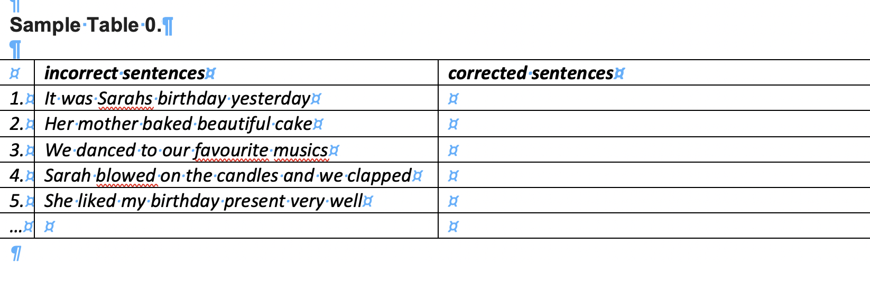
TETE MODULE 4 –CHECKING COMPREHENSION & PROVIDING FEEDBACK
How do you give feedback? Teacher Nosirjon
Teacher collects students notebooks after grammar based writing tasks.
Finding some common errors and place them in a table: One column for incorrect sentences, the other for students’ group work to write corrected sentences.
After group work, each group explains what was wrong with the sentences and teacher adds clarification.
Non-threatening, whole class, corrective feedback
Notes:
HS

Slide 15
TETE MODULE 4 –CHECKING COMPREHENSION & PROVIDING FEEDBACK
Clarifying meaning: Different ways of indirect feedback
Recast
T: Imagine you are the president of the country. Then, tell us what you want to do.
S: If I am a president, I want, want better medicine and hospitals.
T: I see, so, if you were the president, you would want to improve medical science and facilities?
S: Oh, yes, if I were the president, I would work for that.
Requesting Clarification
S: Mmm, can homework finish tomorrow?
T :Could you repeat ...?(Pardon me?/I don’t quite understand)
S: Umm...can I finish the homework…. by tomorrow?
T: Yes. Class, please finish your homework by tomorrow.
Notes:
HS:
Both recase and requesting clarification is indirect corrective feedback. In recast teacher imply the students’ errors by reformulating the sentence and providing the correct model…
In clarifying request, teachers can use phrases like excuse me? Or I don’t understand. Then the teacher indicate the student’s message has not been understood or there is some kind of mistakes.

Slide 16
TETE MODULE 4 –CHECKING COMPREHENSION & PROVIDING FEEDBACK
How to Reduce Students’ Anxiety in Corrective Feedback
If you keep the “affective filter” low and reinforce the positive, you motivate students to speak up and use their English to communicate!
Praise correct answers | Start with the positive | Encouraging Self-Correction
That was a good answer! Well done! Excellent work! I can see you used new vocabulary! You did a very good job on this! I knew you could do it! Correct! Right you are! | Good idea, but let's look more closely at the verb you chose. . .. I understand what you mean, and now let's refine that answer a bit more . . . . That's a good start. Now, how else . . . | You are so close. Keep going! There is no hurry – take your time. So far, so good! Do you remember our lesson on . . . . Let's see now if you can use some of the new vocabulary to be more specific . . .
Notes:
Dr. Fox

Slide 17

TETE MODULE 4 –CHECKING COMPREHENSION & PROVIDING FEEDBACK
Remember! Increase the positive and reduce anxiety when providing feedback
Positive emotion broadens learners’ perspective and repertoire.
Encourages creativity & more conversation
Learner’s motivational energy is the key in language learning.
With positive encouragement, learners experience feelings of joy, relief, and pride from tackling difficult tasks or speaking in class.
Notes:
Dr. Fox

Slide 18
TETE MODULE 4 –CHECKING COMPREHENSION & PROVIDING FEEDBACK
What are your goals of using effective feedback in your English classroom with your students?
YOUR TURN!
Please type your ideas into the chat box or raise your hand to speak!
Notes:
Dr. Fox leads; Hyunsun reports the chat box together

Slide 19
TETE MODULE 4 –CHECKING COMPREHENSION & PROVIDING FEEDBACK
Turning to our Pre-course assessment, let’s anchor with our Module 4 content:
Q7. Oral corrective feedback demotivates foreign language learners, so teachers should not directly correct the errors.
True
False
Q8. Which of the following is NOT true about checking students’ comprehension?
A. Teachers should check students’ comprehension after giving activity instructions, during the activity, and after the activity.
B. Comprehension checks and metacognitive checks are used to keep learners focused during an activity and keep teachers informed about the learners’ progress.
C. Metacognitive checks focus on the learners’ whole understanding of the learning materials.
D. Comprehension checks can be used by teachers as a formative assessment to make instructional adjustments before giving a final or summative assessment.
Notes:
HS

Slide 20
TETE MODULE 4 –CHECKING COMPREHENSION & PROVIDING FEEDBACK
Turning to our Pre-course assessment, let’s anchor with our Module 4 content:
Q7. Oral corrective feedback demotivates foreign language learners, so teachers should not directly correct the errors.
True
False
Answer: False
Q8. Which of the following is NOT true about checking students’ comprehension?
A. Teachers should check students’ comprehension after giving activity instructions, during the activity, and after the activity.
B. Comprehension checks and metacognitive checks are used to keep learners’ focused during an activity and keep teachers informed about the learners’ progress.
C. Metacognitive checks focus on the learners’ whole understanding of the learning materials.
D. Comprehension checks can be used by teachers as a formative assessment to make instructional adjustments before giving a final or summative assessment.
Answer: C
Notes:
HS

Slide 21
TETE MODULE 4 –CHECKING COMPREHENSION & PROVIDING FEEDBACK
D.E.A.R.
Drop Everything And Reflect!
EXIT TICKET
Click on the link in the zoom chat box to complete your exit ticket (1-2 Reflection).
One(1) thing that I can do ……..Two(2) motivate students is……..
Notes:
Dr.Fox (HS will post the exit ticket link)

Slide 22
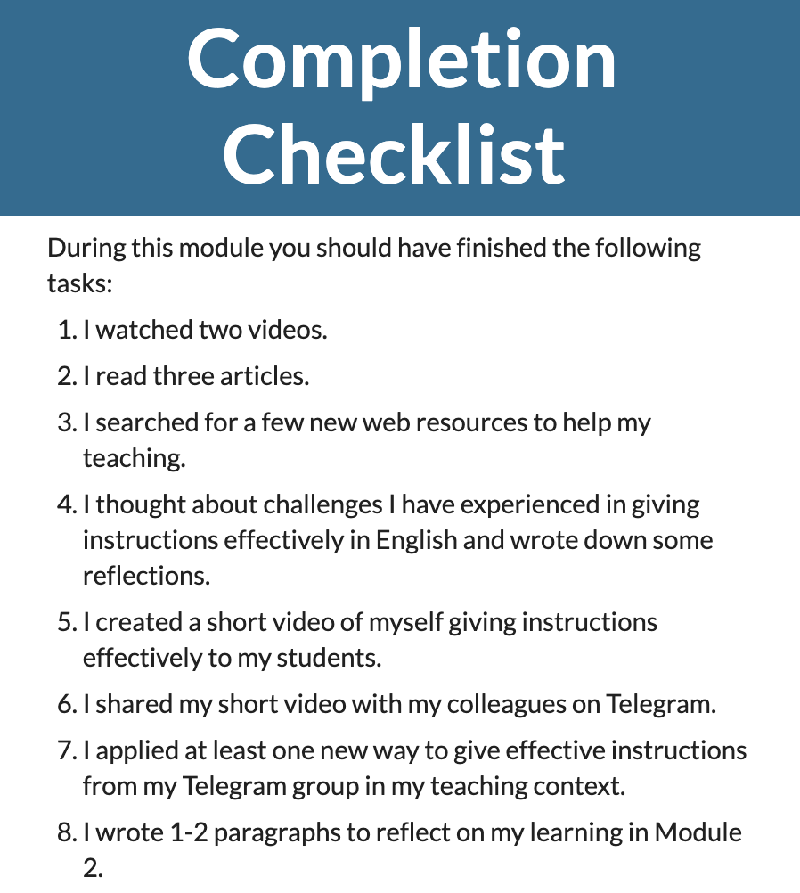
TETE MODULE 4 –CHECKING COMPREHENSION & PROVIDING FEEDBACK
What is due on Sunday, August 1st?
Notes:
HS

Slide 23
TETE MODULE 4 –CHECKING COMPREHENSION & PROVIDING FEEDBACK
LOOKING AHEAD
Module 5: on Monday, August 2nd!
NEXT WEBINAR
Friday, August 6th
7:00-8:00 PM Uzbekistan Time
Notes:
HS

Slide 24
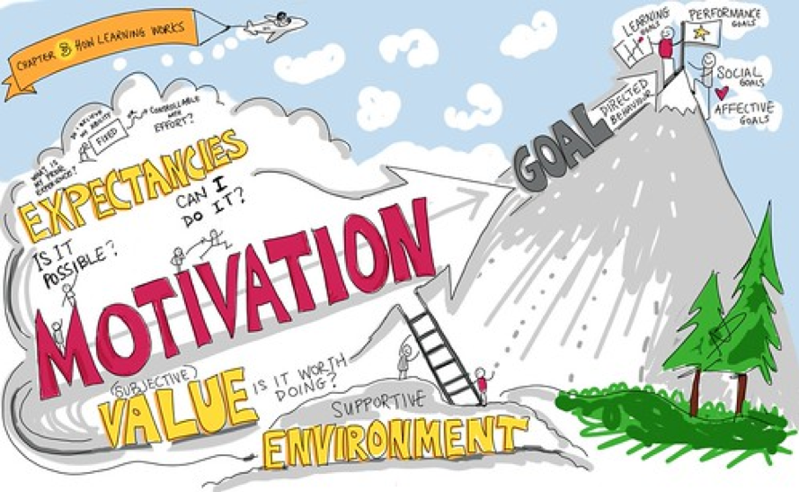
TETE MODULE 4 –CHECKING COMPREHENSION & PROVIDING FEEDBACK
"We expert teachers know that motivation and emotional impact are what matter." - Donald Norman
This Photo by Unknown Author is licensed under CC BY
Notes:
Dr. Fox

Slide 25
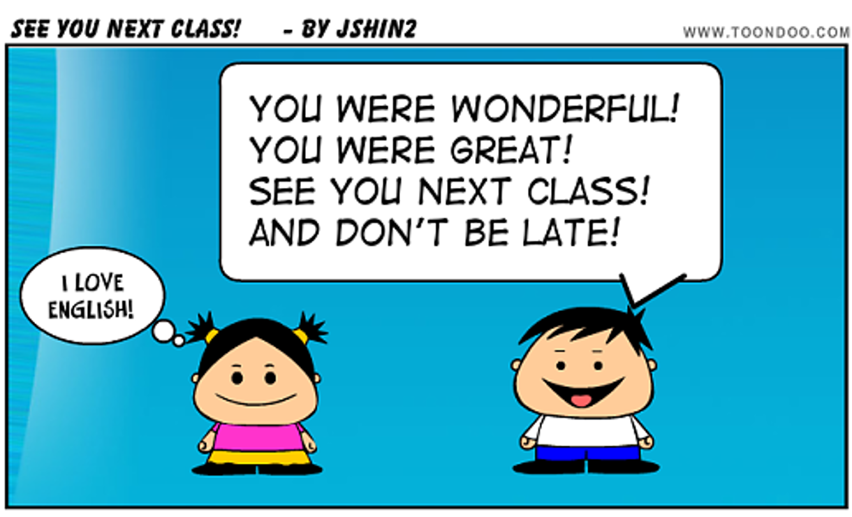
TETE MODULE 4 –CHECKING COMPREHENSION & PROVIDING FEEDBACK
Thanks for attending! See you next Friday!
Notes:
All

