Slide 1
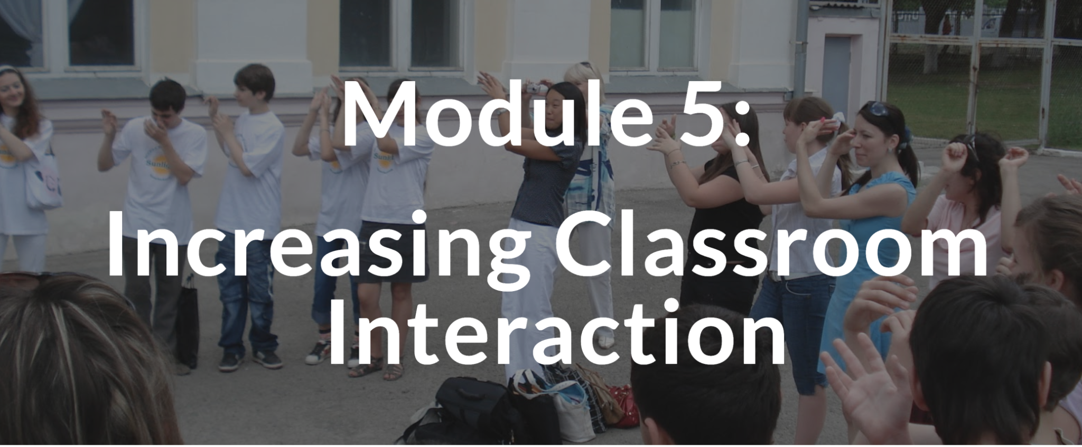
TEACHING ENGLISH THROUGH ENGLISH
Module 5 - Increasing Classroom Interaction
Friday, May 28, 2021
Joan Kang Shin, Ph.D.
Woomee Kim, M.A.
Rebecca Fox, Ph.D.
Anya Evmenova, Ph.D.
Shin, J. K., Kim, W., Fox, R., & Evmenova, A. (May, 2021). Increasing Classroom Interaction. Workshop webinar presented for the Teaching English through English online professional development program (Cohort I): Module 5. U.S. Embassy in Tashkent funded English Speaking Nation Program in Uzbekistan (online). https://bit.ly/3fJ1ufH

Slide 2
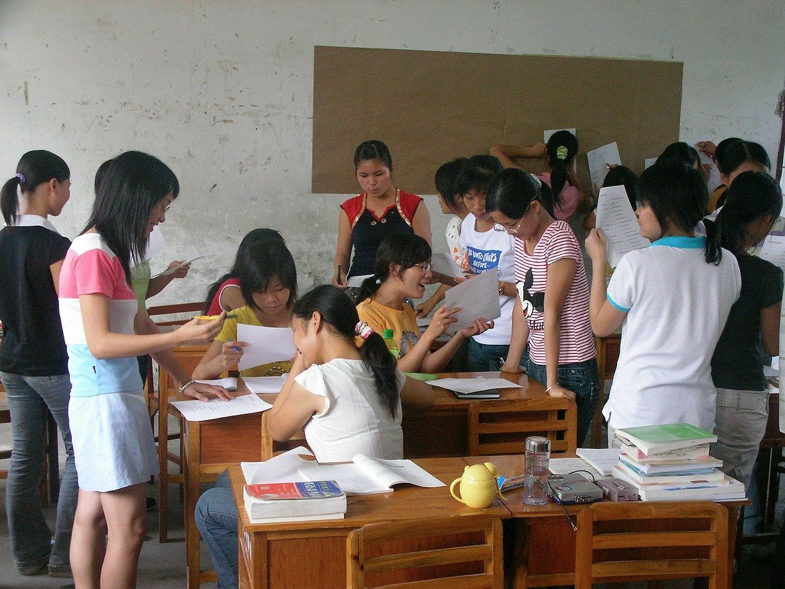
TETE MODULE 5 - INCREASING CLASSROOM INTERACTION
Let’s do a Starter Activity
for increasing student interaction
Notes:
Reading says “non-traditional”, but another way to think of these types of questions is to think of them as “interactive” student responses.

Slide 3

Hello Song
TETE MODULE 5 - INCREASING CLASSROOM INTERACTION
Hello, how are you?
Hello, how are you?
Hello hello, how are you?
I’m very good ~ yeah!
I’m very good ~ yeah!
Thank you very much. And you?

Slide 4
TETE MODULE 5 - INCREASING CLASSROOM INTERACTION
Module 5
Webinar Agenda:
Module 5 content and strategies for increasing student-to-student classroom interaction in English
TETE Portfolio and Mid-Point Reflection
Q & A about TETE Portfolio, Reflection, and Module 5 content

Slide 5

TETE MODULE 5 - INCREASING CLASSROOM INTERACTION
Purpose of Module 5: To prepare you to increase classroom interactions in English
By the end of the module, you will be able to:
describe the importance of student-to-student interaction in a language classroom
examine and use a variety of effective activities that promote meaningful interaction in a classroom
share different communicative activities that are effective for English learners

Slide 6
TETE MODULE 5 - INCREASING CLASSROOM INTERACTION
Why is classroom interaction important for language learning?
YOUR TURN!
Please type your answers into the chat box or raise your hand to say an answer!

Slide 7

TETE MODULE 5 - INCREASING CLASSROOM INTERACTION
"A mouse saved her young from a ferocious cat by barking 'bow-wow.'
After the cat ran away, the mouse said to her offspring
'See, children, it pays to know a second language.'"
- Efstathiadis

Slide 8
TETE MODULE 5 - INCREASING CLASSROOM INTERACTION
Why is classroom interaction important for language learning?
To learn a language, we need to use it.
Students have opportunities to use authentic, “real-life” language.
Mistakes are fine. Students learn to recover from their mistakes in a natural and safe environment.
Students exchange creative ideas and build collaborative relationships.

Slide 9
TETE MODULE 5 - INCREASING CLASSROOM INTERACTION
Module 5 Activities
Getting to know you activities
Using graphic organizers
Bingo
Guiding the Artist

Slide 10
TETE MODULE 5 - INCREASING CLASSROOM INTERACTION
What are your biggest challenges
- increasing classroom interaction?
- getting your students to speak out?
YOUR TURN!
Please type your answers into the chat box or raise your hand to say an answer!

Slide 11
TETE MODULE 5 - INCREASING CLASSROOM INTERACTION
Information Gap Activities
An information gap means that students don’t have all the information they need to complete a task or activity.
Information gap activities require students to speak and share information.
This mirrors real-life communication.
Students have to speak clearly and listen carefully.

Slide 12



TETE MODULE 5 - INCREASING CLASSROOM INTERACTION
Information Gap Activities
Example: Student A has some information. Student B has other information. They need to talk, so both have ALL the information.
A B C
X Y Z
A B C
X Y Z
A B C
X Y Z
A B C

Slide 13
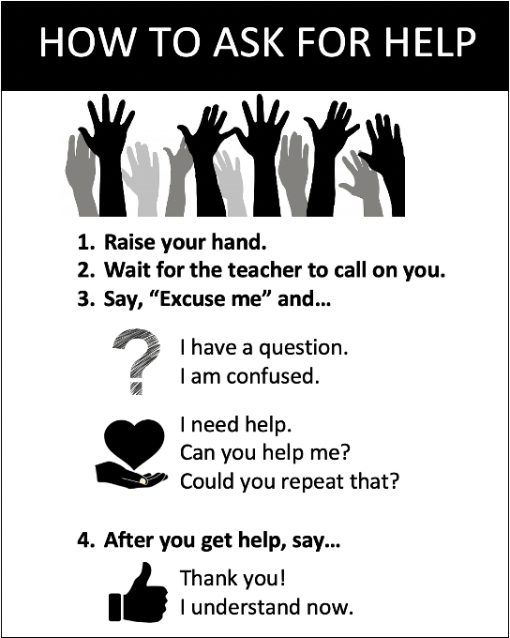
TETE MODULE 5 - INCREASING CLASSROOM INTERACTION
Anchor Charts
Anchor charts are a tool to support students’ language use.
Teachers can create anchor charts with students during a lesson or prepare them before class.
Display them on the classroom walls or whiteboards.

Slide 14
TETE MODULE 5 - INCREASING CLASSROOM INTERACTION
Activities to Increase Classroom Interaction
Concentric Circles
Line Up
Turn and Talk
Guessing Games
Notes:
Questions techniques that are effective and you will see some examples how these can be carried out in your class

Slide 15
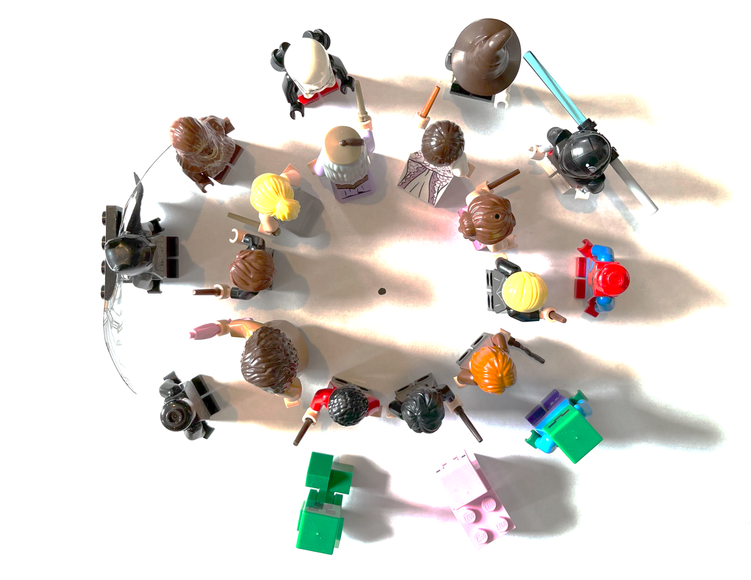
TETE MODULE 5 - INCREASING CLASSROOM INTERACTION
Activities to Increase Classroom Interaction
Concentric Circles

Slide 16
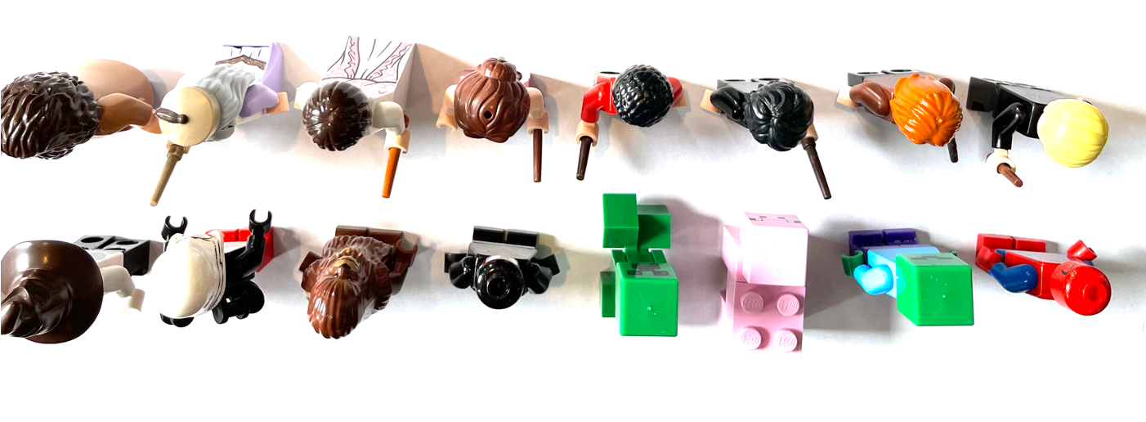
TETE MODULE 5 - INCREASING CLASSROOM INTERACTION
Activities to Increase Classroom Interaction
Line Up
Notes:
Questions techniques that are effective and you will see some examples how these can be carried out in your class

Slide 17
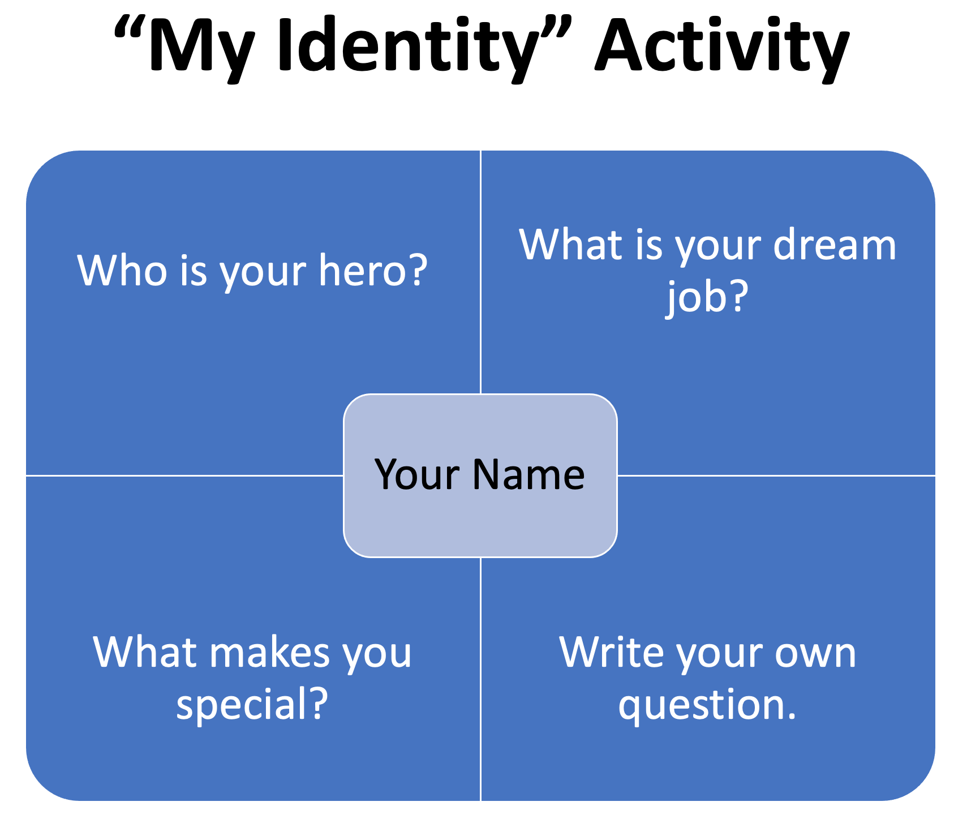
TETE MODULE 5 - INCREASING CLASSROOM INTERACTION

Slide 18
TETE MODULE 5 - INCREASING CLASSROOM INTERACTION
Activities to Increase Classroom Interaction
Turn and Talk
Look at your partner.
Listen to your partner.
Speak quietly to your partner.
Turn to the front when done.
Wait quietly.
A quick routine where students turn and talk to a partner.

Slide 19


TETE MODULE 5 - INCREASING CLASSROOM INTERACTION
Activities to Increase Classroom Interaction
Guessing Game:
What’s in my Backpack?
Anchor Chart
Expressions for asking for information for this topic
Q: What do you use it for?
A: I use it to...
Q: Do you use it to…?
A: Yes, I use it to…
Q: Is it a…?
A: Yes, it is a...

Slide 20
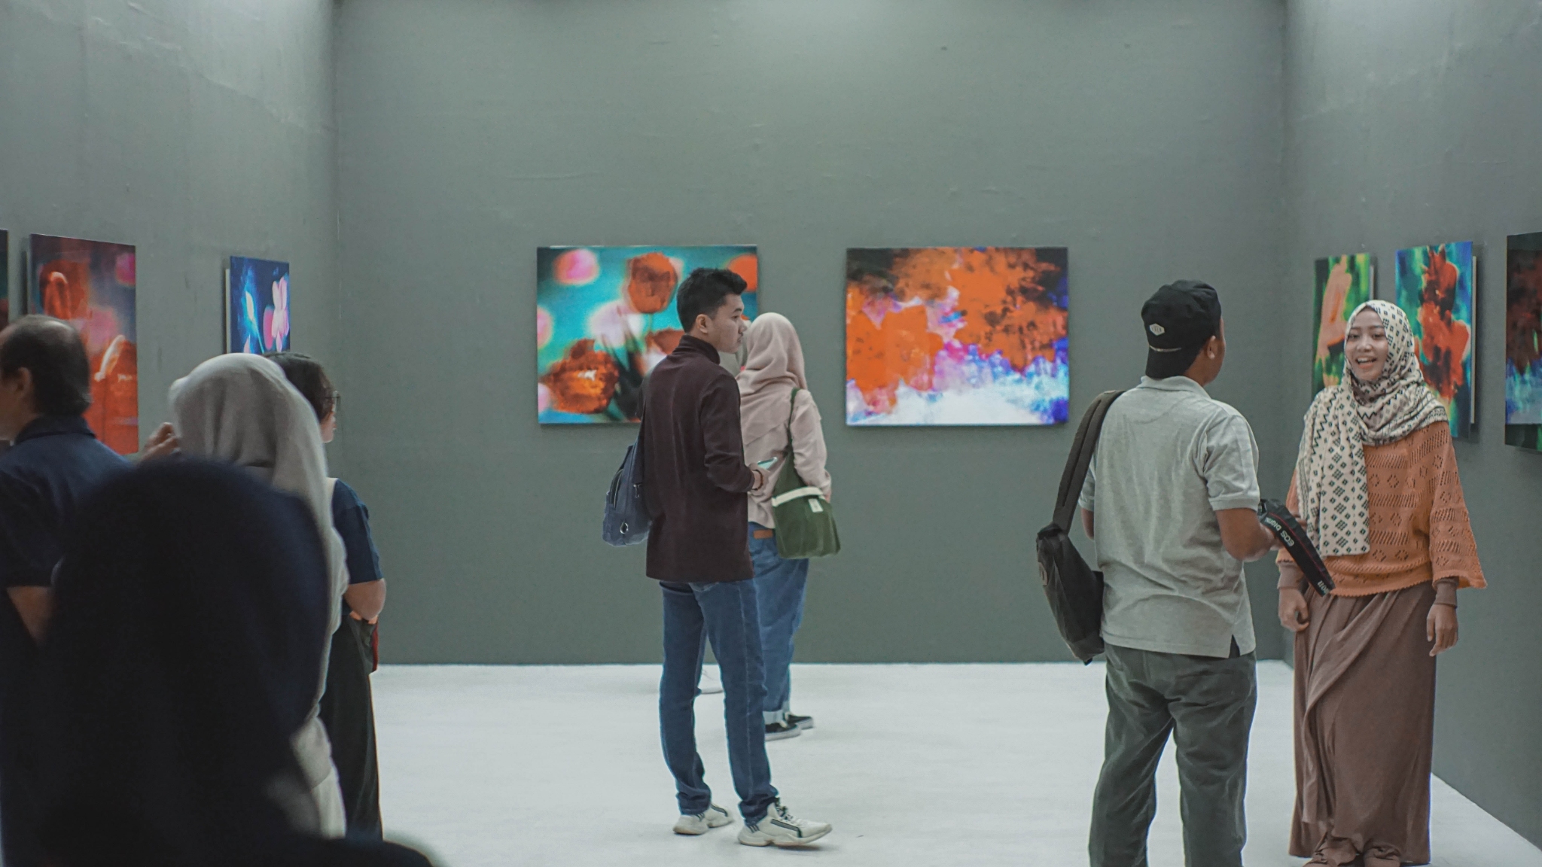
TETE MODULE 5 - INCREASING CLASSROOM INTERACTION
Increasing Interaction Activity from Saidakhon
An imaginary trip to Museum of Inventions.
It is an effective activity to provide authentic usage of the language.
It is a Q&A between a guide and visitors.
Interaction: Pupils work in threes. One guide and two visitors.
Materials: Pictures of various inventions.
Step 1. Hang the pictures of inventions to the different parts of classroom.
The names of inventors and dates of inventions are written on the bottom.
Step 2. Tell the students that one of them will be a museum guide and two will be visitors.
Distribute each student a small piece of paper in which they can find either a GUIDE or a TOURIST.
The number of tourists outweigh the guides. Proportion 2/1.
Step 3. Ask students to line up. Tourists-on the left, Guides- on the right
They stand face-to-face.
Now two tourists together can choose themselves one guide.
Step 4. Tell students that they will tour the museum of inventions.
They will walk around the classroom to see the exhibitions (e.g. pictures of inventions),
and have conversation about them. Visitors ask questions and Guides should try to answer them.

Slide 21

TETE MODULE 5 - INCREASING CLASSROOM INTERACTION
MYSTERY BOX
One student puts hand in Mystery Box.
Other students ask Yes/No questions about it (e.g., Is it big? Is it hard? Is it soft?)

Slide 22
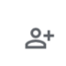
TETE MODULE 5 - INCREASING CLASSROOM INTERACTION
TETE Portfolio
Groups | Portfolio Shared | Portfolio NOT Shared
Group 1 | 6 | 14
Group 2 | 11 | 9
Group 3 | 5 | 15
Group 4 | 5 | 15
Group 5 | 10 | 8
Group 6 | 10 | 13
Share portfolio with georgemasontete@gmail.com by May 31st!

Slide 23


TETE MODULE 5 - INCREASING CLASSROOM INTERACTION
https://sites.google.com/view/tete-portfolio-template
Home Page: Brief Introduction
Module 0: Orientation
Module 1: Building Routines
Module 2: Clear Instructions
Module 3: Effective Q & A
Module 4: Comprehension & Feedback
Module 5: Classroom Interactions
Mid-Point Reflection
Create
Reflect

Slide 24


TETE MODULE 5 - INCREASING CLASSROOM INTERACTION
Mid-Point Reflection
Hmmm. I wonder how this reflection is different from the Module reflections I’ve written? What do I need to do for my Mid-Point Reflection?
Notes:
sample reflection prompts

Slide 25
TETE MODULE 5 - INCREASING CLASSROOM INTERACTION
Mid-Point Reflection
Prepare - Look back on the content of Modules 0 and 1 - 5. Review the content of each module and read the reflections you wrote in each module.
Think - Reflect upon your own learning across these modules. Reflect on where you started, what you knew and were comfortable with before the program, and think about 1) what you have learned, 2) what new knowledge has been the most meaningful to you, particularly with regard to communicative language approaches, and 3) how you and your teaching practice may have changed.
Notes:
sample reflection prompts

Slide 26
TETE MODULE 5 - INCREASING CLASSROOM INTERACTION
Mid-Point Reflection
Write - Now, using our three modes of reflection in the Taggart Pyramid (that we introduced in Module 0), please respond to the three following areas:
Describe ((Technical Mode)- provide a brief listing or description of what stands out in the modules /in your learning
Connect (Contextual Mode) - in what ways does what you have described/listed above connect to readings, new research, new practices
Make Deeper Connections and consider Impact (Dialectical Mode) - this is the mode where you add to/expand upon the Connections section and consider the impact of your learning. You might use some of the following questions to help you as you reflect: Why is your new learning or are these new practices important? If you were able to try out some of the new approaches or strategies, what were the results for you? for your students? How would you like to work on implementing these new practices moving forward?
Notes:
sample reflection prompts

Slide 27
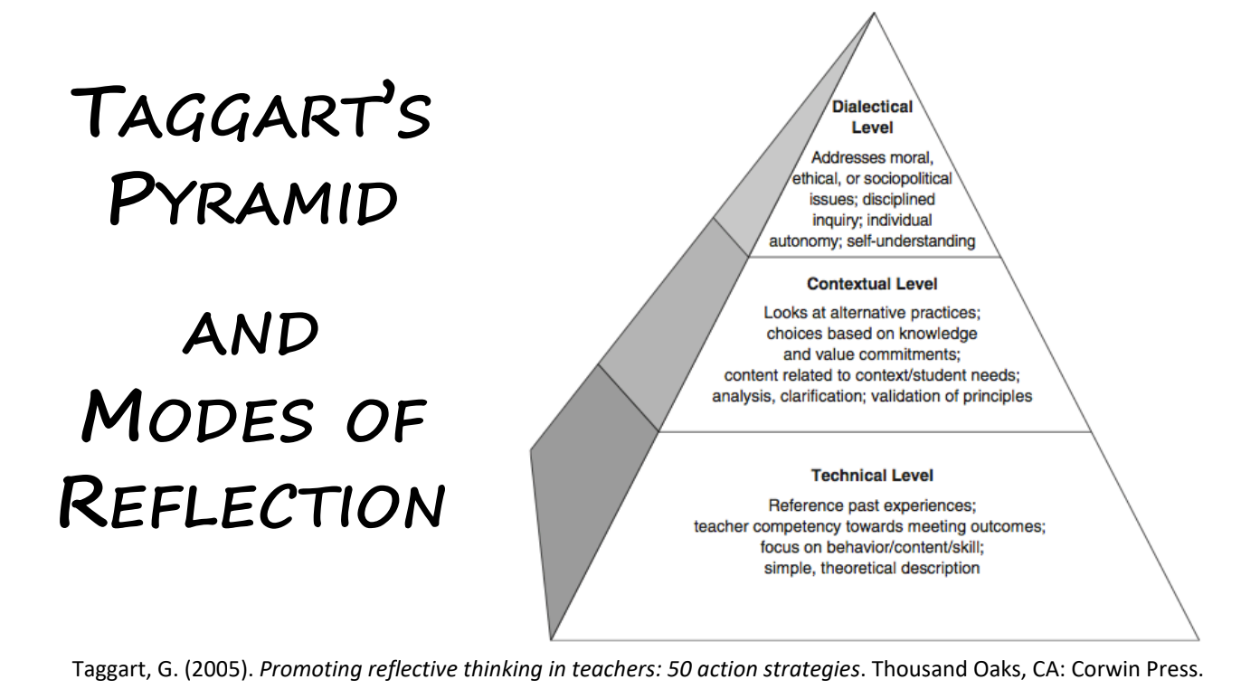
TETE MODULE 5 - INCREASING CLASSROOM INTERACTION
Notes:
sample reflection prompts

Slide 28
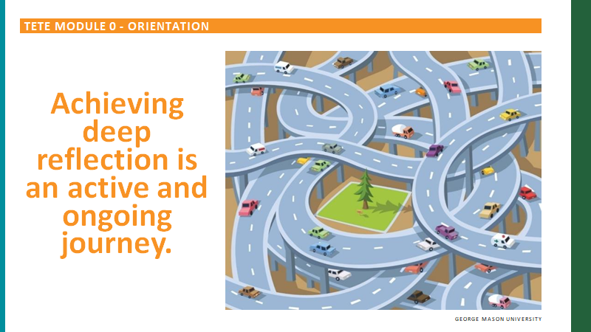
TETE MODULE 5 - INCREASING CLASSROOM INTERACTION
AND Remember!

Slide 29

TETE MODULE 5 - INCREASING CLASSROOM INTERACTION
Still Have Questions?
Ask your Community of Practice in Telegram
Reach out for help:
  TETE Portfolio:
aevmenov@gmu.edu
  Reflection:
rfox@gmu.edu
Notes:
GIVE ANYA’s EMAIL

Slide 30
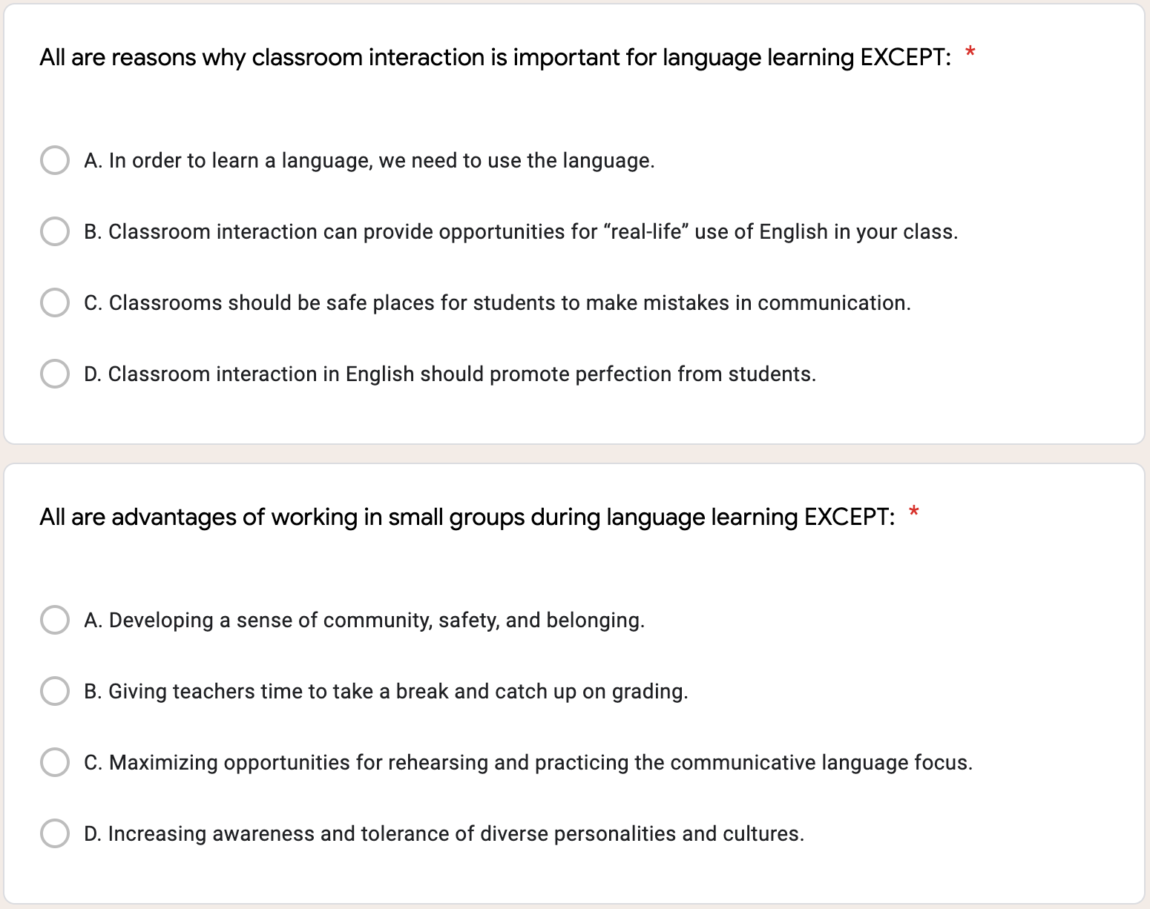
TETE MODULE 5 - INCREASING CLASSROOM INTERACTION

Slide 31
TETE MODULE 5 - INCREASING CLASSROOM INTERACTION

Slide 32
TETE MODULE 5 - INCREASING CLASSROOM INTERACTION

Slide 33
TETE MODULE 5 - INCREASING CLASSROOM INTERACTION
EXIT TICKET - TIME FOR D.E.A.R.
Drop Everything And Reflect
What is one new thing from Module 5 that you will apply to your instruction?
How will it help you increase your classroom interaction and get your students to speak out?
Now we will do our Module 5 Exit Ticket!
Click on the link in the chat box.
Notes:
What are your biggest challenges
- increasing classroom interaction?
- getting your students to speak out?

Slide 34
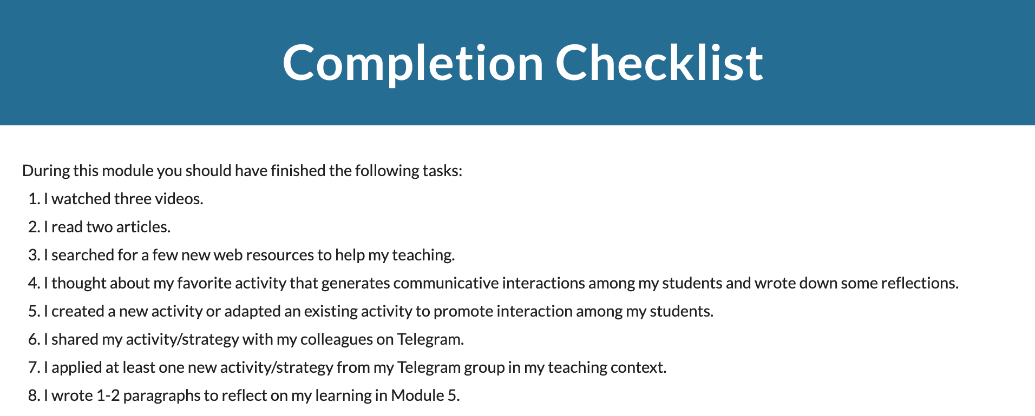
TETE MODULE 5 - INCREASING CLASSROOM INTERACTION
What is due on Sunday, May 30th?
You must have your Portfolio created by May 30th!

Slide 35
TETE MODULE 5 - INCREASING CLASSROOM INTERACTION
ANNOUNCEMENTS
Module 6: PTRA - Plan, Teach, Reflect, Adust
will be announced on Monday, August 9, 2021!
Portfolios with Modules 0-5 are due on June 6th!
Mid-Point Reflections are due on June 13th!
NEXT WEBINAR
Friday, August 13th
7:00-8:00 PM Uzbekistan Time

Slide 36
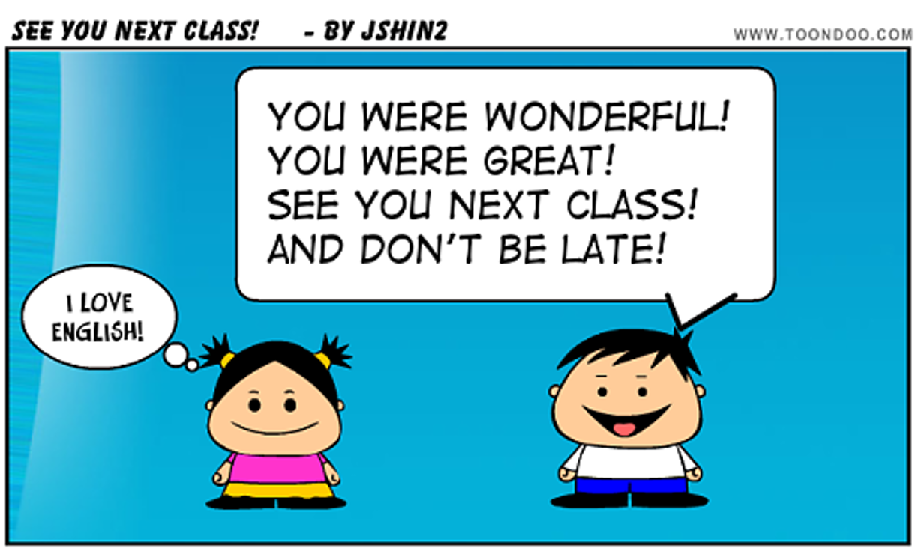
TETE MODULE 5 - INCREASING CLASSROOM INTERACTION
Farewell Routine

Slide 37
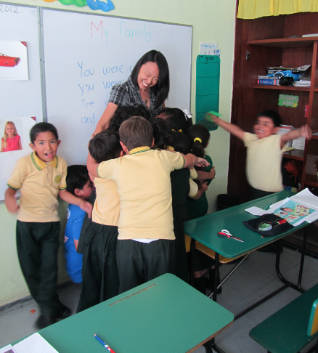
TETE MODULE 5 - INCREASING CLASSROOM INTERACTION
Goodbye Song
Goodbye! It’s time to go.
Time to go.
Time to go.
Goodbye! It’s time to go.
See you later!
From Welcome to Our World published by National Geographic Learning

