Slide 1

TEACHING ENGLISH THROUGH ENGLISH
Module 6 - PTRA - Plan, Teach, Reflect, Adjust
Friday, August 13, 2021
Rebecca Fox, Ph.D
Woomee Kim, M.A.
Fox, R., & Kim, W. (August, 2021). PTRA - Plan, Teach, Reflect, Adjust. Workshop webinar presented for the Teaching English through English online professional development program (Cohorts I & II): Module 6. U.S. Embassy in Tashkent funded English Speaking Nation Program in Uzbekistan (online). https://bit.ly/3fHLn23

Slide 2
TETE MODULE 6 - PTRA: PLAN, TEACH, REFLECT, ADJUST
Recalling Our Learning in Modules 0-5
Module 0: Introduction to our journey into deep reflection
Module 1: Building routines in English
Module 2: Giving Clear Instructions
Module 3: Effective Question and Answer
Module 4: Checking Comprehension and Answer
Module 5: Increasing Classroom Interaction
The focus on the first 5 modules, plus Module 0, was to open the door to many new possibilities for interactive, engaged teaching and learning in our English classrooms.
NOW, we are going to incorporate these new strategies and approaches into reflective, interactive, goal-oriented lessons.
Let’s Go!
Notes:
Reading says “non-traditional”, but another way to think of these types of questions is to think of them as “interactive” student responses.

Slide 3
TETE MODULE 6 - PTRA: PLAN, TEACH, REFLECT, ADJUST
Module 6
Webinar Agenda:
Module 6 content and strategies for effective lesson planning, teaching, reflecting, and adjusting
Q & A about aspects of Lesson Planning and Module 6 content
Continuing to deepen our understanding of Reflection as it relates to lesson planning

Slide 4

TETE MODULE 6 - PTRA: PLAN, TEACH, REFLECT, ADJUST
Purpose of Module 6: To prepare you to design & develop lesson plans, and delve deeper into reflective teaching practice
By the end of this module, you will be able to:
plan, teach, reflect, and adjust lesson plans that promote effective communicative language practice in your classroom
develop an effective lesson plan for English learners that teaches language through meaningful context and promotes communicative interaction using engaging activities
design effective lesson plans for English learners using the following steps: warm up, presentation, practice, application, and wrap up

Slide 5
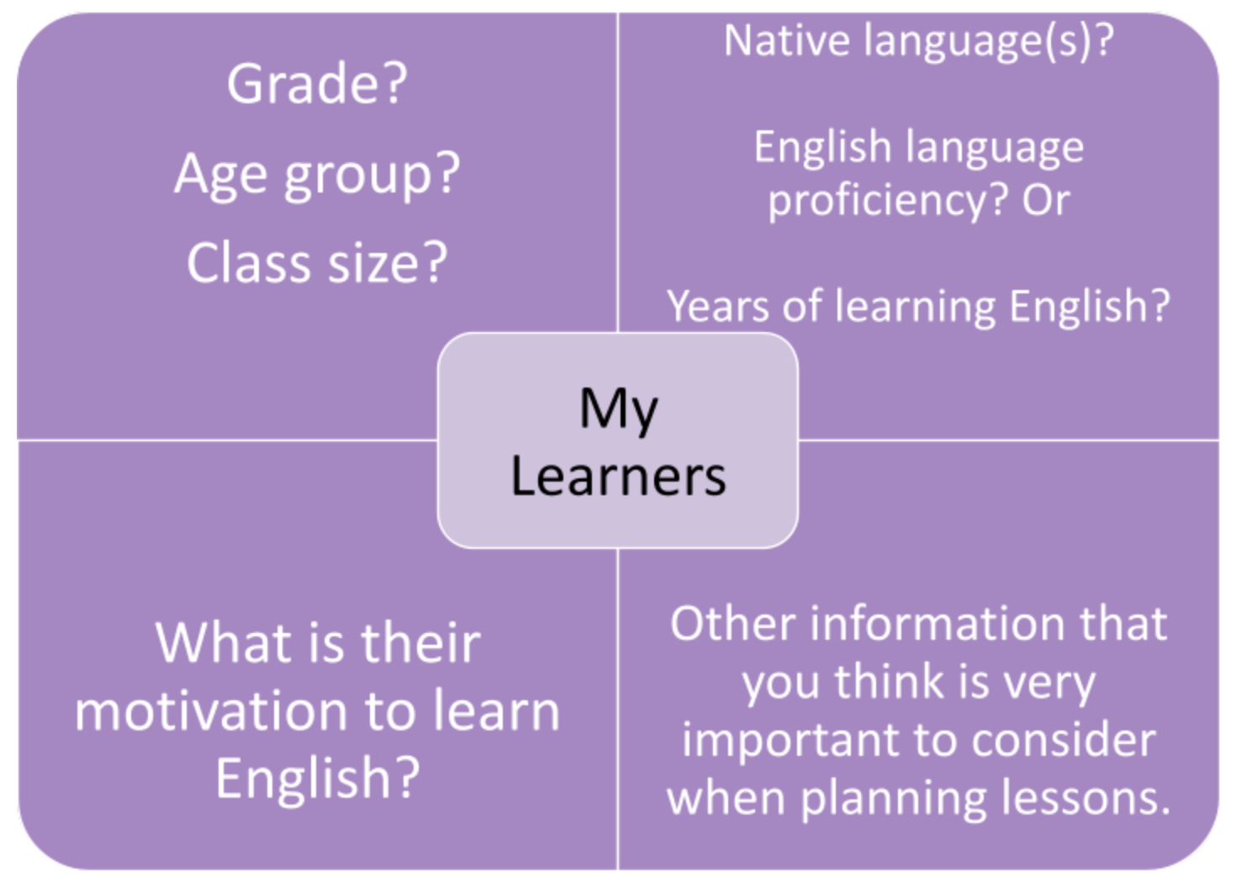
TETE MODULE 6 - PTRA: PLAN, TEACH, REFLECT, ADJUST
Effective lessons . . . .
Start with your learners and classroom context in mind:
Who are your learners?

Slide 6
TETE MODULE 6 - PTRA: PLAN, TEACH, REFLECT, ADJUST
Approaches for Developing
EFFECTIVE Lessons Using PTRA
What is PTRA? How do I plan effectively?
Consider the important process of thinking & inquiry that are involved here!
Setting Objectives: SWBAT
Engage in Steps to lesson planning: WPPAWF
  Thematic Unit Planning
Incorporate Reflective Teaching
  Engage in Reflection to Adjust your teaching

Slide 7
TETE MODULE 6 - PTRA: PLAN, TEACH, REFLECT, ADJUST
Why is it important to PLAN for classroom interaction for language learning?
YOUR TURN!
Please type your answers into the chat box or raise your hand to say an answer!
Notes:
Bring up notions of teaching English through English, WHY it’s important to plan for this (it won’t just happen),

Slide 8
TETE MODULE 6 - PTRA: PLAN, TEACH, REFLECT, ADJUST
Why is it so important to PLAN carefully and thoughtfully for interactive language learning?
Effective lesson planning brings together the wonderful new strategies from Modules 0 - 5 and makes them come alive!
To promote the use of English, we must set the stage in many ways
Students need multiple opportunities to use authentic, “real-life” language and augment “every day” vocabulary in English
Students exchange creative ideas and build collaborative relationships while supporting their language acquisition authentically
Planning is important, but it isn’t enough! We need to look at the results of our planning as we teach: Remember, WHAT students learn and CAN DO is a result of our careful and thoughtful lesson planning

Slide 9
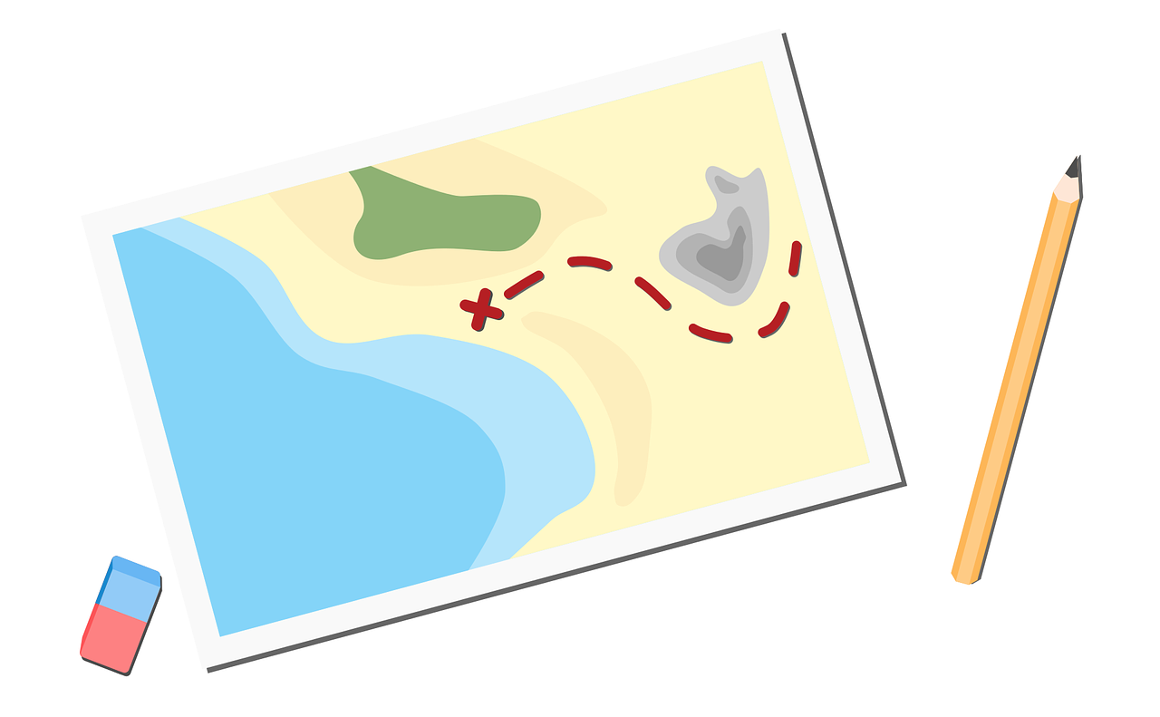
TETE MODULE 6 - PTRA: PLAN, TEACH, REFLECT, ADJUST
Writing Objectives:
The teacher thinks: By the end of this lesson/unit,
SWBAT - “Students will be able to . . .”
Keep the end point in mind
Be concrete
Use an observable action

Slide 10

TETE MODULE 6 - PTRA: PLAN, TEACH, REFLECT, ADJUST
Example: Let’s take a look back at our Module 6 Objectives!
By the end of the module, you will be able to:
plan, teach, reflect, and adjust lesson plans to promote effective communicative language practice in their classrooms
develop an effective lesson plan for English learners that teaches language through meaningful context and promotes communicative interaction using engaging activities
design effective lesson plans for English learners using the following steps: warm up, presentation, practice, application, and wrap up

Slide 11
TETE MODULE 6 - PTRA: PLAN, TEACH, REFLECT, ADJUST
Let’s take a deeper look at the Module 6 Objectives!
By the end of the module, you will be able to:
plan, teach, reflect, and adjust lesson plans to promote effective communicative language practice in their classrooms
develop an effective lesson plan for English learners that teaches language through meaningful context and promotes communicative interaction using engaging activities
design effective lesson plans for English learners using the following steps: warm up, presentation, practice, application, and wrap up
(Note that all of the objectives begin with a verb, an action!)

Slide 12
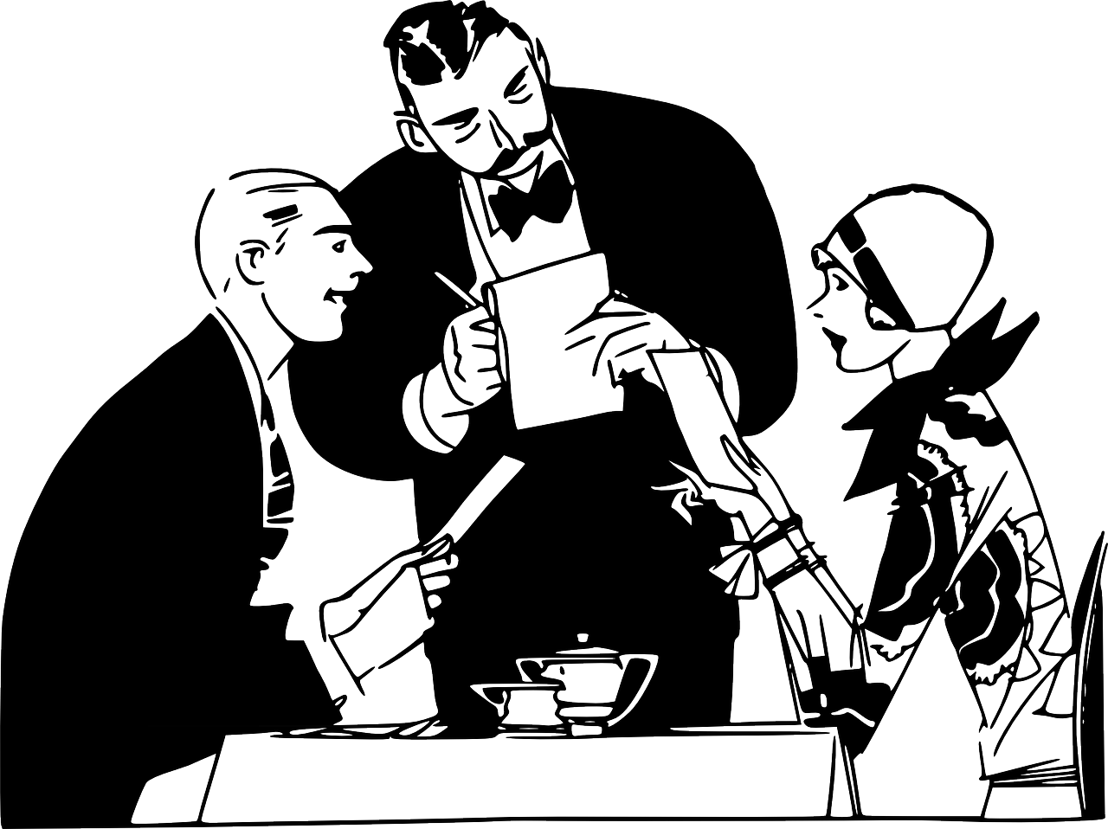
TETE MODULE 6 - PTRA: PLAN, TEACH, REFLECT, ADJUST
What are some concrete and observable objectives you might write for a lesson covering “At the Restaurant”?
Think: As a result of this lesson At the Restaurant, students will be able to (SWBAT)…
YOUR TURN!
Please type ONE concrete objective into the chat box
or raise your hand to say an answer!

Slide 13
TETE MODULE 6 - PTRA: PLAN, TEACH, REFLECT, ADJUST
6 Steps to Lesson Planning: WPPAWF
Warm-up
Presentation
Practice
Application
Wrap-up
Follow-up

Slide 14
TETE MODULE 6 - PTRA: PLAN, TEACH, REFLECT, ADJUST
Activating WPPAWF:
Brainstorm ideas from Modules 1-5
Warm-up
Presentation
Practice
Application
Wrap-up
Follow-up
Notes:
let’s think about how to call on them to insert some of the interactive activities WHILE they are thinking about these steps.
HOW will the content from Modules 1 - 5 and 0 help them to create a rich, language environment that is interactive, engaged, and IN English?

Slide 15
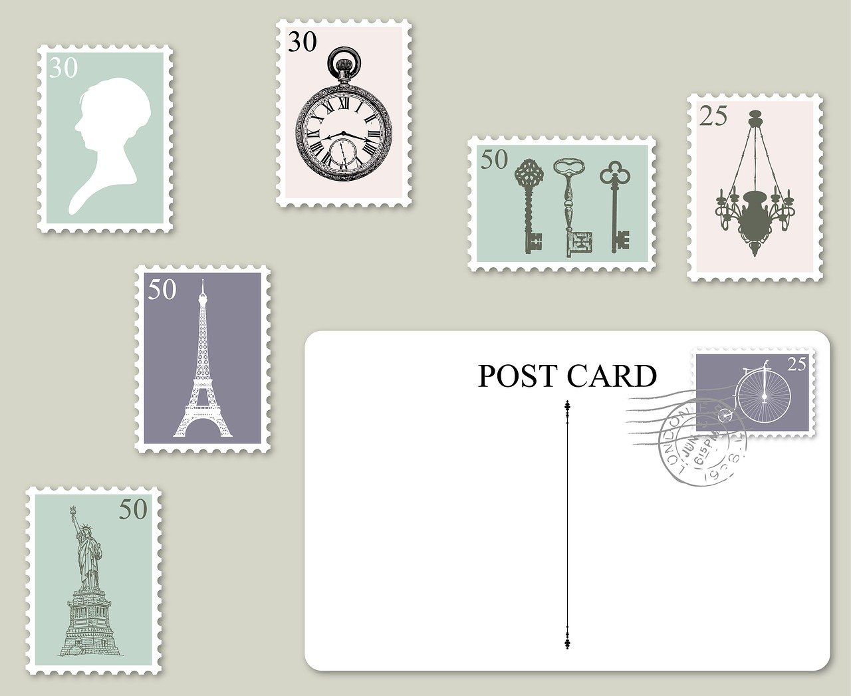
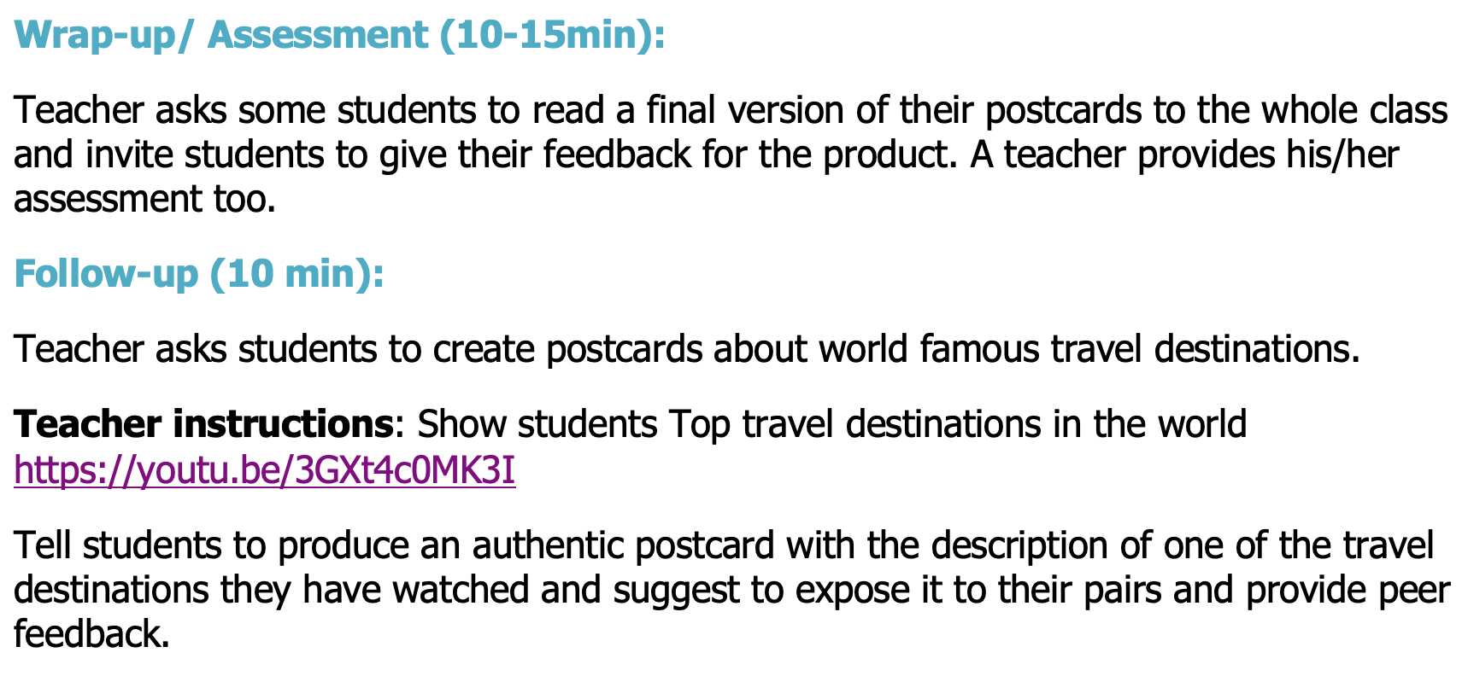
TETE MODULE 6 - PTRA: PLAN, TEACH, REFLECT, ADJUST
6 Steps of a Lesson with Improvements from Lola Uzakova
“Write a Postcard”

Slide 16
TETE MODULE 6 - PTRA: PLAN, TEACH, REFLECT, ADJUST
Think about some challenges you might face as you create communicative lesson plans.
Now, what do you think will be the most helpful to you to overcome these challenges?
YOUR TURN!
Please type your answers into the chat box
or raise your hand to share an answer!

Slide 17

TETE MODULE 6 - PTRA: PLAN, TEACH, REFLECT, ADJUST
"There are three types of lessons:
The one we plan to teach;
the one we actually teach;
and the one we wish we had taught."
- Unknown

Slide 18


TETE MODULE 6 - PTRA: PLAN, TEACH, REFLECT, ADJUST
PTRA: Incorporating Reflection & Adjustment into your Planning
Hmm m, how am I teaching during my lesson (Reflection IN Action: what is going well, what isn’t, and why? )
I want to think deeper about what happened in the lesson after finish teaching (Reflection ON Action).
What can I do to improve my future lesson?
Reflect to Adjust!
Notes:
What might I do to bring my students into their own learning?
sample reflection prompts

Slide 19
TETE MODULE 6 - PTRA: PLAN, TEACH, REFLECT, ADJUST
PTRA: Incorporating Reflection & Adjustment into your Planning
Hmm, I notice that two groups weren’t as engaged as much as I’d hoped :-(.
What can I do to bring ALL my students into the restaurant role play?
They had fun, but I want to look more at WHAT my students actually learned from this lesson - maybe tomorrow I’ll create an exit reflection where they tell me what they liked and what they learned.
Let’s see what the students tell me
so I can make changes.
Reflect to Adjust!
Notes:
What might I do to bring my students into their own learning?
sample reflection prompts

Slide 20
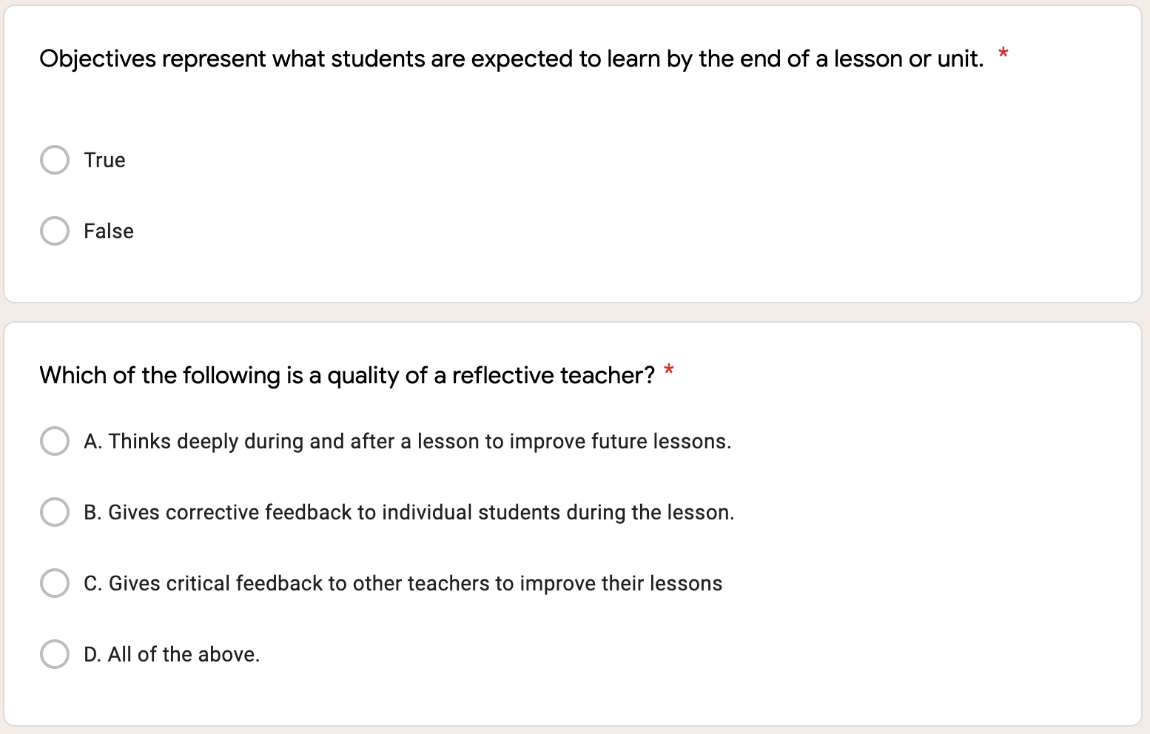
TETE MODULE 6 - PTRA: PLAN, TEACH, REFLECT, ADJUST

Slide 21
TETE MODULE 6 - PTRA: PLAN, TEACH, REFLECT, ADJUST

Slide 22
TETE MODULE 6 - PTRA: PLAN, TEACH, REFLECT, ADJUST

Slide 23
TETE MODULE 6 - PTRA: PLAN, TEACH, REFLECT, ADJUST
EXIT TICKET - TIME FOR D.E.A.R.
Drop Everything And Reflect
What is one new thing from Module 6 that you will apply to your communicative lesson planning process?
Now we will do our Module 6 Exit Ticket!
Click on the link in the chat box.
Notes:
What are your biggest challenges
- increasing classroom interaction?
- getting your students to speak out?

Slide 24

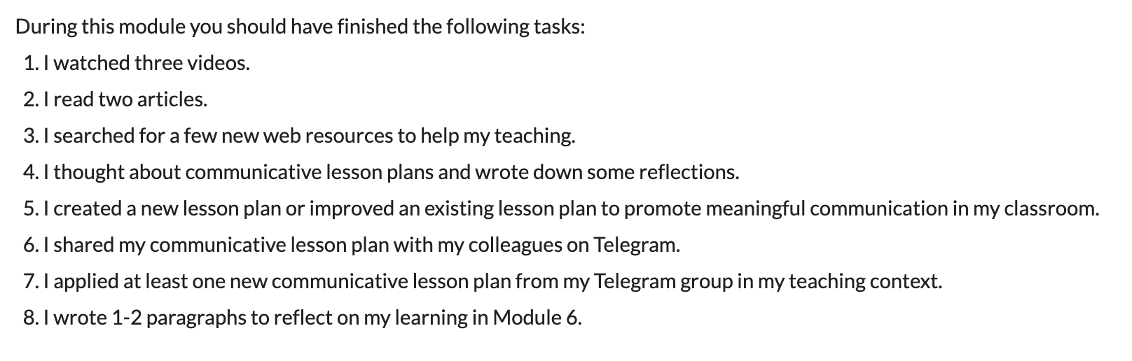
TETE MODULE 6 - PTRA: PLAN, TEACH, REFLECT, ADJUST
What is due on Sunday, August 15th?
Remember to continue building your portfolios!

Slide 25
TETE MODULE 6 - PTRA: PLAN, TEACH, REFLECT, ADJUST
ANNOUNCEMENTS
Module 7: Extending Textbook Activities
will be announced on Monday, August 16, 2021!
NEXT WEBINAR
Friday, August 20th
7:00-8:00 PM, Uzbekistan Time

Slide 26

TETE MODULE 6 - PTRA: PLAN, TEACH, REFLECT, ADJUST
Goodbye Song
Goodbye! It’s time to go.
Time to go.
Time to go.
Goodbye! It’s time to go.
See you later!
From Welcome to Our World published by National Geographic Learning

