Slide 1
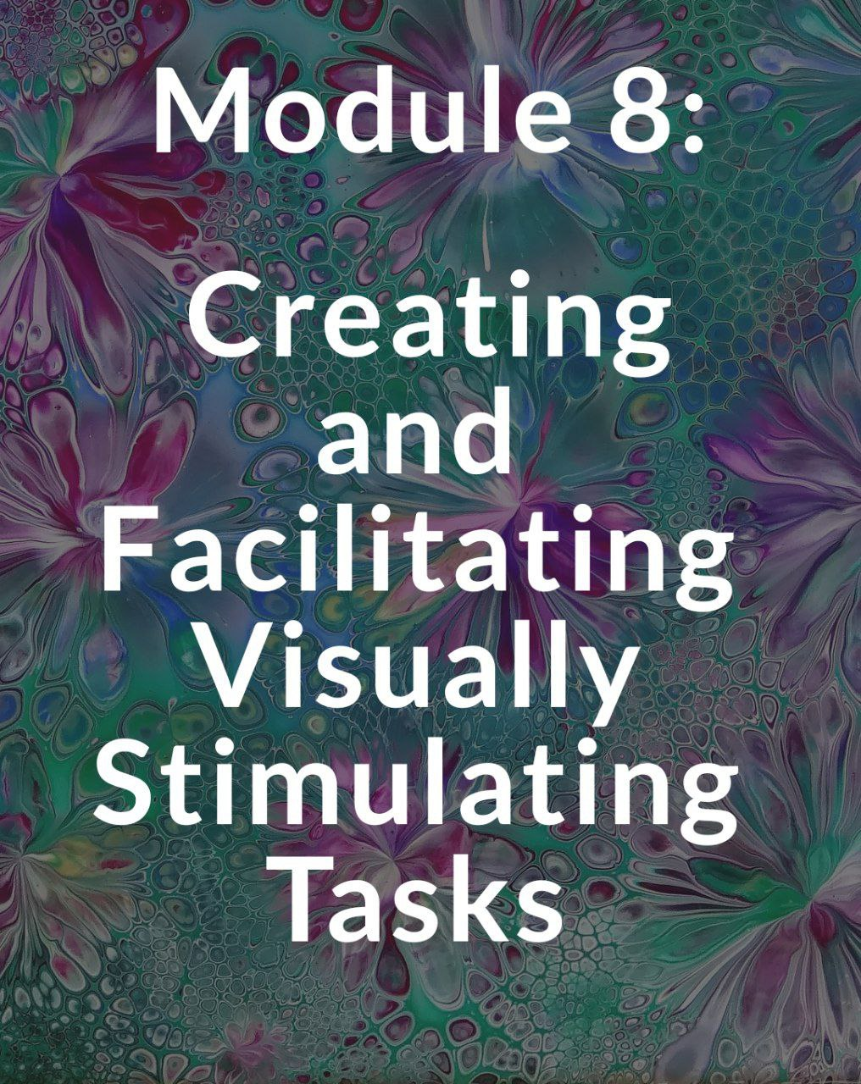

Slide 2
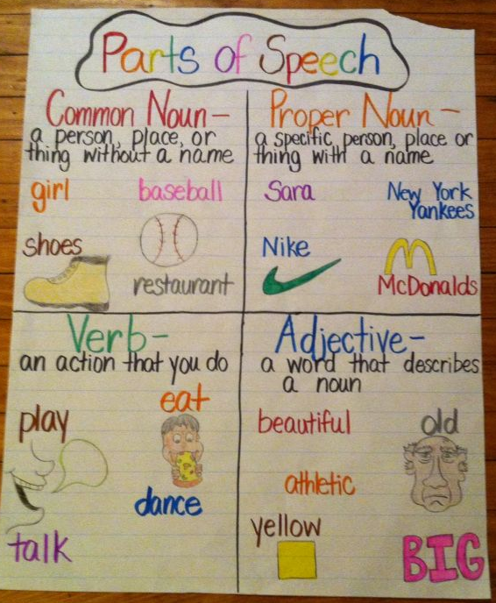
English language students need visual input and stimulation to make meaning of their learning. Visually stimulating tasks can include both instructional resources and learning resources. competence.
Notes:
How can you make this more interactive?

Slide 3
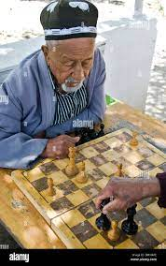
As an instructional resource, visual tools can illuminate language through content and cultural connections. Especially when real-life situations may not be possible to create in the classroom, visual tools are the “realia” that can make language visible to students. Engaging students with visually stimulating tasks for learning, such as examining images of a cultural practice, has the potential to elicit meaningful conversations and discussion.
Imagine your are teaching a topic of hobbies to 6th grade, how can you use realia or examples that are connected to their real life?

Slide 4
In this module, you will explore how language learning can ignite creativity and critical thinking, while also supporting students in their language learning and development of intercultural.

Slide 5
Visual tools can be as simple or as complex as you would like to make them. Let’s start simple.
Do you have a chalkboard, whiteboard, or poster board in your classroom?
These are all resources that can be used for visuals in instructional purposes. If you keep it simple, then you and your students will likely use them again and again for other language learning tasks and activities. Making visuals too complex for students can lead to confusion and unnecessary frustration. So, keep it simple.

Slide 6
Visual tools can be used in so many ways in the language classroom:
to activate prior
knowledge,
support language production,
integrate cultural realia,
assess student comprehension.

Slide 7
Apply What You Learned
Imagine you have a classroom, your students just completed drawing 16 different pictures of 16 different hobbies that young people like to do. What can you ask them to do to present their learning?
Think about the different activities that we have learned during our training course.

Slide 8
A graphic organizer
Organizers. A graphic organizer is
described as “a visual aid that helps language learners understand important ideas and their
relationship to one another. It can also help students learn key academic vocabulary and
grammar so that they can engage with each other about content area topics” (Wenniger, 2019).
Graphic organizers can be used throughout all academic and proficiency levels of language
learning
Notes:
https://drive.google.com/file/d/1cKYf06WJ2RtMyxELkgipzY8A4QY_CjfS/view?usp=sharing Share this Graphic organizer group

Slide 10
See-Think-Wonder
See-Think-Wonder from Harvard Project Zero (2019). This thinking routine
stimulates curiosity and sets the stage for critical thinking and inquiry with your students. First,select an image that focuses on an object, scene, or cultural event. The most interesting images for students to engage with include ones with people, action, or multiple objects that they can use to answer these three questions:
1) What do you see?
2) What do you think about that?
and 3) What does it make you wonder?

Slide 11
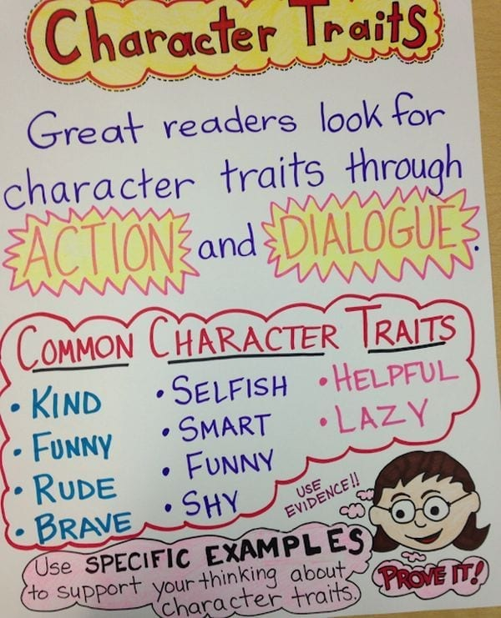
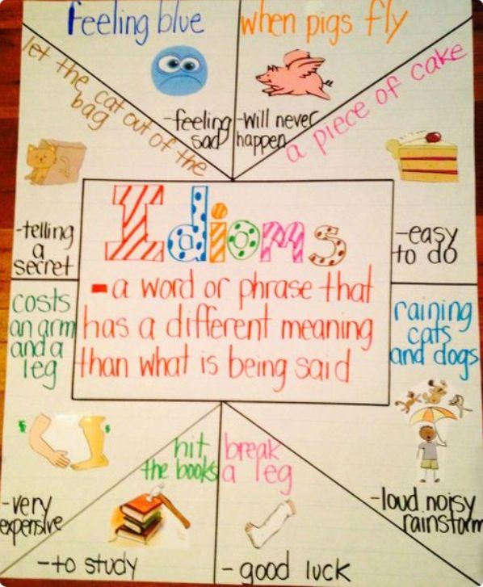
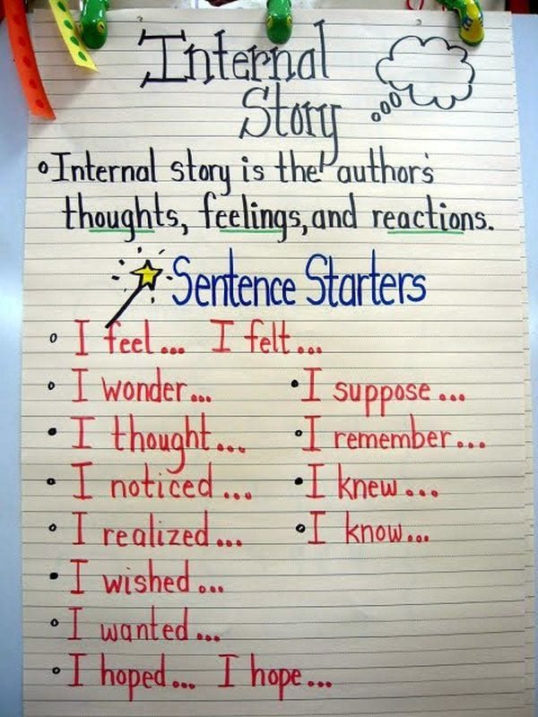
Anchor Charts

Slide 12
Word Walls
Word Walls is another strategy for making learning visually
stimulating. Incorporating word walls into your classroom is a way to build students’ vocabulary
recognition by making learning visible and interactive. Again, simplicity is key for this strategy
too. Some of the most useful word walls for students can be maintained by keeping it simple.
You can even make a section for synonyms and antonyms that students manipulate during review time. Most importantly, give your students ownership of the word wall and allow them to contribute and interact with it during class.

Slide 13
The KWLQ
The KWLQ chart is a variation of the KWL graphic organizer that can be used for assessing
students’ prior knowledge, learning, and remaining questions after introducing a topic. The K stands for the question “What do I Know?” The W is for “What do I Want to know?” The L is for “What did I Learn?” And the Q is for “What Questions do I still have?” Here is an image of what the graphic organizer looks like all together.

Slide 14
The KWLQ chart is a graphic organizer that teachers can use to quickly assess student
comprehension and engagement within a lesson or activity because it can be easily collected or
shared with the teacher.

Slide 15
The KWLQ chart is a graphic organizer that teachers can use to quickly assess student
comprehension and engagement within a lesson or activity because it can be easily collected or
shared with the teacher.

Slide 16
Apply What You Learned
Now we will divide the class into 4 groups.
You will create a sample visual resource. Choose a specific age, topic and objective for how you want your student to use this resource.
Group 1: Word Wall
Group 2: Anchor Chart
Group 3: KWLQ chart
Group 4: Graphic Organizer
Time: 10 minutes Prepare; 10 minutes present
Present by Gallery Walk, One person present to others
Notes:
https://drive.google.com/file/d/1cKYf06WJ2RtMyxELkgipzY8A4QY_CjfS/view?usp=sharing Share this link for Sample graphic organizers

Slide 17
Homework
This week you practice creating a simple visually stimulating resource for your class and post a picture in our Telegram group chat.
Share what students created after seeing your Model.
You will explain who it was created for, how the students used it to complete a specific task.

