Slide 1

TEACHING ENGLISH THROUGH ENGLISH
Module 9 - Facilitating Discussions and Debates
Friday, September 3, 2021
Rebecca Fox, Ph.D.
Kelley Webb, M.A.Ed.
Fox, R., & Webb, K. (September, 2021). Facilitating Discussions and Debates. Workshop webinar presented for the Teaching English through English online professional development program (Cohorts I & II): Module 9. U.S. Embassy in Tashkent funded English Speaking Nation Program in Uzbekistan (online). https://bit.ly/3COwuV7

Slide 2
TETE MODULE 9 - FACILITATING DISCUSSIONS AND DEBATES
Module 9
Webinar Agenda:
Discuss Module 9 content and share ways to incorporate cooperative learning and interactive language tasks, such as discussions and debates, for building language proficiency
Q & A about integrating and managing communicative activities in the language classroom
Module 9 Completion Checklist and Exit Ticket

Slide 3

TETE MODULE 9 - FACILITATING DISCUSSIONS AND DEBATES
Purpose of Module 9: To effectively facilitate discussions and debates
By the end of the module, you will be able to:
describe the benefits of communicative language teaching through discussions and debates and how to use them in the EFL classroom
explore various cooperative learning and interactive language tasks and strategies that build language proficiency and a classroom discourse community
develop higher order thinking questions that encourage critical thinking in the classroom
design ways you plan to integrate and manage learning activities that support a communicative approach for language learning in your classroom

Slide 4
TETE MODULE 9 - FACILITATING DISCUSSIONS AND DEBATES
Benefits of Communicative Language Teaching
Recall and Apply
Recalling our Module Content on interactive and communicative approaches for engaging students in the English language classroom,
think about your most important new learning.
NOW, use the chat box to share one new interactive activity you would like to apply with your
English language classes this academic year.

Slide 5
Creating a Classroom Culture for Authentic Interactions and
Interactive Discussions in English

Slide 6

TETE MODULE 9 - FACILITATING DISCUSSIONS AND DEBATES
Setting the Stage for
Authentic Discussion
Be sure vocabulary is in place
Prepare students with Sentence Starters/Frames and Anchor Pages to guide and reference
Model and role-play what you expect students to do in authentic discussion
Consider ways to purposely partner your students for interactive activities

Slide 7

TETE MODULE 9 - FACILITATING DISCUSSIONS AND DEBATES
Sentence Starters
provide an introduction phrase for students to complete
Sentence Frames
model how students should fill in specific vocabulary in context
Begin with easier sentences and increase level of difficulty as they are ready - Think about your students’ prior knowledge and proficiency level as you prepare.
Example Sentence Starters for
Interacting in Class Discussions
One interesting example I heard from my partner was _______________. I would like to add _________.
This example was interesting to me because _____________.
I agree with my partner that ______ and also think ______..
Thank you for that idea, but I somewhat disagree with my partner because I think that ___________.
My idea is similar to his/hers because we both said that …
My idea is a bit different than his/her idea because I think that ...

Slide 8

TETE MODULE 9 - FACILITATING DISCUSSIONS AND DEBATES
Jobs and Professions (Grade 9)
Vocabulary Word Bank:
journalist -creative
police officer -organized
teacher -patient
firefighter -empathetic
social worker -analytic
accountant -bank
clerk -museum
mechanic -station
artist -school
Sentence Frames:
A __(noun)_ is __(adjective)_ and ___.
The __(adjective) (noun) _works at the ___(place)__.
This interests me because I _(verb)__.
Anchor Pages
designed for students to use individually during the activity
no more than one page
display key vocabulary to use during the activity
include sentence frames to model types of responses expected to be used
provide space for students to add their own ideas during the activity

Slide 9
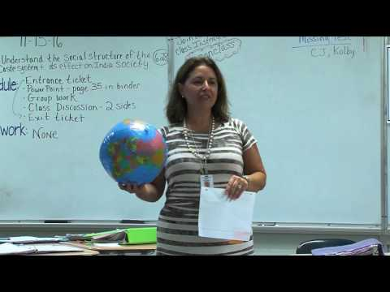
TETE MODULE 9 - FACILITATING DISCUSSIONS AND DEBATES
Supporting Productive Whole Classroom Discussions
Q1 - What do the students do at the start of the class and lesson? Why?
Cason, L. (2017). Classroom Discussion (Secondary). AppalachiaRCC. https://youtu.be/1vu_6KrUQLg

Slide 10
TETE MODULE 9 - FACILITATING DISCUSSIONS AND DEBATES
Supporting Productive Whole Classroom Discussions
Q2 - What strategies does this teacher use to engage students?
Cason, L. (2017). Classroom Discussion (Secondary). AppalachiaRCC. https://youtu.be/1vu_6KrUQLg

Slide 11
TETE MODULE 9 - FACILITATING DISCUSSIONS AND DEBATES
Supporting Productive
Whole
Classroom Discussions
Q3 - What are some of the discussion norms/expectations in this classroom?
Cason, L. (2017). Classroom Discussion (Secondary). AppalachiaRCC. https://youtu.be/1vu_6KrUQLg

Slide 12


TETE MODULE 9 - FACILITATING DISCUSSIONS AND DEBATES
What do Productive Partners do?
Make eye contact
Listen attentively
Consider voice level when speaking
Ask for clarification or restate what is said for understanding
Will you please repeat what you said?
Asking for Clarification
Can you explain what you mean by…?
I don’t quite understand. Do you mean…?

Slide 13
TETE MODULE 9 - FACILITATING DISCUSSIONS AND DEBATES
What factors do you consider when partnering your students?
One factor to consider is the student’s ______________________.
An important factor to consider is __________________________.
A essential factor to consider is _______________________.
Use one of these sentence starters to share your ideas
about this topic.

Slide 14

TETE MODULE 9 - FACILITATING DISCUSSIONS AND DEBATES
Checklist for Partner Activities
when possible, arrange seating for discussions or do elbow partners or a foursome with turn and talk (pairs squared)
purposefully partner students (vary by ability, proficiency) and ask their preferences for partners too
model expectations by role playing with a set of students
establish roles (A/B)- student selection or teacher determination; everyone participates (that is a role, too!)
prepare visible references (anchor charts/pages, vocabulary)
provide language supports (sentence starters, word bank)

Slide 15
TETE MODULE 9 - FACILITATING DISCUSSIONS AND DEBATES
What are some ways that you prepare or “set the stage” for your students to productively participate in discussions?
LET’S HEAR FROM YOU!
Please type your answers into the chat box or raise your hand to share your answer!

Slide 16
Creating Classroom Norms for Discussion Activities

Slide 17




TETE MODULE 9 - FACILITATING DISCUSSIONS AND DEBATES
Getting Started with Discussions and Debates
Use your public voice (slower and louder) when speaking in front of the whole class
Be active listeners
Take turns speaking, being respectful of time allotted
Follow the model and guidelines for the discussion/debate activity

Slide 18
TETE MODULE 9 - FACILITATING DISCUSSIONS AND DEBATES
Academic Language for Discussions and Debates
Agreeing………………………………….....I agree with (name) that...
Disagreeing…………………………..I have a different point of view...
Stating Opinions…………………...…..In my opinion / I believe that...
Clarifying……......I have a question about...Will you please explain…?
Reporting Other’s Ideas…..S/he indicated that...We determined that...
Requesting Responses…………...Do you agree?...What do you think?
Making a Suggestion…..You might consider....We might think about...
Interjecting……….....I have another idea...May I add something else?
Encourage your students to add to this list as you continue in these interactive discussions!

Slide 19
TETE MODULE 9 - FACILITATING DISCUSSIONS AND DEBATES
Nosirjon Davlatov - Group 7
Debates are new type of activity for most language learners. Teachers cannot start debates in their classrooms right away. Students will need thorough instruction and preparation before trying debating as a language development tool.
I have designed an activity Warm-up for Debating for Grade 11 students where they try to identify appropriate language and phrases for different stages of a debate and develop further ideas/arguments.
Step 1.
Teacher sticks the following topics for debating phrases at different parts of the classroom:
Introducing a point
Enumeration of points
Expressing a personal opinion
Expressing pros and cons
Expressing doubt
Step 2
Students approach one by one to the desk of the teacher and choose one piece of paper which contains one of the debating phrases. They read their phrases and go and stand at the corresponding topic. According to the lesson plan there should be three students at each topic.
The following are sample debating phrases:
The question of…
Another example of this is..
The way I see it, …
While admitting that…one should not forget that…
I wonder if you realize that…
Step 3.
Now teacher introduces the debate topic “Driving should be allowed from the age of five.” Students work in groups of three and try to finish their phrases and develop them with more ideas so that they can make sense in a real debate.
For example, one of the groups may develop their arguments as follows: “I wonder if you realize that at this age children are in the crucial period of their school life and have numerous academic requirements to cope with. Therefore, they had better concentrate more on school subjects as they have important exams ahead which affect their final grades.”
Notes:
https://docs.google.com/document/d/1SlmcbImqlbPXYQ_mOGXG8DObhpVq57X5/edit?usp=sharing&ouid=107557841873379183486&rtpof=true&sd=true

Slide 20
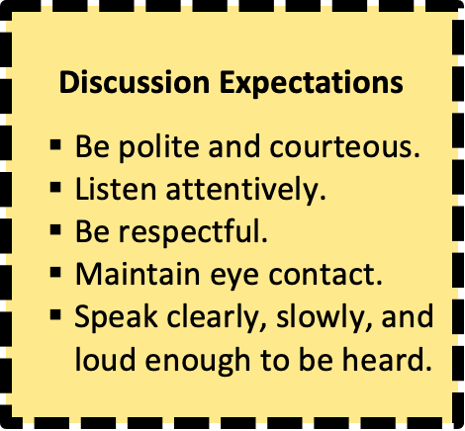

TETE MODULE 9 - FACILITATING DISCUSSIONS AND DEBATES
Managing Cooperative Learning Activities
Prepare materials in advance
Set time limits - set your timer
Assign students with roles
Provide clear expectations for during discussions and transitions
Anchor Chart
Also consider these questions:
How will you monitor student performance? Will you circulate and make notes?
How will you check for student understanding?

Slide 21

TETE MODULE 9 - FACILITATING DISCUSSIONS AND DEBATES
Set time limits
Prepare extra stations
Model the process
Keep a checklist of expectations
Gonzalez, J. (2013). Chat Stations for Class Discussion. Cult of Pedagogy. https://youtu.be/eFUL4yP0vqo

Slide 22
TETE MODULE 9 - FACILITATING DISCUSSIONS AND DEBATES
What classroom norms do you create in advance to promote positive interactions in your class?
LET’S HEAR FROM YOU!
Please type your answers into the chat box or raise your hand to share your answer!

Slide 23
Considerations and Refinements

Slide 24
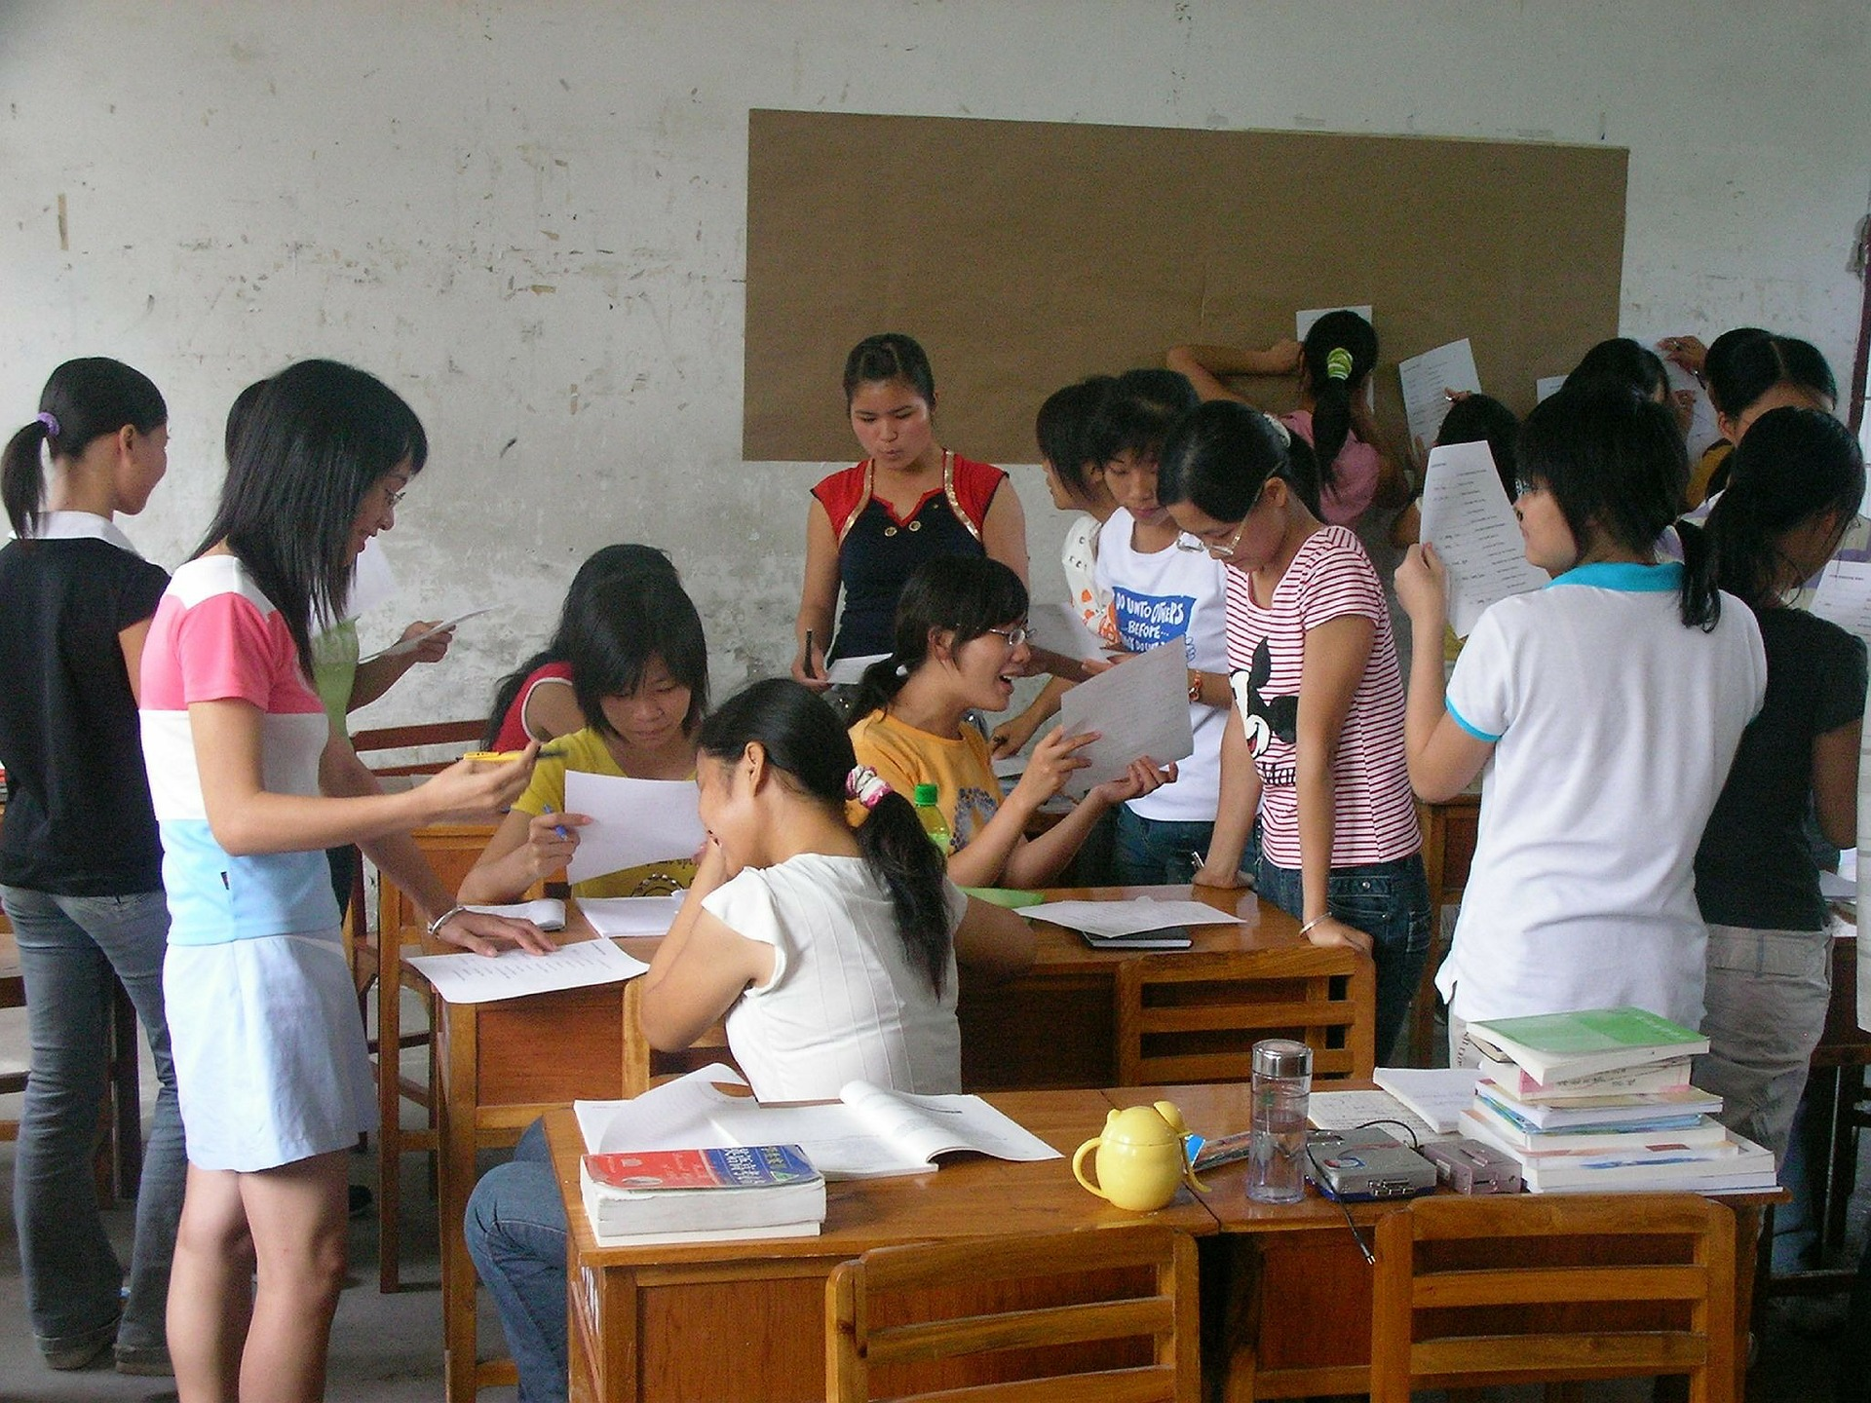
TETE MODULE 9 - FACILITATING DISCUSSIONS AND DEBATES
Working with your Classroom Space to Provide for Discussions and Debates

Slide 25

TETE MODULE 9 - FACILITATING DISCUSSIONS AND DEBATES
Engaging Students to Maximize Participation
PROMPTS THAT LACK ACCOUNTABILITY
Share your answer with your partner.
Are the directions clear?
Would anyone else like to share their answer?
Can anyone tell me some examples?
Who knows the answer to this question?
PROMPTS THAT ENGAGE STUDENTS
Turn to your elbow partner and state what foods are best to eat as a healthy snack and why you think this.
(Student), please tell us what you/we will do in this discussion activity.
(Student), please nominate the next person to share their response.
Students, in your groups, create a list of 3-5 examples together to share with the class.
With your partner, decide the answer that you will present to the class.

Slide 26

TETE MODULE 9 - FACILITATING DISCUSSIONS AND DEBATES
Developing Higher Order Thinking Questions
HOT Questions…
extend responses beyond one/two words
spark students’ depth of knowledge
prompt critical thinking through developing opinions and stating perspectives
They can also be modeled using…
relevant grammatical concepts and vocabulary being studied
current events or topics of interest & adding new vocabulary!
Questions

Slide 27
TETE MODULE 9 - FACILITATING DISCUSSIONS AND DEBATES
Maxsitaliyeva Sayyora - Group 12
Hello dear colleagues. Module 9 is very beneficial in terms of how to organize discussion lessons and debates. Here I tried to create some HOT questions for discussion on topic environment and ideas for debate.
HOT questions for discussion to the theme “Save the world” unit 2, 11th grade textbook.
1. You are passing a place where a lot of trees are being cut down. What is your attitude toward this situation?
2. Would you totally give up using your car to reduce air pollution and global warming? Why/why not?
3. What can we do about water pollution? What do you think is your duty on this issue?
4. What ecological problems do you have in your living area and what solutions do you suggest? Give some examples.
5. Imagine that you are assigned as a responsible person for the ecology and the environment of your school. Share at least five deeds that you would do to change the current condition.
Ideas for debate
Children should not have their own smartphone before 16.
The government should control advertisements on TV.
Subjects at school should not be compulsory.
Parents should choose a career for their children.

Slide 28


TETE MODULE 9 - FACILITATING DISCUSSIONS AND DEBATES
Is it HOT or Not?
What would happen if I only ate potato chips at every meal of the day?
What are some healthy food choices for snacks and why?
Do you like potato chips or pretzels?
Do you eat snacks during the day?

Slide 29

TETE MODULE 9 - FACILITATING DISCUSSIONS AND DEBATES
Students Leading the Discussion
What do you notice about the classroom arrangements for this class discussion?
How do these students interact with each other?
What does the teacher do / say during the discussion?
EngageNY. (2016). Teacher uses questioning techniques to engage students - Example 19. https://www.youtube.com/watch?v=1WQCWF7ENfI

Slide 30
TETE MODULE 9 - FACILITATING DISCUSSIONS AND DEBATES
Cooperative Learning & Interactive Language Tasks
Activities for Building Practice and Proficiency
Tower Build
Information Gap Activities
Jigsaw Activities - https://youtu.be/euhtXUgBEts
Games - Bucket of Prompts / Would you rather?
FlipGrid - Recording and responding to conversations - www.flipgrid.com

Slide 31
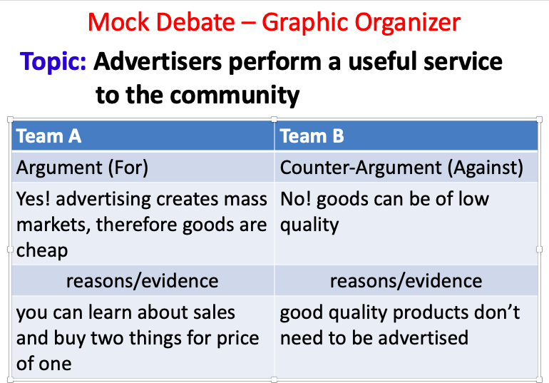
TETE MODULE 9 - FACILITATING DISCUSSIONS AND DEBATES
Oleg Beliy - Group 10 - https://bit.ly/38CTWHo
The debate activity I want to share is called Mock Debate.
Topic “Advertisers perform a useful service to the community”
This activity is effective because it gives students an opportunity to share their thoughts on the topic and be engaged into the discussion and debate. You’ll be surprised how many arguments and counter-arguments can children offer!
Step 1: Divide students into two groups.
Step 2: Ask one group to make up arguments ‘for’
Step 3: Ask the other group to make up arguments ‘against’
Step 4: Listen to each other arguments and try to comment on them

Slide 32
TETE MODULE 9 - FACILITATING DISCUSSIONS AND DEBATES
As you think about creating more interactive discussions and debates in your classroom, what challenges do your foresee?
How might you think about overcoming these challenges?
YOUR TURN!
Please type your answers into the chat box
or raise your hand to share an answer!

Slide 33


TETE MODULE 9 - FACILITATING DISCUSSIONS AND DEBATES
Module 9: Wrap-up & Reflect
Wrap-up: Think about ways that you might scaffold your students’ learning to create a classroom culture where discussion and interactive idea-sharing become the norm.
Reflect Actively and Creatively:
In what ways might I also begin to prepare for and scaffold a culture of discussion and integrate new processes with my younger learners? This can set the stage for more involved interactive activities when they become secondary learners.

Slide 34
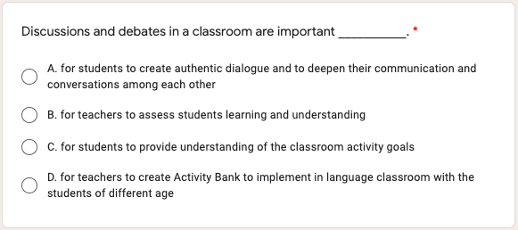
TETE MODULE 9 - FACILITATING DISCUSSIONS AND DEBATES
Let’s Review!
Type your answer in the Chat Box.

Slide 35
TETE MODULE 9 - FACILITATING DISCUSSIONS AND DEBATES
The answer is...

Slide 36
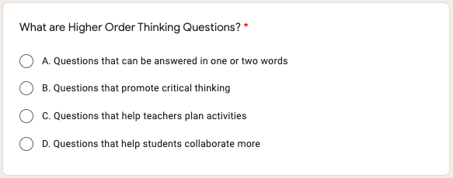
TETE MODULE 9 - FACILITATING DISCUSSIONS AND DEBATES
Let’s Review!
Type your answer in the Chat Box.

Slide 37
TETE MODULE 9 - FACILITATING DISCUSSIONS AND DEBATES
The answer is...

Slide 38
TETE MODULE 9 - FACILITATING DISCUSSIONS AND DEBATES
EXIT TICKET - TIME FOR D.E.A.R.
Drop Everything And Reflect
What is one new thing from Module 9 that you learned about facilitating interactive and communicative activities in your classroom that you would like to try out this academic year?
Now we will do our Module 9 Exit Ticket!
Click on the link in the chat box.
Notes:
Module 9 Exit Ticket Link - https://forms.gle/wQEjpWhMEHHjf3E49

Slide 39
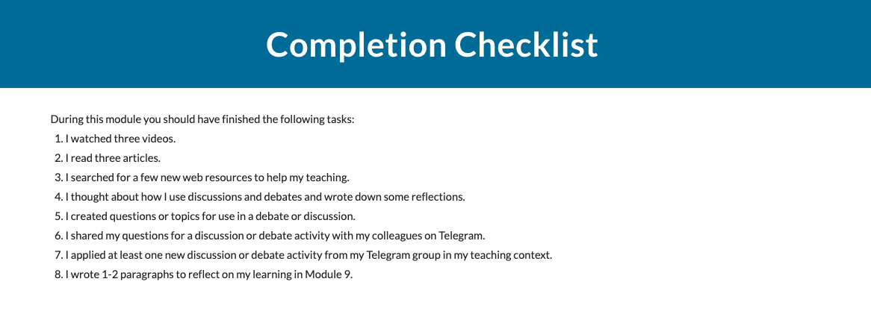
TETE MODULE 9 - FACILITATING DISCUSSIONS AND DEBATES
What is due on Sunday, September 5th?
Remember to continue building your portfolios!

Slide 40
TETE MODULE 9 - FACILITATING DISCUSSIONS AND DEBATES
ANNOUNCEMENTS
Module 10: Managing Cooperative Activities
will be announced on Monday, September 6th!
FINAL WEBINAR
Friday, September 10th
7:00-8:00 PM Uzbekistan Time

Slide 41

TETE MODULE 9 - FACILITATING DISCUSSIONS AND DEBATES
"If you talk to a man in a language he understands, that goes to his head.
If you talk to him in his own language, that goes to his heart."
‒ Nelson Mandela

Slide 42

TETE MODULE 9 - FACILITATING DISCUSSIONS AND DEBATES
QUESTIONS?
You can communicate with the TETE Academic Team at georgemasontete@gmail.com or
through your Telegram Chat groups.

Slide 43
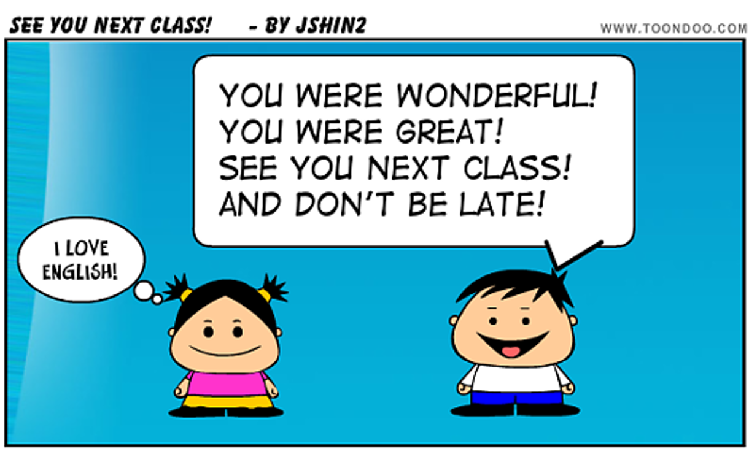
TETE MODULE 9 - FACILITATING DISCUSSIONS AND DEBATES
Farewell Routine

