Slide 1
Modules
0 and 1
Teaching English Through English

Slide 2
TETE MODULE 0 - ORIENTATION
Teaching English Through English
What is TETE?

Slide 3
TETE MODULE 0 - ORIENTATION
Teaching English through English (TETE) is ten-module professional development (PD) course, that will help you:
Learn how to build a classroom environment that encourages real communication in English
Explore effective approaches for teaching English while enhancing your ability to use English to manage language learning activities in the classroom.
Share ideas with peers in a community of practice (CoP)
Apply course content to your teaching context
Practice using English for a variety of instructional purpose

Slide 4
TETE MODULE 0 - ORIENTATION
Learning Objectives and Learner Outcomes
By the end of this course, you will be able to:
explain and use various interactive and communicative approaches for teaching English to secondary students.
identify the language needed to carry out various instructional tasks in the classroom.
prepare classroom language needed for various types of lessons and activities.
practice and improve ability to manage your classroom and develop effective language tasks in English.
develop lesson plans and teaching materials that reflect accurate English.
create a reflective teaching portfolio for continuous improvement in teaching English through English.
engage in deep, critical reflection within a CoP of English language teaching professionals in your country.

Slide 5
TETE MODULE 0 - ORIENTATION
Purpose of Module 0: To prepare you for a successful start in this professional learning process
By the end of the module, you will be able to:
explain the goals and outcomes for this course.
navigate through the Teaching English Through English Google site
get to know your colleagues in an online community of practice.
describe what it means to be a reflective English language educator
Welcome Video: https://www.youtube.com/watch?v=36DuNIwVZwI&t=292s

Slide 6
TETE MODULE 0 - ORIENTATION
The Role of Reflection & Critical Reflection in our TETE Modules and in your teaching
What is the reflection?
What does it mean to be a reflective English language educator?
Write briefly in the chat box what the word “Reflection” means to you.
Let’s look at the term, critical reflection
We often have different understandings across languages and cultures
What does this term mean to you?
Please refer to the video and the PPT that are part of Module 0 for more details

Slide 7

Activating Reflection and Critical Reflection into Each Module
In each module, there will be specified times when you will be called to Stop and Reflect on aspects of your learning and to apply your thinking to your classroom.

Slide 8
Reflection and Critical Reflection
In Module 0, we also lay the foundation for understanding that here are levels of reflection that can help you develop as critically reflective English educators.
You will also learn about the differences and benefits of reflection-IN-action that occurs while teaching, and Reflection-ON-action, reflection that occurs after teaching.

Slide 9
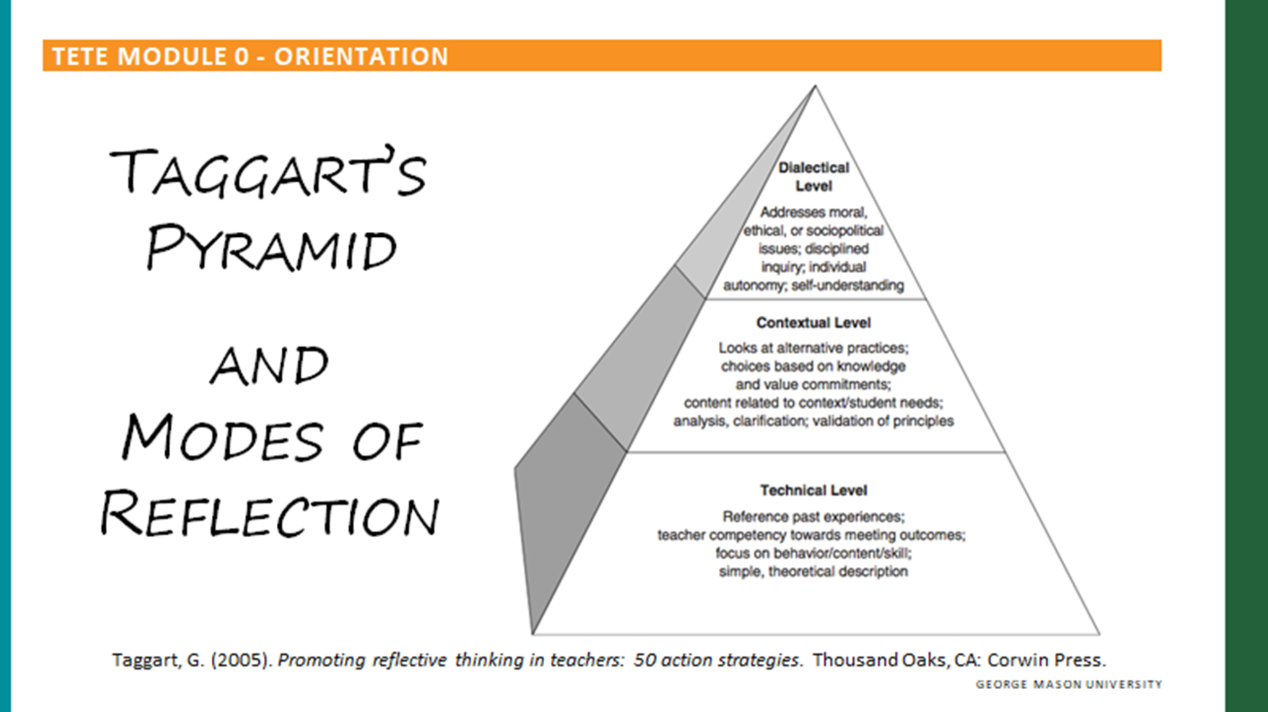

Slide 10

TETE MODULE 0 - ORIENTATION
Reflection is at the heart of our work in TETE. Within each module, reflection will help educators to:
Consider classroom practice through new eyes
See changes in our practice & the responses of our students to new learning approaches
Be engaged in the teaching-learning cycle WITH our students
Connect with new content in the modules in highly thoughtful ways
Take an inquiry stance toward our teaching - ask questions and investigate answers
See our own growth and change as educators over time
Connect more deeply with colleagues
Become reflective teacher leaders
Critical reflection serves to connect and engage educators with new content as you make sense of your new learning through TETE and activate new knowledge in your contexts

Slide 11
TETE Module 0 - Orientation
Think of one impactful moment in your teaching that had a profound influence on you and your teaching.
Describe that moment and reflect on why it was significant.
Try to describe it and it’s influence on them.
What questions did it raise for you?
What is or will be the significance for you and your students?
Were there any changes you made in your teaching as a result of this moment?
Remind participants to take notes while listening to their peers.

Slide 12
TETE MODULE 0 - ORIENTATION
“I never stop learning,
because life never stops teaching.”

Slide 13

TETE MODULE 0 - ORIENTATION

Slide 14
Teaching English through English
Module 1
Building Routines in English

Slide 15
Objectives
Module 1
I can describe the purpose and process of good instructional routines using English to maintain a well-managed and communicative learning environment.
I can apply some of the new classroom routine expressions in the classroom
I can share some of the effective instructional routines you want to use in your current classroom to increase the use of English

Slide 16
Welcome Message
Effective classroom routines have purpose and meaning far greater than simple management. As you strive to establish good routines toward a communicative language classroom environment, your students will increase in learning and use of the target language. This module will help you explore different classroom routines you can apply to your teaching context while using English. You will learn the purpose and examples of classroom routines to enhance the use of English in your communicative classroom.

Slide 17
What is your favorite classroom routine that you regularly use when teaching?
What part of the class do you use this routine - in the beginning, when transitioning, or at the end of a lesson? Why is it your favorite?
What do you do to involve your students in the daily routines in your classroom?

Slide 18
TETE MODULE 1 - BUILDING ROUTINES IN ENGLISH
Why are routines important?
YOUR TURN!

Slide 19
TETE MODULE 1 - BUILDING ROUTINES IN ENGLISH
Why are routines important?
Promote classroom management
Establish shared expectations with your students
Reduce stress for language learning
Develop students’ independence and confidence
Provide smooth transitions from one stage of the lesson to the next
Give more opportunities to use English communicatively!

Slide 20
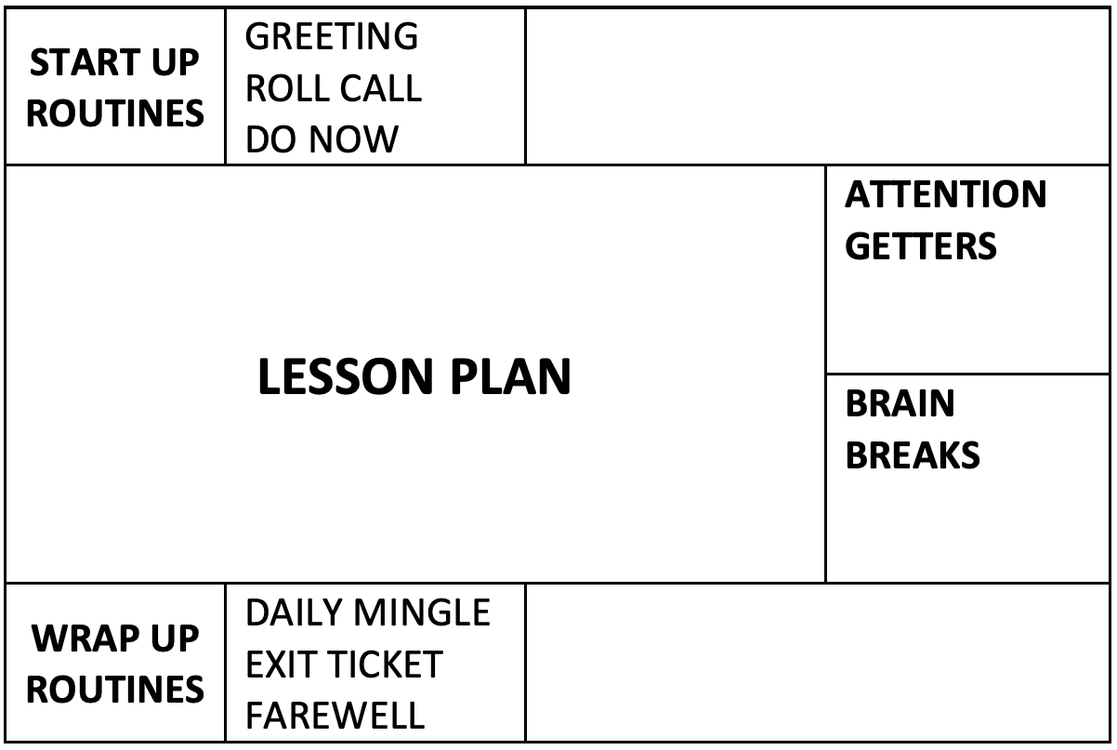
TETE MODULE 1 - BUILDING ROUTINES IN ENGLISH
Plan your lessons with routines!
Routine Chart
by Joan Kang Shin

Slide 21
TETE MODULE 1 - BUILDING ROUTINES IN ENGLISH
Plan your lessons with routines!
Routine Chart
by Joan Kang Shin

Slide 22
TETE MODULE 1 - BUILDING ROUTINES IN ENGLISH
Start-Up Language Routines
Greetings: follow-up questions, students greet each other
Roll call: attendance
Warm-up routines: weather chart, visual aids, daily learning objectives

Slide 23

TETE MODULE 1 - BUILDING ROUTINES IN ENGLISH
https://youtu.be/XauhiNLr6L0?t=268

Slide 24
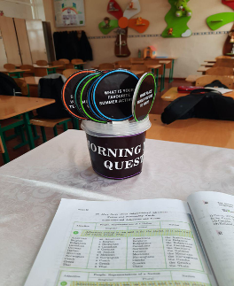
TETE MODULE 1 - BUILDING ROUTINES IN ENGLISH
Start-Up Language Routine from Shahnoza
Morning Meeting Questions
Questions:
Give one adjective to describe your morning.
What are you looking forward to this week?
What is one thing you are excited for this weekend?
What is your favorite place in our community?
What is one way you can show someone you care?
Who is your hero?
What does it mean to be a good friend?
What is one thing you want to learn this year?
If you could have any superpower, what would you choose?

Slide 25
TETE MODULE 1 - BUILDING ROUTINES IN ENGLISH
Do Now Routines
Do this routine at the start of every class
Write a “Do Now” on the board at the beginning of a lesson
Have a student read it out loud
Check for understanding

Slide 26
TETE MODULE 1 - BUILDING ROUTINES IN ENGLISH
Plan your lessons with routines!
Routine Chart
by Joan Kang Shin

Slide 27
TETE MODULE 1 - BUILDING ROUTINES IN ENGLISH
Wrap-Up Routines
Do this routine at the end of every class
The purpose is to reflect on the class
It can be done individually, in pairs, or in groups

Slide 28
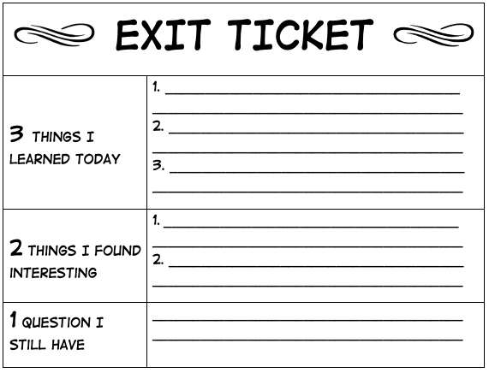

Exit Ticket - Wrap Up Routine
TETE MODULE 1 - BUILDING ROUTINES IN ENGLISH
Easy assessment routine
Teachers use it at the end of each class before students “exit” the class.
Students can show what they learned before they leave class.

Slide 29
TETE MODULE 1 - BUILDING ROUTINES IN ENGLISH
Wrap Up Daily Mingle
A daily mingle is a short activity where learners walk around the classroom and talk to each other.
It can be a good wrap-up routine.
Students practice speaking with one another and share their reflections.

Slide 30

TETE MODULE 1 - BUILDING ROUTINES IN ENGLISH
Wrap-Up Sample Questions
DISCUSS WITH A PARTNER!
What is one thing that you learned today?
What is one question that you still wonder?
What is one way someone helped you to learn?

Slide 31
TETE MODULE 1 - BUILDING ROUTINES IN ENGLISH
Daily Mingle Challenges:
Not enough time
Not enough space
Students are too noisy
How can we overcome these challenges?
YOUR TURN!

Slide 32

TETE MODULE 1 - BUILDING ROUTINES IN ENGLISH
Farewell Routine

Slide 33
TETE MODULE 1 - BUILDING ROUTINES IN ENGLISH
Routines for Everyday Language
Do a daily calendar activity (e.g. important events)
Involve students in classroom routines (e.g. jobs board)
Do a daily mingle

Slide 34
TETE MODULE 1 - BUILDING ROUTINES IN ENGLISH
Plan your lessons with routines!
Routine Chart
by Joan Kang Shin

Slide 35

Attention Getters
TETE MODULE 1 - BUILDING ROUTINES IN ENGLISH
Signals:
Bells
Whistles
Lights out
Clapping

Slide 36



Brain Breaks
TETE MODULE 1 - BUILDING ROUTINES IN ENGLISH
Shake Shakes: Shake one hand (or foot) for 3 seconds then the other. Repeat 5x.
Arm and Leg Stretch: Stretch arms and legs standing up or sitting down.
Breathing Break: Close your eyes and breathe in, breathe out (5x)
Nosey Ear: Get your left hand to touch your right ear lobe and then get your right hand to touch the tip of your nose. Then swap positions. Repeat 5x.
One Minute Dance Party: Play a song for one minute and let students dance (while seated if no space)

Slide 37
Wrap-up Reflection Questions
• What is one thing that you learned today?
• What is one question that you still wonder?
• What is one way someone helped you to learn?
For the wrap up at the end of the session, you can set up instructional routines such as paired or group reflection for sharing.
Your reflective wrap-up questions can be:

Slide 38

Homework
Telegram Group Discussion
Post your reflection in the Telegram group. Read your peers’ posts and comment at least to two posts by using ‘reply’ function in the Telegram chat.
(Handout )

