Slide 1

Teaching English Through English
Introductions

Slide 2
Teaching English Through English
Overview of The 6 Principles for Exemplary Teaching of English Learners

Slide 3
Objectives
Title. Overview of The 6 Principles for Exemplary Teaching of English Learners
I can…
understand the general purpose of this workshop.
- say the general notion and the concept of the 6Ps.
- prepare and deliver lessons effectively concerning to the learners interest.
- learn how to use activities for creating friendly learning atmosphere

Slide 4
Welcome Message
Good morning dear Colleagues,
Our team is pleased to have you with us. On behalf of all the organizers, coordinators, coaches of this project let us say Congratulations and welcome to the team!
Today, together with you we are going to start the next stage of this project, which are created an opportunity to enrich and enlarge your knowledge and skills in teaching English effectively. Together with you we are great and strong team.
We believe that what a strong group of people can accomplish together is much larger, far greater, and will exceed what an individual can achieve alone.

Slide 5
Daily Quote

Slide 6
Daily
Agenda
Warm up 15 minutes | Snowball: Name+Adjective
Class Rules 7 minutes | Class Rules
Preview. 10 minutes | Introduction to the workshop
Pair work 15 minutes | Experience – Scavenger Hunt
Individual/pair work 20 minutes | Overview. Think-Pair-Share
Individual work 13 minutes | Reflection. Activity Tracker Scavenger Hunt

Slide 7

Activity. Snowball: Name+Adjective
Use these Adjectives

Slide 8
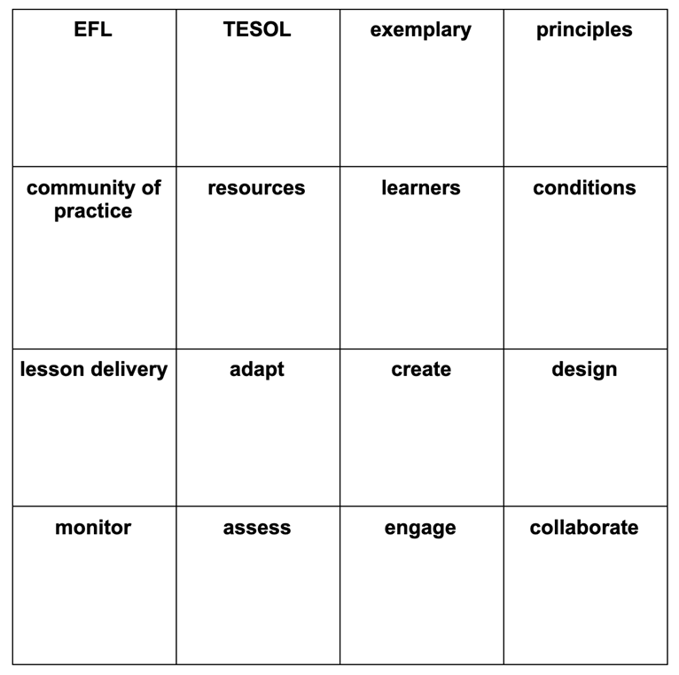
Topic. Overview of the 6Ps
Activity Scavenger Hunt

Slide 9

Topic. Overview of the 6Ps
Activity Scavenger Hunt

Slide 10

Topic. Overview of the 6Ps
Activity. Overview: Think-Pair-Share

Slide 11
Wrap-up Reflection Activity Tracker
Scavenger Hunt
1. What did we do?
2. How did we do it?
3. Why did we do it?
4. How can I adapt this activity to use in my classroom?
For the wrap up at the end of the session, you can t reflect on the sample activity you have experienced by answering the questions written in the table chart Activity Tracker:

Slide 12

Homework
Telegram Group Discussion
Post your reflection in the Telegram group. Read your peers’ posts and comment at least to two posts by using ‘reply’ function in the Telegram chat.

