Slide 1
Module 7 extending textbook activities
7.4 – THINK
7.5 – CREATE
7.6 – SHARE

Slide 2
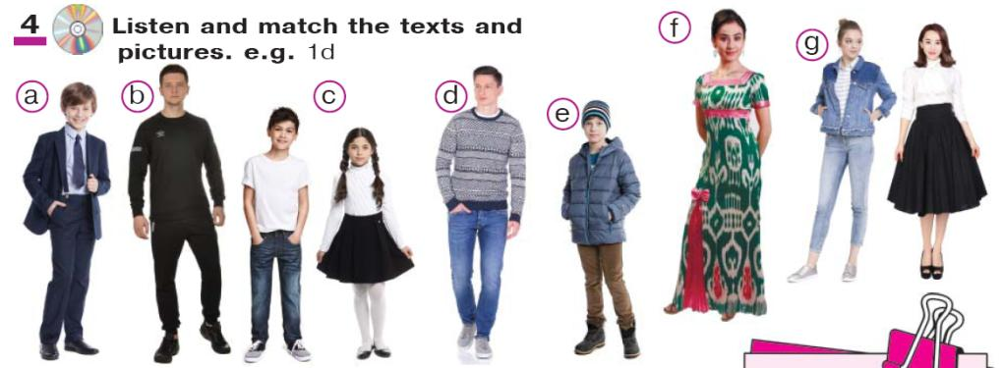
Hello, Colleagues!
The lesson I’d like to share is What are you wearing
(Grade 7, Unit 5, Lesson 2, exercise 4)
textbook TEENS’ 7

Slide 3
This activity is not interactive enough. Listen and match does not require any interaction to complete. Hence, it does not encourage communication and only enforces students’ listening skills. However, it presents relevant and useful vocabulary for our daily lives. I enhance it the following way.
First, students do listen and match, learn the vocabulary.

Slide 4
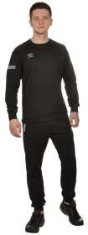
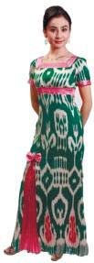
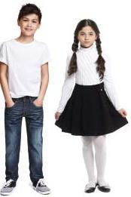
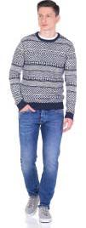
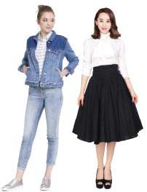
Activity 4 Listen and match the texts and pictures
1. 2. 3. 4. 5. 6. 7.
As for shoes, I prefer wearing low-heeled shoes and I wear some classic black shoes to school. I don’t like high-heeled shoes because they’re uncomfortable. And my brother prefers casual clothes to formal too, because he feels comfortable in it. His favourite colour is white, so he likes white sweaters and T-shirts.
I like to wear good clothes. I have a lot of clothes in my wardrobe. I have five pairs of jeans, because I wear jeans all the time. I usually put on a shirt or a short-sleeved T-shirt with them. Now it’s cold and I’m wearing a sweater.
My favourite clothes are sportswear. My casual clothes are sports trousers with long sleeved T-shirt. Also, I like wearing jackets when I go for a walk. At the moment I’m wearing black sports trousers and my shoes are black trainers.
My name’s Inobat. I’m 14 years old. I’m in class 7. I don’t have many clothes. I have some black skirts and white blouses. They are my usual school uniform. I also have some jeans and T-shirts, which I often wear when I go for a walk with friends.
The choice of clothes depends on seasons and weather conditions. In summer, for example, I put on short-sleeved T-shirts and shorts. In winter it’s important to have some warm clothes. I’m wearing a warm coat, a pair of boots and a hat.
At school I wear a school uniform. But after lessons I prefer wearing dresses and skirts. Today my cousin Bahodir’s going to have a wedding party. So I’m wearing my atlas dress because I love national costume.
I wear a school uniform at school. I like it because it’s comfortable. These are black trousers, a blue shirt and a black jacket. I wear casual clothes at home.
A
B
C
D
E
F
G
Texts:
A
B
C
D
E
F
G
keys: 1-D; 2-B; 3-A; 4-G; 5-E; 6-F; 7-C

Slide 5
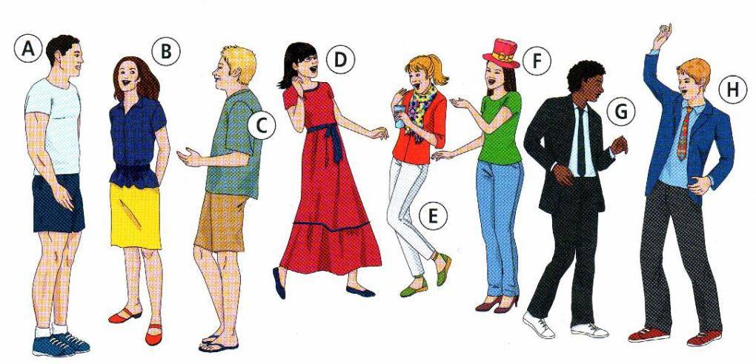
Next, I divide students into pairs and tell them they are going to create a dialogue. Then, I show students a picture with several people in it.
Before students start working independently I make a model-dialogue.
-I am looking for David. Do you know where he is?
-There he is. He is wearing a jacket and tie and he has reddish blonde hair.
-Ok, thanks.
example:

Slide 6
Before students start working independently I act a model-dialogue with one of students.
-I am looking for David. Do you know where he is?
-There he is. He is wearing a jacket and tie and he has reddish blonde hair.
-Ok, thanks.
Students must find out what person is being described.
Model:

Slide 7
Then I ask students to choose two people from the picture and make up their own dialogues and act it aloud for their classmates. The classmates are trying to find out what person the students are describing.

Slide 8
To make communication longer I usually ask follow-up questions.
For example: -Is Bella here? -Yes, she is. Where? I can’t see her.
-She is dark hair and wearing blue jeans.
Students: Bella is person F.
Teacher: How do you know that?
Students: There are three girls with dark hair but only person F is wearing blue jeans or There are two girls wearing jeans in the picture and only girl F’s jeans are blue.

Slide 9
THANK YOU

