Slide 1

The 6 Principles for
Exemplary Teaching of English Learners
Overview
TESOL International Association
English Language Teaching
Leadership Development Program – Uzbekistan
September 2021
www.the6principles.org
© 2021 TESOL International Association. All rights reserved.

Slide 2
Welcome &
Introductions
www.the6principles.org
© 2021 TESOL International Association. All rights reserved.

Slide 3
ACTIVITY
Scavenger Hunt
www.the6principles.org

Slide 4

DIRECTIONS – Scavenger Hunt
Look at the vocabulary word in each box on this paper.
Write a note about the meaning of each vocabulary word that you know.
When I give you a signal, walk around the room for five minutes. Ask other people the meanings of the vocabulary you do not know.
Sit down when you finish or when I give you a signal.

Slide 5
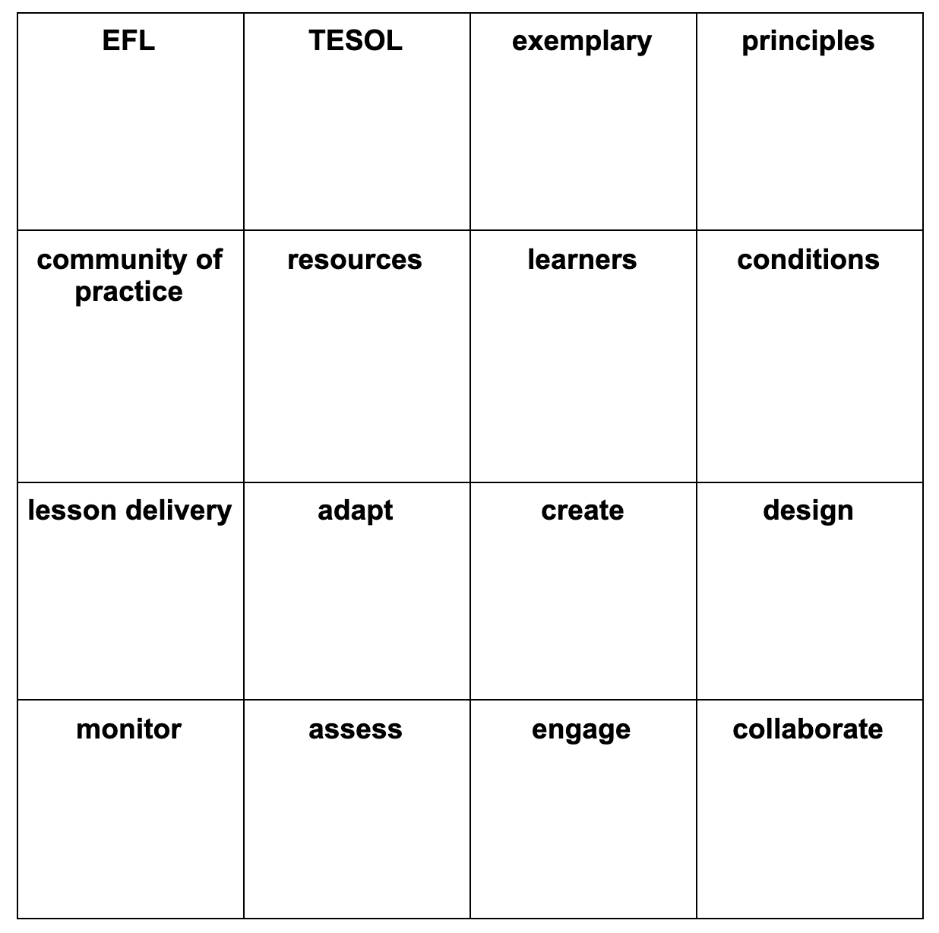
MODELING – Scavenger Hunt

Slide 6
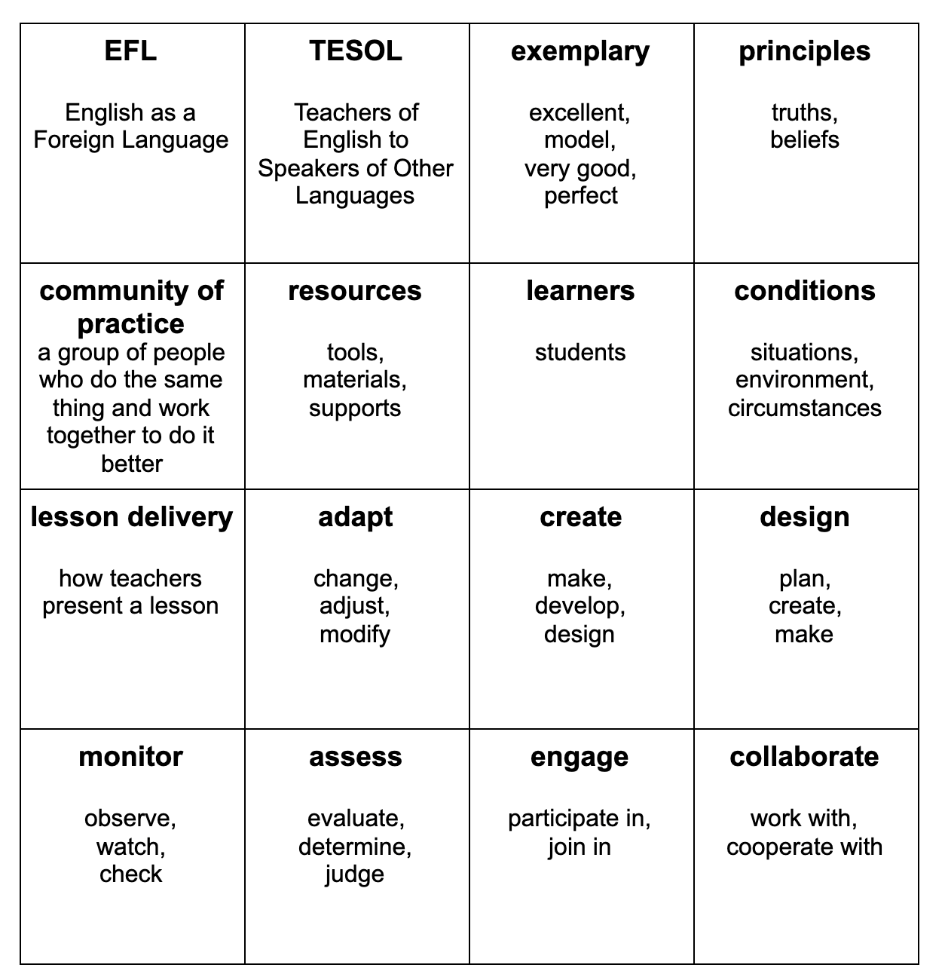
ACTIVITY – Scavenger Hunt

Slide 7
ACTIVITY
Turn and Talk / Activity Tracker:
Scavenger Hunt
www.the6principles.org

Slide 8
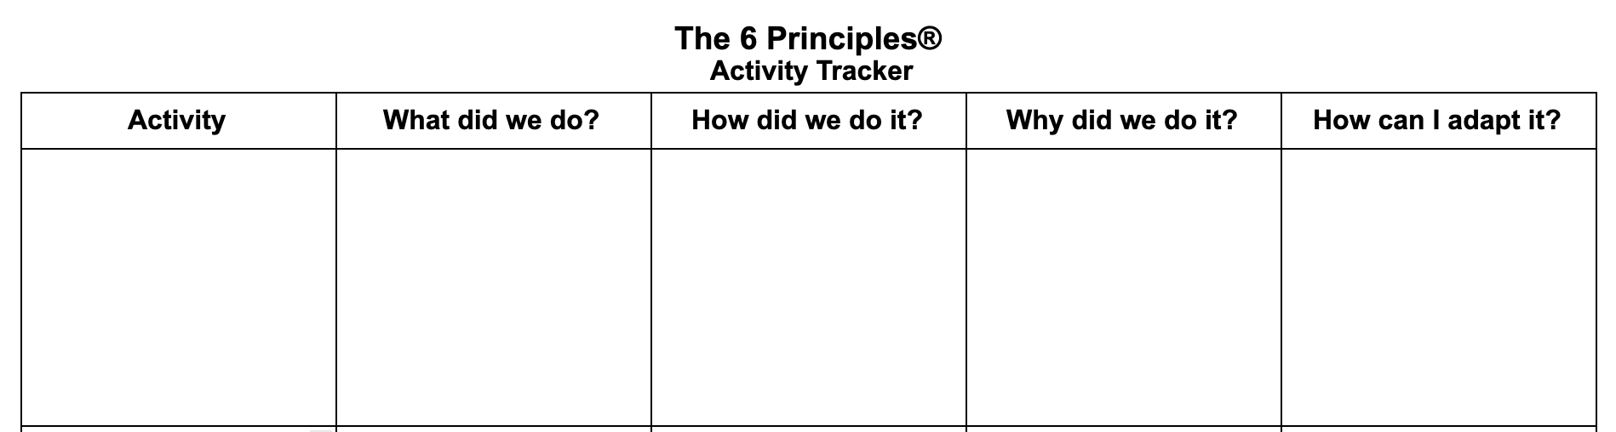
ACTIVITY – Turn and Talk / Activity Tracker: Scavenger Hunt

Slide 9
Introduction to The 6 Principles for Exemplary Teaching of English Learners
(The 6 Ps)
www.the6principles.org

Slide 10
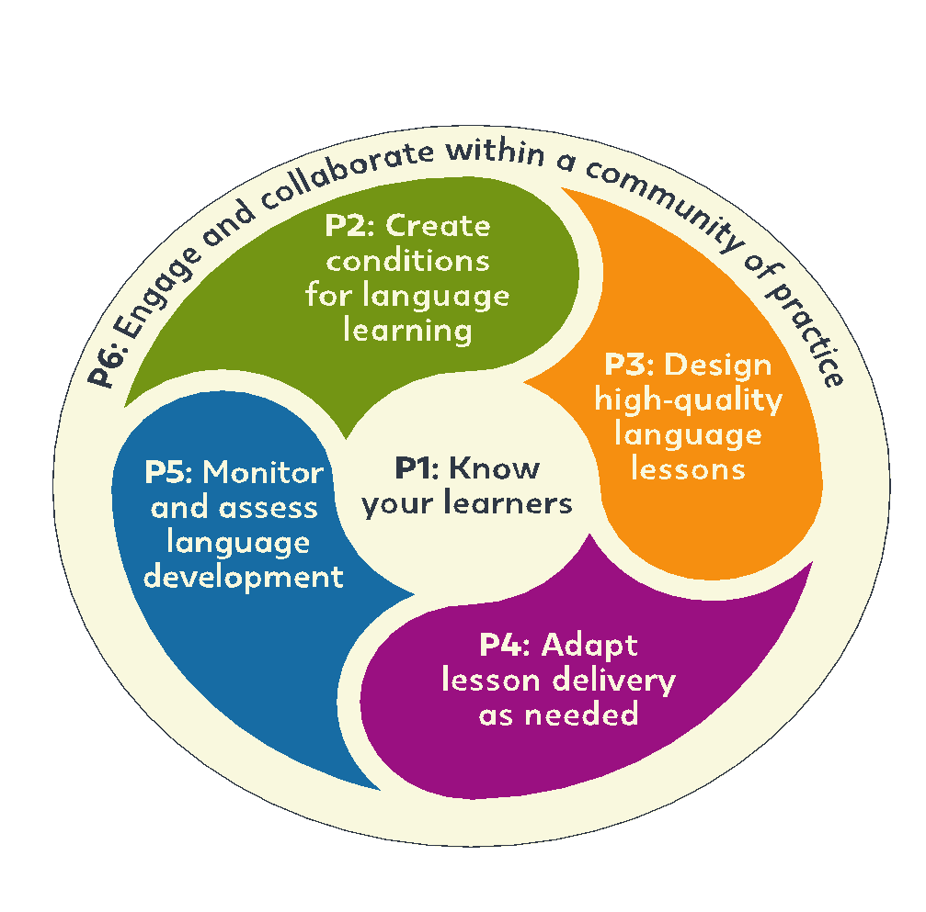
www.the6principles.org

Slide 11
How and why did TESOL develop The 6 Ps?
The 6 Principles are TESOL’s ideas for excellent teaching of English learners.
The 6 Principles connect TESOL’s . . .
values
professional learning
standards
publications

Slide 12



How and why did TESOL develop The 6 Ps?
The 6 Principles . . .
are universal.
help teachers and students be successful in any program.
come from many years of research.

Slide 13
How and why did TESOL develop The 6 Ps?
The 6 Ps are universal, come from many years of research, and help teachers and students be successful in any program.
“Knowledge of more than one language and culture is advantageous for all students.”
(TESOL)

Slide 14
The 6 Principles for
Exemplary Teaching of English Learners
Day 1
TESOL International Association
English Language Teaching
Leadership Development Program – Uzbekistan
September 2021
www.the6principles.org
© 2021 TESOL International Association. All rights reserved.

Slide 15

Table-Group Introductions

Slide 16
Today’s Objectives
Participants will be able to
identify The 6 Principles for Exemplary Teaching of English Learners;
discuss how we teach English
describe the characteristics of specific age groups; and
explore Principles 1, 2, and 3 in more detail.

Slide 17
ACTIVITY
Stand Up / Sit Down
www.the6principles.org

Slide 18
DIRECTIONS – Stand Up / Sit Down
Listen to and/or read each statement. If it is true for you, stand up. If it is not true for you, sit down.
Look around so you can learn new information about your colleagues.
EXTENSION: Ask follow-up questions to people near you.

Slide 19
MODELING – Stand Up / Sit Down
I live in the United States.
I have taught English for more than 25 years.
I have a pet.

Slide 20
ACTIVITY – Stand Up / Sit Down
Stand up if you . . .
like to visit new places.
have a passport.
have traveled by plane.
have visited the United States.
would like to travel to space.
can stand on one foot for 10 seconds (show us!)

Slide 21
ACTIVITY: MODELING
Turn and Talk / Activity Tracker
www.the6principles.org

Slide 22
DIRECTIONS – Turn and Talk / Activity Tracker: Stand Up / Sit Down
After each activity, you will talk in your table-group about these four questions:
What did we do?
How did we do it?
Why did we do it?
How can I adapt this activity to use in my classroom?
As you discuss each activity, take notes on your Activity Tracker.

Slide 23
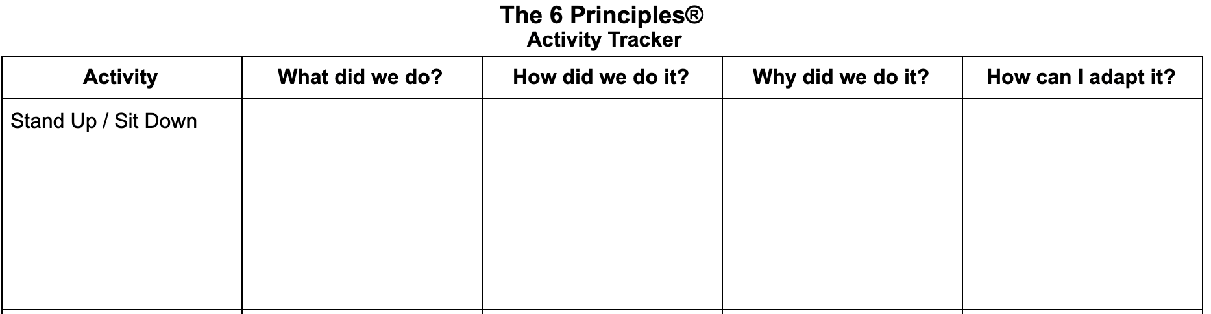
MODELING – Turn and Talk / Activity Tracker: Stand Up / Sit Down

Slide 24
How We Learn English
www.the6principles.org

Slide 25
ACTIVITY
Four Corners
www.the6principles.org

Slide 26
DIRECTIONS – Four Corners
Read and/or listen to the statement.
Think about the statement and choose your opinion:
  Agree
  Strongly Agree
  Disagree
  Strongly Disagree
Move to the corner of the room which best represents your opinion.
Elaborate on your choice if asked.

Slide 27
MODELING – Four Corners
Chocolate is the best kind of ice cream.
Agree | Strongly Agree
Disagree | Strongly Disagree

Slide 28
ACTIVITY – Four Corners
Belief 1: My job is to teach my students English. I don’t need to think about their ability to speak another language(s).
Agree | Strongly Agree
Disagree | Strongly Disagree

Slide 29
ACTIVITY – Four Corners
Belief 1: My job is to teach my students English. I don’t need to think about their ability to speak another language(s).
Alternative Response to Consider: Being bilingual helps students remember more at one time. Successful teachers help students develop their bilingualism.

Slide 30
ACTIVITY – Four Corners
Belief 2: I cannot motivate my students if they do not want to learn English.
Agree | Strongly Agree
Disagree | Strongly Disagree

Slide 31
ACTIVITY – Four Corners
Belief 2: I cannot motivate my students if they do not want to learn English.
Alternative Response to Consider: Motivation is important to learning. Successful teachers make a classroom environment and lessons that can help to motivate students.

Slide 32
ACTIVITY – Four Corners
Belief 3: Students should start learning English when they are very young.
Agree | Strongly Agree
Disagree | Strongly Disagree

Slide 33
ACTIVITY – Four Corners
Belief 3: Students should start learning English when they are very young.
Alternative Response to Consider: Teachers should help students start learning at any age. Students of different ages have different strengths.

Slide 34
ACTIVITY – Four Corners
Belief 4: Some students can learn English, and some students cannot learn English.
Agree | Strongly Agree
Disagree | Strongly Disagree

Slide 35
ACTIVITY – Four Corners
Belief 4: Some students can learn English, and some students cannot learn English.
Alternative Response to Consider: Anybody who learned a first language can learn a second language if teachers offer the right ways to practice.

Slide 36
ACTIVITY
Turn and Talk / Activity Tracker:
Four Corners
www.the6principles.org

Slide 37
ACTIVITY – Turn and Talk / Activity Tracker: Four Corners

Slide 38
What Teachers Need to Make Effective English Lessons
www.the6principles.org

Slide 39

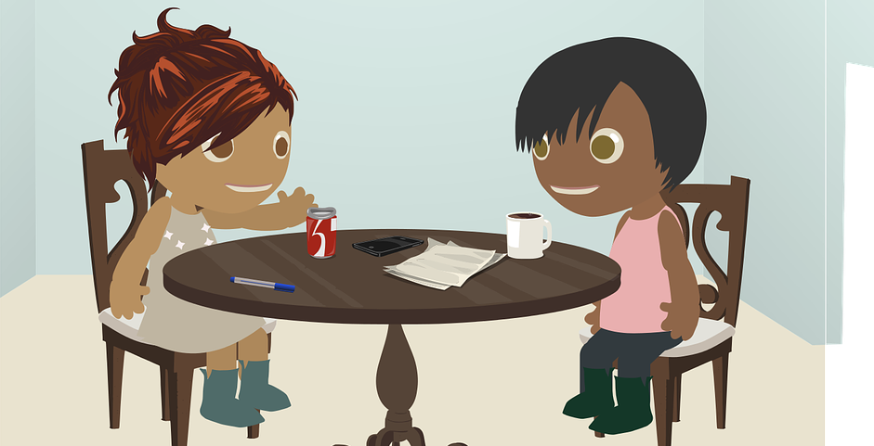



What Teachers Need to Make Effective English Lessons
Teachers need to use many different resources.
interactions
pictures
technology
routines
hand /face expressions

Slide 40





What Teachers Need to Make Effective English Lessons
2. Teachers need to help students use their own resources.
finishing a previous level
knowing another language
playing a musical instrument
having a friendly smile
using a bilingual dictionary

Slide 41
What Teachers Need to Make Effective English Lessons
3. Teachers need to know a lot about English.
What are the most important words/phrases to learn?
What are the most useful sentence patterns to learn?
How can we combine phrases to make longer sentences?
What are the formal rules of grammar?

Slide 42
ACTIVITY
Response Cards
www.the6principles.org

Slide 43
DIRECTIONS – Response Cards
When I read a true statement, raise your handout to say “True.”
When I read a false statement, raise your handout to say “False.”

Slide 44
MODELING – Response Cards
Tashkent is the capital of Uzbekistan.
Samarkand is the capital of Uzbekistan.

Slide 45
ACTIVITY – Response Cards
The 6 Ps apply to English teaching and learning around the world.
TESOL means Teaching English to Secondary Learners Only.
It is best to think about how The 6 Ps work together, not separately.

Slide 46
ACTIVITY
Turn and Talk / Activity Tracker:
Response Cards
www.the6principles.org

Slide 47
ACTIVITY – Turn and Talk / Activity Tracker: Four Corners

Slide 48

The 6 Principles
www.the6principles.org

Slide 49
PRINCIPLE 1
Know Your Learners
www.the6principles.org

Slide 50
PRINCIPLE 1: Know Your Learners
BEST PRACTICE 1
Teachers collect information about their students.

Slide 51
PRINCIPLE 1: Know Your Learners
What kinds of information can you collect?
prior knowledge
talents
interests
life experiences
influences
characteristics of specific age groups

Slide 52
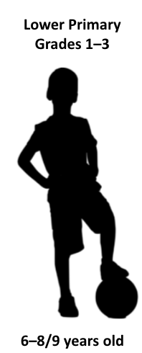
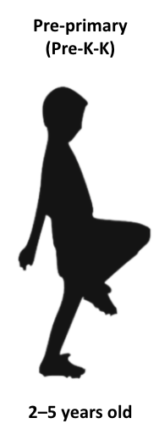

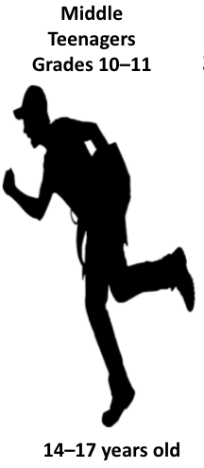
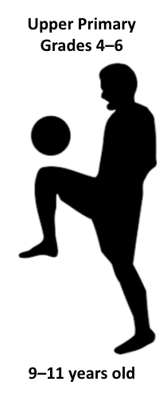
PRINCIPLE 1: Know Your Learners
Characteristics of Specific Age Groups

Slide 53
PRINCIPLE 1: Know Your Learners
Characteristics of Children in Different Age Groups
Physical – body
Cognitive – brain
Social-emotional – experiences, expressions, and emotions

Slide 54
ACTIVITY
Jigsaw Reading
www.the6principles.org

Slide 55

DIRECTIONS – Jigsaw Reading
Jigsaw activities promote cooperative learning by giving students the opportunity to actively help each other understand information.

Slide 56
DIRECTIONS – Jigsaw Reading
Count off 1, 2, 3, 4, 5 in your table groups. Remember your number for your Numbered Heads Together group.
Go to your Numbered Heads Together group. If your group is too large, you can divide into smaller sub-groups.
Read, discuss, and clarify meaning for the physical, cognitive, and social-emotional characteristics of your assigned group for 15 minutes.

Slide 57
DIRECTIONS – Jigsaw Reading
4. After 15 minutes, return to your table-group as
the “expert” of your assigned age group. As the expert, you will summarize the characteristics of your age group while your table-group mates take notes. Be ready to answer and clarify meaning for them.

Slide 58
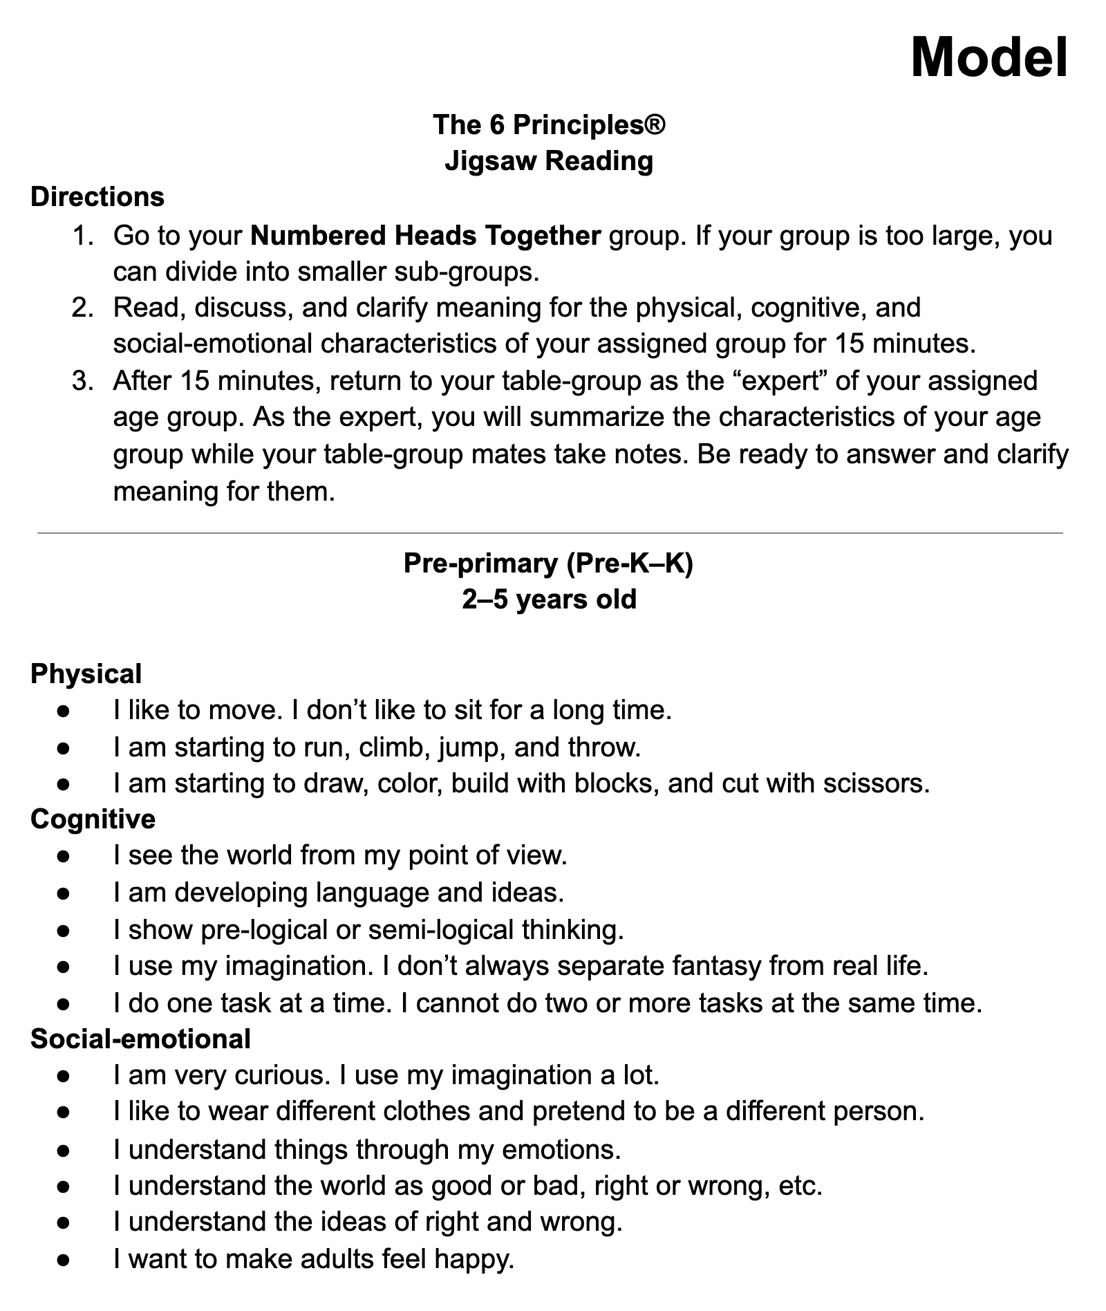
MODELING – Jigsaw Reading

Slide 59

PRINCIPLE 1: Know Your Learners
Pre-primary
(Pre-K-K)
Physical
I like to move. I don’t like to sit for a long time.
I am starting to run, climb, jump, and throw.
I am starting to draw, color, build with blocks, and cut with scissors.
2–5 years old

Slide 60

PRINCIPLE 1: Know Your Learners
Pre-primary
(Pre-K-K)
Cognitive
I see the world from my point of view.
I am developing language and ideas.
I show pre-logical or semi-logical thinking.
I use my imagination. I don’t always separate fantasy from real life.
I do one task at a time. I cannot do two or more tasks at the same time.
2–5 years old

Slide 61
PRINCIPLE 1: Know Your Learners
Social-emotional
I am very curious. I use my imagination a lot.
I like to wear different clothes and pretend to be a different person.
I understand things through my emotions.
I understand the world as good or bad, right or wrong, etc.
I understand the ideas of right and wrong.
I want to make adults feel happy.
Pre-primary
(Pre-K-K)
2–5 years old

Slide 62

PRINCIPLE 1: Know Your Learners
Lower Primary
(Grades 1–3)
Physical
I use one side of my body more than the other side.
I prefer to use either my right hand or left hand most of the time.
I am improving my ability to run, climb, jump, throw, and dance.
I love to play physical games like “Tag” and “Catch.”
My handwriting is improving.
I enjoy art and music activities.
6–8/9 years old

Slide 63
PRINCIPLE 1: Know Your Learners
Lower Primary
(Grades 1–3)
Cognitive
I can concentrate for a longer time, but I can still get restless and lose interest.
I can solve specific problems, such as counting and sorting activities.
I understand new concepts better through activities that let me touch and feel.
I can recognize other people’s views, but I can’t always understand why they feel that way.
I am starting to understand cause and effect and consequences.
6–8/9 years old

Slide 64
PRINCIPLE 1: Know Your Learners
Lower Primary
(Grades 1–3)
Social-emotional
I am developing a sense of identity. I am starting to understand who I am.
I enjoy being with people, including people from different backgrounds.
I identify more with children of the same gender.
I need rules to control my behavior and to provide structure and a feeling of safety.
I am starting to play more games and sports and less fantasy play.
6–8/9 years old

Slide 65

PRINCIPLE 1: Know Your Learners
Upper Primary
(Grades 4–6)
Physical
My small and large muscles are getting stronger because I do a lot of physical activities.
I am very active. I like to ride bikes, run, play soccer, or do gymnastics.
I am starting to play team sports.
My small muscles are developing more, and my handwriting is improving.
9–11 years old

Slide 66
PRINCIPLE 1: Know Your Learners
Upper Primary
(Grades 4–6)
Cognitive
I can concentrate for a longer time on school assignments and tasks.
I think logically. I like to work on real tasks which have a goal, such as gardening, taking care of animals, or science experiments.
I can understand other people’s opinions.
I am beginning to solve problems and can classify things by rank. I understand that a problem can have more than one solution.
9–11 years old

Slide 67
PRINCIPLE 1: Know Your Learners
Upper Primary
(Grades 4–6)
Social-emotional
I am beginning to understand my position in relation to the world.
I like to be with people. I want to spend more time with my friends than my family.
I am more independent and can make decisions by myself.
My relationships with people are more confusing.
9–11 years old

Slide 68

PRINCIPLE 1: Know Your Learners
Young Teenagers
(Grades 7–9)
Physical
My body and skin are changing a lot (girls develop two years before boys).
I worry about my appearance, and I think a lot about how other people look.
12–14 years old

Slide 69
PRINCIPLE 1: Know Your Learners
Young Teenagers
(Grades 7–9)
Cognitive
I think I understand most things.
I can solve problems better.
I express myself better in speaking. I argue more and question what others tell me.
I am excited for learning.
I think about and test unproven and non-specific ideas.
I take more risks and do things without thinking about the result.
I have strong opinions.
I see things as good or bad, right or wrong.
12–14 years old

Slide 70
PRINCIPLE 1: Know Your Learners
Young Teenagers
(Grades 7–9)
Social-emotional
I think about myself the most.
I am very emotional.
I want to belong to the popular group of students.
My classmates and popular trends influence me.
I need my classmates to accept me. I am less affectionate to adults. I may seem rude.
Part of me wants to be independent, and the other part still needs to be dependent.
12–14 years old

Slide 71

PRINCIPLE 1: Know Your Learners
Middle Teenagers
(Grades 10–11)
Physical
My body stops growing.
14–17 years old

Slide 72
PRINCIPLE 1: Know Your Learners
Middle Teenagers
(Grades 10–11)
Cognitive
I understand that questions have many answers.
I can work independently.
I make good plans and better decisions.
I can manage group work without much help from teachers.
I understand the results of my actions.
14–17 years old

Slide 73
PRINCIPLE 1: Know Your Learners
Middle Teenagers
(Grades 10–11)
Social-emotional
I focus more on individual friendships and less on groups.
I like to spend time with mixed groups of girls and boys.
I understand my role in society more.
I am starting to think about my future (career, beliefs, philosophy, social causes). I think more about the world beyond myself.
14–17 years old

Slide 74
ACTIVITY
Jigsaw Note Taking
www.the6principles.org

Slide 75
DIRECTIONS – Jigsaw Note Taking
Take turns telling your group about your assigned age group.
Take notes about each age group.

Slide 76
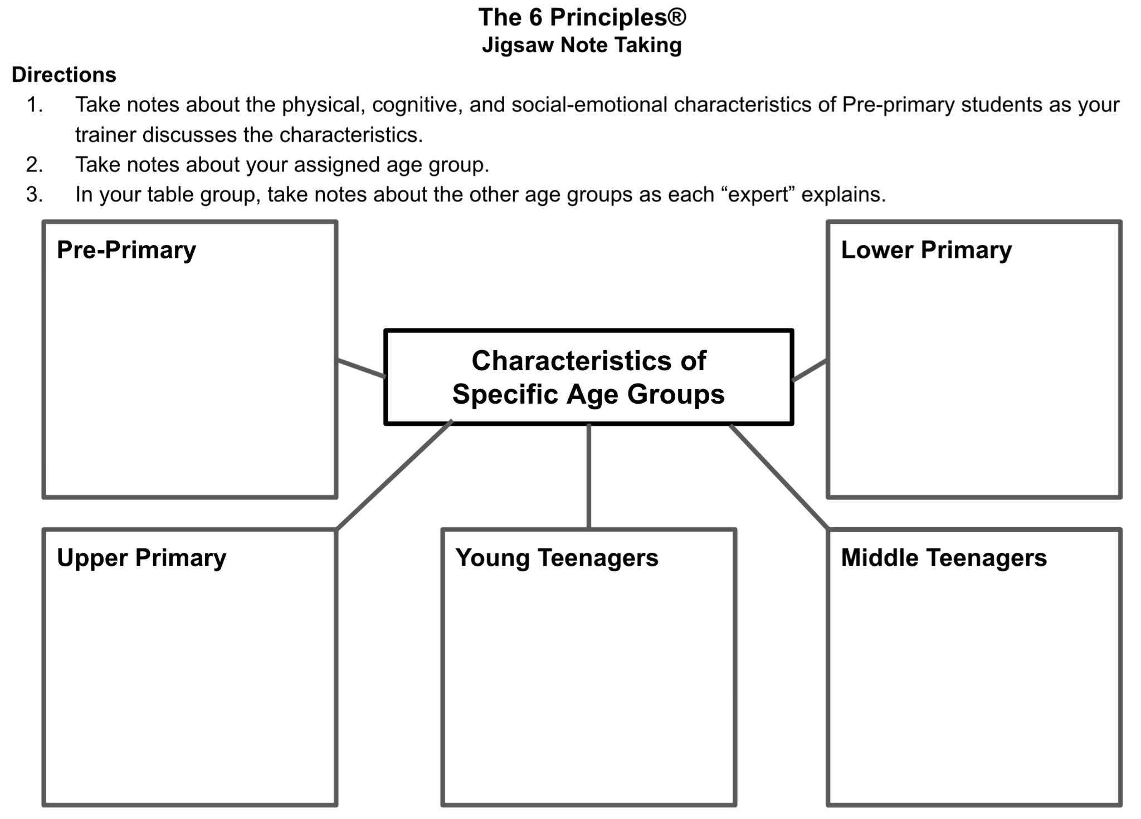
MODELING – Jigsaw Note Taking

Slide 77
ACTIVITY
Turn and Talk / Activity Tracker:
Jigsaw Reading and Note Taking
www.the6principles.org

Slide 78
ACTIVITY – Turn and Talk / Activity Tracker: Four Corners

Slide 79
ACTIVITY
Thumbs Up / Thumbs Down
www.the6principles.org

Slide 80
ACTIVITY – Thumbs Up / Thumbs Down
The 6 Principles come from three years of research.
We can learn about characteristics of children at different age groups by looking at their physical, cognitive, and social-emotional stages.
A jigsaw activity is a good way for students to help each other build comprehension in a small group.

Slide 81
Principle 1: Know Your Learners
BEST PRACTICE 2
Teachers plan lessons to collect and use information about students.

Slide 82
PRINCIPLE 1: Know Your Learners
What kinds of lessons can you plan to gather information about students?
games and warm-up activities
questionnaires
needs assessments
interest and background inventories
observation checklists
one-on-one discussions
picture stories
autobiography projects

Slide 83
ACTIVITY
Find Someone Who . . .
www.the6principles.org

Slide 84
DIRECTIONS – Find Someone Who...
Read the statement in each box.
When I give you a signal, walk around the room for five minutes. Ask other people questions to see if they fit one of the statements below (e.g., “Have you ever traveled by train?”).
Write their name in the appropriate box.
Sit down when you finish or when I give you a signal.

Slide 85
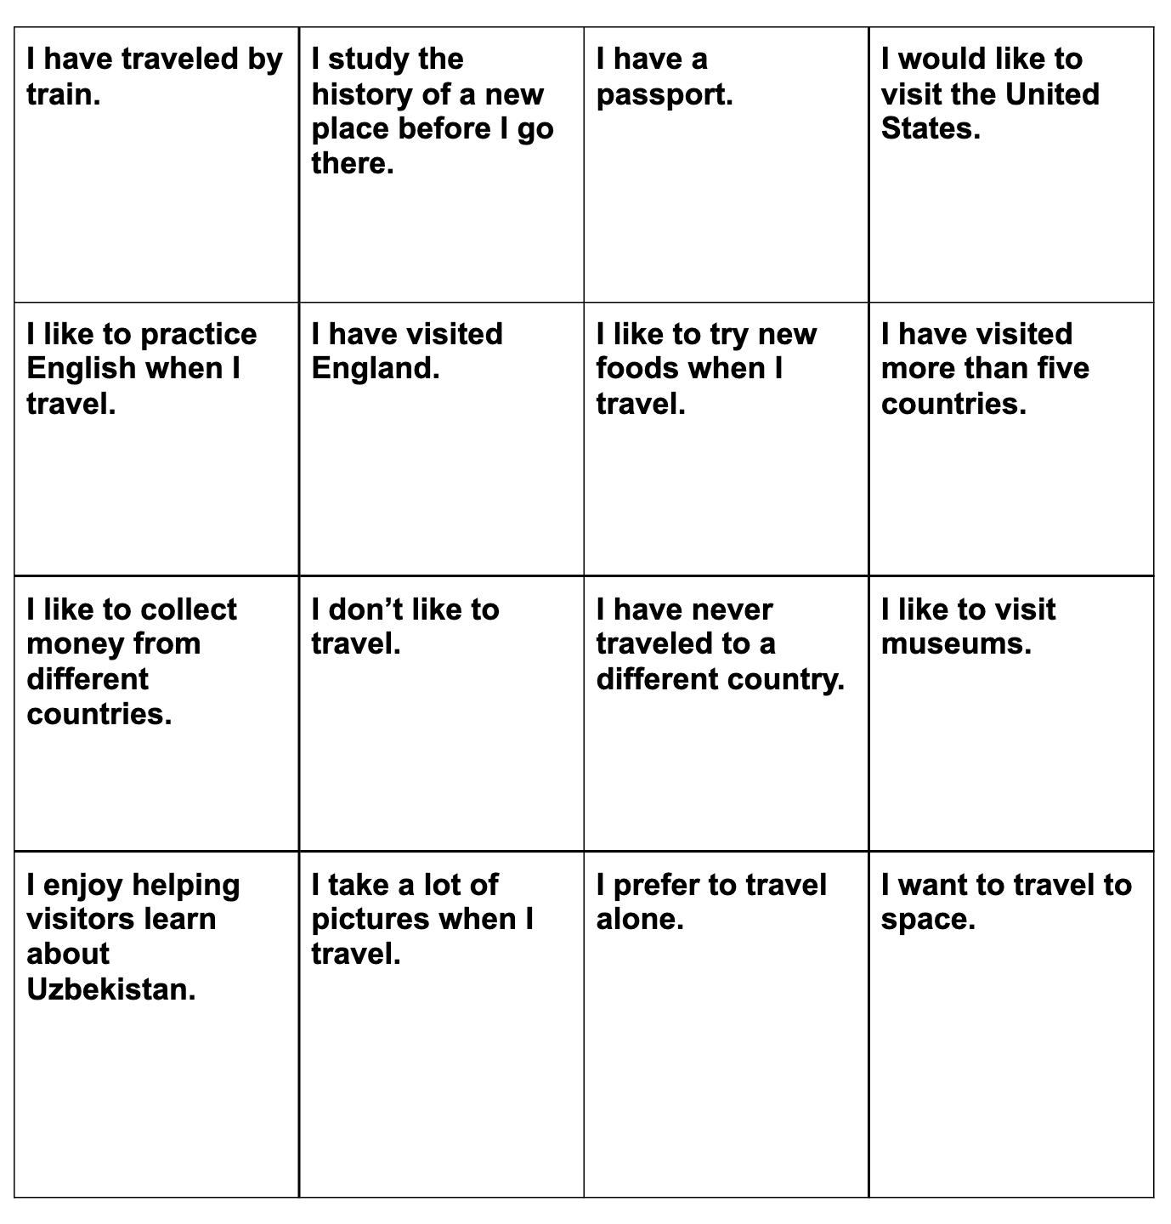
MODELING – Find Someone Who...

Slide 86
ACTIVITY
Turn and Talk / Activity Tracker:
Find Someone Who . . .
www.the6principles.org

Slide 87
ACTIVITY – Turn and Talk / Activity Tracker: Find Someone Who . . .

Slide 88
PRINCIPLE 2
Create Conditions for Language Learning
www.the6principles.org

Slide 89
DIRECTIONS – Personal Inventory
Read each statement.
Rate yourself with the following criteria:
      A – always or almost always
      S – sometimes
      N – never or almost never
Put a star (★) next to the three statements you most want to improve on.

Slide 90
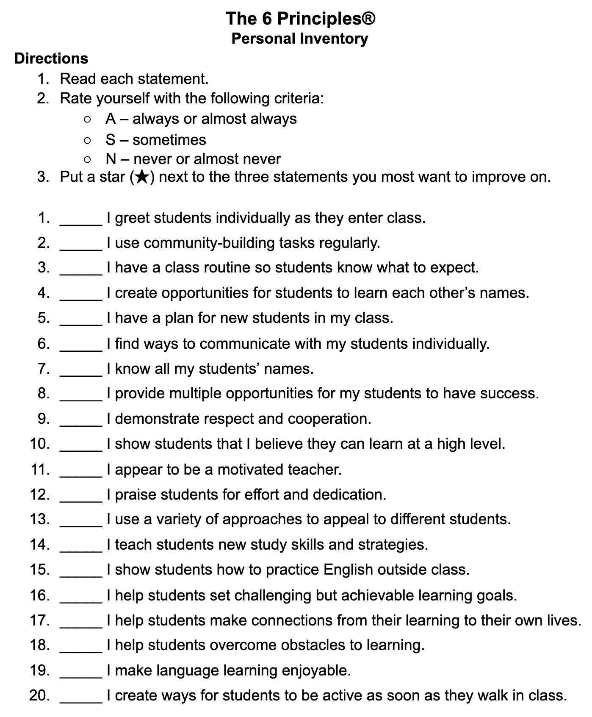
MODELING – Personal Inventory

Slide 91
ACTIVITY
Think-Pair-Share
www.the6principles.org

Slide 92
DIRECTIONS – Think-Pair-Share
Think about the question that you hear and/or read.
Pair with a partner, and discuss your answers.
Share in a larger group.

Slide 93
MODELING – Think-Pair-Share
Question: What are some activities that we have done today that could motivate students in my classroom?

Slide 94
Principle 2: Create Conditions for Language Learning
BEST PRACTICE 1
Teachers create a positive and organized classroom where students feel happy and comfortable.

Slide 95
PRINCIPLE 2: Create Conditions for Language Learning
Think-Pair-Share
What are some ways you can create a positive and organized classroom where students feel happy and comfortable?

Slide 96
PRINCIPLE 2: Create Conditions for Language Learning
Personal Inventory 1–10
_____ I greet students individually as they enter class.
_____ I use community-building tasks regularly.
_____ I have a class routine so students know what to expect.
_____ I create opportunities for students to learn each other’s names.
_____ I have a plan for new students in my class.
_____ I find ways to communicate with my students individually.
_____ I know all my students’ names.
_____ I demonstrate respect and cooperation.
_____ I appear to be a motivated teacher.
_____ I praise students for effort and dedication.

Slide 97
PRINCIPLE 2: Create Conditions for Language Learning
BEST PRACTICE 2
Teachers demonstrate that they have high expectations of all students.

Slide 98
PRINCIPLE 2: Create Conditions for Language Learning
Think-Pair-Share
How do you demonstrate that you have high expectations of all students?

Slide 99
PRINCIPLE 2: Create Conditions for Language Learning
Personal Inventory 11–15
11. _____ I provide multiple opportunities for my students to have success.
12. _____ I show students that I believe they can learn at a high level.
13. _____ I teach students new study skills and strategies.
14. _____ I help students set challenging but achievable learning goals.
15. _____ I help students overcome obstacles to learning.

Slide 100
PRINCIPLE 2: Create Conditions for Language Learning
BEST PRACTICE 3
Teachers plan lessons that motivate students.

Slide 101
PRINCIPLE 2: Create Conditions for Language Learning
Think-Pair-Share
How do you plan lessons to motivate students?

Slide 102
PRINCIPLE 2: Create Conditions for Language Learning
Personal Inventory 16–20
16. _____ I show students how to practice English outside class.
17. _____ I help students make connections from their learning to their own lives.
18. _____ I make language learning enjoyable.
19. _____ I use a variety of approaches to appeal to different students.
20. _____ I create ways for students to be active as soon as they walk in class.

Slide 103
ACTIVITY
Turn and Talk / Activity Tracker:
Think-Pair-Share
www.the6principles.org

Slide 104
REVIEW and WRAP-UP
Review: Retell your partner what you learned about Principles 1-3. How did we facilitate your learning today?
Extend: 6Ps Resources Graphic Organizer, What other activities do you know that might support each principle? Add a few to the notes column.
Reflect: What questions do you have? What connections are you making between The 6Ps and your teaching?

